Slide 1
Winning Big in Hard Times: Learning from Our Ancestors
December 26, 2013
Mark M. McDermott
www.markmmcdermott.com
www.facebook.com/markmcdermottworkshops

Slide 2
Are you concerned that the future will be more difficult and less just and secure for your children and the young people that you love compared to your generation?

Slide 3
We the People Are Nervous about the Future in 2013
Are you concerned about falling out of your current economic class over the next few years? 59%
Compared to the middle class of your parents’ generation, do you think the middle class has more or less:
  Opportunity to get ahead? 26% yes; 52% no
  Job and financial security? 16% yes; 65% no
  Expendable income after expenses? 20% yes; 60% no
Notes:
Source: Allstate and National Journal, “Heartland Monitor Monitor Poll XVI,” April 9, 2013. http://assets.nationaljournal.com/Topline-Results.pdf
Questions 15 and 34-36.

Slide 4
Do You Believe Creating a Brighter and More Just and Secure Future for All Requires?
Fair Elections Not Dominated by Big Money
Democratic Law Making that Serves the People
Sharing Fairly in the Fruits of Our Labor
Fair Taxes
Equal Treatment and Opportunity for All
Affordable Quality Educational Opportunities
Security and Help in Hard Times
International Solidarity with People in Other Countries
Healthy sustainable environment

Slide 5
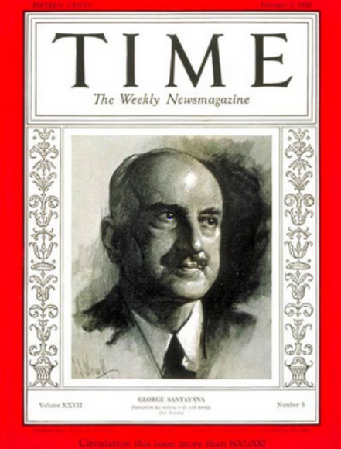
The Power of Our Stories
“Those who cannot learn from history are doomed to repeat it. Those who do not remember their past are condemned to repeat their mistakes."
George Santayana, 1936
Notes:
Sources:
Image: http://www.time.com/time/covers/0,16641,19360203,00.html Image may be subject to copyright.

Slide 6
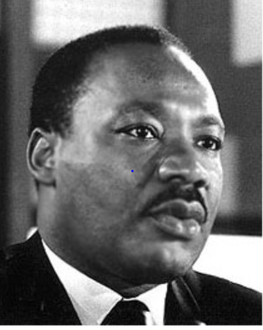
Organized Labor and Our Allies Built the American Dream
“The labor movement was the principal force that transformed misery and despair into hope and progress…The captains of industry did not lead this transformation.”
Rev. Dr. Martin Luther King Jr.
Notes:
Source:
Image: http://www.stmartin.edu/whatsnew/MediaReleases/images/MartinLutherKingJr.jpg Image may be subject to copyright.
Quote: Peter Bollen, Great Labor Quotations, page 138.

Slide 7
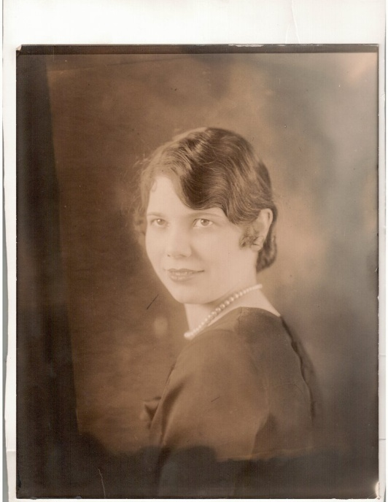
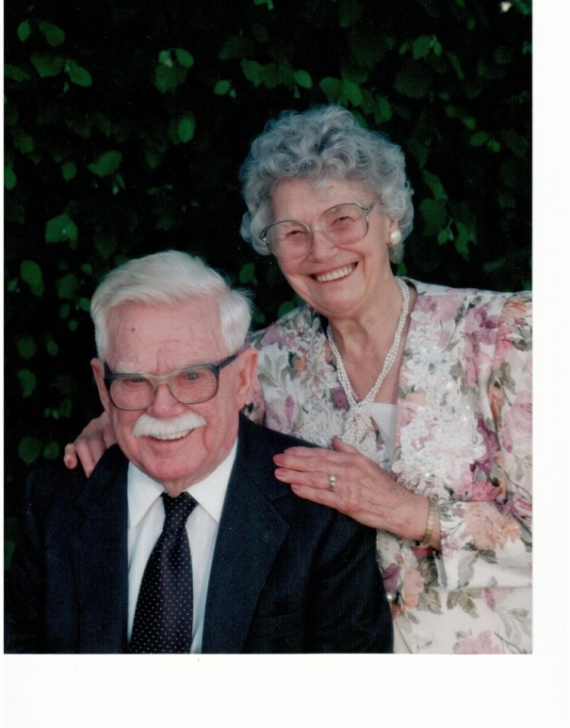
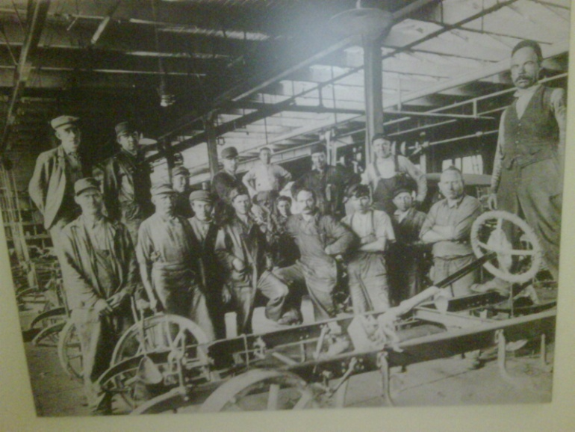
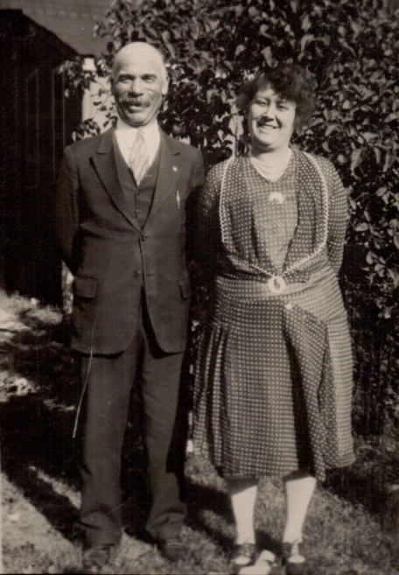
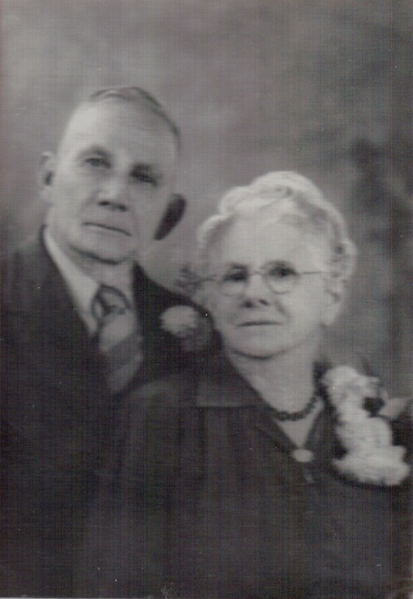
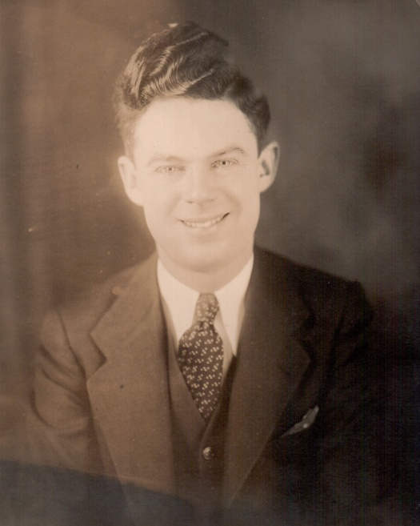
My Family’s Story
Notes:
My family’ story spans three generations of working class history in the United States. It is a story of struggle to create a more prosperous and secure future that would provide greater opportunity for each succeeding generation. My Irish-American grandfather had a third grade education, went to work at age 10 and retired after 65 years of work. My German-American grandfather had a sixth grade education and worked until he was laid off by Ford Motor Company at the start of the Great Depression. He died an untimely death at age 53 as an unemployed autoworker after being seriously injured. He died in poverty without unemployment insurance or health insurance that might have allowed him to get better medical care that might have saved his life. We don’t know if better care would have saved his life but we know that no money and insurance made his chances much slimmer.
My grandparents were union men and their generation helped build the great fortunes of America but they never shared fairly in the wealth they created.
Throughout the lives of my grandparents’ generation, working people fought to win the right to organize unions and bargain collectively, unemployment insurance, public assistance for families in need, affordable housing, health care protections, social security when they were old, protections for their bank deposits and security during hard economic times. They fought from the 1880s into the 1930s and were repeatedly defeated but they kept the faith and continued to struggle.
The Great Depression would provide the historic opportunity to change the lives of working people for decades to come.

Slide 8
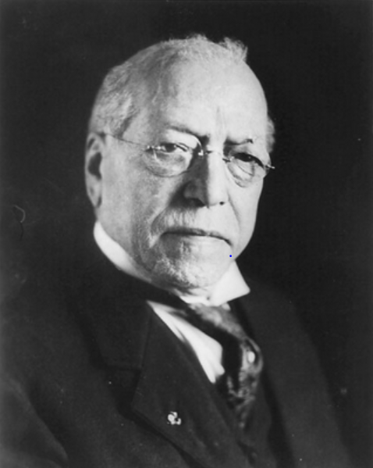
What Does Labor Want?
A Real American Dream for Everyone
“We want more schoolhouses and less jails; more books and less arsenals; more learning and less vice; more leisure and less greed; more justice and less revenge; more opportunities to make childhood more happy and bright.” – Samuel Gompers
Notes:
Sources:
Image: http://memory.loc.gov/ammem/nfhtml/nfexww1.html Image may be subject to copyright.
Quote: http://www.goodreads.com/quotes/109897-what-does-labor-want-we-want-more-schoolhouses-and-less

Slide 9
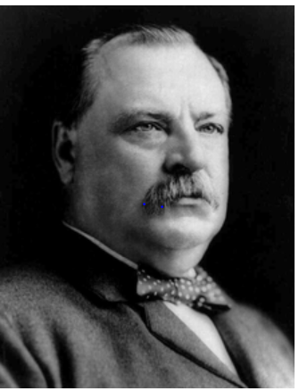
President Grover Cleveland
1886 State of the Union Address
“Corporations, which should be the carefully restrained creatures of the law and the servants of the people, are fast becoming the people’s masters.”
Notes:
Source:

Slide 10

Corporations are Legal Persons with Constitutional Rights - 1886
Notes:
Source: http://en.wikipedia.org/wiki/Supreme_Court_of_the_United_States Image may be subject to copyright.
Note: Santa Clara County versus Southern Pacific Railroad case grants legal personhood to corporations under the 14th Amendment intended to grant full rights to former slaves.

Slide 11
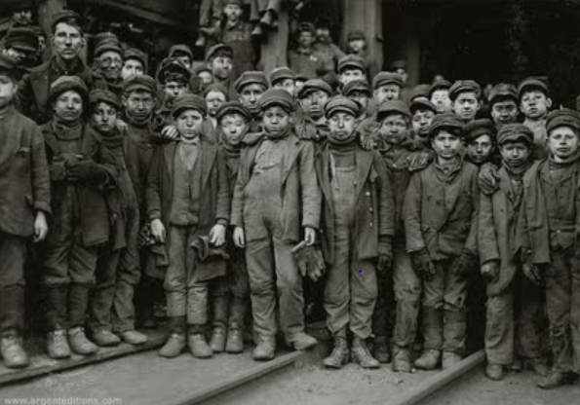
Great-Uncle Davey Hill: Coal Miner Age 10
Notes:
Source: Image: http://ramapophotoj.blogspot.com/2009/02/jacob-riis-lewis-hine.html Image may be subject to copyright.
"There is work that profits children, and there is work that brings profit only to employers. The object of employing children is not to train them, but to get high profits from their work.“ -- Lewis Hine
“We are fighting in the defense of our homes, our families, and posterity. We have petitioned, and our petitions have been scorned. We have entreated, and our entreaties have been disregarded. We have begged, and they have mocked when our calamity came.
We beg no longer; we entreat no more; we petition no more. We defy them!”
Source: http://en.wikipedia.org/wiki/Cross_of_Gold_speech
“You shall not crucify mankind upon a cross of gold.”

Slide 12

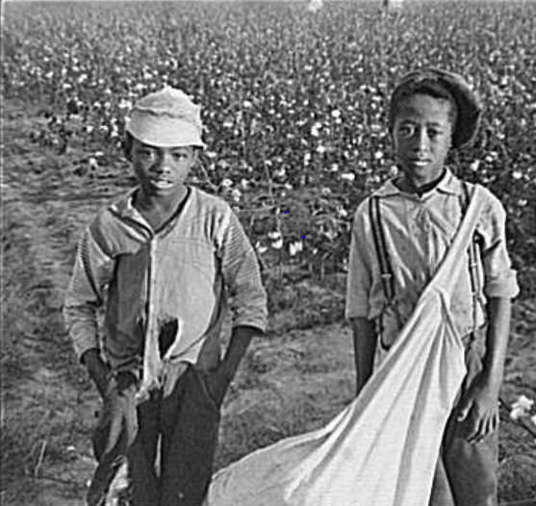
The most beautiful sight that we see is the child at labor. As early as he may get at labor, the more beautiful, the more useful does his life get to be.
Asa Griggs Candler, founder of Coca-Cola
Notes:
Sources:
Quote: Peter Bollen, Great Labor Quotations: Sourcebook and Reader, page 7.
Image: Coca-Cola - http://logobuffer.com/coca-cola-logo-coca-cola-logo-wallpaper-2012-logo-database/ Image may be subject to copyright.
Image: http://newleftpatriot.blogspot.com/2005_03_01_archive.html Image may be subject to copyright.

Slide 13
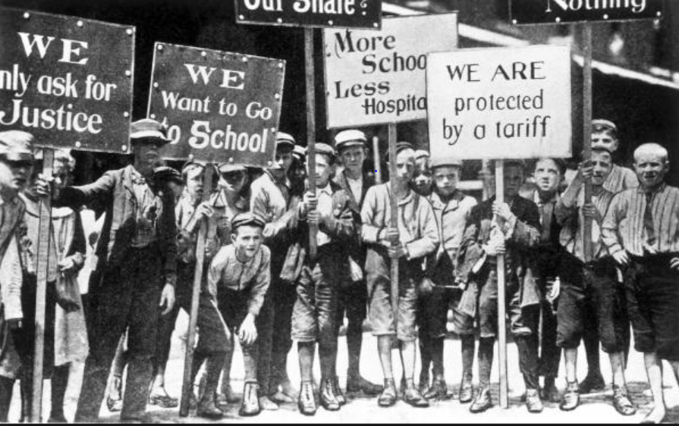
100,000 Strike for 55 Hour Week
16,000 Child Workers Join the Fight - 1903
Notes:
Image: http://teeniegehres.blogspot.com/2011_12_01_archive.html Image may be subject to copyright.
Quote and information: Susan Campbell Bartoletti, Kids on Strike, pages 1098 and 129.
“10-year old James Ashworth walked all day, carrying bundles of yarn from one department to the next. The bundles weighed 75 pounds. James’s stooped back and shoulders showed signs of deformity: he looked like an old man.”
The strike was broken after three months. Six years later, Pennsylvania passed a new child labor law outlawing child labor under the age of 14. The hour maximum was 58 hours.

Slide 14
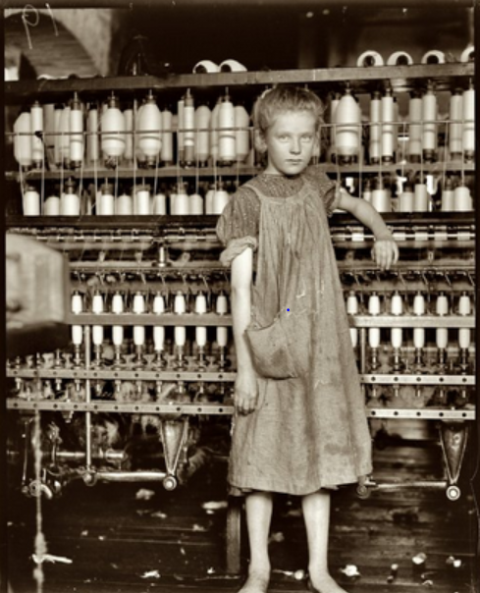
Labor Fighting to Give Our Ancestors a Childhood
“It was the tradesmen who came to the legislature to plead the cause of public education, for they realized that their sons and daughters would forever remain slaves to an industrial machine unless given equal opportunity for education with the sons and daughters of the wealthy.” – Horace Mann
Notes:
Sources:
Image: http://yesteryearsnews.wordpress.com/tag/textile-mills/ Image may be subject to copyright.
Quote: Peter Bollen, Great Labor Quotations: Sourcebook and Reader,” page 117.
Muckraker John Spargo’s book The Bitter Cry of the Children

Slide 15
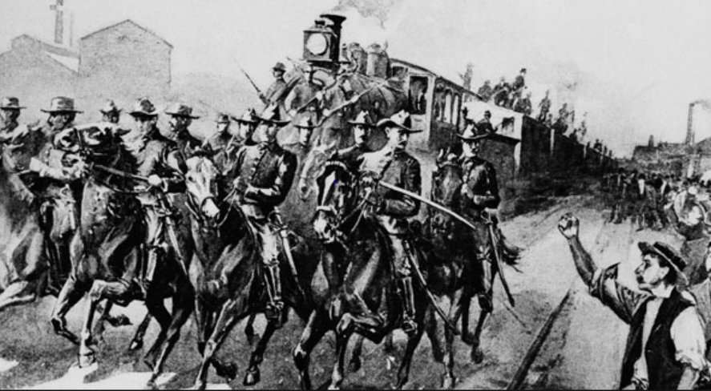
President Cleveland Uses the Army to Crush
Nationwide Rail Strike - Dozens Killed - 1894
Notes:
Note: President Cleveland mobilizes 14 thousand Army troops to crush the nation-wide rail strike sparked by the strike at Pullman Corporation in Chicago. Governor Altgeld and the Chicago mayor oppose the use of federal troops. 34 killed.
Source: http://www.politico.com/news/stories/0311/50885.html Image may be subject to copyright.

Slide 16
We the People Cry Out and Demand:
Tax the Rich – 1890s Style
In 1894, Congress passes 2% flat tax that only applies to the richest 10 percent of families.
Corporate-dominated U.S. Supreme Court rules federal income tax unconstitutional.
Notes:
Source: http://westlawinsider.com/legal-research/today-in-1895-federal-income-tax-ruled-unconstitutional/

Slide 17
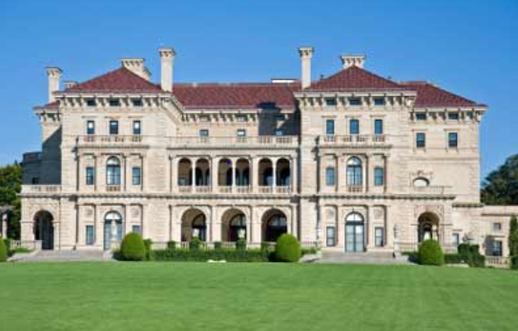
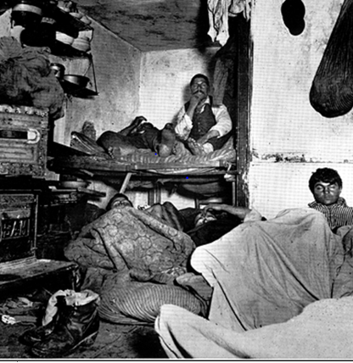
“You Shall Not Crucify Humanity on a Cross of Gold”
Newport Rhode Island Summer Home
Working Class Housing in New York City
Notes:
Image: http://www.newport-discovery-guide.com/newport-mansions.html Image may be subject to copyright
Image: http://hgreerecs.wordpress.com/2012/11/27/jacob-riis-how-the-other-half-lives/ Image may be subject to copyright.
Quote: http://en.wikipedia.org/wiki/Cross_of_Gold_speech

Slide 18
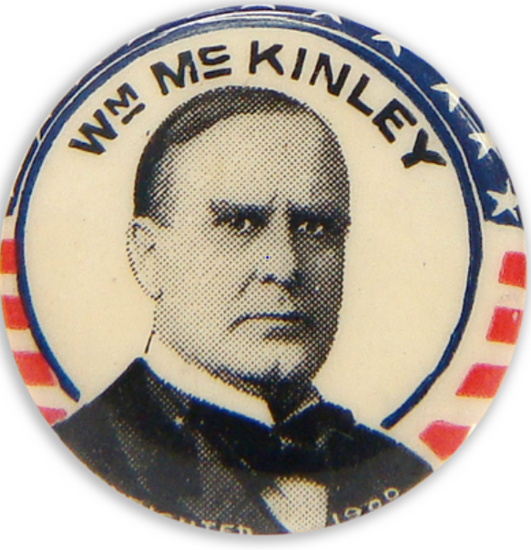
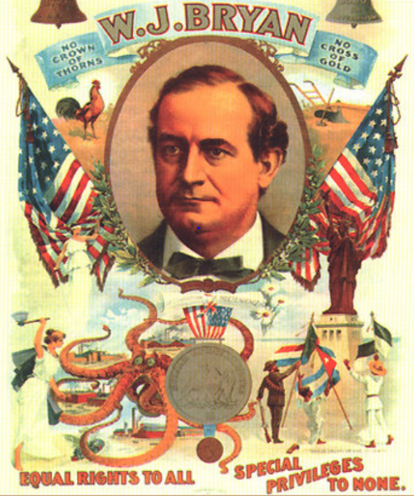
Buying the White House – 1896 Style
McKinley Outspends Bryan 11 to 1
Notes:
Source: http://en.wikipedia.org/wiki/Cross_of_Gold_speech
Source: Congressman Jim McDermott: Early Campaign Finance Reform. Y:\Mark_Mcdermott\mark\Documents\Labor Educator
Source: Popular vote – McKinley 51%; Bryan 47%. http://en.wikipedia.org/wiki/United_States_presidential_election,_1896
Image: http://prosperityuk.com/2001/01/a-wonderful-wizard-of-oz-a-monetary-reform-parable/ Image may be subject to copyright.
Image: http://www.nytstore.com/Vintage-1896-William-McKinley-Stars-and-Stripes-Pin_p_9612.html Image may be subject to copyright.

Slide 19
We the People Organize and Win Fairer Elections and a More Just Tax System
1907 – Congress passes Tillman Act – first major limitations on corporate campaign efforts
1913 - U.S. constitutional amendment requiring direct election of Senators
1913 – U.S. constitutional amendment for income tax which only taxes the wealthy

Slide 20
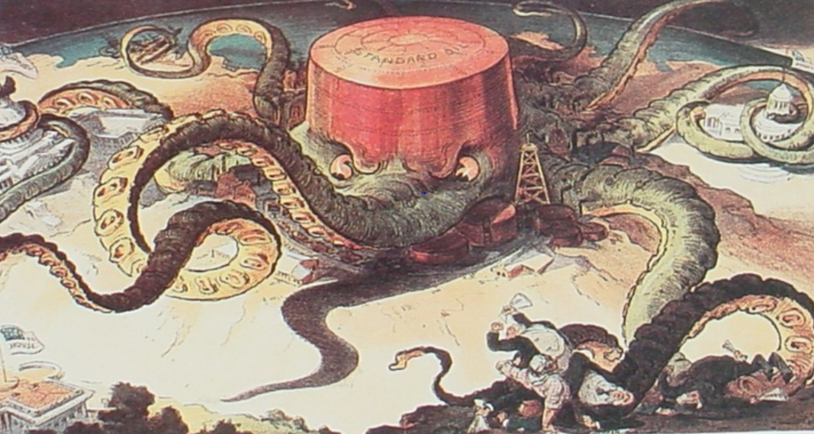
We the People Demand: Bust the Trusts
Break Up Standard Oil
Notes:
Source: http://userpages.umbc.edu/~lindenme/hist102/Identifications/ids05.htm Image may be subject to copyright.
Note: Supreme Court orders the break up of Standard Oil in 1911. http://en.wikipedia.org/wiki/Standard_Oil_Company_of_New_Jersey_v._United_States

Slide 21
Corporate Strategy: Divide and Conquer
Crush Black/White Unity – 1870s-1910s
Black-majority interracial coalitions formed in every southern state. Results:
  Raised taxes to improve education
  Progressive labor laws
  Curbs on corporate power
  More than 25% of white voters voting for black-majority coalitions
Notes:
Source: NAACP, “National Voting Rights Toolkit,” pages 8-10. http://www.sfvnaacp.org/archives/Western%20Region%201%202013%20Training/Voting%20Rights/National%20Voting%20Rights%20Toolkit.pdf

Slide 22
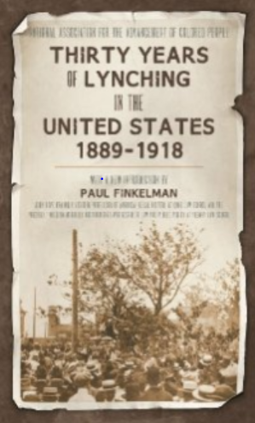
Racist Terror Against African-Americans
We the People Fail to Rise Up
In 1919, the NAACP reports 3,224 lynchings of American-Americans between 1889-1918.
Congress refuses to pass anti-lynching legislation.
Notes:
Sources:
Image: http://www.amazon.com/Thirty-Lynching-United-States-1889-1918/dp/1584779659 Image may be subject to copyright.

Slide 23

Voter Suppression – Early 20th Century:
Vote Right or Lose Your Right to Vote
“‘We wrested our state government from Negro supremacy.’ Almost all blacks and most poor whites were disenfranchised. In Mississippi, voter participation fell from 70% in 1876 to less than 10% in 1920.”
Notes:
Source: Colin Woodard, American Nations, page 305.
Image: http://www.sfvnaacp.org/archives/Western%20Region%201%202013%20Training/Voting%20Rights/National%20Voting%20Rights%20Toolkit.pdf Image may be subject to copright.

Slide 24

We the People Organize and Expand Our Democracy and Win Greater Rights
Organized labor and their allies curb corporate power by:
Initiatives
Referendums
Public ports
Workers’ compensation

Slide 25
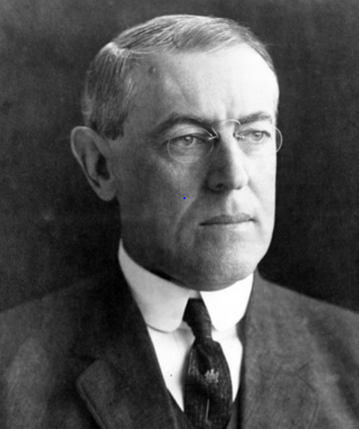
Woodrow Wilson, President of Princeton and Future President of United States
Southern European countries are “unburdening themselves of the more sordid and hapless elements of their population.”
Eastern Europeans – “had neither skill nor energy nor any initiative of quick intelligence.” - 1903
Notes:
Source: Susan Martin, A Nation of Immigrants, page 141-42. Quotes Woodrow Wilson, History of the American People, 1903, page 212.
Image: http://www.studyblue.com/notes/note/n/history-130-test-2/deck/767061 Image may be subject to copyright.

Slide 26
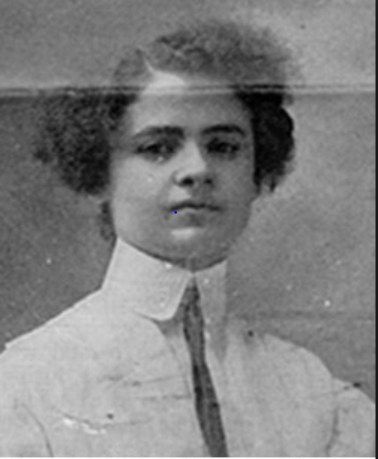
The Rising of Immigrant Women: 20,000 Strike in NYC Garment Industry – 1909-10
"They used to say you couldn't even organize women. They wouldn't come to union meetings. Well, we showed them! I have listened to all the speakers, and I have no further patience for talk. I move we go out in a general strike!“ – Clara Lemlich, Ukrainian Jewish immigrant
Notes:
Sources:
Image: http://www.xtimeline.com/evt/view.aspx?id=43225 Image may be subject to copyright
Quote: https://www.indypendent.org/2012/03/12/honoring-working-womens-struggles

Slide 27
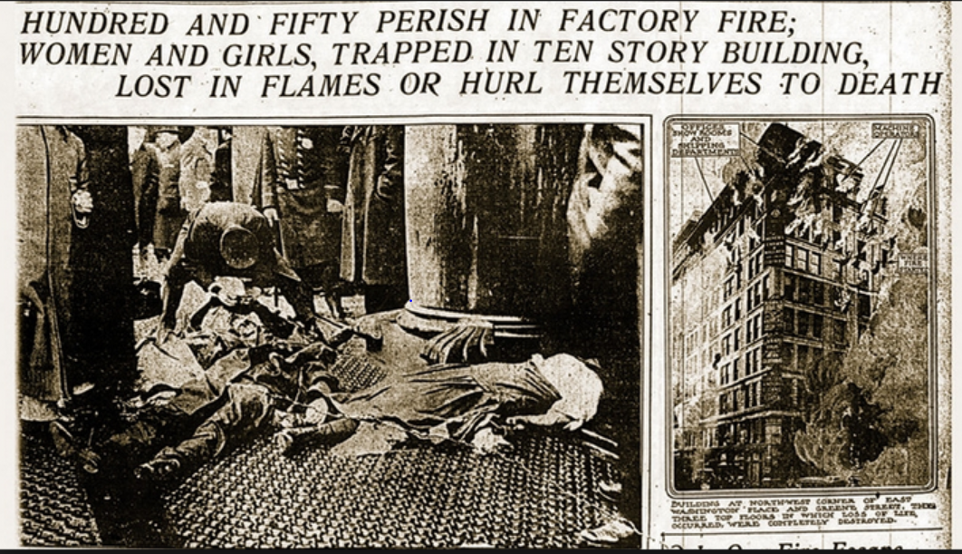
Corporate Massacre – 1911
The Triangle Shirt Waist Fire
Notes:
Source: http://www.hernblawg.com/the-triangle-shirtwaist-factory-100-years-later-and-the-tsca-responsibility-as-opportunity/ Image may be subject to copyright

Slide 28
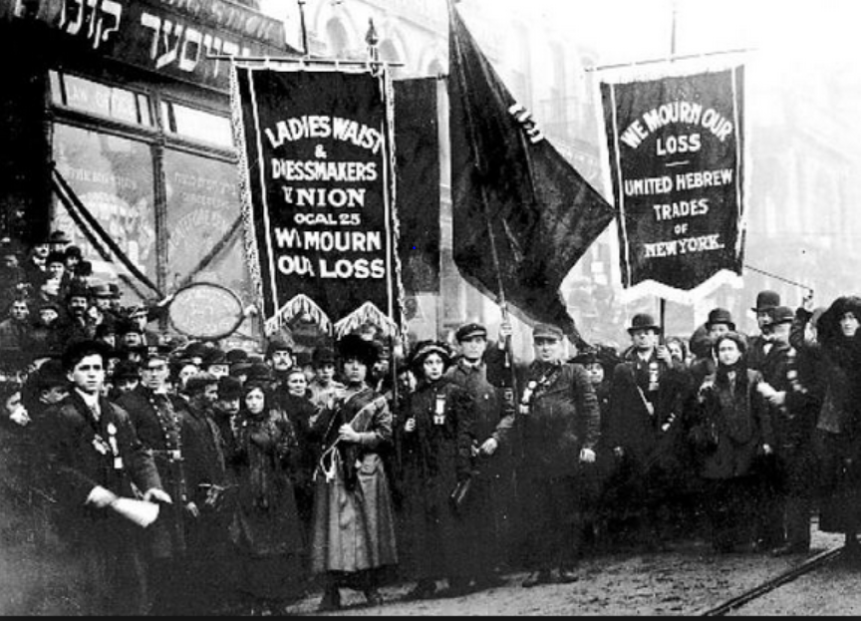
We Mourned and We Organized:
We Did Not Let Them Die in Vain
Notes:
Source: http://www.nydailynews.com/opinion/horrific-deaths-triangle-shirtwaist-fire-launched-century-progress-safer-fairer-workplaces-article-1.119557 Image may be subject to copyright

Slide 29
We the People Organize and Triumph in New York State
Under extreme pressure from the working class and their allies, the State Legislature acted. 3 dozen new laws were passed:
Workplace safety
Stronger fire codes
Child labor protections
Wage and hour regulations
Unions were recognized in the industry.
These great victories were models for the great national victories in the 1930s and the 1960s.
Notes:
Source:
http://www.nydailynews.com/opinion/horrific-deaths-triangle-shirtwaist-fire-launched-century-progress-safer-fairer-workplaces-article-1.119557

Slide 30

Decades of Struggle to Expand Democracy:
Women Win the Right to Vote in 1920
5,000 women march in D.C. in 1913
Violent attacks against marchers
Army called in to protect the marchers
100 marchers injured
Notes:
Source: http://www.lwv.org/blog/celebrating-100th-anniversary-women’s-suffrage-marc Image may be subject to copyright.

Slide 31
100 Years of Struggle to Win Free Public Education for Children
By 1918, all states had adopted mandatory education laws.
1852 – Massachusetts
1871 – Washington tied for 3rd
1915 – Texas, Florida, South Carolina, Alabama
1918 - Mississippi
Notes:
Source: http://www.infoplease.com/ipa/A0112617.html

Slide 32
The Fight to Ban Child Labor Continues
U.S. Supreme Court strikes down two federal laws as unconstitutional – 1918 and 1923
Constitutional amendment passes House and Senate in 1924
Amendment fails - only 28 of 36 states needed ratify the amendment. States which suppress black and working class white voting are key to killing the amendment.
Notes:
Source: http://en.wikipedia.org/wiki/Child_Labor_Amendment
Source: http://www.dol.gov/oasam/programs/history/flsa1938.htm

Slide 33
VICTORY: 100 Years of Struggle to Give America’s Children a Childhood
Fair Labor Standards Act of 1938 passes.
Bans children under 16 working during school
Bans employment in “oppressive child labor”
Minimum wage and overtime after 40 hours per week
Initially only covers 20% of workforce
At long last, most of our children had free public education, were required to attend school and the most abusive child labor was being ended.
Notes:
Source: http://www.dol.gov/oasam/programs/history/flsa1938.htm
http://en.wikipedia.org/wiki/Fair_Labor_Standards_Act#cite_note-uooonav-3

Slide 34
GROUP EXERCISE
What thoughts and feelings do you have after hearing this story of our ancestors’ struggles for the American Dream and to limit corporate power?

Slide 35
BREAK

Slide 36
The Struggle Continues for a Brighter and More Just and Secure Future for All
Fair Elections Not Dominated by Big Money
Democratic Law Making that Serves the People
Sharing Fairly in the Fruits of Our Labor
Fair Taxes
Equal Treatment and Opportunity for All
Affordable Quality Educational Opportunities
Security and Help in Hard Times
International Solidarity
Healthy sustainable environment

Slide 37

Corporate America Under Pressure:
Share the Wealth
"The job of management is to maintain an equitable and working balance among the claims of the various directly affected interest groups: stockholders, employees, customers, and the public at large." - Frank Abrams, Chairman, Standard Oil of New Jersey, 1951.
Notes:
Sources:
Standard Oil: http://missloumotormafia.wordpress.com/2008/08/page/3 Image may be subject to copyright.
Abrams quote: Harold Meyerson, “The Forty Year Slump,”The American Prospect,” September 2013, page 21.

Slide 38
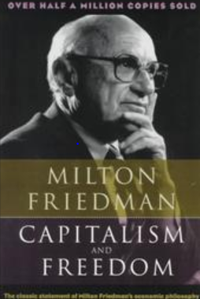
Milton Friedman: Economic Godfather of the New Corporate Dominance
“Few trends could so thoroughly undermine the foundations of our free society as the acceptance by corporate officials of a social responsibility other than to make as much money as possible for their stockholders as possible.”
Notes:
Sources:
Image: http://fiddleferme.blogspot.com/2008_09_01_archive.html Image may be subject to copyright
Quote: Milton Friedman, Capitalism and Freedom, page 133. Cited in Hedrick Smith, Who Stole the American Dream, page 49.

Slide 39
The Rise and Decline of the American Labor Movement - 1890 to 2012
Notes:
Source: Years 1890 - 1929, Vernon Briggs, Immigration and American Unionism, pages 71 and 113. Years 1930 -1970, U.S. Department of Commerce, “Historical Statistics of the U. S. – Colonial Times to 1970, page 178. Years 1971 to 2003, U.S. Department of Commerce, “Statistical Abstract of the U.S., several issues, tables typically labeled “Labor Union Membership by Sector. Years 2003 to 2012 Bureau of Labor Statistics
Barry T. Hirsch and David A. Macpherson, "Union Membership and Coverage Database from the Current Population Survey: Note," Industrial and Labor Relations Review, Vol. 56, No. 2, January 2003, pp. 349-54. (in pdf) URL: http://www.unionstats.com/
1982 data point added for continuous private sector data series.

Slide 40
Workers Wages’ Share of National Income Hits All-Time Record Lows – 2010-11
Source: Bureau of Economic Analysis, “Table 1.12 National Income by Type of Income, Table 1.12 National Income by Type of Income. http://www.bea.gov/iTable/iTable.cfm?ReqID=9&step=1
Notes:
121 million households in the U.S. 2011 – Census Bureau

Slide 41
Corporate After-Tax Profits Hit All-Time Record Highs – 2010-11
Corporate after-tax profits hit all-time record highs in 2010 and 2011 as a share of the national income while claiming the need for tax cuts and higher profits.
Notes:
Source: Bureau of Economic Analysis, “Table 1.12. National Income by Type of Income,” National Income and Product Accounts Tables. http://www.bea.gov/iTable/iTable.cfm?ReqID=9&step=1
Table calculated by dividing Line 15: Corporate profits after tax with IVA and CCAdj by Line 1: National Income

Slide 42
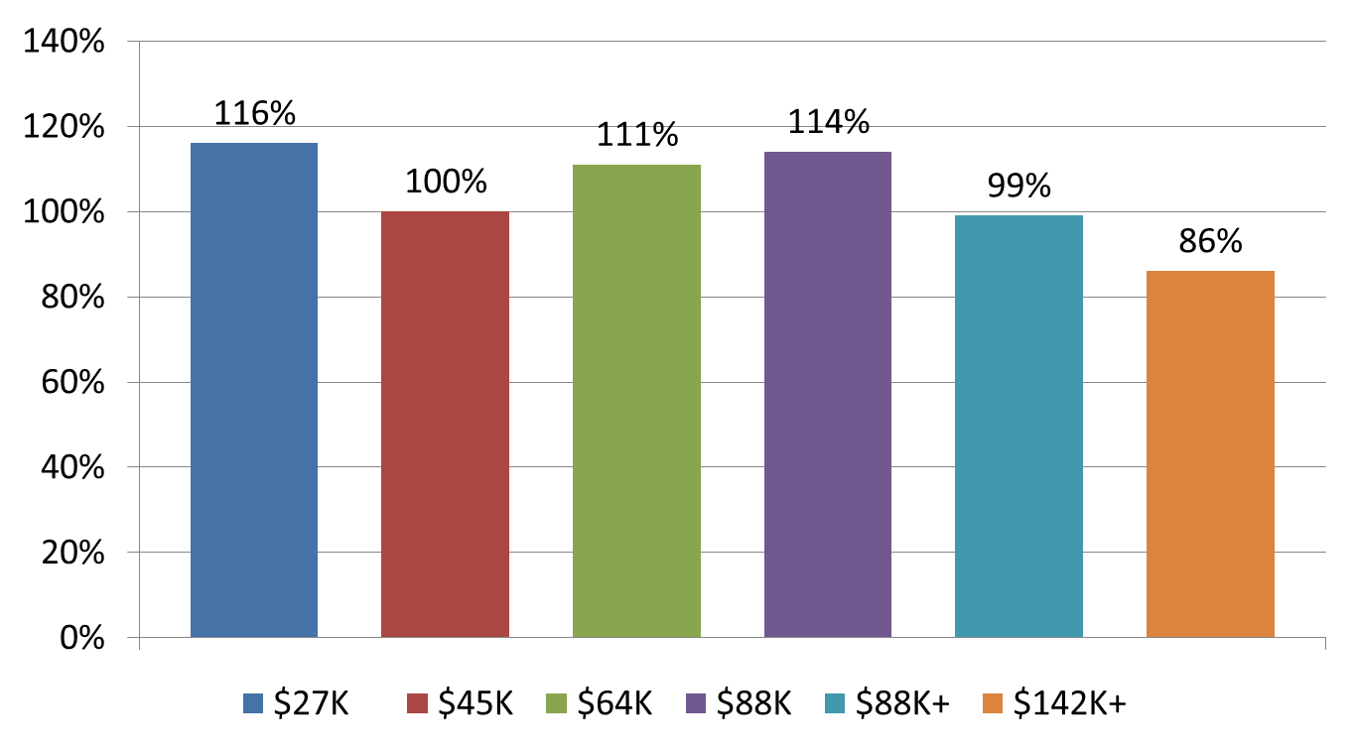
Decades of Shared Prosperity – 1947-1979
Notes:
Source: Mishel and Bernstein, The State of Working America 1994-95, M.E. Sharpe, 1994, page 37. U.S. Census Bureau, Historical Income Tables. F-1 for income ranges in 2010 dollars and F-3 for income changes. http://www.census.gov/hhes/www/income/data/historical/families/index.html

Slide 43
Corporate America Stealing our Shared Prosperity – 1979-2011

Slide 44
The Super-Rich Stealing our Shared Prosperity: 1979-2011
Richest 11,000 families’ average income rises 386%. Their minimum income is $8.6 million and their average income is $35.5 million (2006 data.)
Notes:
Source: U.S. Census Bureau, Historical Income Tables. F-1 for income ranges in 2010 dollars and F-3 for income changes. http://www.census.gov/hhes/www/income/data/historical/families/index.html Top 0.01% 1979 to 2005. Congressional Budget Office, “Historical Effective Tax Rates,” 2008., Table 3. http://www.cbo.gov/ftpdocs/98xx/doc9884/12-23-EffectiveTaxRates_Letter.pdf

Slide 45
GROUP EXERCISE
How do we ensure that we get our fair share of the wealth we create?

Slide 46
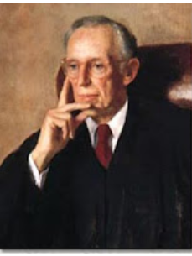
Future Supreme Court Justice Powell’s Secret Blueprint for Corporate Domination: 1971
“Strength lies in organization, in careful long-range planning and implementation; in consistency of action over an indefinite period of years; in the scale of financing available only through joint effort; and in the political power only through united action and national organization”
Notes:
By the early 1970’s, leading strategists for Corporate America were developing long-term plans to reassert corporate dominance of our country. Throughout much of the 1960’s and early 1970’s, corporate power was being further restricted by the rising power of new movements. Race, gender, disability and age discrimination in the workplace was being restricted. Water, air and ground pollution by corporations was subject to major increases in federal regulation. The passage of the federal Occupational Safety and Health Act (OSHA) increased protections for workers and began to limit corporate abuses. The passage of pension protection legislation restricted corporate abuses of pension plans. This is only a partial list.
Movements of people of color, women, gays, youth, seniors, and environmentalists posed strong challenges to corporate power. Waves of strikes also put pressure on Corporate America.
It was time to launch a major long-term counterattack. One leading strategist was Lewis Powell, a corporate lawyer from Richmond, Virginia who served on many major corporate boards. On August 23, 1971, he wrote a confidential memo to a close ally and senior official at the U.S. Chamber of Commerce. In the memo, Powell outlined a brilliant long-term strategy for reasserting corporate dominance. Fundamentally, he called for Corporate America to use their money, power and influence to win a “War of Big Ideas.” In doing so, they would fundamentally reshape the thinking of the American people regarding the way our economic life should be shaped.
He called for the creation of a powerful intellectual machine that would wage that war.
Source: Greenpeace. http://www.greenpeace.org/usa/en/campaigns/global-warming-and-energy/polluterwatch/The-Lewis-Powell-Memo/

Slide 47
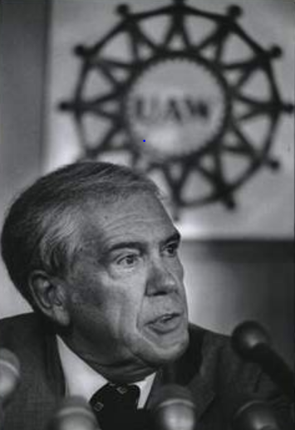
Doug Fraser: UAW President – 1978
“ I believe leaders of the business community, with few exceptions, have chosen to wage a one-sided class war today in this country … a war against working people, the unemployed, the poor … even many in the middle class.”
Notes:
Sources:
Image: http://www.freep.com/article/20121028/BUSINESS01/310280131/UAW-saw-an-opening-with-Honda-s-arrival Image may be subject to copyright.
Quote: Hedrick Smith, Who Stole the American Dream, page 17.

Slide 48
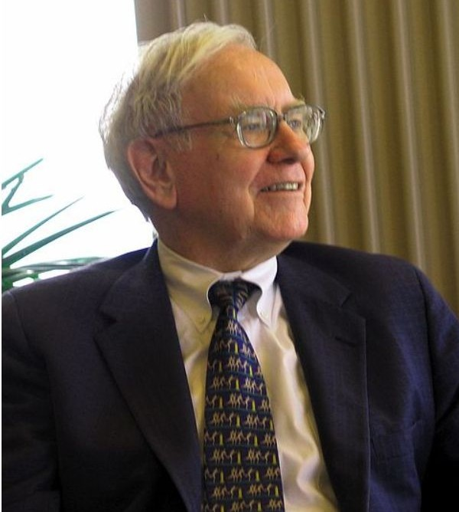
Warren Buffett: An Honest Billionaire – 2006
At Least One of Them Admitted the Truth
“There’s Class Warfare, all right. But it’s my class, the rich class, that’s making war, and we’re winning.”
Notes:
I like an honest man. Mr. Buffett is speaking the truth. There is a class war in America and working people and their allies are losing. Their dreams of a brighter and more secure future with greater opportunity are being stolen from them by Corporate America in a one-sided class war.
Source: Wikipedia. http://en.wikipedia.org/wiki/File:Warren_Buffett_KU_Visit.jpg
Quote: http://www.nytimes.com/2006/11/26/business/yourmoney/26every.html?_r=0

Slide 49

We the People Demand Elections That Are Not Dominated by Big Money
Notes:
Source: http://www.changingworld.com/catalog/political-c-5_67.html Image may be subject to copyright.

Slide 50

Corporate Power Gets Organized - 1975
“The effective operation of a democratic political system usually requires some measure of apathy and noninvolvement on the part of some individuals and groups. In the past, every democratic society has had a marginal population, of greater or lesser size, which has not actively participated in politics.”
Notes:
Sources:
Image: http://www.american-buddha.com/lit.crisisdemoc.htm Image may be subject to copyright
Quote: Samuel Huntington, http://www.american-buddha.com/lit.crisisdemoc.htm

Slide 51
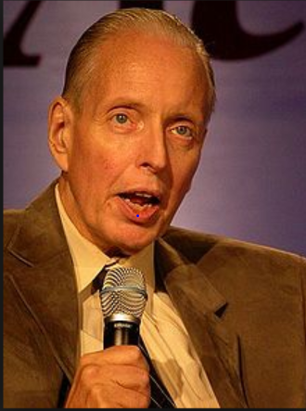
Corporate Attacks on Democratic Elections
“ I don’t want everybody to vote…our leverage in the elections quite candidly goes up as the voting populace goes down.” – Paul Weyrich, 1980. Co-founder of the Heritage Foundation.
Notes:
Source:
Image: http://en.wikipedia.org/wiki/Paul_Weyrich Image may be subject to copyright.
Quote: Robert McChesney, Digital Disconnect, page 59.
Note: Co-founder of the Heritage Foundation, largest conservative think tank in WA D.C. and partially funded by Charles Koch Foundation and other right-wing billionaires.

Slide 52
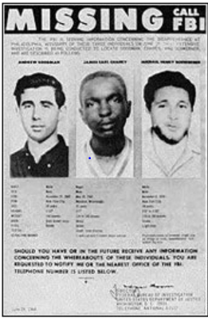
Heroes and Heroines Died Winning Voting Rights:
Department of Justice Defends Them
Between 1982 and 2006, DOJ blocked over 700 proposed voting changes by state and local governments…
Republican-controlled Congress found a majority were “calculated decisions to keep minority voters from fully participating in the political process.”
Notes:
Sources:
Image: http://www.infoplease.com/spot/bhmjustice4.html Image may be subject to copyright.
Quote: U.S Supreme Court, “Shelby County, Alabama v. Holder, 2013, page 44. http://www.supremecourt.gov/opinions/12pdf/12-96_6k47.pdf

Slide 53
U.S. Supreme Court Strikes Down Key Provisions of Voting Rights Act - 2013
2006 – Republican controlled Congress extends Act by votes of 390 to 33 and 98 to 0.
Republican House Judiciary Committee Chair: “One of the most extensive considerations of any piece of legislation that the United States Congress has dealt with in the 27½ years” he had served in the House.”
Notes:
Note: U.S Supreme Court, “Shelby County, Alabama v. Holder, 2013, pages 39 and 67. http://www.supremecourt.gov/opinions/12pdf/12-96_6k47.pdf

Slide 54
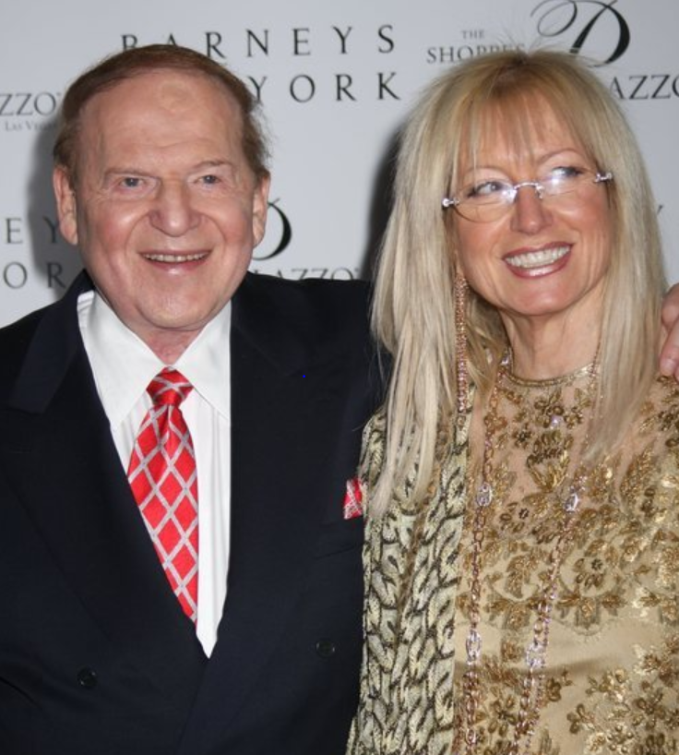
Supreme Court’s Citizens United Decision:
Buying Elections – 2012 Style
Sheldon Adelson and wife
Sheldon and his wife donated over $90 million in the 2012 election. 31 others donated another $220 million. Total: $312 million.
3.7 million people donating less than $200 gave $313 million.
Notes:
Source: http://www.contactmusic.com/photo/sheldon_adelson_5077493 Image may be subject to copyright.
U.S. PIRG, http://uspirg.org/sites/pirg/files/reports/BillionDollarDemocracy.pdf

Slide 55

Edward Bernays: Father of Public Relations
Master of “Engineering of Consent”
“The conscious and intelligent manipulation of the organized habits and opinions of the masses is an important element in democratic society. Those who manipulate this unseen mechanism of society constitute an invisible government which is the true ruling power of our country.” - 1928
Notes:
Sources:
Image: http://escapeesblog.wordpress.com/2012/04/18/edward-bernays-propoganda-book/edward-bernays-propoganda-book01/ Image may be subject to copyright.
Quote: Edward Bernays, Propaganda, IG Publishing, page 37.

Slide 56
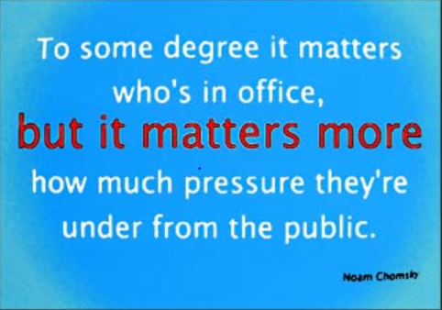
Notes:
Sources: Chomsky quote: http://www.changingworld.com/catalog/noam-chomsky-quote-postcard-some-degree-matters-whos-office-pressure-theyre-under-click-read-more-election-p-5839.html Image may be subject to copyright.

Slide 57
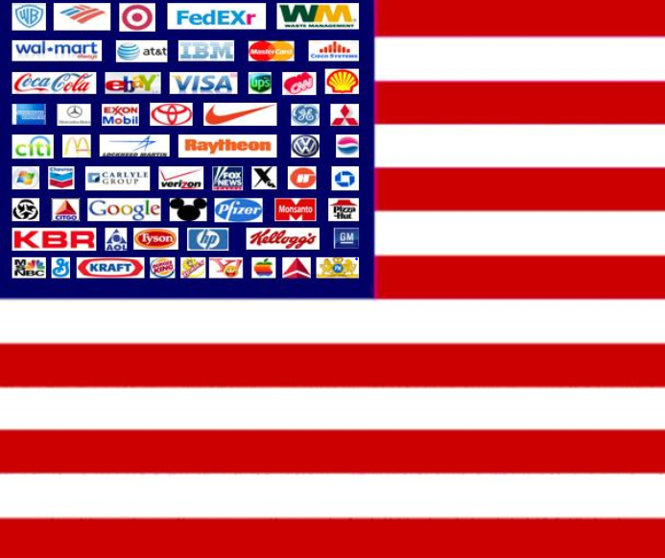
United States of Corporations
Notes:
Source: http://beforeitsnews.com/alternative/2011/02/the-u-s-corporation-and-the-maritime-flag-406269.html Image may be subject to copyright.

Slide 58
Lobbying: Corporate America Buys the Best Politicians Available – 1998 to 2012
Notes:
Source: Center for Responsive Politics. Calculations based on data from the U.S. Senate Office of Public Records. http://www.opensecrets.org/lobby/index.php

Slide 59

We the People Demand a Just Tax System: General Electric Legal Tax Evasion
U.S. profits – 2002-11:
$80.2 billion
Average tax rate: 1.8%
Official rate: 35%
GE saves: $26.5 billion
GE lobbying – 2002-11:
$220 million
Return on lobbying:
12000%
Notes:
Source: Citizen for Tax Justice, February 27, 2012. http://ctj.org/taxjusticedigest/archive/2012/02/press_release_general_electric.php
OpenSecrets.org http://www.opensecrets.org/lobby/top.php?showYear=a&indexType=s
Picture: OpenMarkets.in http://openmarkets.in/3104/new-plant-for-ge-in-pune-at-an-investment-of-rs-1000-crore

Slide 60
GROUP EXERCISE
How do we build stronger support in our communities to make our elections, government and tax system work well for we the people?

Slide 61
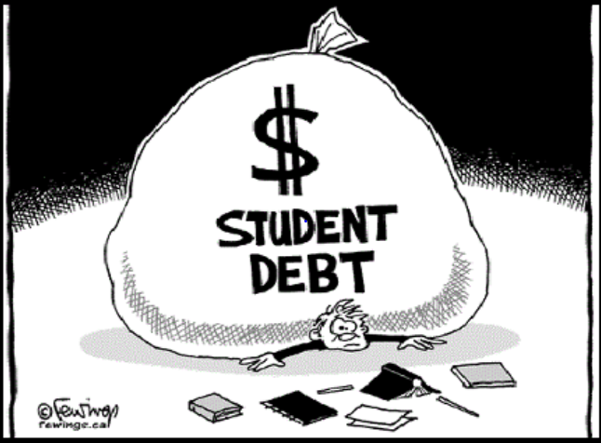
We the People Demand Affordable Quality Education for All
“the U.S does not have as much mobility as most other advanced countries.”
“Family background plays more of a role in the U.S. than most comparable countries.”
$1,000,000,000,000 and counting!!!
Notes:
Source: Jason DeParle, “Harder for American to Rise from Lower Rungs,” New York Times, January 4, 2012. http://www.nytimes.com/2012/01/05/us/harder-for-americans-to-rise-from-lower-rungs.html?_r=1&nl=todaysheadlines&emc=tha23
Source: $1 trillion, Consumer Financial Protection Bureau, http://www.consumerfinance.gov/blog/too-big-to-fail-student-debt-hits-a-trillion/
Picture: http://www.classwarfareexists.com/wsj-student-loan-debt-tops-1-trillion/ Image may be subject to copyright.

Slide 62
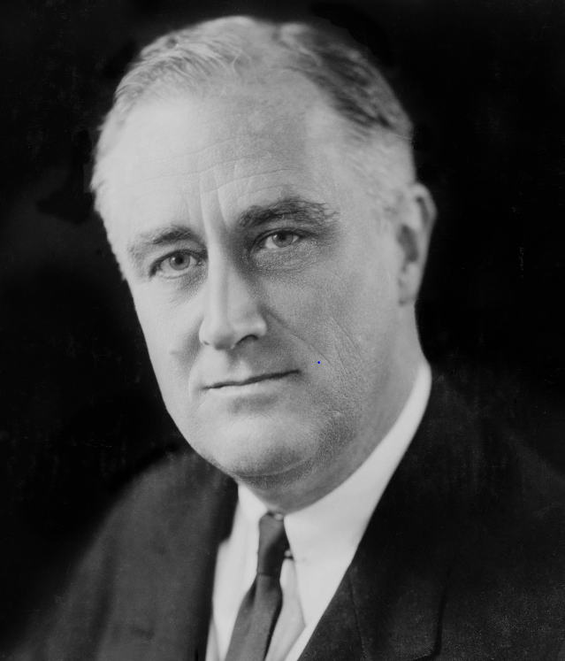
We the People Demand A Safety Net that Protects Us in Hard Times
“The test of our progress is not whether we add more to the abundance of those who have much; it is whether we provide enough for those who have little.”
President Franklin Delano Roosevelt
Notes:
Sources:
Image: http://en.wikipedia.org/wiki/File:FDR_in_1933_edit.jpg Picture may be subject to copyright.
Quote: http://www.brainyquote.com/quotes/quotes/f/franklind163168.html

Slide 63
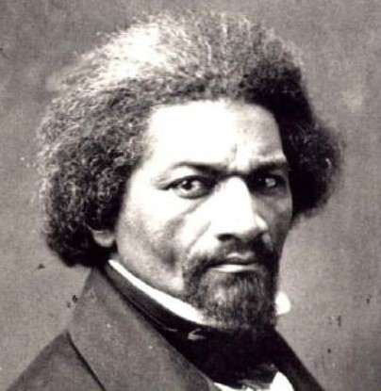
Fighting for the American Dream:
Finding Hope and Getting Organized
“If there is no struggle, there can be no progress…find out what any people will quietly submit to and you will have found out the exact measure of injustice and wrong which will be imposed upon them.”
Frederick Douglass, 1857
Notes:
Frederick Douglass is a great American hero. He was an escaped slave, a national leader in the fight to abolish slavery, and a lifelong fighter to make the American Dream real for everyone. He wrote these prophetic words when the U.S Supreme Court ruled in the infamous Dred Scott decision that escaped slaves in the free states could be forcibly returned to slavery in the southern states. It was truly a dark day in our national history. Yet he spoke the truth to unjust power.
His words ring true today. Corporate America and their allies will keep exploiting and abusing we the people until we rise up as our ancestors have before and take back our country. This is our historic task.

Slide 64
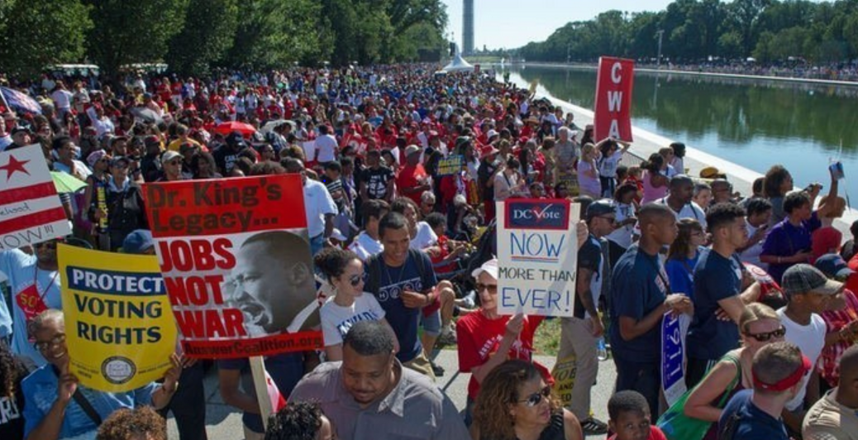
United We Can Defend and Expand Our American Dream to All – August 24, 2013
Notes:
Source: http://www.channelnewsasia.com/news/world/crowds-swell-washington/789326.html Image may be subject to copyright.

Slide 65
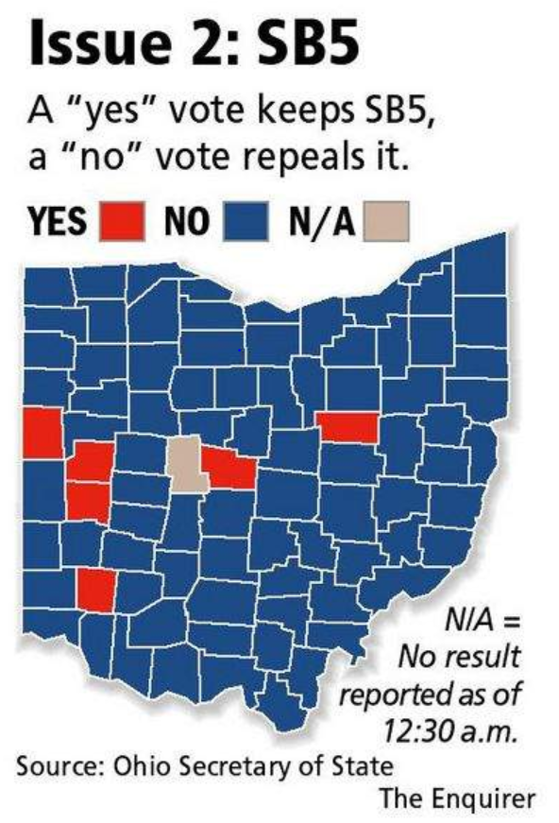
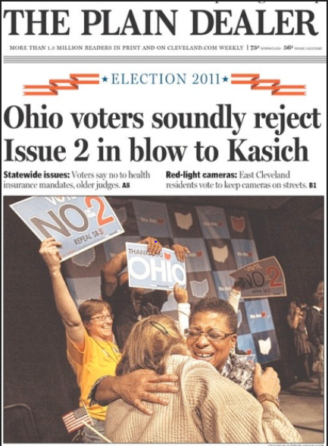
Who Says We Can’t Win Big? Not Ohio Anti-Union Law Repealed 61% to 39%
Notes:
Sources:
http://mirroronamerica.blogspot.com/2011_11_01_archive.html
http://news.cincinnati.com/article/20111108/NEWS0108/111090341/Issue-2-rejected-overturning-SB-5 Image may be subject to copyright.

Slide 66
Safeway, QFC, Fred Meyer and Albertsons demands elimination of health insurance, dental insurance and vision care for 8,000 part-time workers and a three year wage freeze for almost 30,000 workers.
Stand With Our Checkers
Website: http://standwithourcheckers.com/
https://www.facebook.com/standwithourcheckers

Slide 67
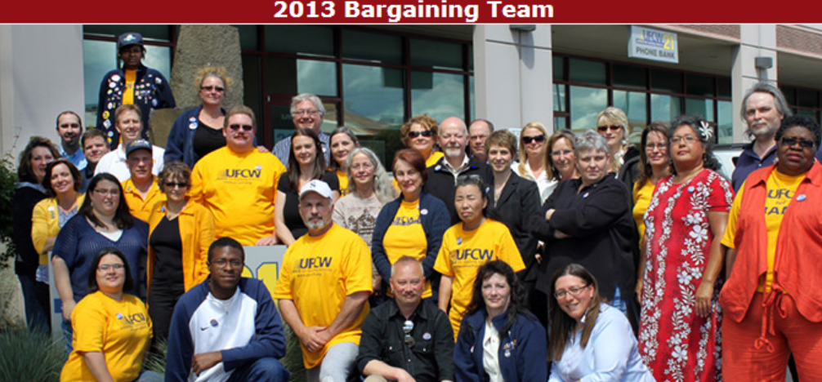
Western Washington Grocery Workers Win Big: Defeat 50 Concessions and Make Gains
Notes:
Source: http://www.ufcw21.org/content/98-strike-authorization

Slide 68
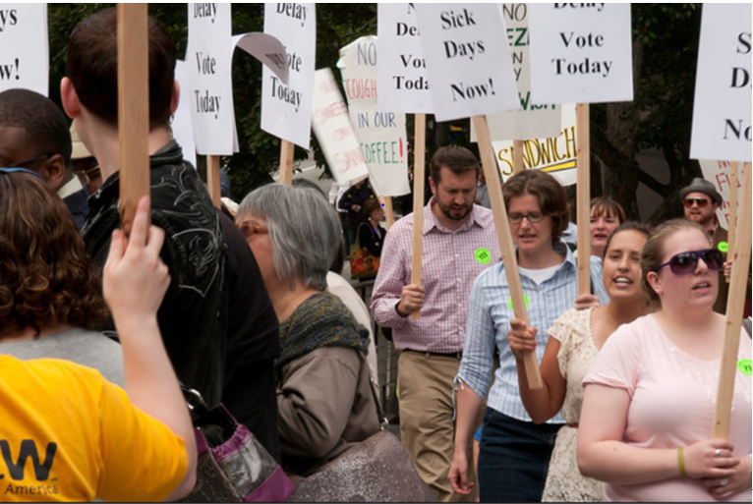
We the People Organize and Win: 190,000 Workers Get Paid Sick Leave in Seattle
Notes:
Source: PSARA

Slide 69
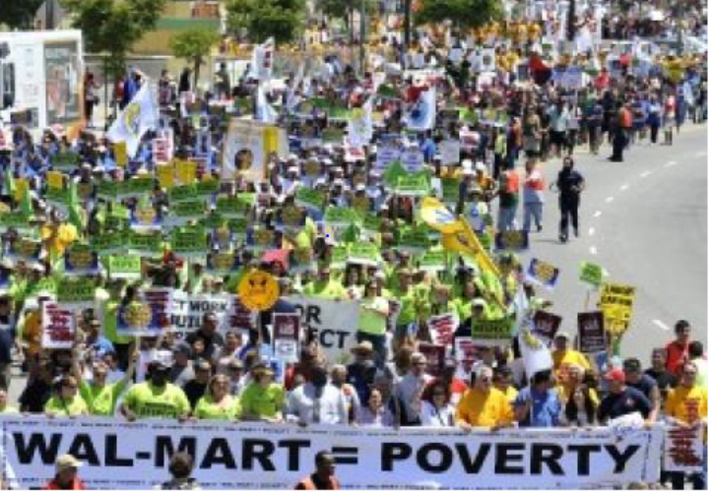
The Power of the People versus Walmart
Making Change at Walmart Contact:
Elena Perez - 206-359-1885
Notes:
Source: http://portside.org/2013-05-28/walmart-workers-launch-first-ever-prolonged-strikes-today Joe Klamar/AFP/Getty Images. Image may be subject to copyright.

Slide 70
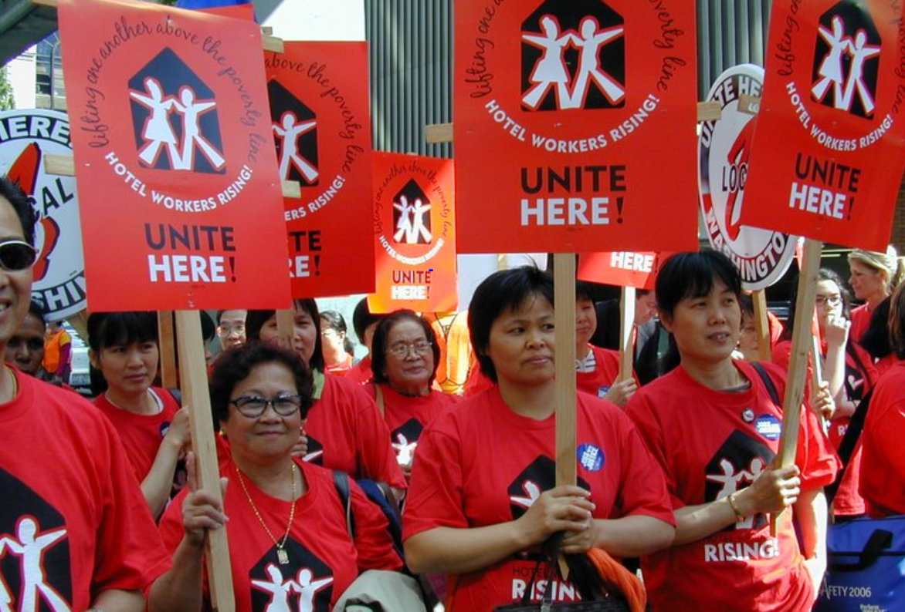
Hotel Workers Union Launches Boycott of Grand Hyatt and Olive 8 Hotels
Contact: Levi Pine – 312-296-7449
Notes:
Source: http://www.unitehere8.org/wp-content/uploads/Seattle-New-Website-21.jpg

Slide 71
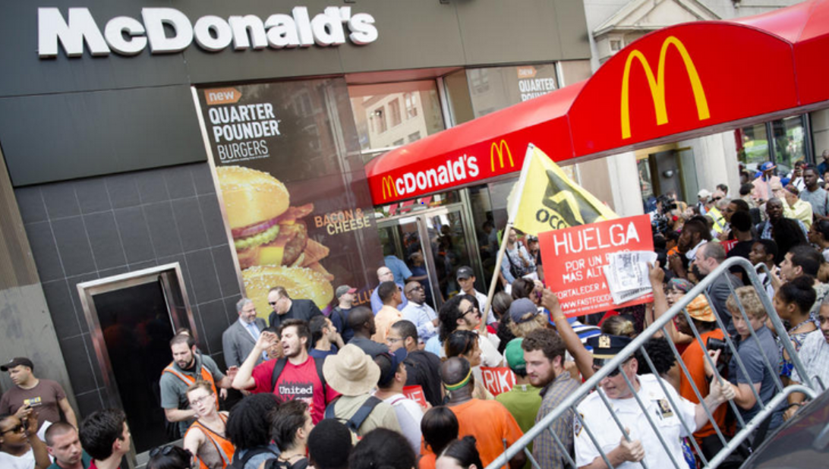
Fast Food Strikes – 2013
McDonalds Profits: $5.5 Billion - 2012
Notes:
Source: http://www.cbsnews.com/8301-505124_162-57599405/fast-food-workers-urged-to-stage-nationwide-strike/ Image may be subject to copyright. August 21, 2013.

Slide 72
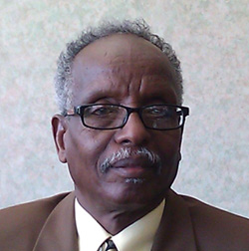
One story at Sea-Tac Airport:
Samatar Abdullahi
I came to Seattle from Somalia in 1999 to be with my family, including my 4 grandchildren.
For nearly 9 years, I have worked for the contractor DGS, cleaning the cabins of Alaska Airlines planes. In three of those years, I was given commendations for exceptional service.
When I started working at DGS I was paid $8.25 an hour. After nearly nine years I am only making $9.89 an hour, and DGS has now reduced my hours.

Slide 73
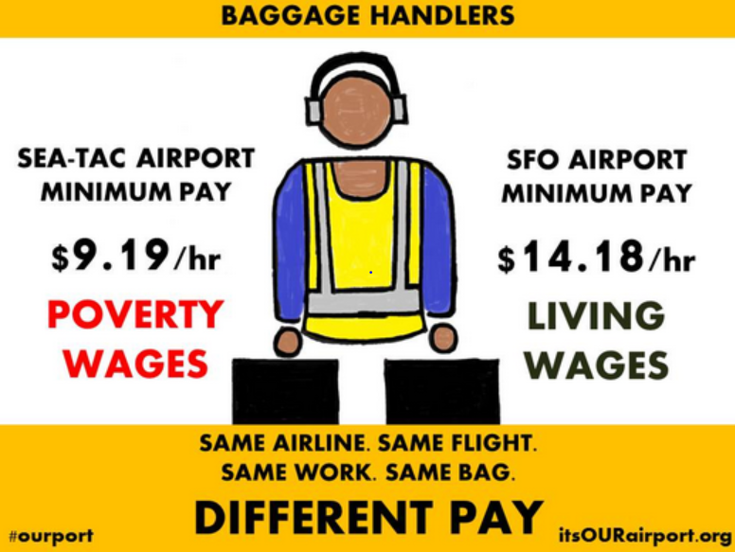
Big Victory
$15/Hour Minimum Wage at Sea-Tac Airport
Notes:
Source: http://sayanythingblog.com/entry/seatacs-idea-for-a-15-minimum-wage-doesnt-fly-critics-say/

Slide 74











Fighting for and Winning Marriage Equality
Notes:
Source: http://washingtonunitedformarriage.org/category/coalition/labor/ Images may be subject to copyright.

Slide 75

AFL-CIO Fighting for Equal Pay
Lilly Ledbetter Act - 2009
“Women, people of color, older Americans and people with disabilities continue to face pay discrimination in the workplace. Every discriminatory paycheck received by a worker is an insult to his or her dignity.” – AFL-CIO.
Notes:
Source: http://edit.aflcio.org/Press-Room/Press-Releases/Statement-by-AFL-CIO-President-John-Sweeney-On-the20
Image: https://www.facebook.com/photo.php?fbid=613040208708100&set=a.376425895702867.96342.203135923031866&type=1&theater Image may be subject to copyright

Slide 76
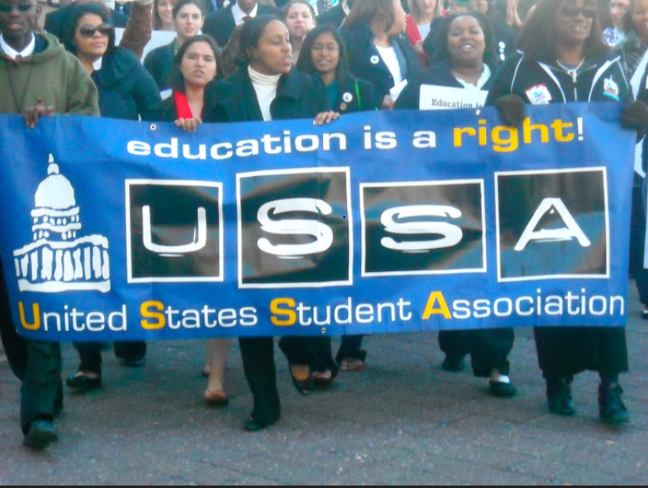
Militant Students Force Congress to Keep Lower Interest Rates for Student Loans - 2012
Notes:
Source: U.S. Student Association http://usstudentassociation.blogspot.com/ Image may be subject to copyright.

Slide 77
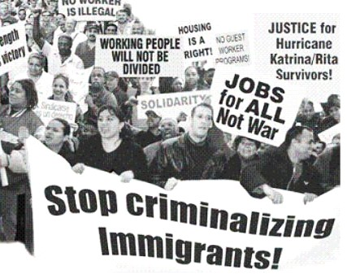
We the People Demand Equal Treatment and Justice for All: Immigration Reform Now
Notes:
Since 2008, the American people have suffered through the hardest economic times since the Great Depression of the 1930’s. A dark side of our national history is to blame and scapegoat immigrants for our economic difficulties.
When I use this PowerPoint in my workshops, I use this graphic to ask the following question: “How many of the Wall Street executives who wrecked our economy are undocumented workers from Mexico?” Typically there is nervous laughter but no one answers. I follow up: “ No, this is a serious question.” Then someone correctly answers that the number is zero. No undocumented immigrants wrecked our economy.
However if I was a space alien monitoring broadcasts from the U.S., the level of hostility against many immigrants might lead you to believe that 80% of the responsible Wall Street executives were undocumented immigrants.
We cannot allow people to fall for this blame game. No undocumented immigrants working at sub-minimum wage in very exploited conditions are responsible for any factories moving overseas, corrupt bank officials pushing bad housing loans, or illegally foreclosing on hard-pressed homeowners. None.
Honest people can disagree about how to address the complex issues of legal and illegal immigration but none of us should fall into the trap of taking out our frustration and anger on the immigrants. They did not cause this crisis. They are victims too. They are our sisters and brothers, not our enemies.

Slide 78

Bengla Deshi Workers are Our Brothers and Sisters in Our Struggle for a Better World
Notes:
Source:
http://www.theosthinktank.co.uk/comment/2013/05/01/bangladesh-factory-collapse-pope-hits-out-at-slave-labour-amid-may-day-protests Image may be subject to copyright.

Slide 79
The Struggle Continues for a Brighter and More Just and Secure Future for All
Fair Elections Not Dominated by Big Money
Democratic Law Making that Serves the People
Sharing Fairly in the Fruits of Our Labor
Fair Taxes
Equal Treatment and Opportunity for All
Affordable Quality Educational Opportunities
Security and Help in Hard Times
International Solidarity
Healthy sustainable environment

Slide 80
People Like Us Have and Can Change the World. This is our Time.
Free public education
Banning child labor
Women’s right to vote
Constitutional amendment for progressive income tax
Right to organize unions
Battling big money in elections
Expanding civil rights, human rights and voting rights
Creating safety net for hard times
Expanding access to higher education
The United States – 2013 forward
Notes:
Let’s us dedicate ourselves to building a better world. As the Reverend Dr. Martin Luther King Jr. once said: “The moral arc of the universe is long and it bends toward justice.” I humbly add: “But only if the people make it bend.” This is our historic task.

Slide 81

United We Can Change Our World
The ultimate test of a person, a union, a movement and a people is not whether or not we get knocked down. It is what we do when we get up. Are we stronger, smarter, more determined, and more united?
This is always our choice.
Notes:
These young leaders are taking Margaret Mead’s famous quote to heart and taking action to build new movements. We must join with them. We need to remember that our ancestors faced great odds and obstacles to creating a better future. They won after decades of defeats. We face new yet similar challenges. Yes, we can.
Source: Quote: http://www.goodreads.com/author/quotes/61107.Margaret_Mead

Slide 82
Key Questions
Where will you find your power and courage to stand up for a better future alongside others?
How do we build the power at the national, state and local levels to take our country and democracy back?

Slide 83
Mark M. McDermott www.markmmcdermott.com www.facebook.com/markmcdermottworkshops
Email: markmmcdermott1@msn.com

Slide 84
Appreciations
I want to thank United Food and Commercial Workers (UFCW) Local 21 and International Brotherhood of Electrical Workers (IBEW) Locals 46, 73, 76, 112 and 191 for their support of the creation of this new workshop.

