Slide 1
Making the American Dream a Reality for Everyone
IBEW 46 Organizing Blitz – Kent
Mark McDermott
September 25, 2012
Notes:
3 periods of history in which working people and their allies fought for an American Dream with greater economic opportunity and security. Their victories and their defeats.
FUNDAMENTAL TRUTH: WHEN WE ARE UNITED WE CAN WIN. WHEN WE ARE DISUNITED WE WILL LOSE.
WORKING PEOPLE LIKE US HAVE CHANGED THE COURSE OF HISTORY. WE CAN AND WILL. THE QUESTION IS HOW?
EXPANSION OF ECONOMIC AND POLITICAL DEMOCRACY IS THE KEY TO LONG-TERM SUCCESS.
Ground rules. Please limit your comments to allow more people to participate.
We will cover a lot of history and information and I acknowledge that there is much more to talk about with many subjects.
I want this workshop to be interactive so there will be several places to comment and share as well as a discussion at the end.

Slide 2
Finding Common Ground
How many of you, your family members, your close friends or their family members have experienced the following?
Lost a job in the past four years
Worried about losing job or can’t find full-time work
Couldn’t get or exhausted unemployment benefits
Lost or didn’t have health insurance
Were not paid wages that were legally owed

Slide 3
Finding Common Ground
How many of you, your family members, your close friends or their family members have experienced the following?
Difficulties in paying the bills or facing bankruptcy
Lost their home, facing foreclosures, underwater mortgage, or difficulties in paying the rent
Facing large student loans
Moved in relatives because they can’t pay the rent
Worried about adequate income in retirement

Slide 4
How do you feel about these problems facing you, your family, and your friends and their families?
Notes:
Pair off into twos. Talk for one minute each.
Report out to the group one word or short phrase that summarize a key feeling.
Do you feel hopeful? Raise your hands.

Slide 5
What does the American Dream mean to you and your family?

Slide 6
“Those who cannot learn from history are doomed to repeat it. Those who do not remember their past are condemned to repeat their mistakes."
George Santayana

Slide 7
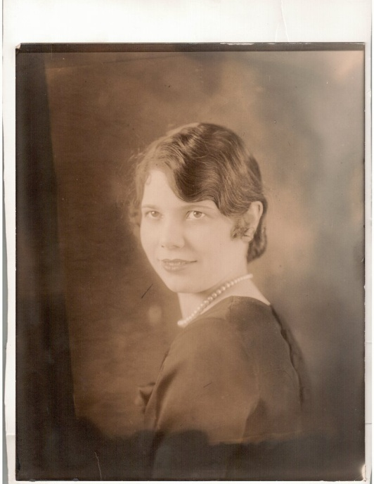
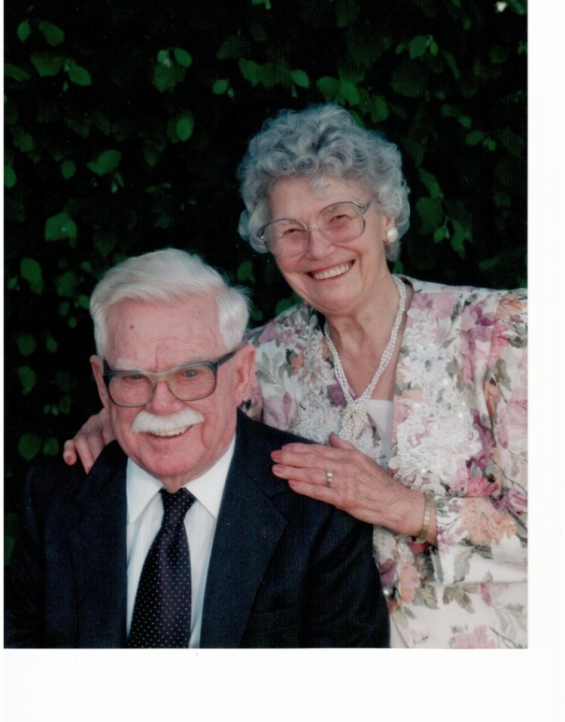
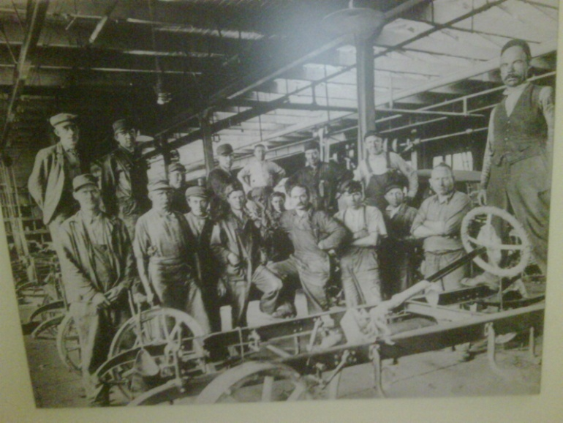
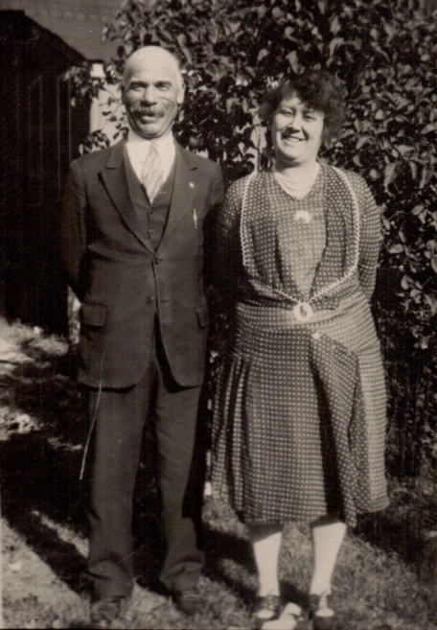
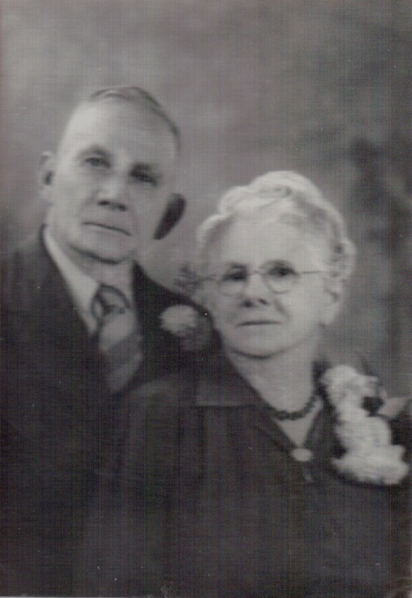
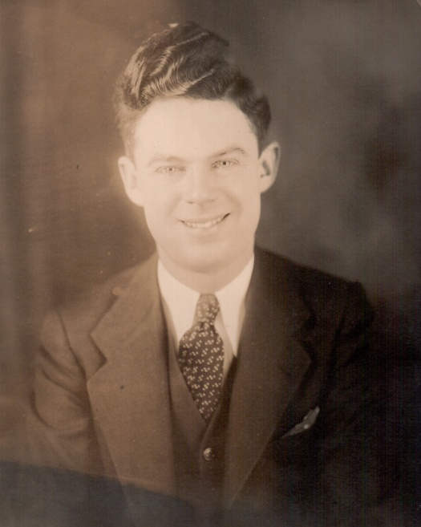
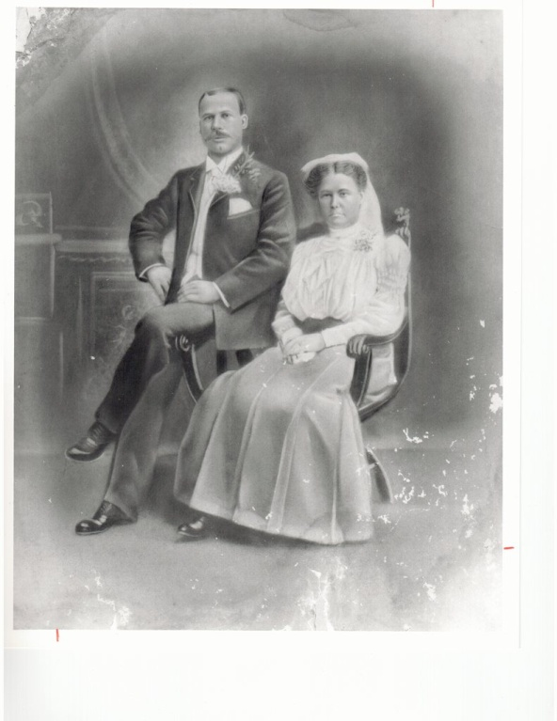
My Family’s Story
Notes:
My family’ story spans three generations of working class history in the United States. It is a story of struggle to create a more prosperous and secure future that would provide greater opportunity for each succeeding generation. My Irish-American grandfather had a third grade education, went to work at age 10 and retired after 65 years of work. My German-American grandfather had a sixth grade education and worked until he was laid off by Ford Motor Company at the start of the Great Depression. He died an untimely death at age 53 as an unemployed autoworker after being seriously injured. He died in poverty without unemployment insurance or health insurance that might have allowed him to get better medical care that might have saved his life. We don’t know if better care would have saved his life but we know that no money and insurance made his chances much slimmer.
My grandparents were union men and their generation helped build the great fortunes of America but they never shared fairly in the wealth they created.
Throughout the lives of my grandparents’ generation, working people fought to win the right to organize unions and bargain collectively, unemployment insurance, public assistance for families in need, affordable housing, health care protections, social security when they were old, protections for their bank deposits and security during hard economic times. They fought from the 1880s into the 1930s and were repeatedly defeated but they kept the faith and continued to struggle.
The Great Depression would provide the historic opportunity to change the lives of working people for decades to come.

Slide 8
Racism and Bigotry as Corporate Strategy
Swift Meatpacking – 1904: “Last week we employed Slovaks. We change among the nationalities and languages. It prevents them from getting together. We have the thing systematized.”
Philip Armour, CEO Armour Meatpacking admitted: “We pursue policies to keep the races and nationalities apart after working hours, and to foment suspicion, rivalry and enmity among such groups.”
23 blacks and 15 whites killed in white-initiated race riot in Chicago during failed packinghouse organizing drive in 1919.

Slide 9
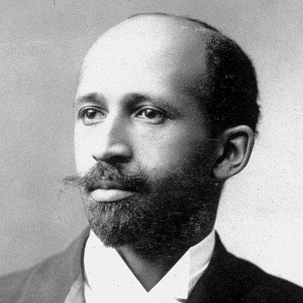
Racism Dividing Working People and Undercuts Needed Unity
The net result of all this
(union racism) has been
to convince the American Negro,
that his greatest enemy
is not the employer who robs him,
but his fellow white workingman.
W.E.B. DuBois (1913)
Source: Howard Zinn, People’s History of the U.S., page 321. Michael D. Yates, Why Unions Matter, page 147.
Notes:
In 5 years, black union membership rises 100 to 500 thousand. 1935 to 1940
In the 1930s, many unions opened their doors to black and other workers of color like never before. Some unions remained resistant to full integration.
Black union membership – Philip Foner, Organized Labor and the Black Worker, 1619 to 1973, page 231.
DuBois quote – Michael D. Yates, Why Unions Matter, page 147. Cites Michael Goldfield, “Race and the CIO: Response to Critics,” International Labor and Working Class History, no. 46, Fall 1994, page 2.

Slide 10
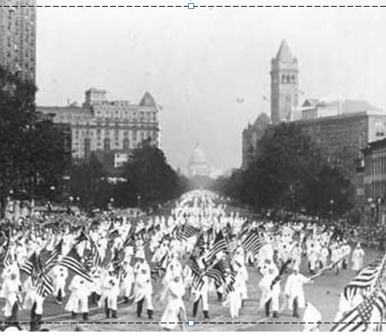
A Nation Divided
Ku Klux Klan March in D.C. - 1925
Source: Smithsonian National Museum of American History. Copyright.
Notes:
During the period of the 1890’s through the 1920’s, the American people were deeply divided by racism, anti-immigrant hostility, and other forms of bigotry. This is a Ku Klux Klan (KKK) march down Pennsylvania Avenue in Washington D.C. in 1925. The U.S. Capitol building is in the far background.
The KKK hated and persecuted blacks, other people of color, Jews, Catholics, immigrants, atheists and women who asserted their rights or believed to be immoral. In the mid-1920’s, the KKK had 4 to 5 million members. In today’s America, this would be the equivalent of 12 to 15 million members.
The conscious building of hatred served the interests of Corporate America well and made it extremely different for working people and their allies to come together to demand a better present and future.

Slide 11
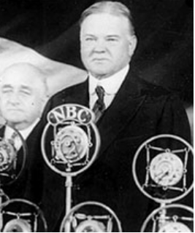
President Herbert Hoover - 1929
Darling of Corporate America
“We in America today are nearer to the final triumph over poverty than ever before in the history of any land.”
Notes:
Source: Quote: Howard Zinn, People’s History of the United States, page 378.

Slide 12
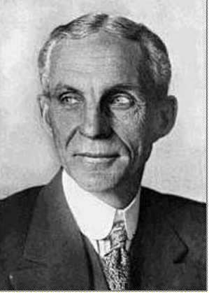
Henry Ford - 1931
“The average man won't really do a day's work unless he is caught and cannot get out of it. There is plenty of work to do if people would do it.”
Notes:
Source: Photo: Wisconsin Historical Society – 1997. Copyright. Quote: Howard Zinn, People’s History of the United States, page 378.

Slide 13
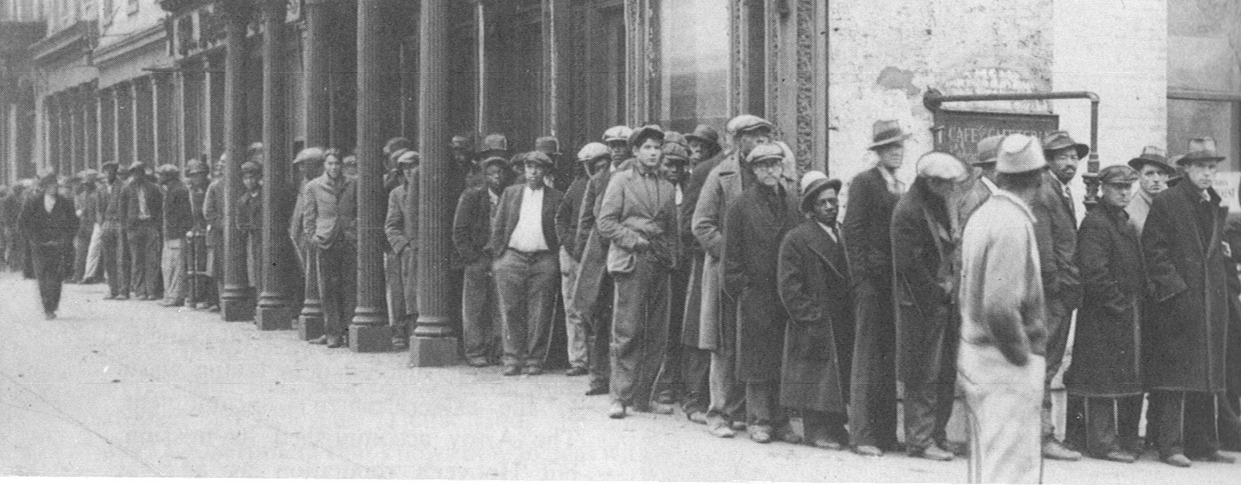
Hunger, Poverty and Homelessness Plagues Our Nation - Depression 1932
Source: M. B. Schnapper, American Labor: A Bicentennial History, Public Affairs Press, 1975, page 462. Copyright.
Notes:
COMMUNITY ORGANIZING RISES IN RESPONSE TO THE DEEPENING CRISIS.
By 1932, the Great Depression had reached its depths. The official national unemployment rate was 25 percent and the unofficial rate of working involuntarily working part-time was 35 percent. People of color were particularly hard hit.
For decades, Corporate America and their political allies had prevented legislation that would have provided unemployment insurance, adequate public assistance to the needy, affordable housing, badly needed food, social security for the elderly and the disabled, and an end of home and farm foreclosures. Working people, both employed and unemployed, were living in misery and desperation.
In midst of this untold and unjustified suffering, people began to organize particularly around issues of unemployment insurance, public assistance, affordable housing, social security. Massive demonstrations became a permanent part of the American story. Workers, whether employed or unemployed, the poor and the oppressed would not remain silent.

Slide 14
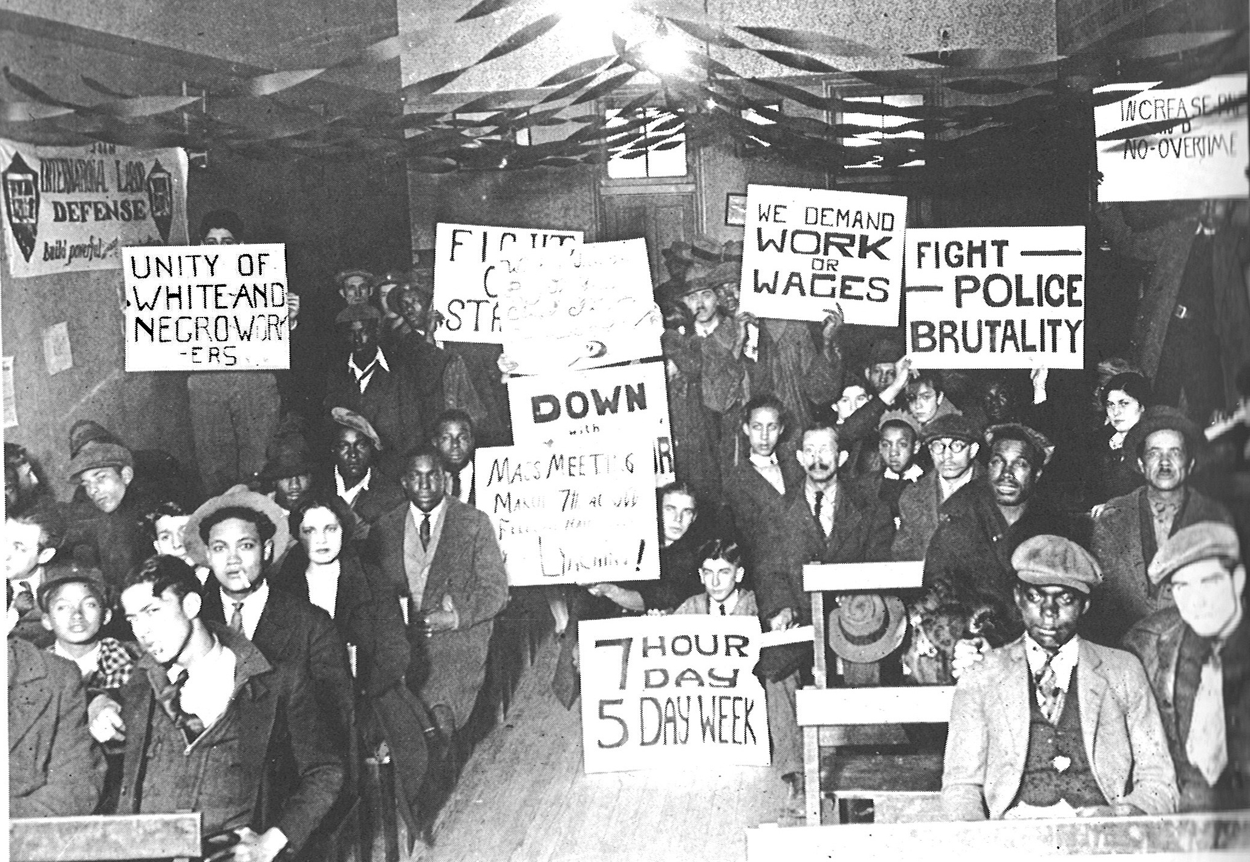
Growing Solidarity Between Black and White Workers – Early 1930s
Source: M. B. Schnapper, American Labor: A Bicentennial History, Public Affairs Press, 1975, page 474. Copyright.
Notes:
From the late 1790s to the early 1930s, the American labor movement largely excluded or restricted the membership of people of color. Many unions had outright bans while others restricted membership to segregated locals. This racist approach was both wrong but also played into the hands of the corporations that were determined to keep America non-union.
There were important exceptions to racial exclusion in the Mine Workers, the Amalgamated Clothing Workers, International Ladies Garment Workers and the Brewery Workers Unions. There were also many examples of white and people of color unionists joining together to build unions and demand justice on the job and in the larger community.
Racism, sexism, religious intolerance and anti-immigrant hatred divided the working class. By the early 1920s the Ku Klux Klan had 4 to 5 million members which is equivalent to 12 to 15 million members in 2011.
However, there was growing awareness among political radicals, progressive trade unionists and working class people that the struggle against racism and for genuine multi-racial unity was critical to creating a better life for all Americans. This awareness was being translated into movements of the unemployed and their families as well as organizing unions in the great mass production industries of auto, steel, meatpacking, rubber and others. A new consciousness was emerging out of a long history of racism and divisions among working people.

Slide 15
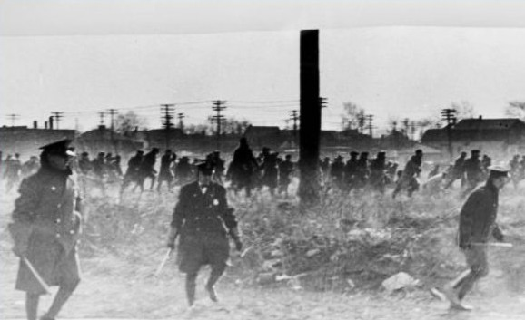
Police Kill 5 Ford Hunger Marchers - 1932
Source: Wayne State University, Walter P. Reuther Library, Ford Hunger Strike Collection, #DN_77646_2,. Copyright. https://www.reuther.wayne.edu/print/7283
Notes:
COMMUNITY ORGANIZING FOR ECONOMIC JUSTICE.

Slide 16
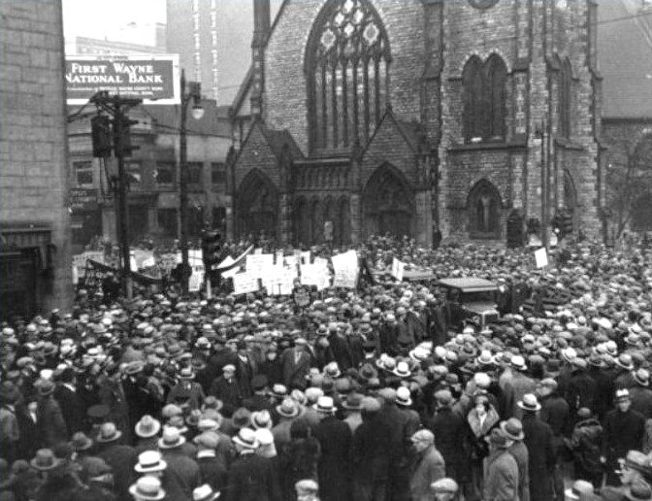
Funeral Procession for Martyrs of Ford Hunger March Massacre
Source: Wayne State University, Walter P. Reuther Library, Ford Hunger Strike Collection, #12273 Copyright. https://www.reuther.wayne.edu/print/7262

Slide 17
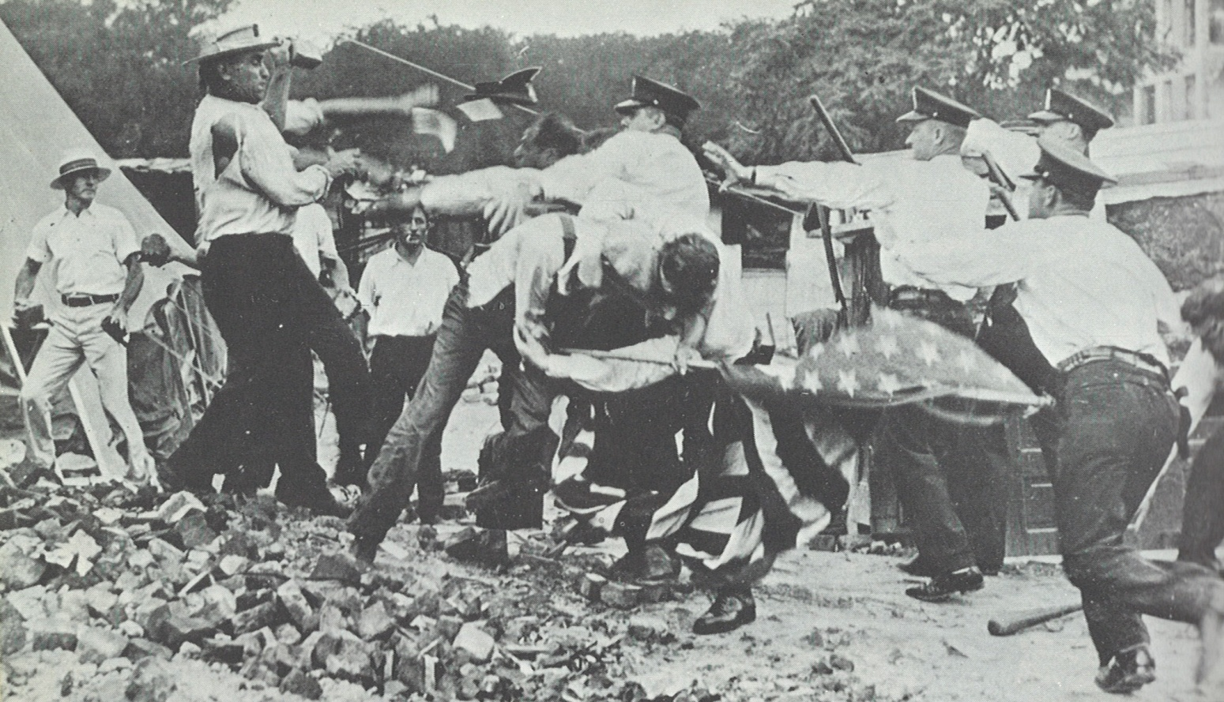
Police and U.S. Army Kill 2 Bonus Marchers and Destroy Occupy D.C. - 1932
Source: M. B. Schnapper, American Labor: A Bicentennial History, Public Affairs Press, 1975, page 460. Copyright.
Notes:
In 1932, thousands of World War 1 veteran marched on Washington D.C. demanding early payments of their war bonuses that were scheduled to be paid in 1943. They could not wait 11 more years while their families suffered from hunger, homelessness and unemployment. They camped in Anacostia Flats. Their “Occupy D.C.” of its day was burned to the ground by the U.S. Army led by General Douglas MacArthur and his chief of staff, future President Dwight Eisenhower. 2 were killed and 18 wounded.
On March 7, 1932 while my grandfather was dying, thousands of whites and blacks marched demanding justice and a meeting with Henry Ford. They demanded:
Jobs for all laid-off Ford workers
No discrimination against Negroes in jobs, relief, and medical services
Free medical aid at Ford Hospital for all employees and unemployed Ford workers and their families
Five tons of coal for the winter
No foreclosures
Abolition of forced bribery to get jobs
The right to organize
Dearborn and Detroit police and company gunmen opened fire killing 5 dead including 1 black and wounded 75. The marchers were attacked with water cannon on a bitter cold day. This day is known as the Dearborn Massacre. - Foner, Organized Labor and the Black Worker, page 196. Sugar, The Ford Hunger March.

Slide 18
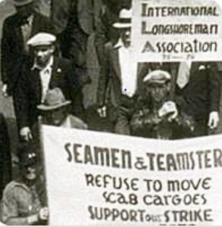
Solidarity Critical in Victory in 83-Day 1934 West Coast Longshore Strike
Source: The Pogues Forum. http://www.pogues.com/forum/viewtopic.php?f=38&t=11561&p=200646

Slide 19
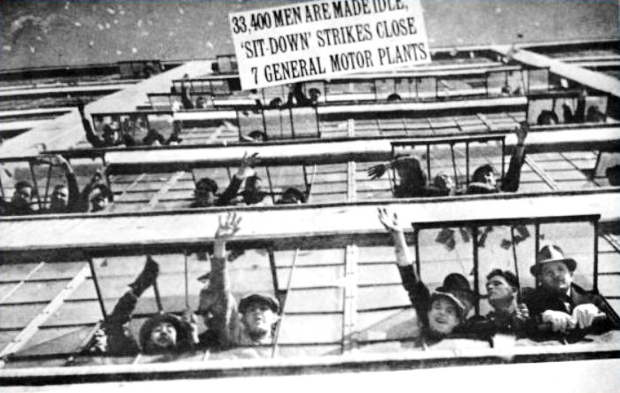
GM Sit-Down Strikers:
Occupy Flint, Michigan - 1937
Source: Wayne State University, Walter Reuther Library, Flint Sit-Down Strike Collection, #3991. Copyright. https://www.reuther.wayne.edu/node/3123

Slide 20
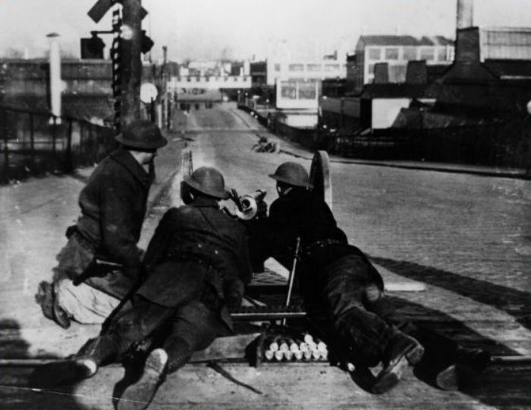
National Guard Occupies Flint
Source: Wayne State University, Walter Reuther Library, Flint Sit-Down Strike Collection, #3991. Copyright. https://www.reuther.wayne.edu/node/3123

Slide 21
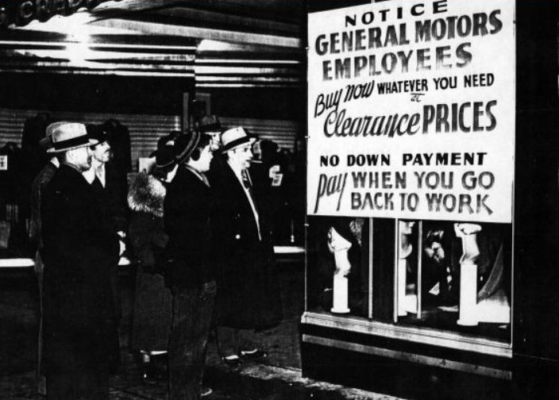
Community Rallies Behind Strikers
Source: Wayne State University, Walter Reuther Library, Flint Sit-Down Strike Collection, #3871. Copyright. https://www.reuther.wayne.edu/node/3123

Slide 22
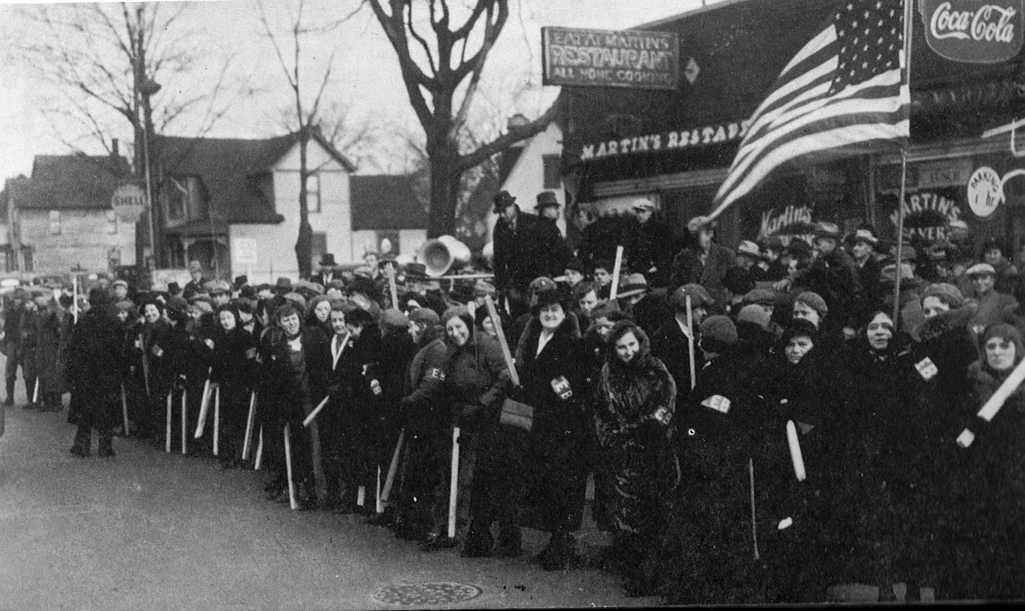
Women Defending Striking Workers
Source: M. B. Schnapper, American Labor: A Bicentennial History, Public Affairs Press, 1975, page 523. Copyright.
Notes:
In January 1937, the small Autoworkers Union began massive sit-down strikes in the General Motors plants in Flint Michigan. GM was the largest and most powerful corporation in the world. They were the bedrock of anti-union corporate power.
At GM’s urging, Flint police attacked the sit-down strikers but were driven out of the plants by determined strikers and their supporters. At this point, the Union called for supporters to come for all over the Midwest to defend the sit-down strikers. Thousands came to Flint to defend the strikers and to hopefully prevent another massacre. This was the Occupy Flint movement of its time. They occupied the factories where wealth was being created. It was the Arab Spring of its time.
Armed with a court injunction, GM called on Governor Murphy to use the National Guard to drive the strikers out. The Governor refused. GM called on President Roosevelt to use the U.S. Army to drive them out. The President refused. After a siege of 44 days, GM surrendered and signed a six month contract.
This was a turning point in American history.
A few months later, U.S. Steel, the world’s largest steel maker, surrendered and signed a contract with the new United Steel Workers Union without a strike. 18 years earlier, when 365 thousand steel workers struck for recognition, U.S. Steel had the support of the police and National Guard in Gary Indiana where 18 strikers were killed.
In 2 years, the percentage of unionized workers doubled to record highs. It was the rising of native born and foreign born, white and people of color, male and female workers. At long last, it was the time of the working class and their allies.

Slide 23
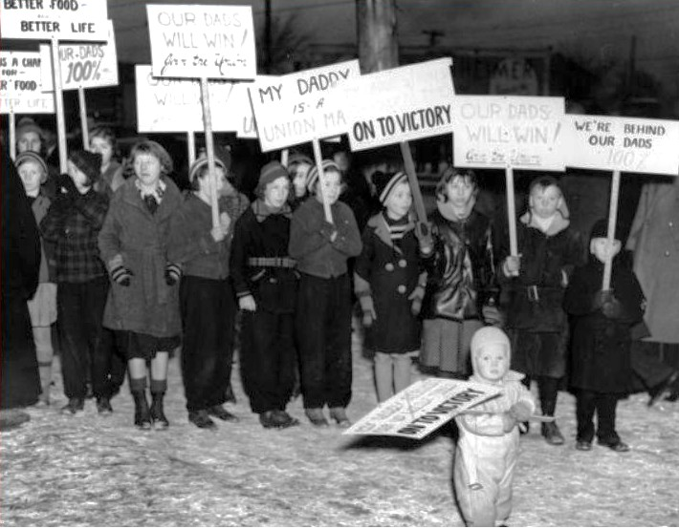
Children on the Picket Lines

Slide 24
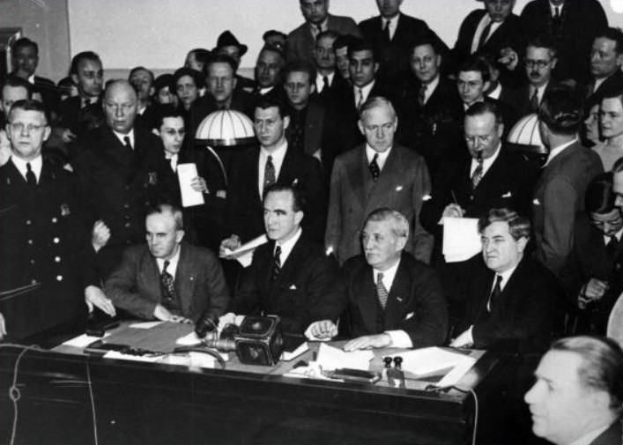
Occupy GM in Flint: Victory
Source: Wayne State University, Walter Reuther Library, Flint Sit-Down Strike Collection, #3997. Copyright. https://www.reuther.wayne.edu/node/3123

Slide 25
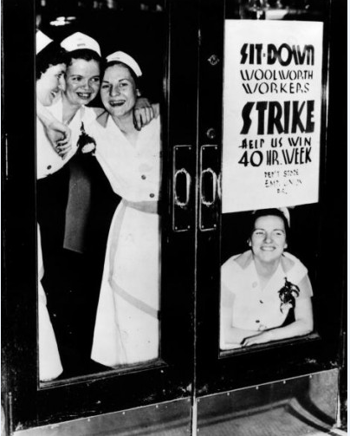
Women Sitdown Strikers Occupy Woolworth
Source: UFCW Local 324. http://www.ufcw324.org/WorkArea/linkit.aspx?LinkIdentifier=id&ItemID=777

Slide 26
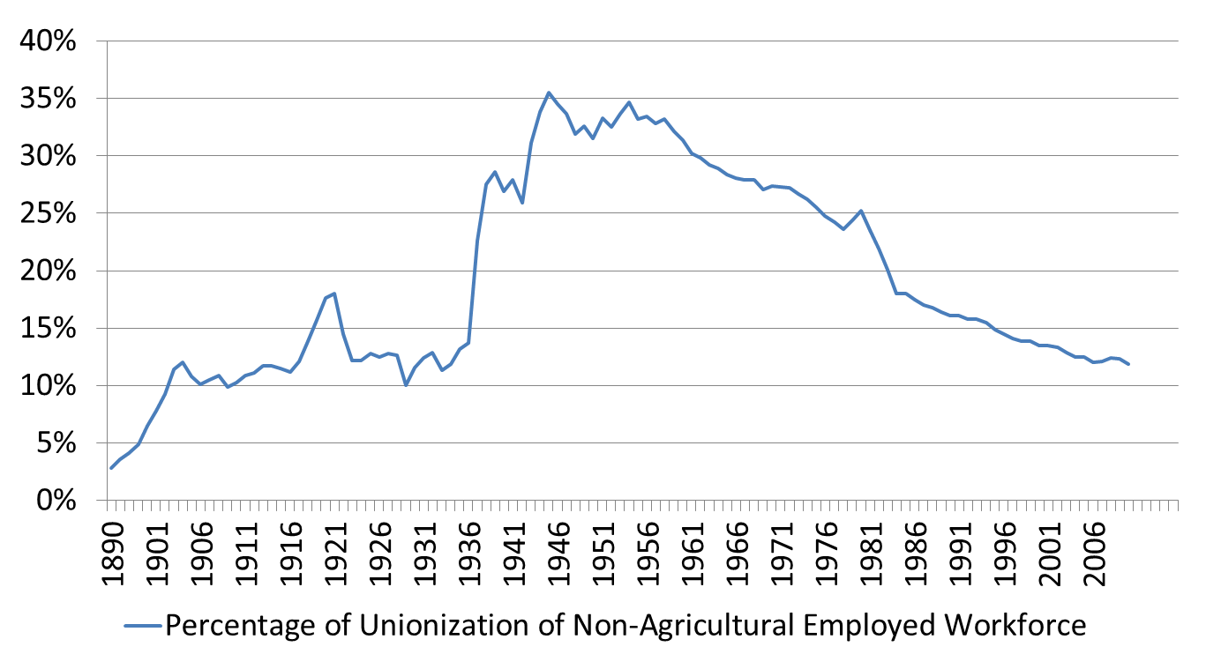
The Growth and Decline of the American Labor Movement - 1890 to 2010
Source: Years 1890 - 1929, Vernon Briggs, Immigration and American Unionism, pages 71 and 113. Years 1930 -1970, U.S. Department of Commerce, “Historical Statistics of the U. S. – Colonial Times to 1970, page 178. Years 1971 to 2003, U.S. Department of Commerce, “Statistical Abstract of the U.S., several issues, tables typically labeled “Labor Union Membership by Sector. Years 2003 to 2010 Bureau of Labor Statistics
Notes:
The great rising of American workers in the late 1930s saw the percentage of unionized workers leap from 14% to 28% between 1936 and 1938. The Autoworkers Union saw its membership skyrocket from 20,000 to 400,000 in 12 months. After decades of struggle from the 1880s to 1935, only 12 percent of workers were unionized. By 1945, 35 percent were union members.
During the mid-1930s, the rising of the American working class won many major reforms that had been denied for decades: The right to organize unions, social security, unemployment insurance, public assistance for poor families, protections for their bank deposits, assistance in buying homes and preventing foreclosures, strong regulation and controls over banks and financial institutions and more. A strong labor movement tightly connected to communities across the country provided the pressure and support to force through these life and society changing reforms that we enjoy to this day. It was a new day for America’s working people and the poor.
In the 1960s, while organized labor was still strong, America saw another wave of reforms in President Johnson’s Great Society. Medicare, Medicaid, expanded financial assistance for college, civil rights, voting rights and much more.
Unlike my unemployed autoworker grandfather Wabel, my beloved mother and father died in their 90s with the best health care in the world. They were poor but the victories of Medicare, Medicaid and Social Security coupled with the support of their children ensured that they died in dignity. My grandfather died one of the wretched of the earth with no justice in his death. My parents died with dignity and justice. It was the struggles of working people and organized labor that gave them help as they aged.

Slide 27
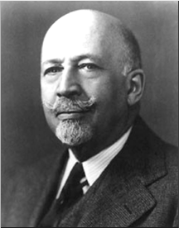
Growing Racial Solidarity
Key to Victories 1930-40s
Probably the greatest
and most effective effort
toward interracial understanding
among the working masses
has come about through
the trade unions…Probably
no movement in the past 30 years
has been so successful
in softening race prejudice
among the masses.
W.E.B. DuBois (Late 1940s)

Slide 28
Historic Victories End Decades of Defeats 1930s
Social Security
Unemployment insurance
Public assistance for poor families
Minimum wage and overtime pay
Child labor and child welfare protections
Right to organize unions and strong labor movement
Secure bank deposits
Strong regulation of financial industries
Notes:
Increasing solidarity among working people – white and people of color; native-born and immigrant; people of various faith traditions; young and old; men and women; employed and unemployed – key to explosive growth in the labor movement and winning the New Deal reforms.
In the mid-1930s, most of the American people won Social Security, unemployment insurance, the right to organize unions, minimum wage and overtime pay, child welfare, public assistance for poor families, protections for bank deposits, assistance in buying homes and more.
After decades of defeats, working people had won many fundamental labor, economic and social rights in five years.

Slide 29
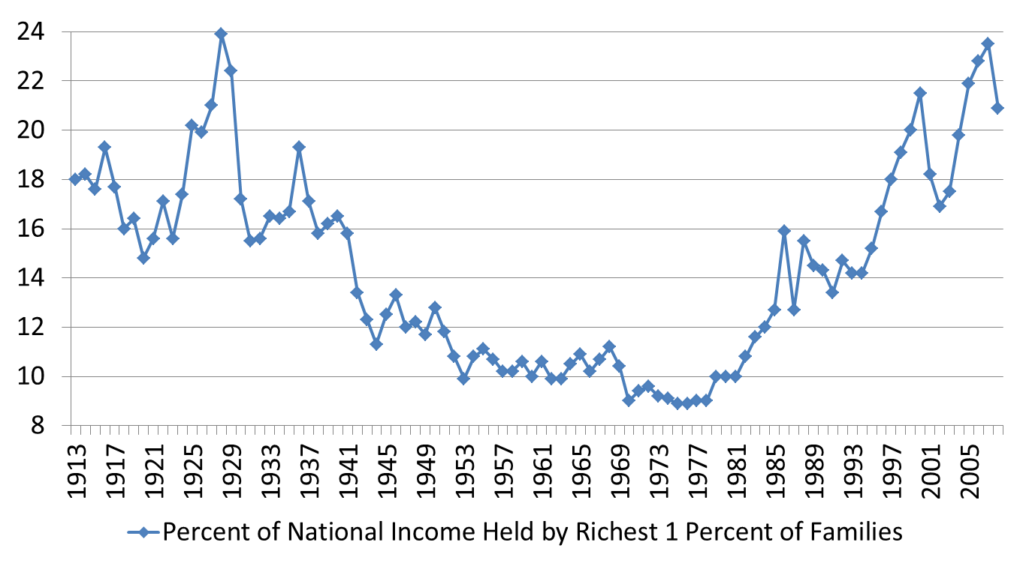
Who Gets What Share of the National Income: The Top 1% versus the 99%
Source: Saez, Emmanuel, “Income Inequality in the U.S., 1913-1998 - Updated to 2008, http://elsa.berkeley.edu/~saez/ See article and the Updated to 2008 in Excel - Table A0
Notes:
The share of the national income going to the top 1% rose during the 1920s when the labor movement was being decisively defeated. The top 1%’s share dropped greatly during the period of rapid union growth and strength from the early 1930s through the early 1950s. Their share remained very low by historical standards through the end of the 1970s. The rapid increase in their share of the national income corresponded with the successful renewed offensive of corporate America and their political allies against organized labor starting the early 1980s. By 2007, a weakened labor movement stood in stark contrast with the power of the top 1%. Once again the 1% saw their of the national income reach levels unseen since the late 1920s.
Many factors contributed to this explosive growth in income for the top 1% but the weakness of organized labor and their political allies to prevent this rapid growth in inequality played a key role.

Slide 30
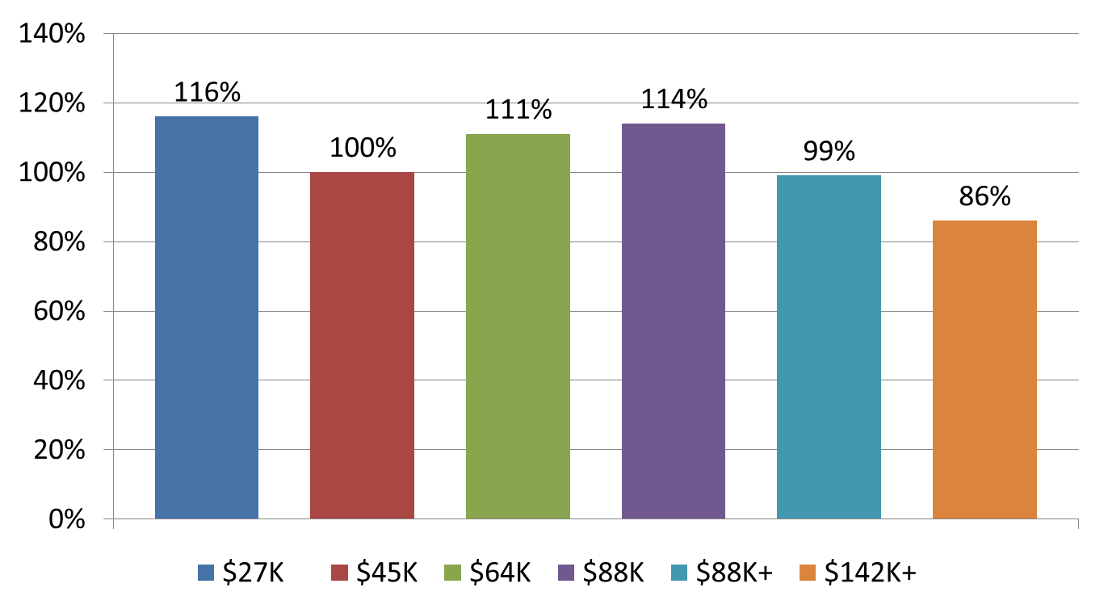
30 Years of Shared Prosperity – 1947-1979
Source: Mishel and Bernstein, The State of Working America 1994-95, M.E. Sharpe, 1994, page 37. U.S. Census Bureau, Historical Income Tables. F-1 for income ranges in 2010 dollars and F-3 for income changes. http://www.census.gov/hhes/www/income/data/historical/families/index.html
Notes:
The 1960s saw another great upsurge of working people, people of color, women and others demanding an expansion of economic and social rights. Community organizing was key to these important efforts.

Slide 31
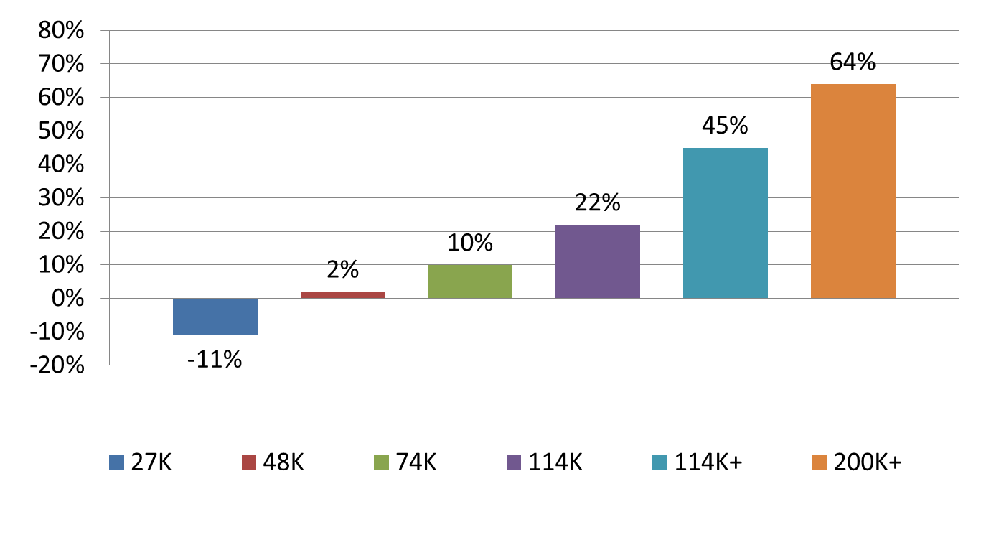
30 Years of Stolen Prosperity: 1979-2010
Source,: U.S. Census Bureau, Historical Income Tables. F-1 for income ranges in 2010 dollars and F-3 for income changes. http://www.census.gov/hhes/www/income/data/historical/families/index.html

Slide 32
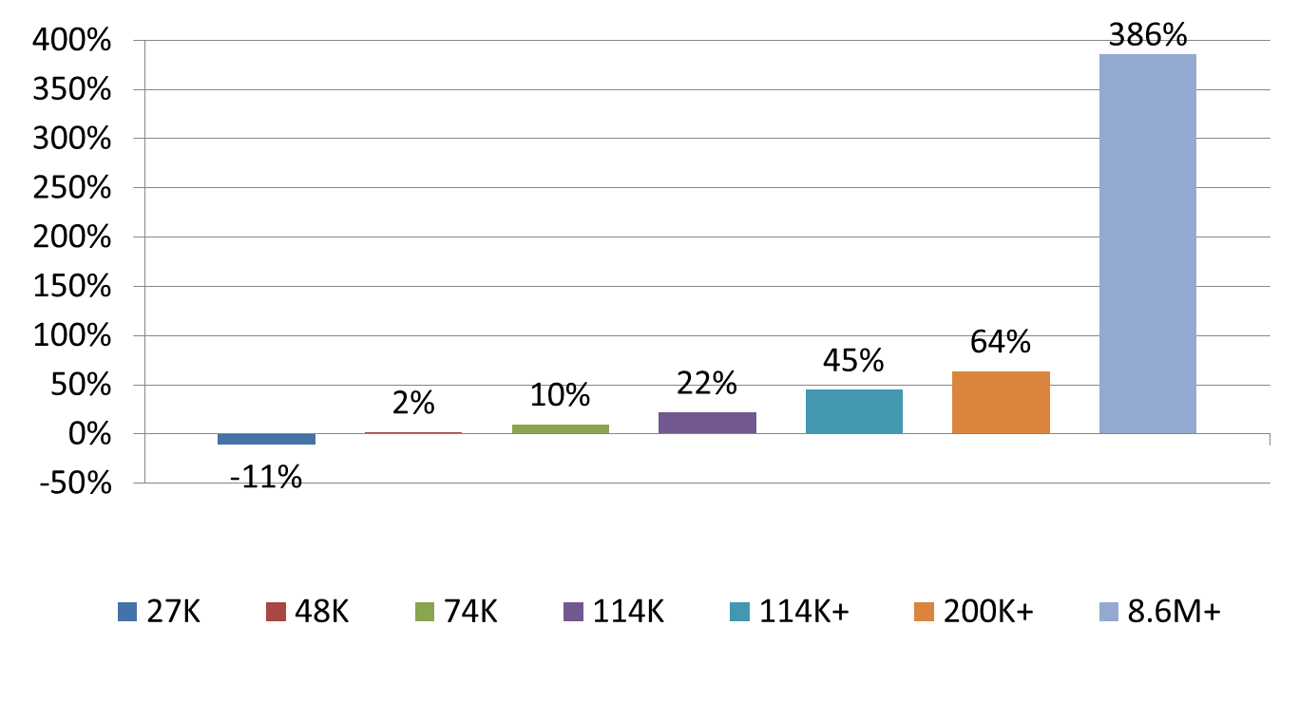
30 Years of Stolen Prosperity: 1979-2010
Source,: U.S. Census Bureau, Historical Income Tables. F-1 for income ranges in 2010 dollars and F-3 for income changes. http://www.census.gov/hhes/www/income/data/historical/families/index.html
Top 0.01% 1979 to 2005. Congressional Budget Office, “Historical Effective Tax Rates,” 2008., Table 3. http://www.cbo.gov/ftpdocs/98xx/doc9884/12-23-EffectiveTaxRates_Letter.pdf

Slide 33
Which values or principles that you hold dear are violated by our shared prosperity being stolen from us?

Slide 34
What lessons can we learn from this history that will help us move toward making the American Dream real for everyone?

Slide 35
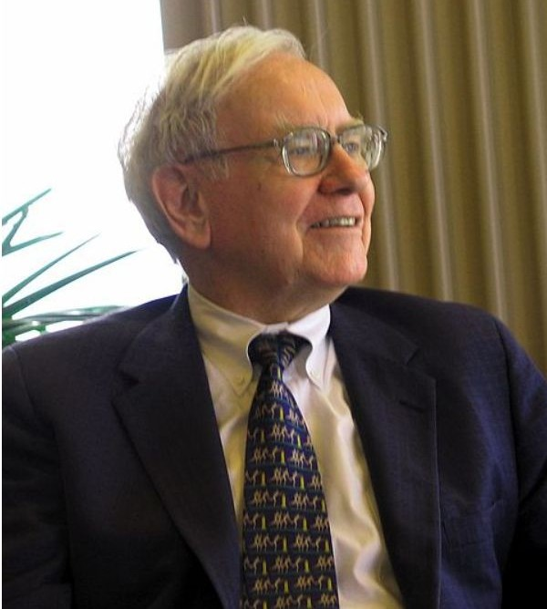
Corporate America Declares War On America’s Workers: 1980 to Present
“There’s Class Warfare, all right. But it’s my class, the rich class, that’s making war, and we’re winning.”
Warren Buffett, World’s Third Richest Man
Source: Wikipedia. http://en.wikipedia.org/wiki/File:Warren_Buffett_KU_Visit.jpg

Slide 36
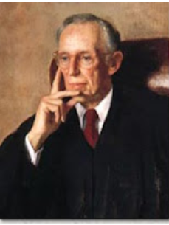
Lewis Powell – August 23, 1971
Confidential Memo
To: Eugene Sydnor, Chairman, Education Committee, U.S. Chamber of Commerce
Subject: Attack on Free Enterprise System
2 months after this then secret memo, President Nixon appointed Powell to the U.S. Supreme Court.
Notes:
Source: Greenpeace. http://www.greenpeace.org/usa/en/campaigns/global-warming-and-energy/polluterwatch/The-Lewis-Powell-Memo/

Slide 37
Corporate America Winning the War of Big Ideas
1973 – Heritage Foundation
1977 – Cato Institute – 1977
1970 – American Enterprise Institute – 10 staff and $1 million; by 1980 – 125 staff and $8 million (1980)
1980 – Heritage publishes Mandate for Leadership. Reagan gives a copy to all Cabinet members at first meeting.
1988 – 2/3 of 2000 recommendations implemented.
Notes:
http://www.aei.org/about/history/

Slide 38
Corporate America’s Class Warfare
Weaken unions
Undermine democracy with massive campaign spending by corporations and wealthy
Deregulate financial industries and corporations
Cut social programs for poor, unemployed and needy
Sharply reduce taxes on corporations and the wealthy
Privatize government
Promote free trade and export manufacturing jobs
Notes:
The major victories of the 1960s and the early 1970s caused great alarm among corporate America, their right wing political allies and corporate mainstream politicians. Many of these victories coupled with an upsurge in labor unrest threatened many of their fundamental interests and furthered limited their power and freedom. Corporate America desperately wanted to regain political dominance and greater freedom from government control and strong unions.
On August 23, 1971, Lewis Powell, wrote a famous confidential memo to the U.S. Chamber of Commerce calling for a major counterattack by corporate America. http://reclaimdemocracy.org/corporate_accountability/powell_memo_lewis.html This memo along with the writings of other corporate allies laid the foundation for the corporate counterattack that helped achieve the election of Ronald Reagan in 1980s and a fundamental shift in American economic and political life.
The key elements and messages of the strategy are listed above. They also included the importance of winning the battle for the future vision of the country coupled with values, themes and messages that would become the dominant view of our future. This battle of ideas would be supported by the creation of many think tanks, endowment of chairs in university economics departments and business schools, attacks on leftist and progressive intellectuals, strengthening lobbying efforts, dominating the media and building powerful and well-funded permanent political and election campaign organizations. Crushing unions would be key.
What were the results? We have already seen the dramatic shift to economic inequality. Long gone were the days of a rising tide would lift all boats.

Slide 39
The Growth and Decline of the American Labor Movement - 1890 to 2010
Source: Years 1890 - 1929, Vernon Briggs, Immigration and American Unionism, pages 71 and 113. Years 1930 -1970, U.S. Department of Commerce, “Historical Statistics of the U. S. – Colonial Times to 1970, page 178. Years 1971 to 2003, U.S. Department of Commerce, “Statistical Abstract of the U.S., several issues, tables typically labeled “Labor Union Membership by Sector. Years 2003 to 2010 Bureau of Labor Statistics
Notes:
The great rising of American workers in the late 1930s saw the percentage of unionized workers leap from 14% to 28% between 1936 and 1938. The Autoworkers Union saw its membership skyrocket from 20,000 to 400,000 in 12 months. After decades of struggle from the 1880s to 1935, only 12 percent of workers were unionized. By 1945, 35 percent were union members.
During the mid-1930s, the rising of the American working class won many major reforms that had been denied for decades: The right to organize unions, social security, unemployment insurance, public assistance for poor families, protections for their bank deposits, assistance in buying homes and preventing foreclosures, strong regulation and controls over banks and financial institutions and more. A strong labor movement tightly connected to communities across the country provided the pressure and support to force through these life and society changing reforms that we enjoy to this day. It was a new day for America’s working people and the poor.
In the 1960s, while organized labor was still strong, America saw another wave of reforms in President Johnson’s Great Society. Medicare, Medicaid, expanded financial assistance for college, civil rights, voting rights and much more.
Unlike my unemployed autoworker grandfather Wabel, my beloved mother and father died in their 90s with the best health care in the world. They were poor but the victories of Medicare, Medicaid and Social Security coupled with the support of their children ensured that they died in dignity. My grandfather died one of the wretched of the earth with no justice in his death. My parents died with dignity and justice. It was the struggles of working people and organized labor that gave them help as they aged.

Slide 40
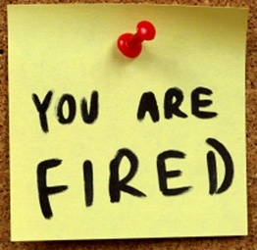
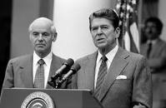
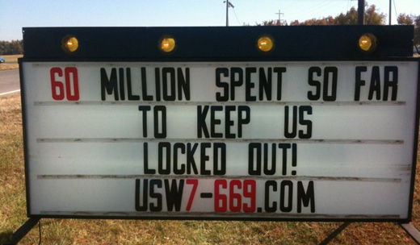
The War Against Workers
Published on Thursday, February 10, 2005 by the Associated Press
As Union Nears Win, Wal-Mart Closes Store
Notes:
UNIONS ARE THE LARGEST AND STRONGEST MOVEMENT RESISTING CORPORATE DOMINATION.
ECONOMIC RESISTANCE TO PROFIT MAXIMIZATION
STRONG POLITICAL EFFORTS TO ELECT PRO-JUSTICE CANDIDATES
CORPORATE AMERICA KNOWS OUR HISTORY BETTER THAN WE DO
Corporate America, aided by the political allies, launched a massive offensive against organized labor in the 1980’s. President Reagan’s mass firing of striking air traffic controllers in the 1981 PATCO strike sent a signal to corporate America that the federal government was their ally in destroying organized labor.
Many major strikes were lost including Phelps-Dodge in the copper industry, Greyhound in interstate transportation, Caterpillar in heavy equipment and many more. Corporate America wanted major concessions in wages, benefits, pensions, working conditions and if possible to wipe out the unions. They also wanted to ensure that the growing service industries would remain nonunion. A union-free America was their dream and battle cry.
Between 1980 and 1990, the percentage of unionized workers was cut by a third. Systematic violations of labor laws became the order of the day. The widespread use of permanent striker replacements became a way of life. The days of organized labor serving as a powerful counterbalance to corporate power were fading away in the workplace and in political life.
I lost my job in a union bust in 1982 when the unionized plant I worked in was sold. We were all fired on 5 hours notice and the union was broken. I lost my pension and spent the next 15 months out of work. I took a 50% pay cut when I finally found a new job in a new career field. It was a new day in America for workers. A dark, dark day.

Slide 41
Pop Quiz
How many workers were given or ordered to receive back pay after filing unfair labor practice charges by the National Labor Relations Board between 2000-2009?
8,000
19,000
65,000
246,000
Notes:
The National Labor Relations Board investigates unfair labor practice (ULP) charges filed by workers against employers when the workers believe they have been illegally terminated or denied employment while they are exercising their legal rights to organize and bargain collectively. The Board can order back pay when it determines or gets the employer to voluntarily give these workers back pay for lost wages and benefits.

Slide 42
Answer: 246,000
How would you describe a nation in which employers were legally found to have fired a quarter of a million workers over a 10 year period when they participated legally in elections to elect leaders who would represent their political and economic interests?
National Labor Relations Board, “Annual Reports.” 2000 to 2009, Table 4. https://www.nlrb.gov/sites/default/files/documents/119/nlrb2005.pdf
Notes:
Firing or refusing to hire workers because they are exercising their legal rights to form unions, bargain collectively and conduct union business harms many workers beyond those directly affected. These violations of rights intimidate other workers and discourage them from exercising their own rights. The fear of losing one’s job and being without income and badly needed benefits for months or years is both real and potentially very damaging to the worker and his/her family.
Between 2000 and 2009, the National Labor Relations Board reported that 246,000 workers were illegally fired or denied employment while they were exercising their rights to organize a union or bargain collectively. Most of these workers lost their jobs while trying to win an election for union representation or win a first contract. All of these workers received back pay or their employer was ordered to give them back pay. Some got their jobs back.
Widespread and systematic employer violations of law are clearly documented. They act with impunity knowing the penalties are insufficient to stop them from smashing workers’ efforts to build a union. Consider the following:
An employer has 500 employees who could join the union. If a union wins recognition and a first contract the employer might have to pay an additional 50 cents/per hour for each of the next three years. 50 cents the first year would cost the employer $1 million for 500 employees working an average of 2000 hours per year. The second year another 50 cent raise would cost a combined $2 million. The third year a combined $3 million. This is $6 million over three years. Without the union, the employer might pay out $3 million in additional costs. Thus the union cost the employer $3 million over three years.
The solution: Fire the 5 union leaders and intimidate the remaining 495 workers. This can smash the union drive. If the employer is required to pay back wages of $50,000 per years for 2 years, it cost the employer $500,000. In this case, the employer saves $2.5 million by illegally firing the union leaders. This is good business and bad for working people.

Slide 43
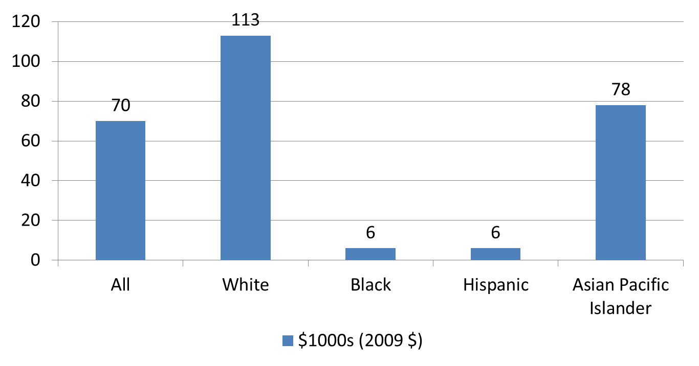
The Great Racial Wealth Divide
2009
Source: Pew Research Center, “Twenty to One: Wealth Gaps Rise to Record Highs Between Whites, Blacks and Hispanics, July 26, 2011., page 15. http://www.pewsocialtrends.org/files/2011/07/SDT-Wealth-Report_7-26-11_FINAL.pdf
Notes:
Wealth is defined as assets minus liabilities
Assets included financial assets, income producing property, business or professional assets, motor vehicles, vacation homes IRAs, 401(k)s, and other financial resources. It does not include defined benefit pensions, cash value of life insurance, household furnishings and jewelry and future claims on Social Security.
Liabilities include secured and unsecured liabilities such as mortgages, vehicle loans, credit cards, student loans, medical bills, and other loans.
This study uses the data from the Census Bureau’s Survey of Income and Program Participation (SIPP).
Edward Wolff, a long-time expert in wealth analysis, has produced similar results for 2007. Using the Federal Reserve Board’s Survey of Consumer Finances data, he found that the net worth of white households was $144 thousand, $9.3 thousand for blacks and $9.1 thousand for Hispanics. Wolff also found that 14.5% of white households had negative net worth, blacks 33.4% and Hispanics 33.5%. He did not report on Asian households.
Both studies confirm huge gaps between racial groups using different federal government data sets.
Source: Edward Wolff, Recent Trends in Household Wealth in the United States Rising Debt and the Middle-Class Squeeze,” Edward Levy Institute, 2010. http://www.levyinstitute.org/pubs/wp_589.pdf

Slide 44
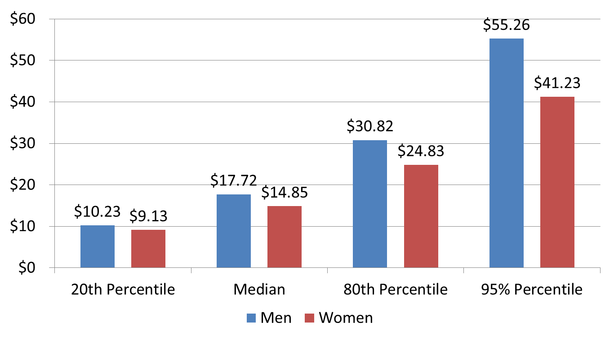
Gender Gap in Hourly Wages - 2009
Source: Economic Policy Institute, “Change in real hourly wages for men and women by wage percentile, 1973-2009.” http://www.stateofworkingamerica.org/charts/view/188 http://www.stateofworkingamerica.org/charts/view/187

Slide 45
Our Youth Face a Difficult Future
High levels of unemployment particularly for black, Latino and Native Americans
Skyrocketing tuition costs
Huge student loan debts
Education cutbacks
Upward mobility in the U.S. lower than many wealthy industrialized countries

Slide 46


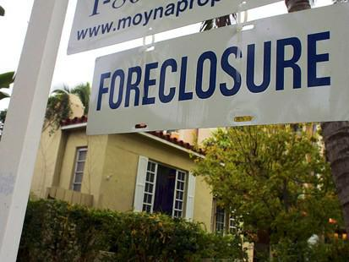
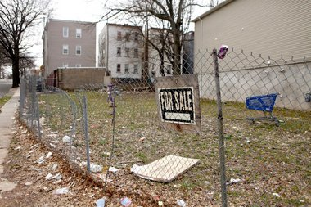
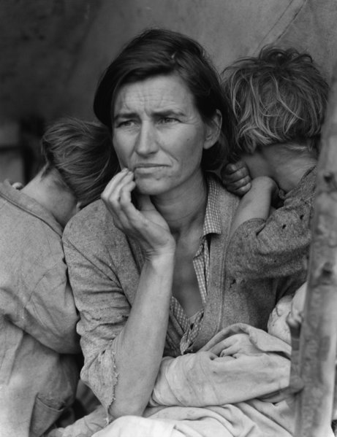
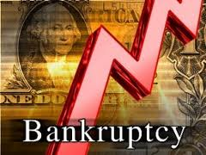
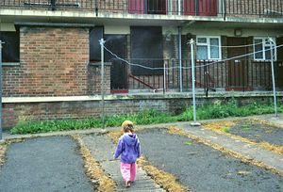
Notes:
Years of financial deregulation and rapacious and abusive corporate behavior, rapidly rising housing prices, stagnant incomes for many Americans and tax cuts for the wealthy and corporations eventually led to a financial and economic crisis. The financial crisis of 2007-08 and the resulting Great Recession has wreaked havoc in the lives of tens of millions of Americans and their families.
The number of Americans in poverty soared by 8.9 million between 2007 and 2010 with the poverty rates for blacks and Hispanics more than twice that of whites. The poverty rate for Asians was slightly lower than the rate for whites.
The number of Americans reducing their food intake due to a lack of money rose from 11.9 million in 2007 to 17.7 million in 2009.
Personal bankruptcies skyrocketed from 598,000 in 2006 to 1.54 million in 2010.
The rate of homeowners with prime mortgages in foreclosure exploded 560 percent between 2006 and 2009.
Sources:
U.S. Census Bureau, “Historical Poverty Tables, Table 2.” http://www.census.gov/hhes/www/poverty/data/historical/people.html
Nord, Mark, Coleman-Jensen, Alisha, Andrews, Margaret, and Carlson, Steven, “Household Food Security in the United States, 2009, U.S. Department of Agriculture, page 6. http://www.ers.usda.gov/Publications/ERR108/ERR108.pdf
American Bankruptcy Institute, “Annual Business and Non-Business Filings by Year (1980-2009). www.abiworld.org/AM/AMTemplate.cfm?Section=Home&CONTENTID=60229&TEMPLATE=/CM/ContentDisplay.cfm
U.S. Census Bureau, Statistical Abstract of the U.S 2011, “Mortgage Originations and Delinquency and Foreclosure Rates”, Table 1193. http://www.census.gov/compendia/statab/2011/tables/11s1193.pdf

Slide 47
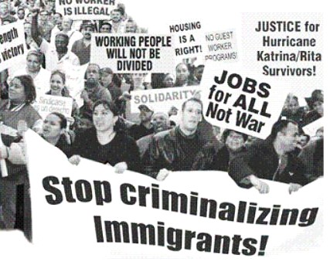
Immigrants Didn’t Wreck the Economy: They are our Sisters and Brothers

Slide 48
FIGHTING FOR OUR FUTURE
Our Nation is Not Broke: Corporate America and the Wealthy Are Hijacking the American Dream
Notes:
We, the American people, are being told that the country is broke and we cannot afford to pay for critically needed services and programs. We are told that corporations and the wealthy cannot afford to pay more in taxes. In fact, raising their taxes would be harmful to the economy and the nation. It is working people, the elderly, the young and the poor who must bear the brunt of hard times and make sacrifices to reclaim the American Dream and a brighter, more secure future.
Let’s look at the facts.

Slide 49
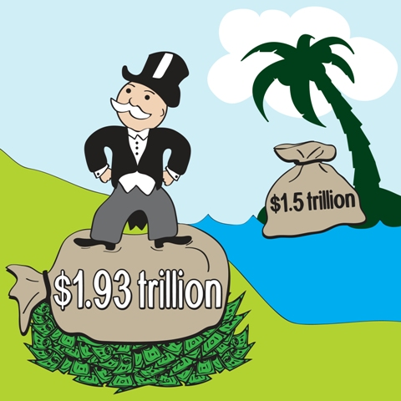
Record After-Tax Profits for U.S. Corporations
2010: $1.93 Trillion Cash and $1.5 trillion in Offshore Corporate Profits
Notes:
2010 saw the after-tax corporate profits as a share of the national income reach its highest level in more than 8 decades. The Wall Street Journal reported that corporations were sitting on almost $2 trillion in cash, the highest percentage of their assets in 51 years. At the same time, U.S. corporations were holding an additional $1.5 trillion in cash overseas and were refusing to bring this cash home until Congress and the President agreed to lower their tax rates on these profits. The Seattle Times reported in September 11, 2011 that U.S corporations were still sitting on $2 trillion in cash while the people suffered.
Sources: Bureau of Economic Analysis, NIPA Table 1.12 – Corporate Profits as a Share of the National Income http://www.bea.gov/iTable/iTable.cfm?ReqID=9&step=1
David Kocieniewski, “Companies Push for Tax Break on Foreign Cash, New York Times, June 20, 2011, http://www.nytimes.com/2011/06/20/business/20tax.html?_r=1&nl=todaysheadlines&emc=tha2 J
Justin Lahart, “Companies Cling to Cash, The Wall Street Journal, December 10, 2010. http://online.wsj.com/article/SB10001424052748703766704576009501161973480.html
Seattle Times, “Household wealth erodes; companies hold record cash,” September 17, 2011.

Slide 50
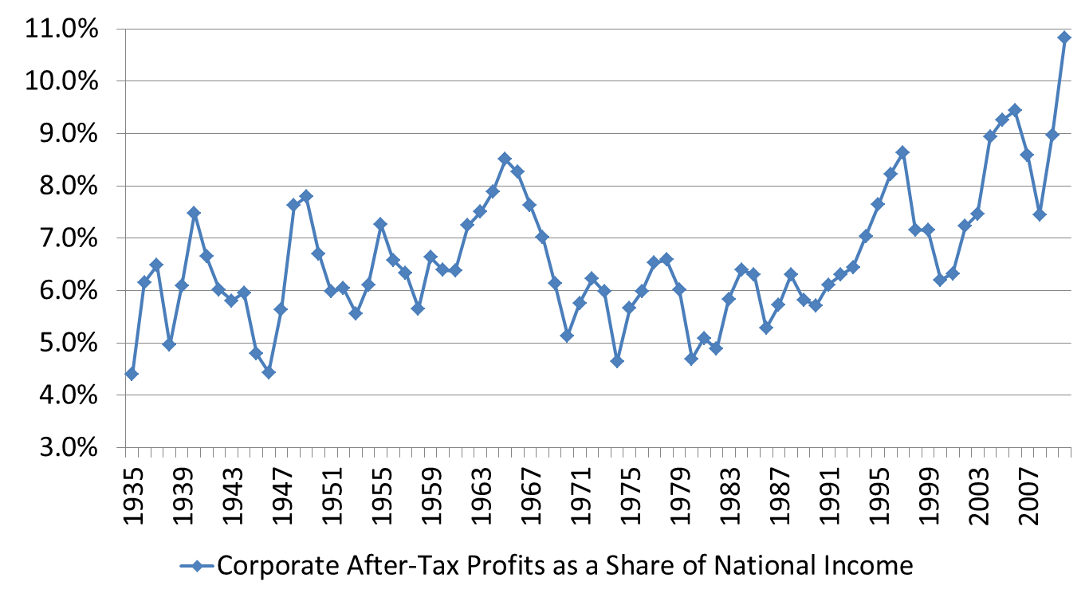
Hard Times? Hard Times for Whom? Corporate After-Tax Profits Hit Record High in 2010
Source: Bureau of Economic Analysis, “Table 1.12. National Income by Type of Income,” National Income and Product Accounts Tables. http://www.bea.gov/iTable/iTable.cfm?ReqID=9&step=1
Notes:
Table calculated by dividing Line 15: Corporate profits after tax with IVA and CCAdj by Line 1: National Income

Slide 51
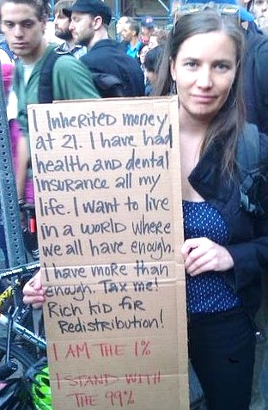
We Pay Our Taxes – What about the Rich?
In 2010:
3,000 earning more than $2 Million paid $0
24,000 earning more than $550,000 paid $0
78,000 earning $200,000 - $550,000 paid $0
Source: Bruce Bartlett, “Who Doesn’t Pay Federal Income Taxes (Legally),” New York Times, June 28, 2011. Just Faith. http://wp.patheos.com/community/mainlineportal/files/2011/10/315682_10100400881018057_3609313_54763859_1247143155_n-1.jpg
Notes:
Source: Bruce Bartlett, “Who Doesn’t Pay Federal Income Taxes (Legally),” New York Times, June 28, 2011. http://economix.blogs.nytimes.com/2011/06/28/who-doesnt-pay-federal-income-taxes-legally/?scp=2&sq=Bruce%20Bartlett&st=Search
Just Faith. http://wp.patheos.com/community/mainlineportal/files/2011/10/315682_10100400881018057_3609313_54763859_1247143155_n-1.jpg

Slide 52
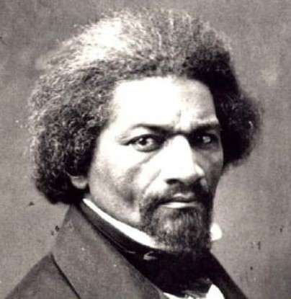
Fighting for the American Dream:
Finding Hope and Getting Organized
“If there is no struggle, there can be no progress…find out what any people will quietly submit to and you will have found out the exact measure of injustice and wrong which will be imposed upon them.”
Frederick Douglass, 1857

Slide 53
Corporations Have Too Much Power:
The People Speak - 2011
National Harris Poll, June 2011
These groups have too much power:
Major corporations – 88% Harris Poll
Banks and financial institutions – 85%
Lobbyists – 84%
Harris Poll, “Big Companies, PACs, Banks, Financial Institutions and Lobbyists Seen by Strong Majorities as Having Too Much Power and Influence in DC,”, June 1, 2011. http://www.harrisinteractive.com/NewsRoom/HarrisPolls/tabid/447/mid/1508/articleId/790/ctl/ReadCustom%20Default/Default.aspx
Notes:
The American people clearly understand that the powerful corporations and their lobbyists have too much power. Figuring out how to curb their power and redirect their behavior to benefit the vast majority of Americans, the 99%, is the central question facing our economic and political democracies.
Sources: Zukin, “The American Public and the Next Social Contract: Public Opinion and Political Culture in 2007,” page 3. http://www.newamerica.net/files/nafmigration/NSCZukinPublicOpinion.pdf
Harris Poll, “Big Companies, PACs, Banks, Financial Institutions and Lobbyists Seen by Strong Majorities as Having Too Much Power and Influence in DC,”, June 1, 2011. http://www.harrisinteractive.com/NewsRoom/HarrisPolls/tabid/447/mid/1508/articleId/790/ctl/ReadCustom%20Default/Default.aspx
Gallup Poll, “Americans Decry Power of Lobbyists, Corporations, Banks, and Feds,” April 11, 2011. http://www.gallup.com/poll/147026/americans-decry-power-lobbyists-corporations-banks-feds.aspx
In 2007, the people said:
We need stronger guarantees of equal opportunities to succeed – 91%
Too much power concentrated in big companies – 76%
Businesses and corporations make too much profit – 65%

Slide 54
Many Movements: Too Little Justice
Labor
Communities of color
Seniors
Women
Immigrant rights
Environmental
Hunger, housing, homelessness, human services
Occupy Wall Street and across America
Gays and lesbians
Faith
Students and youth
Fair trade
International solidarity
Corporate responsibility
Political reforms

Slide 55
Democratic President, Big Congressional Majorities - What Happened?
1965-68, 1977-80, 1993-94, and 2009-10. Democratic President and large Congressional majorities.
We only won broad reforms in 1965-68 – Great Society victories.
Labor law reform beaten four times.
Last three periods – major reforms largely blocked
Why?

Slide 56
What is Needed to Move Major Reform Agenda?
Widely shared, clearly articulated vision, values and agenda
Effective education and communication
Permanent long-term coalitions
Aggressive mass movements
Credible threat to replace Democrats who oppose reform agenda

Slide 57
Pop Quiz
Right-wing Republican Governors Attack Public Employees and their Unions - 2011
Which group most supports public sector unions and public sector employees against these attacks?
18 to 34 year olds
35 to 55 year olds
55 and older

Slide 58
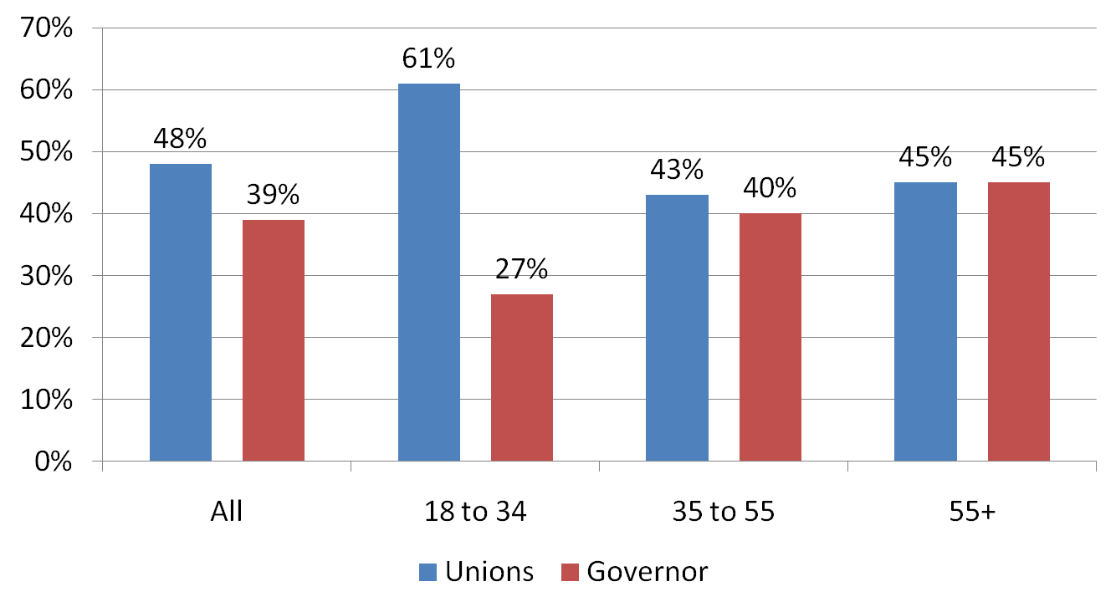
America’s Young People Strongly Support Public Sector Unions Against Governors’ Attacks - April 2011
Source: Gallup Poll, “More Americans Back Unions Than Governors in State Disputes,” April 1, 2011. http://www.gallup.com/poll/146921/Americans-Back-Unions-Governors-State-Disputes.aspx
Notes:
It is clear that young people are the strongest supporters of public sector unions against the attacks of right wing Governors and their allies. This is an important source of hope for the future.

Slide 59
A Brighter Future: Youth More Progressive as Racial Differences Shrink
Our young people strongly support:
  Role of unions in protecting working people
  Government should ensure that all people have adequate food and affordable housing
  Increased federal spending for public education
Gaps between whites and blacks and Hispanics shrink
White youth reject conservative views of their elders.
Source: Amanda Logan and David Madland, “Millennial Economics: It Don’t Matter if You’re Black or White or Hispanic”, Center for American Progress Action Fund, October 2008. http://www.americanprogressaction.org/issues/2008/pdf/progressive_gap.pdf
Notes:
Another source of hope is the strongly progressive views of our young people across racial lines. Most encouraging is the shrinking gap between the views of white young people and their counterparts of color.

Slide 60
Major Victories Led by Young People 2011-12
Bank of America $5 debit charge stopped
Verizon $2 pay online charge stopped
Student loans – Congress forced to keep 3.4% interest rate
President’s directive staying deportations of young immigrant students

Slide 61
People Like Us Have and Can Change the World. This is our Time.
Women’s right to vote - 1920
American labor movement – 1930s
Civil rights movement – 1950-60s
Viet Nam anti-war movement – 1960-70s
Anti-apartheid movement in South Africa – 1940-90s
Toppling the Berlin Wall – 1980-90s
The Arab Spring – 2010s
The United States – 2012 forward
Notes:
Let’s us dedicate ourselves to building a better world. As the Reverend Dr. Martin Luther King Jr. once said: “The moral arc of the universe is long and it bends toward justice.” I humbly add: “But only if the people make it bend.” This is our historic task.

Slide 62
Taking Action
If you agree with the message of this presentation, what are you willing to do about it?
In what ways do you think we can best spread the information that you have learned to other people?

Slide 63
The author wishes to acknowledge the financial contributions and technical assistance from United Food and Commercial Workers Local 21 that helped create the original version of this presentation and slideshow. The author is solely responsible for the content.

Slide 65
Poorest 20% of Families
Average Income $16,800 in 1979
Average Income Gain 1947 to 1979
116%

Slide 66
Lower Middle 20% of Families
Average Income $36,300 in 1979
Average Income Gain 1947 to 1979
100%

Slide 67
Middle 20% of Families
Average Income $54,700 in 1979
Average Income Gain 1947 to 1979
111%

Slide 68
Upper Middle 20% of Families
Average Income $75,400 in 1979
Average Income Gain 1947 to 1979
114%

Slide 69
Richest 20% of Families
Average Income $129,300 in 1979
Average Income Gain 1947 to 1979
99%

Slide 70
Richest 5% of Families
Average Income $191,300 in 1979
Average Income Gain 1947 to 1979
86%

Slide 71
Poorest 20% of Families
Average Income $15,000 in 2010
Average Income Loss 1979 to 2010
Lost 11%

Slide 72
Lower Middle 20% of Families
Average Income $37,100 in 2010
Average Income Gain 1979 to 2010
2%

Slide 73
Middle 20% of Families
Average Income $60,400 in 2010
Average Income Gain 1979 to 2010
10%

Slide 74
Upper Middle 20% of Families
Average Income $92,000 in 2010
Average Income Gain 1979 to 2010
22%

Slide 75
Richest 20% of Families
Average Income $187,400 in 2010
Average Income Gain 1979 to 2010
45%

Slide 76
Richest 5% of Families
Average Income $313,300 in 2010
Average Income Gain 1979 to 2010
64%

Slide 77
Richest 0.01% - 11,000 Families
Average Income $35,500,000 in 2010
Average Income Gain 1979 to 2010
386%
Notes:
2006 data.

Slide 78
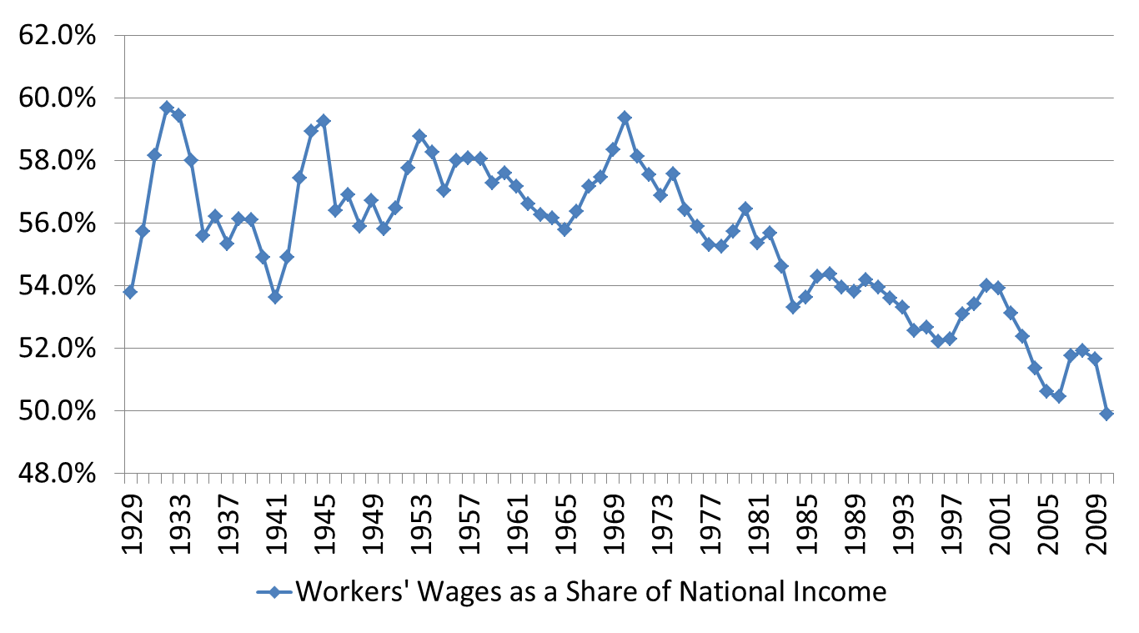
Workers’ Wages as a Share of National Income Hits Record Low in 2010
Source: Bureau of Economic Analysis, “Table 1.12 National Income by Type of Income, Table 1.12 National Income by Type of Income. http://www.bea.gov/iTable/iTable.cfm?ReqID=9&step=1
Notes:
The U.S. Department of Commerce publishes data called the National Income and Product Accounts. These data show the percentage of the national income that is paid as workers’ wages and salaries.
During the years from 1947 to 1979, workers’ wages and salaries as a share of the total national income averaged 56% or more. By 2010, it had dropped to 50%. If the workers’ share in 2010 was 56%, workers and their families would have received an additional $762 billion in wages and salaries. If this additional income had been shared equally by the bottom 80 percent of households in income, the average income increase per household would be more than $8,000.
The data clearly shows that the percentage of the national income going to workers’ wages and salaries have been steadily declining since the early 1970s. By 2010, the workers’ share was the lowest in has been since at least the 1920s. This is in sharp contrast to the explosive growth of the top 1% share of the national income.
Some will argue that the wage share is not the best measure of what workers are getting because of the increased value of various fringe benefits. Even when fringe benefits like health care and pension are added, the workers’ share of the national income has steadily declined since the early 1980s and is at its lowest point since the mid-1960s.

Slide 79
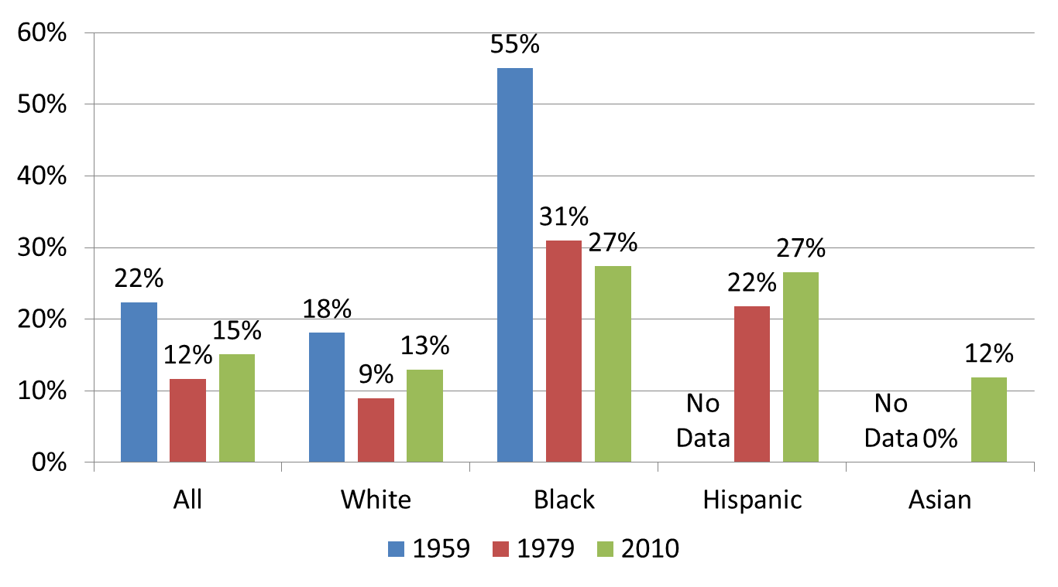
Winning the War on Poverty – 1959 to 1979
Losing the War on Poverty – 1979 to 2010
Source: U.S. Census Bureau, “Historical Poverty Tables – People,” Tables 2 and 3. http://www.census.gov/hhes/www/poverty/data/historical/people.html
Notes:
The years, 1959 to 1979, saw our nation make substantial progress toward eliminating poverty. The overall rate was almost cut in half and the black poverty rate plummeted from 55% to 31% in 20 years. Despite these gains, the black poverty rate was more than 3 times the white rate and the Hispanic rate was 2 ½ times the white rate in 1979. We still had a long way to go but the direction was positive.
The corporate counterattack starting in the late 1970s reversed the long-term decline in poverty. By 2010, the overall rate was above 15%. The poverty rate gaps between blacks and Hispanics and whites had narrowed as the white rate had grown substantially.
This Census Bureau data source does not report poverty rates for Native Americans.

Slide 80

Americans Want Stronger Laws to Protect Right to Organize and Bargain Collectively – 2008
Source: Peter D. Hart Research Associates, “Public Opinion Regarding The Employee Free Choice Act, National Survey Results,” January 8, 2009. http://www.aflcio.org/joinaunion/voiceatwork/efca/upload/Employee_Free_Choice_Act_polling_memo_1.pdf
Notes:
Four times in the past 45 years, corporate America and their political allies in both parties have prevented the passage of major collective bargaining reform legislation. Each effort was an attempt to curb the growing power of corporations to intimidate their employees into opposing unionization and blocking efforts to reach a contract settlement.
As documented earlier, corporate abuses are widespread and current law does not serve as a deterrent to these abuses. Despite corporate control of the mainstream media, substantial majorities of the American people wanted stronger law to protect collective bargaining rights in the workplace. Despite this strong support, Congress once again failed to vote on the Employee Free Choice Act in 2009 and 2010.

Slide 81

Hard Times? Hard Times for Whom? Corporate After-Tax Profits Hit Record High in 2010
Source: Bureau of Economic Analysis, “Table 1.12. National Income by Type of Income,” National Income and Product Accounts Tables. http://www.bea.gov/iTable/iTable.cfm?ReqID=9&step=1
Notes:
After-tax corporate profits as a share of the total national income was the highest in more than 80 years. Only four years has the rate been above 9%. All four years occurred since 2004. Only 10 years was the rate greater than 8%. Six of the ten were in the 2000s.
Corporate America wants fearful, intimidated and docile workers. Weakening the labor movement, gutting labor laws, threatening to move jobs, and widespread violations of the right to organize are key elements. Raising the level of fear about keeping one’s job is key. In the mid-1990s, Federal Reserve Board Chairman Greenspan puzzled over why wages weren’t rising faster during a time of extremely low unemployment. “The old belief held that with such a low unemployment rate workers would have the upper hand and demand higher wages. Yet the data showed that wages weren’t rising that much. It was one of the central mysteries of the time. Greenspan hypothesized at one point to colleagues within the Fed about the “traumatized worker” – someone who felt job insecurity in the changing economy and so was accepting smaller wage increases. He had talks with business leaders who said their workers were not agitating and were fearful that their skills might not be marketable if they were forced to change jobs.”
If this strategy worked well during boom times, what happens during the Great Recession and very high unemployment? Corporate America reached record levels of after-tax profits.
Note: Table calculated by dividing Line 15: Corporate profits after tax with IVA and CCAdj by Line 1. National Income. Source: Bureau of Economic Analysis, “Table 1.12. National Income by Type of Income,” National Income and Product Accounts Tables. http://www.bea.gov/iTable/iTable.cfm?ReqID=9&step=1

Slide 82
We Need an Economic Bill of Rights for the American Dream
Organize unions and fair treatment on the job
Share fairly in our growing national wealth
Affordable educational and training
Freedom from economic insecurity
Equal treatment for all
Time for family, community activities and personal enrichment
Notes:
The following victories of working people are major examples of the expansions of the five rights listed above. This is not an exhaustive list.
Right #1: Freedom to organize unions and collectively bargain and rigorous enforcement of workers’ rights on the job
Right to organize and bargain collectively (1935) – Farm workers, domestics, state and local government employees, and health care workers denied the right. Racism at work; Right to minimum wage and overtime pay (1938); Safety and health on the job (1970);Pension protections (1974);Child labor protections (1938); Right to non-discrimination at work (1960s forward); Unions win defined benefit pensions and many other non-wage benefits (1940s forward)
Right #2: Freedom to participate in a well-managed economy like the period of 1947 to 1979
No financial crises for 45 years; Productivity gains shared fairly; Standard of living more than doubled with inequality narrowing; Top 1% has lowest share of national income in decades
Right #3: Freedom to pursue opportunities through access to high quality affordable education and training throughout life
Massive expansion of public universities, colleges and community colleges – 1950s to 1970s; GI Bill for college and a home – 1944; Growing financial aid for college students – 1960s to 1970s; Creation and expansion of retraining programs – 1960s to 1970s; Head Start program for millions of pre-school children – 1965
Right #4: Freedom from economic insecurity, material want and discrimination
Social Security – Farm workers and domestics denied coverage in 1935. Racism and sexism at work; Medicare and Medicaid; Unemployment insurance; Government assistance for basic shelter and food; Government protections for retirement plans, bank deposits, and the safety of water, air and consumer products; Employment, housing and civil rights protections for people of color, women, persons with disabilities, and the elderly
Right #5: Freedom to time for a healthy family life and civic involvements while working
A 40-hour work week makes it easier for parents to care for their families and be active in their union and community; Millions win vacation and sick leave; Family and medical leave Act

Slide 83
Pop Quiz
Right-wing Republican Governors Attack Public Employees and their Unions - 2011
Which age group most supports public sector unions and public sector employees against these attacks?
18 to 34 year olds
35 to 55 year olds
55 and older

Slide 84

Upward Mobility for Men – Your Father’s Income Makes a Bigger Difference in the U.S. than in Other Countries
Source: Miles Corak, “Do Poor Children Become Poor Adults,” IZA Discussion Paper No. 1993. Cited iby Julia B. Isaacs, “International Comparisons of Economic Mobility,’’Chapter 3, Brooking Institution, page 2.

Slide 85

The Changing Face of Organized Labor
1983 to 2008 (Percentage of each group in a union)
Source: Schmitt and Warner, “The Changing Face of Labor, 1983-2008,” Center for Economic Policy and Research, page 11-12. http://www.cepr.net/documents/publications/changing-face-of-labor-2009-11.pdf
Notes:
In 1983 and 2008, black men had the highest rate of union membership. This has been true for several decades. In 1983, black women, Latino men and white men were essentially tied for the second highest rate of union membership. In 2008, white men and black women were tied for the second highest rate.
It is very important to recognize the devastating impact that the corporate class warfare against unions and workers has had on black and Latino workers. The largest percentage declines in union membership have taken place among black and Latino workers. Between 1983 and 2008, the rate of union membership for black and Latino men was cut by more than 50%. Black men dropped from 36% to 17% and Latino men dropped from 27% to 12%. The declines for black women and Latino women were also very large. All of these declines were much higher than for whites and Asians.
It is not well understood that the class war against unions and workers had a disproportionate impact on workers of color. The need to continue the struggle against racism still exists.

Slide 86

Fewer High Test Score Poor Students Graduate College than Mediocre Test Score Well-Off Students
Source: Carnevale and Strohl, How Increasing College Access Is Increasing Inequality, and What to Do about It, page 154 -59. http://tcf.org/publications/2010/9/how-increasing-college-access-is-increasing-inequality-and-what-to-do-about-it

Slide 87
Corporate Political Domination Requires Crushing Organized Labor
In 2008, union voters - 67% to 30% Obama vs. McCain
Non-union voters - 51% to 47% Obama
The Obama margin over McCain among union voters over 65 was 46%; McCain won by 8% among all voters over 65
Obama won by 23% among union white non-college graduates McCain won by 18 points among all white non-college graduates
Corporate America can count. They clearly understand the political threat posed by organized labor. Imagine if we had an additional 16 million union members in 2012. Enter Scott Walker and the country-wide attack against union rights.
David Moberg, “Obama and the Union Vote,” In These Times, November 10, 2008. http://www.inthesetimes.com/print/obama_and_the_union_vote/

Slide 88
Key Principles of the American Dream
We, the people, have the right to a job or an income that will support our families
Working hard and playing by the rules earns us a fair share of the wealth that we produce
All honest work has dignity
We are all one family. Our sisters and brothers in need should be helped
All people should be treated fairly and with dignity
Our democracy is of, by and for the people.

Slide 89
America’s Young People Strongly Support Public Sector Unions Against Governors’ Attacks - April 2011
Source: Gallup Poll, “More Americans Back Unions Than Governors in State Disputes,” April 1, 2011. http://www.gallup.com/poll/146921/Americans-Back-Unions-Governors-State-Disputes.aspx
Notes:
It is clear that young people are the strongest supporters of public sector unions against the attacks of right wing Governors and their allies. This is an important source of hope for the future.

Slide 90

Hourly Wage Gender Gap Between Men and Women Shrinks - 1979-2009
Source: Economic Policy Institute, “Change in real hourly wages for men and women by wage percentile, 1973-2009.” http://www.stateofworkingamerica.org/charts/view/188 http://www.stateofworkingamerica.org/charts/view/187

Slide 91

Full-Time Union Workers Earn Better Wages: 2011
Source: Bureau of Labor Statistics, Table 2. Median weekly earnings of full-time wage and salary workers by union affiliation and selected characteristics. http://www.bls.gov/news.release/union2.t02.htm

Slide 92
It is Time for a Citizens’ Arrest of Corporate America and the Wealthy for Stealing the American Dream
Corporate America and the Wealthy
Working People
Corporate after-tax profits – highest in 80+ years
Richest 1% of families’ share of national income – highest in 77 years in 2007
Corporate tax rate – lowest in 65+ years
Corporations sitting on $1.93 trillion in cash – highest in 51 years
U.S. corporations sitting on $1.5 trillion in overseas profits. Want tax break to bring them home.
Long-term unemployment – highest in 70+ years
Workers wages share of national income – record low
Personal bankruptcies increase 157% between 2006 and 2010
2.9 million mortgage foreclosures
15 million Americans were hungry due to lack of income to buy food in 2009. People of color particularly hard hit.
1/3 of black and Hispanic households have negative net worth
92
Notes:
It is time for the American people to make a citizen’s arrest of Corporate America and the wealthy. Their uncontrolled greed and disregard for the people is intolerable. This is not new but the pain of the people demands action now. The so-called recovery is not a recovery for tens of millions of hard-working Americans, students who want a chance to go to college, senior citizens wanting a secure retirement and those in need who are in desperate straits. We need to put people back to work, support the unemployed and those in need, and give our children a brighter future. Instead we see the following about the record level of cash sitting in the accounts of the corporations:
“The cash buildup shows the deep caution many companies feel about investing in expansion while the economic recovery remains painfully slow and high unemployment and battered household finances continue to limit consumers' ability to spend.” - Wall Street Journal December 2010. This problem continues.
92

Slide 93

Ku Klux Klan: 4-5 Million Members 1925
Source: Authentic History. http://www.authentichistory.com/1921-1929/4-resistance/2-KKK/index.html Copyright – authentichistory.com

Slide 94
Deeply Divided Working People
1880s to 1920s
Deep racism and anti-Semitism
Most unions discriminate against workers of color
Widespread hostility against immigrants
Bigotry against Catholics and Jews
Culture wars – evolution and Prohibition
Notes:
Deep racism fuels the rise of the Ku Klux Klan with 4-5 million members.
Many, but not all, unions, bar or discriminate against people of color.
Decades of anti-immigrant hostility and scapegoating of immigrants leads to major restrictions on immigration.
Al Smith, the first Catholic Presidential candidate, faces widespread anti-Catholic bigotry. Anti-semitism continues.
Wars over prohibition and evolution
These divisions helped to weaken efforts to achieve many needed economic, political and social reforms desperately needed by working people.

Slide 95
Immigration: 1880s to 1920s and Today
Large scale immigration
Exploitation of immigrants
Widespread discrimination
Rising anti-immigrant anger and hysteria
Issue used to divide working people
Notes:
The immigration reforms of 1965 opened the doors for large-scale immigration after 4 decades of tight restrictions. Millions of hard-working immigrants have entered the workforce.
Many immigrants and particularly undocumented immigrants are subject to discrimination and economic exploitation, and are falsely accused of creating economic hard times.
Immigrants understand the importance of unions. Almost 13 percent of union members nationwide are immigrants.
Immigrant union members earn 17% more and are 50% more likely to have employer-paid health care than non-union immigrants with similar characteristics.
Immigration statistics – John Schmitt, “Unions and Upward Mobility for Immigrant Workers,” Center for Economic and Policy Research, March 2010, page 1. http://www.cepr.net/documents/publications/unions-immigrants-2010-03.pdf

Slide 96

Workers Produce More but No Longer Share Fairly after 1979
Source: Mishel, Bernstein and Allegretto, State of Working America 2006-2007, page 48. U.S. Census Bureau, Table F-5. Race and Hispanic Origin of Householder--Families by Median and Mean Income ; Bureau of Labor Statistics, Output per Hour, Nonfarm Business, Average Hourly Earnings of Production and Nonsupervisory Employees.

Slide 97
Reclaiming the American Dream.
It can be done.
New vision, agenda, and messages of hope
Learn from our history
Organize locally, think globally
Strong, broad and permanent coalitions
Make the economy work for the people
Take back our government
Our ancestors built it. We can take it back.
Notes:
It is critical to learn or relearn the history of working people and their allies over decades of struggle to build the American Dream. Our ancestors persisted despite decades of many major defeats and reshaped our nation in the 1930s and again in the 1960s. Today we are better educated than our ancestors in terms of formal education. But they had been educated in decades of struggle to build a better future for their children and grandchildren.
We should honor their great courage and struggles and persist as they did in fighting for a better world. Si, se puede. Yes, we can.

Slide 98
Key Lessons: 1933-1979
Just and hopeful vision
Growing unity of workers and community allies
Committing to long-term struggle
Educating and mobilizing at work and community
Most unions opening up to people of color
Commitment to addressing racism and sexism
Notes:
Fighting for a just and hopeful vision that all people can and should benefit from a growing economy
Building success on the growing unity of working people and community allies
Committing to keep fighting for decades
Educating and mobilizing people at work and in the community
Opening the doors of organized labor after decades of exclusion and discrimination
Deepening a commitment to addressing racism and sexism that harmed people of color and women and divided working people
The great working class upsurge of the 1930’s was critical to the passage of the many major New Deal programs that laid the foundation for a more economically just nation and a broadly shared prosperity for the following four decades. Building strong alliances between organized labor and their communities and forcing the integration of large sections of the labor movement were key elements in achieving these great victories for working people, the poor and the elderly.
The victories were the product of decades of struggle and were anchored in a deep understanding that economic justice must apply to all people. This vision of shared prosperity also required a strong government and strong labor movement to counterbalance the power of corporate America.
Once again in the 1960’s, working people and communities of color won another great set of victories. Major victories were won against institutionalized racism and discrimination with the Civil Rights and Voting Rights Acts. The legislative victories of the Great Society program broadened the social safety for all Americans while opening many doors that had been closed to people of color and low-income whites.
Great progress had been made but broadly shared prosperity, genuine equality of educational and economic opportunity, and economic security was still not a reality for everyone. As the 1970s ended, the nation was at a crossroads. Ronald Reagan, the Republican Party, and corporate America had their opportunity to reshape our nation’s future.

Slide 99

Full-Time Union Workers Earn Better Wages: 2011
Source: Bureau of Labor Statistics, Table 2. Median weekly earnings of full-time wage and salary workers by union affiliation and selected characteristics. http://www.bls.gov/news.release/union2.t02.htm
Notes:
Union versus non-union full-time wage and salary workers. Overall difference is $209 per week.

Slide 100
Freedom to Choose a Union
United Nations: Universal Declaration of Human Rights (1948)
  “Everyone has the right to form and to join trade unions for the protection of his interests.”
U.S Congress and President: The National Labor Relations Act (1935)
  “Employees shall have the right to form labor organizations and to bargain collectively”
Notes:
“According to Prof. Theodore St. Antoine, former Dean of the University of Michigan School of Law and president of the National Academy of Arbitrators, the nation’s leading organization of labor-management neutrals, ‘the intensity of opposition to unionization which is exhibited by American employers has no parallel in the western industrial world’.”
The Dunlop Commission, a presidential commission on worker-management relations chaired by a former U.S. Secretary of Labor, reported: “The incidence of unlawful firing of workers exercising the right to organize increased from 1 in every 20 elections adversely affecting 1 in 700 union supporters (in the early 1950s) to 1 in every 4 elections victimizing 1 in 50 union supporters (by the late 1980s).”
Using NLRB records, Professor Charles Morris reports that 125,000 workers received back pay because they suffered reprisals for associational activity (legal union activities) from 1992 to 1997. “Morris estimated that by the late 1990s, 1 of every 18 workers involved in an organizing campaign was a victim of discrimination for union activity.”
A 2009 study showed: “Employers threatened to close the plant in 57% of elections, discharged workers in 34%, and threatened to cut wages and benefits in 47% of elections.”
Sources: Human Rights Watch, “Unfair Advantage: Workers’ Freedom of Association in the United States under International Human Rights Standards - Chapter 5, 2000, pages 1-2. http://www.hrw.org/legacy/reports/2000/uslabor/USLBR008-07.htm
Kate Bronfenbrenner, “No Holds Barred: The Intensification of Employer Opposition to Organizing, 2009, page 1. http://epi.3cdn.net/edc3b3dc172dd1094f_0ym6ii96d.pdf
The NLRA created the National Labor Relations Board (NLRB) to protect workers exercising their rights to organize and bargain collectively.
National Labor Relations Board, “Annual Reports.” 2000 to 2009, Table 4. https://www.nlrb.gov/sites/default/files/documents/119/nlrb2005.pdf

Slide 101
What Lessons Can We Learn from Our Past That Will Help Us Today?

Slide 102
Let’s Vote
Do you want our economy to produce:
Broadly shared prosperity like the period 1947 to 1979; or
The prosperity of 1979 to today which greatly benefits the super-rich and the wealthy while working people and the poor see few if any gains

Slide 103
Pop Quiz
Choose the demographic group which had the highest percentage of its members belonging to a union in:
1983?
2008?
White men
White women
Black men
Black women
Latino men
Latino women
Asian men
Asian women

Slide 104
Pop Quiz
How many Wall Street executives who created the financial crisis and the Great Recession are undocumented immigrants (illegal aliens)?
O
34
619
24,365

Slide 105
Papal Support for Labor Unions
Pope Leo XIII taught that the right of workers to choose to join a union was based on a natural right and that it was the government’s obligation to protect that right rather than undermine it. (1891)
Pope John Paul II declared that unions are “indispensable element of social life, especially in modern industrialized societies.” (1981)
Pope Benedict XVI: “The repeated calls within the Church’s social doctrine…for the promotion of workers’ associations that can defend their rights must therefore be honored today even more than in the past.” (2009)
Source: Richard McBrien, “Bishops should support workers’ union rights,” National Catholic Reporter Online, October 17, 2011. http://ncronline.org/print/27111
Notes:
Source: Richard McBrien, “Bishops should support workers’ union rights,” National Catholic Reporter Online, October 17, 2011.
http://ncronline.org/print/27111

Slide 106
The Game is Rigged: Moving Up Economically Gets More Difficult
Five recent major studies: U.S. has less upward mobility than similar countries.
“John Bridgeland, a former aide to President George W. Bush, said he was ‘shocked’ by the international comparisons. ‘Republicans will not feel compelled to talk about income inequality…But they will need to talk about a lack of mobility – a lack of access to the American Dream.’”
DeParle, Jason, “Harder for Americans to Rise From Lower Rungs,” New York Times,” January 4, 2012. http://www.nytimes.com/2012/01/05/us/harder-for-americans-to-rise-from-lower-rungs.html?_r=1&nl=todaysheadlines&emc=tha23
Notes:
“It’s becoming conventional wisdom that the U.S. does not have an much mobility as most other advance countries.” – Isabel Sawyer, Brookings Institution economist.

Slide 107
We are told our nation doesn’t have the money to build a better future.
We, the people, pay our taxes.need more government spending to address which issues?

Slide 108
Pop Quiz
Right-wing Republican Governors Attack Public Employees and their Unions - 2011
Which age group most supports public sector unions and public sector employees against these attacks?
18 to 34 year olds
35 to 55 year olds
55 and older

Slide 109
How Would You Take Action to Make the American Dream a Reality for Everyone?
How would you connect building a stronger union with our broader national fight for a better future?
How would you work to build needed unity to move forward toward long-term system-wide changes for greater economic justice and democracy?
Notes:
Note SHSC has a vision for a better future.

Slide 110
Growing Racial Solidarity Key to Victories 1930-40s
W.E.B. DuBois, founder of the NAACP:
"The net result of all this (union racism) has been to convince the American Negro, that his greatest enemy is not the employer who robs him, but his fellow white workingman." – 1913
“Probably the greatest and most effective effort toward interracial understanding among the working masses has come about through the trade unions…Probably no movement in the past 30 years has been so successful in softening race prejudice among the masses.” – Late 1940s
Source: Howard Zinn, People’s History of the U.S., page 321. Michael D. Yates, Why Unions Matter, page 147.
Notes:
In 5 years, black union membership rises 100 to 500 thousand. 1935 to 1940
In the 1930s, many unions opened their doors to black and other workers of color like never before. Some unions remained resistant to full integration.
Black union membership – Philip Foner, Organized Labor and the Black Worker, 1619 to 1973, page 231.
DuBois quote – Michael D. Yates, Why Unions Matter, page 147. Cites Michael Goldfield, “Race and the CIO: Response to Critics,” International Labor and Working Class History, no. 46, Fall 1994, page 2.

Slide 111

Do You Think Corporate America Is Over-Taxed?
Corporate Federal Tax Rates – 1947 to 2010
Source: U.S. Bureau of Economic Analysis, Table 1.12. National Income by Type of Income, June 24. 2011. http://www.bea.gov/iTable/iTable.cfm?ReqID=9&step=1#
Notes:
Corporate America and their political allies assert that a critical element of restoring a strong economy requires sharply reducing the federal deficit. Their argument claims that this takes precedence over more direct job creation efforts and expanded assistance to homeowners facing foreclosure, students facing skyrocketing education costs, unemployed workers and their families, seniors and others in need. They claim that corporate tax rates need to be cut even more. Really?
The effective corporate tax rate in the United States has been steadily dropping for the most of the past six decades. This is particularly true since 1980s except for the tax code changes in the mid-1980s. Do you believe that U.S. corporations cannot afford a tax increase in the midst of record after-tax profits? They are sitting on $2 billion in cash which they are reluctant to invest because consumers do not have the resources to purchase more goods and services during these hard times.
Are we to believe that continued tax cuts for profitable corporations serves the interests of the American people?
You be the judge.

Slide 112
IRS Reports $385 Billion in Unpaid Federal Taxes for 2006
Vast majority of unpaid taxes due to underreporting of income.
Vast majority of income for workers (wages and salaries) is reported by their employers.
Large corporations increased their underreporting by 92% between 2001 and 2006.
Source: Internal Revenue Service, “Tax Gap for Tax Year 2006,” January 6, 2012. http://www.irs.gov/pub/newsroom/overview_tax_gap_2006.pdf

Slide 113
War on Workers Hits Workers of Color Very Hard
1983
Black men – 36%
Black women – 28%
White men – 27%
Latino men – 27%
2008
Black men – 17%
Black women – 15%
White men – 15%
White women – 13%
4. Asian women – 13%
Source: Schmitt and Warner, “The Changing Face of Labor, 1983-2008,” Center for Economic Policy and Research, page 11-12. http://www.cepr.net/documents/publications/changing-face-of-labor-2009-11.pdf

Slide 114
Young People Strongly Support Public Sector Unions Against Governors’ Attacks - April 2011
Source: Gallup Poll, “More Americans Back Unions Than Governors in State Disputes,” April 1, 2011. http://www.gallup.com/poll/146921/Americans-Back-Unions-Governors-State-Disputes.aspx
Notes:
It is clear that young people are the strongest supporters of public sector unions against the attacks of right wing Governors and their allies. This is an important source of hope for the future.

Slide 115

Repression of Striking Workers Demanding a Union and Economic Justice – 1930s
Source: M. B. Schnapper, American Labor: A Bicentennial History, Public Affairs Press, 1975, page 491. Copyright.
Notes:
By the mid 1930s, militant workers and their allies were on the march. They began to use sit-down strikes in which they occupied the factories and workplaces rather than walking out and the employers replacing them with desperate hungry unemployed workers. Strong organizing in the working class communities and growing racial unity provided strong support for strikers demanding justice on the job and in their communities.
Organized labor and the community were increasingly one.
The employers and their allies in the courts repeatedly brought out the National Guard, police, company gunmen, and private security companies to attack, kill and wound many strikers and their supporters. Repeatedly unarmed strikers and their supporters were killed by the government and private agents working to break their strikes.
General strikes in San Francisco, Minneapolis and other cities signified the growing militance and class solidarity for justice. A new day was coming to America and its working people.
In 1935, after 140 years of efforts, the National Labor Relations Act (Wagner Act) was passed by Congress. It gave most private sector workers the legal right to organize and bargain collectively for the first time in our nation’s history. Armed with new rights, the struggle accelerated and broadened.

Slide 116
Lunch time

Slide 117
Corporations Have Too Much Power:
The People Speak - 2011
National Harris Poll, June 2011
These groups have too much power:
Major corporations – 88% Harris Poll
Banks and financial institutions – 85%
Lobbyists – 84%
Harris Poll, “Big Companies, PACs, Banks, Financial Institutions and Lobbyists Seen by Strong Majorities as Having Too Much Power and Influence in DC,”, June 1, 2011. http://www.harrisinteractive.com/NewsRoom/HarrisPolls/tabid/447/mid/1508/articleId/790/ctl/ReadCustom%20Default/Default.aspx
Notes:
The American people clearly understand that the powerful corporations and their lobbyists have too much power. Figuring out how to curb their power and redirect their behavior to benefit the vast majority of Americans, the 99%, is the central question facing our economic and political democracies.
Sources: Zukin, “The American Public and the Next Social Contract: Public Opinion and Political Culture in 2007,” page 3. http://www.newamerica.net/files/nafmigration/NSCZukinPublicOpinion.pdf
Harris Poll, “Big Companies, PACs, Banks, Financial Institutions and Lobbyists Seen by Strong Majorities as Having Too Much Power and Influence in DC,”, June 1, 2011. http://www.harrisinteractive.com/NewsRoom/HarrisPolls/tabid/447/mid/1508/articleId/790/ctl/ReadCustom%20Default/Default.aspx
Gallup Poll, “Americans Decry Power of Lobbyists, Corporations, Banks, and Feds,” April 11, 2011. http://www.gallup.com/poll/147026/americans-decry-power-lobbyists-corporations-banks-feds.aspx
In 2007, the people said:
We need stronger guarantees of equal opportunities to succeed – 91%
Too much power concentrated in big companies – 76%
Businesses and corporations make too much profit – 65%

Slide 118
Critical Elements Needed to Win and Implement Broad Reform Agenda
In 1965-68, 1977-80, 1993-94, and 2009-10, we had a Democratic President and large Congressional majorities. We only won broad reforms in 1965-68. Labor law reform beaten all four times. Why? We lacked:
A widely shared clearly articulated vision and agenda
Coordinated, powerful mass movements actively and relentlessly pressuring President and Congress to act
Credible threat to Congressional Democrats if they hid behind the filibuster.

