Slide 1
Which Side of History Are You On?
Society of Professional Engineering Employees in Aerospace
June 13, 2015
Mark M. McDermott
www.markmmcdermott.com
markmmcdermott1@msn.com
www.facebook.com/markmmcdermottworkshops

Slide 2
Do You Believe:
All workers have a right to organize and be paid a living wage
All people should be treated fairly and equally
All people should have a real chance for a hopeful future
All people in need should get help
All of us are part of one human family
All of us must work with current, future and unlikely allies to build a better future for those we love

Slide 3
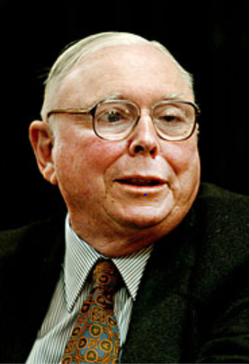
Charles Munger – Warren Buffett’s #2
$1.2 Billion Net Worth
“We should ‘thank God’ for the bailout of Wall Street, but ordinary Americans should just ‘suck it in and cope.’”
September 27, 2013
Notes:
Source: https://www.google.com/search?q=charles+munger+net+worth&rlz=1C1SFXN_enUS499US504&es_sm=93&source=lnms&tbm=isch&sa=X&ei=RrtFUtWIDamajAK2_4CwDw&ved=0CAkQ_AUoAQ&biw=1280&bih=659&dpr=1#facrc=_&imgdii=_&imgrc=XPNrIJSYSGzqJM%3A%3BLG9efdplyAZhcM%3Bhttp%253A%252F%252Fhollywoodnose.com%252Fimages%252Fnet_worth6%252Fcharlie-munger-wealth%252Fcharlie-munger-net-worth.jpg%3Bhttp%253A%252F%252Fhollywoodnose.com%252Fnet-worth%252Fcharlie-munger-wealth%3B190%3B273 Image may be subject to copyright
Paul Krugman, “Plutocrats Feeling Persecuted,” New York Times, September 27, 2013. http://www.nytimes.com/2013/09/27/opinion/krugman-plutocrats-feeling-persecuted.html?nl=todaysheadlines&emc=edit_th_20130927&_r=0

Slide 4
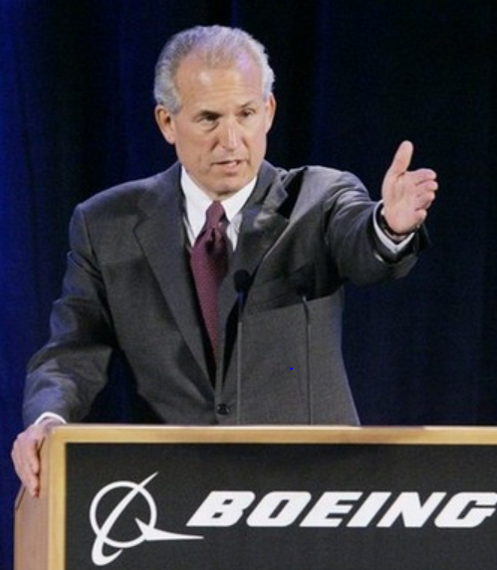
Boeing CEO Jim McNerney Speaks
Which Statement Do You Believe is True?
His plans after turning 65. “The heart will still be beating, the employees will still be cowering, I’ll be working hard,” he said. July 23, 2014.
"There was no intent to slight anyone.”
July 24, 2014
Notes:
Image: http://www.ttrweekly.com/site/2013/04/boeing-rushes-to-fit-batteries/ Image may be subject to copyright.
Quotes: http://www.bloomberg.com/news/2014-07-23/boeing-boosts-2014-forecast-as-jetliner-deliveries-surge.html

Slide 5
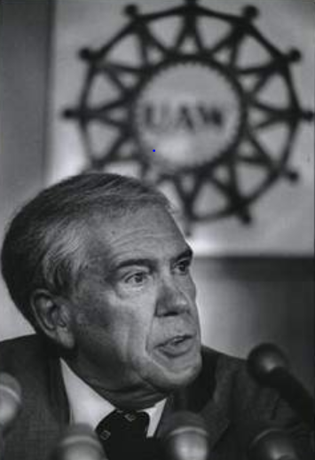
Doug Fraser: UAW President – 1978
A Lonely Prophet Speaking the Truth
“I believe leaders of the business community, with few exceptions, have chosen to wage a one-sided class war…a war against working people, the unemployed, the poor … even many in the middle class.”
Notes:
Sources:
Image: http://www.freep.com/article/20121028/BUSINESS01/310280131/UAW-saw-an-opening-with-Honda-s-arrival Image may be subject to copyright.
Quote: Hedrick Smith, Who Stole the American Dream, page 17.

Slide 6
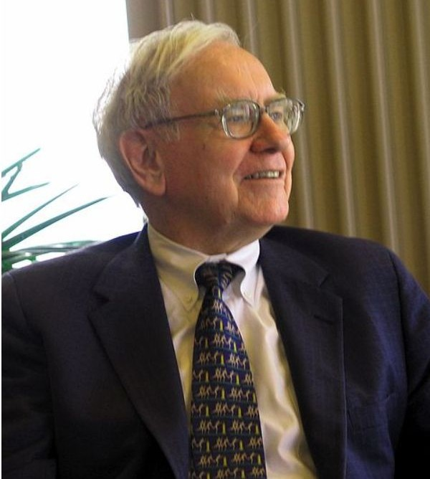
Corporate America’s Class War
4 Decades and Counting
“There’s Class Warfare, all right. But it’s my class, the rich class, that’s making war, and we’re winning.”
Warren Buffett – 2006
Notes:
Sources: Image: Wikipedia. http://en.wikipedia.org/wiki/File:Warren_Buffett_KU_Visit.jpg Image may be subject to copyright.
Quote: http://www.nytimes.com/2006/11/26/business/yourmoney/26every.html?_r=0

Slide 7
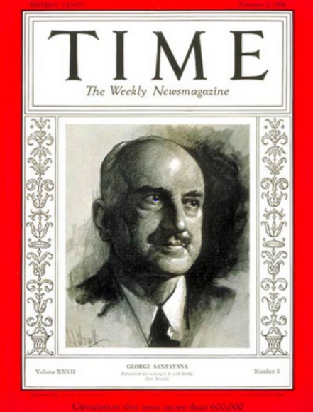
History is the Game Films of Our Struggles
“Those who cannot learn from history are doomed to repeat it. Those who do not remember their past are condemned to repeat their mistakes."
George Santayana, 1936
Notes:
Sources:
Image: http://www.time.com/time/covers/0,16641,19360203,00.html Image may be subject to copyright.

Slide 8
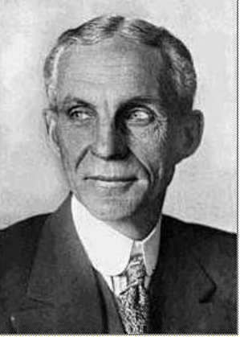
Henry Ford Speaks from His Heart After Laying Off 91,000 – 1931
“The average man won't really do a day's work unless he is caught and cannot get out of it. There is plenty of work to do if people would do it.”
Notes:
Source: Photo: Wisconsin Historical Society – 1997. Copyright. Quote: Howard Zinn, People’s History of the United States, page 378.

Slide 9
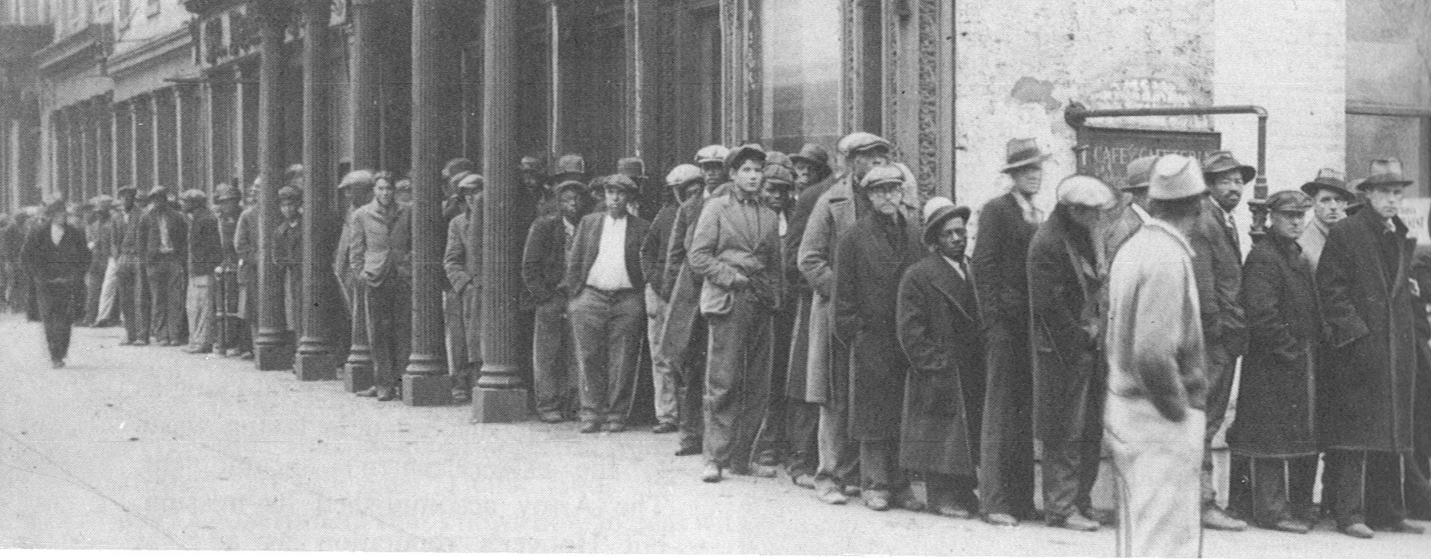
Wall Street Speculators Collapse the Economy – Tens of Millions Suffer
.
Notes:
Source: M. B. Schnapper, American Labor: A Bicentennial History, Public Affairs Press, 1975, page 462. Copyright.
COMMUNITY ORGANIZING RISES IN RESPONSE TO THE DEEPENING CRISIS.
By 1932, the Great Depression had reached its depths. The official national unemployment rate was 25 percent and the unofficial rate of working involuntarily working part-time was 35 percent. People of color were particularly hard hit.
For decades, Corporate America and their political allies had prevented legislation that would have provided unemployment insurance, adequate public assistance to the needy, affordable housing, badly needed food, social security for the elderly and the disabled, and an end of home and farm foreclosures. Working people, both employed and unemployed, were living in misery and desperation.
In midst of this untold and unjustified suffering, people began to organize particularly around issues of unemployment insurance, public assistance, affordable housing, social security. Massive demonstrations became a permanent part of the American story. Workers, whether employed or unemployed, the poor and the oppressed would not remain silent.

Slide 10
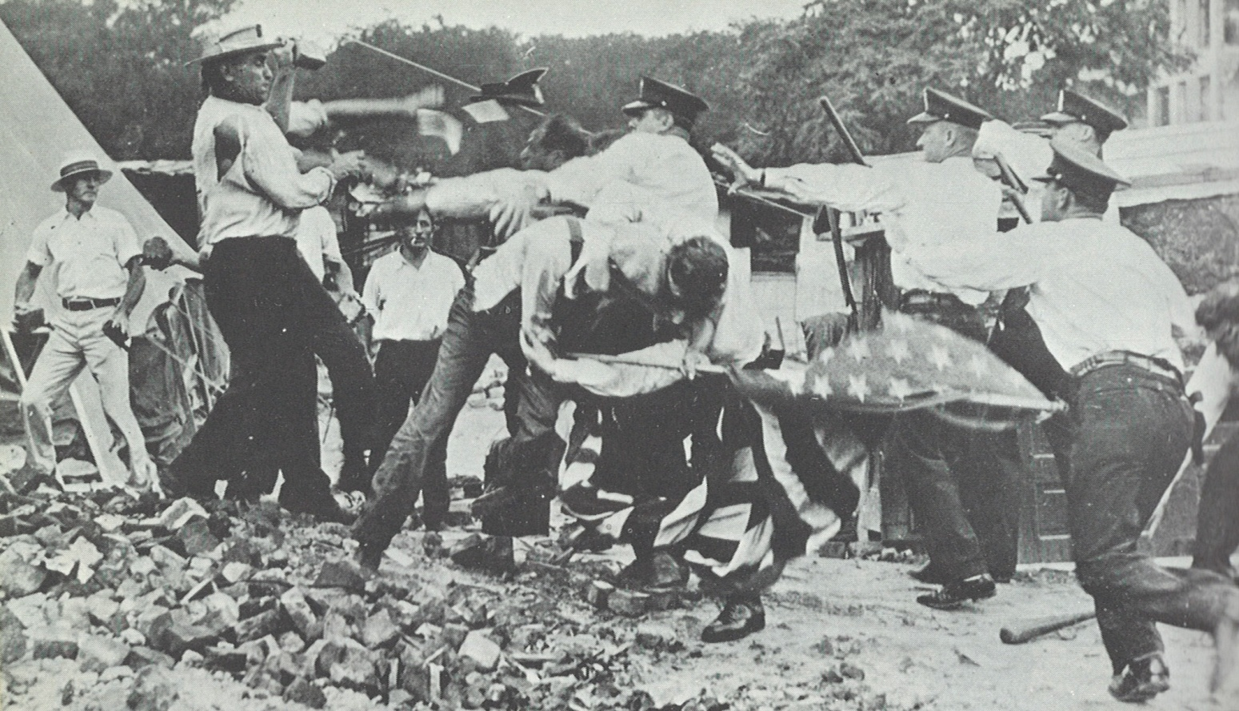
Police and U.S. Army Kill 2 WW 1 Veterans in Bonus March to D.C. – 1932
.
Notes:
Source: M. B. Schnapper, American Labor: A Bicentennial History, Public Affairs Press, 1975, page 460. Copyright.
Meanwhile the hungry, homeless and desperate unemployed were literally on the march in Washington D.C. In 1932, thousands of World War 1 veterans marched on Washington D.C. demanding early payments of their war bonuses that were scheduled to be paid in 1943. They could not wait 11 more years while their families suffered from hunger, homelessness and unemployment. They camped in Anacostia Flats. Their “Occupy D.C.” movement of its day was burned to the ground by the U.S. Army led by General Douglas MacArthur and his chief of staff, future President Dwight Eisenhower. 2 were killed and 18 wounded.
These men had served their country in the war that was called “The War to End all Wars.” Their sacrifices and demands for justice were met with bullets and repression. This was not the democracy that they had been told they had fought to defend.

Slide 11
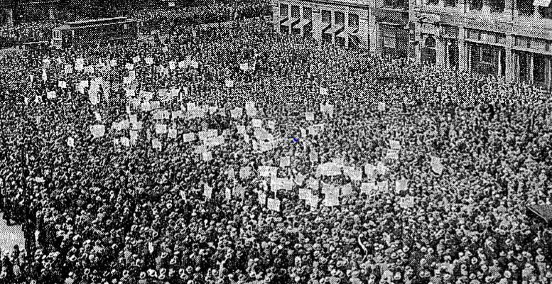
The Great Uprising of the People – 1930s
Jobs, Labor Rights and Help for the Unemployed and Those in Need
Notes:
Image: http://www.progressivehistorians.com/2010/04/international-unemployment-day.html Image may be subject to copyright.

Slide 12
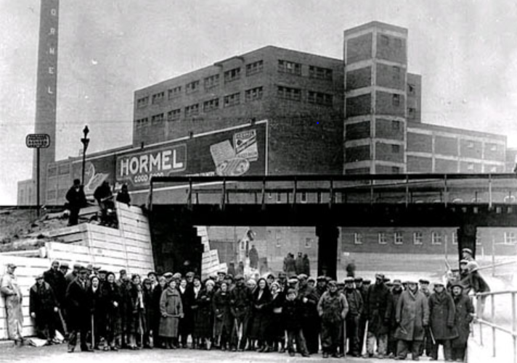
New Strategies for a Better Future
Sit Down Strike in Austin Minnesota - 1933
Notes:
Image: https://www.wsws.org/en/articles/2009/08/mpls-a27.html Image may be subject to copyright.
Striking workers occupied Hormel meatpacking plant in November 1933 and win union recognition. This historic event was a sign of a rising tide of sit down strikes that would sweep the country later in the 1930s.

Slide 13
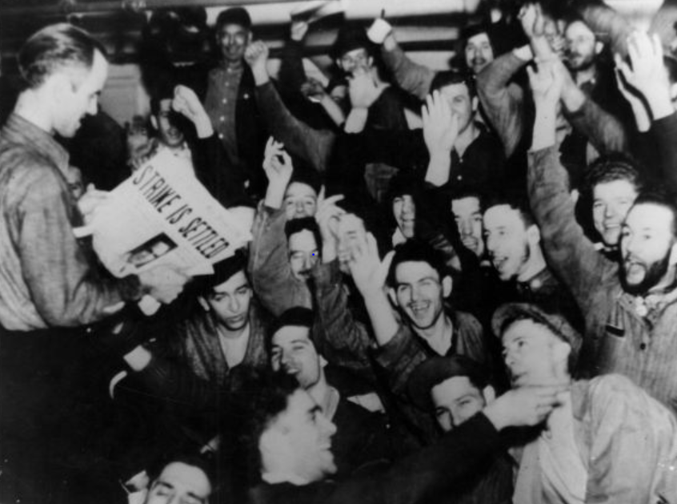
The Great Uprising of the People – 1937
UAW Defeats GM – Flint MI
Notes:
WE WON. THEY SAID WE COULDN’T FIND OUR COMMON GROUND, STICK TOGETHER AND DEFEAT THE MOST POWERFUL AND WEALTHIEST CORPORATION ON EARTH.
After a siege of 44 days, GM surrendered and signed a six month contract.
This was a turning point in American history.
A few months later, U.S. Steel, the world’s largest steel maker, surrendered and signed a contract with the new United Steel Workers Union without a strike. 18 years earlier, when 365 thousand steel workers struck for recognition, U.S. Steel had the support of the police and National Guard in Gary Indiana where 18 strikers were killed.
In 2 years, the percentage of unionized workers doubled to record highs. It was the rising of native born and foreign born, white and people of color, male and female workers. At long last, it was the time of the working class and their allies.
Source: https://www.reuther.wayne.edu/node/2068 Image may be subject to copyright.

Slide 14
Growing Class Solidarity, Increased Militancy and New Strategies Built Our Power
Notes:
Source: Years 1890 - 1929, Vernon Briggs, Immigration and American Unionism, pages 71 and 113. Years 1930 -1970, U.S. Department of Commerce, “Historical Statistics of the U. S. – Colonial Times to 1970, page 178. Years 1971 to 2003, U.S. Department of Commerce, “Statistical Abstract of the U.S., several issues, tables typically labeled “Labor Union Membership by Sector. Years 2003 to 2012 Bureau of Labor Statistics
Barry T. Hirsch and David A. Macpherson, "Union Membership and Coverage Database from the Current Population Survey: Note," Industrial and Labor Relations Review, Vol. 56, No. 2, January 2003, pp. 349-54. (in pdf) URL: http://www.unionstats.com/

Slide 15
Labor Leads the Fight to the Great Victories of the 1930s
Right to organize unions and strong labor movement
Social Security and public assistance for poor families
Unemployment insurance, minimum wage and overtime pay, eight hour day and five day week
Child labor and child welfare protections
Help for homebuyers and farmers
Strong regulation of financial industries
Farmworkers and domestic workers excluded from many rights and programs
Notes:
Increasing solidarity among working people – white and people of color; native-born and immigrant; people of various faith traditions; young and old; men and women; employed and unemployed – key to explosive growth in the labor movement and winning the New Deal reforms.
In the mid-1930s, most of the American people won Social Security, unemployment insurance, the right to organize unions, minimum wage and overtime pay, child welfare, public assistance for poor families, protections for bank deposits, assistance in buying homes and more.
After decades of defeats, working people had won many fundamental labor, economic and social rights in five years.

Slide 16
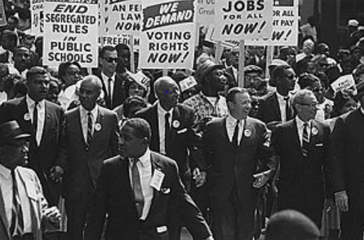
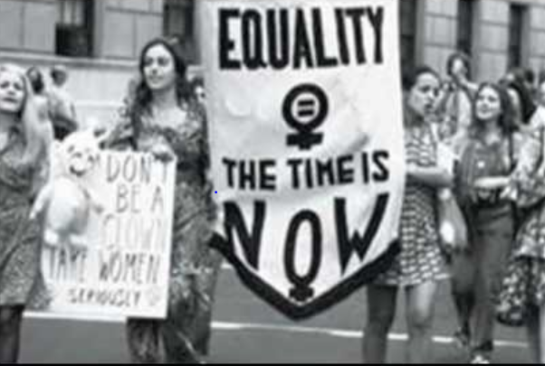
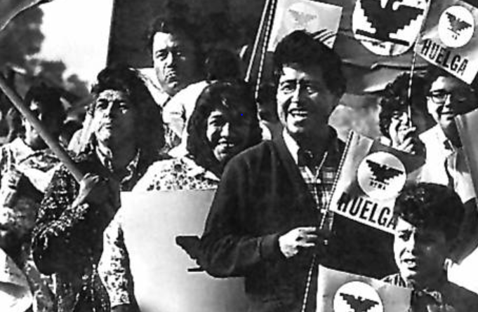
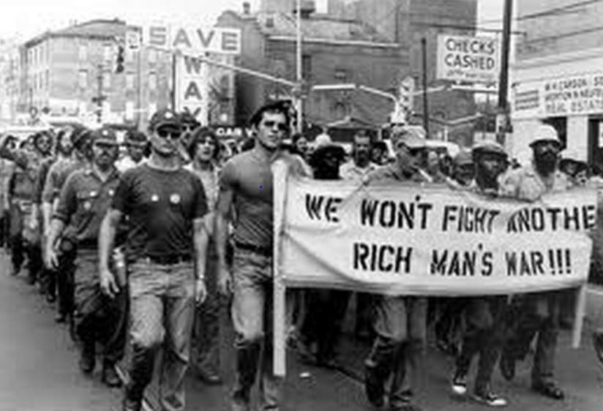
The Great Uprising of the People – 1960’s
Notes:
Sources:
Civil Rights: http://en.wikipedia.org/wiki/Civil_rights_movement Image may be subject to copyright.
Women’s Rights: http://www.youtube.com/watch?v=bX2hfiLEiiQ Image may be subject to copyright.
Viet Nam War: http://www.lpusd.k12.ca.us/rm1/online/hotpotatoestav/TAV17-3b.htm Image may be subject to copyright
Farmworkers: http://www.ncfh.org/?pid=4&page=2 Image may be subject to copyright.

Slide 17
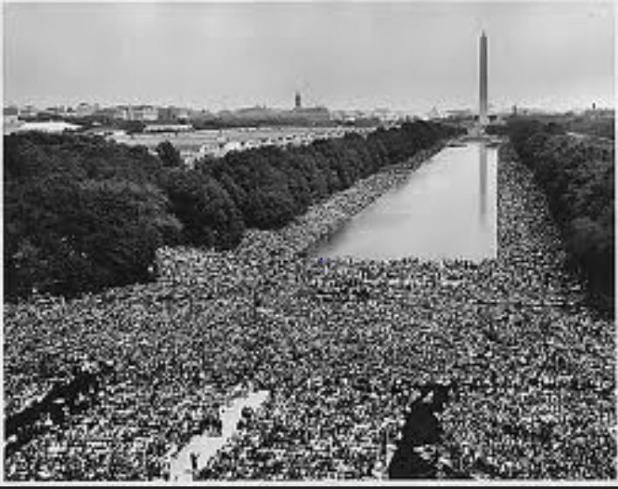
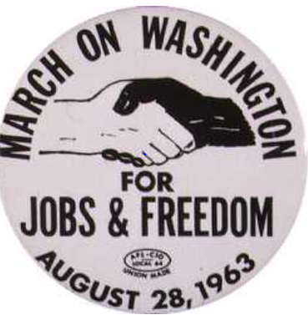
Fighting to Build Unity Across Our Differences
National AFL-CIO Refuses to Endorse March
Notes:
Source: http://60snow.blogspot.com/2008_08_24_archive.html Image may be subject to copyright.
www.Heroesofcharacter.org Educator blog. Image may be subject to copyright.

Slide 18
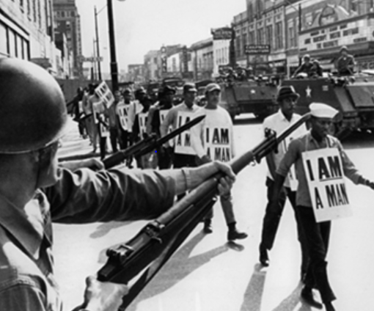
Dr. King Died Supporting Public Sector Workers Striking for Recognition
“The labor movement was the principal force that transformed misery and despair into hope and progress…the captains of industry did not lead this transformation.”
Reverend Dr. Martin Luther King Jr. - 1961
Notes:
Sources:
Image: http://media.commercialappeal.com/mlk/ Image may be subject to copyright.
Quote: Peter Bollen, Great Labor Quotations, page 138.

Slide 19
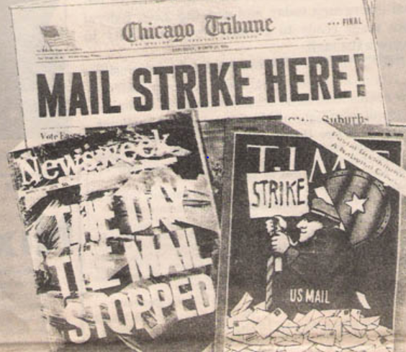
200,000 Postal Workers Wildcat – 1970
Win Collective Bargaining Rights
Notes:
Image: http://www.nylcbr36.org/history.htm Image may be subject to copyright.
Source: http://en.wikipedia.org/wiki/U.S._postal_strike_of_1970

Slide 20
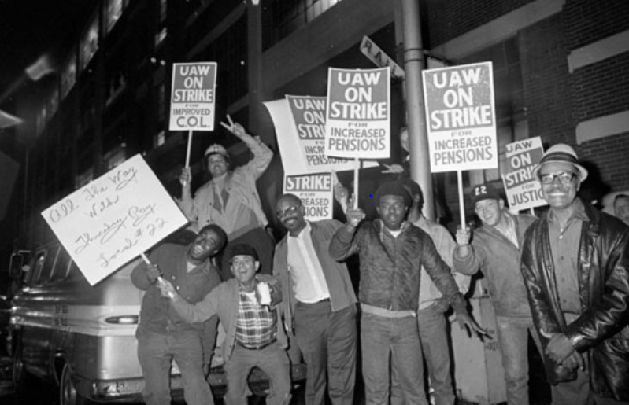
The Great Uprising of the People
5,700 Strikes – 3+ Million Strikers – 1970
Notes:
Image: https://libcom.org/history/union-management-gm-strike-1970-jeremy-brecher Image may be subject to copyright.
Sources: http://www.versobooks.com/books/282-rebel-rank-and-file

Slide 21
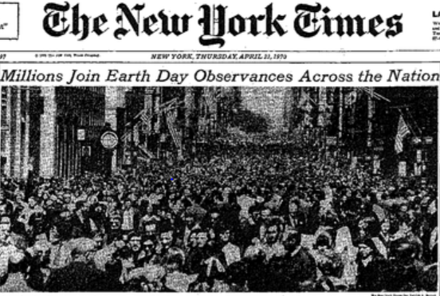
Notes:
Image: http://tomandkatehickeyfamilyhistory.blogspot.com/2014/04/44-years-ago-seventh-grade-teachers.html Image may be subject to copyright.

Slide 22
Labor and Our Allies Win Historic People’s Victories – 60s and Early 70s
Civil Rights and Voting Right Acts
Medicare/Medicaid
Anti-poverty programs
Anti-discrimination and open housing laws
Expanded higher education opportunities
Environmental victories – Clean air and water
Safer workplaces – OSHA
Health insurance and pensions
Some public employees win bargaining rights
Notes:
These new movements led to many historic victories that expanded our democracy and economic opportunities for tens of millions of Americans. Once again the people had demonstrated their power to demand and win major changes. None of these victories were given to the people. They built power to make them a reality. It was the second great uprising of the people in the 20th century.
These victories had very direct impacts on my family. My unemployed autoworker grandfather Wabel died at age 53 lacking affordable health care that might have saved his life. In sharp contrast, my beloved mother and father died in their 90s with access to some of the best health care in the world at the University of Washington. They were poor but the victories of Medicare, Medicaid and Social Security coupled with the support of their children ensured that they died in dignity. My grandfather died one of the wretched of the earth with no justice in his death. My parents died with dignity and justice. It was the victorious struggles of working people, organized labor and their many allies that gave them the help they needed as they aged.

Slide 23
Danger Signs
If We Don’t Grow; We Die
Notes:
Source: Years 1890 - 1929, Vernon Briggs, Immigration and American Unionism, pages 71 and 113. Years 1930 -1970, U.S. Department of Commerce, “Historical Statistics of the U. S. – Colonial Times to 1970, page 178. Years 1971 to 2003, U.S. Department of Commerce, “Statistical Abstract of the U.S., several issues, tables typically labeled “Labor Union Membership by Sector. Years 2003 to 2012 Bureau of Labor Statistics
Barry T. Hirsch and David A. Macpherson, "Union Membership and Coverage Database from the Current Population Survey: Note," Industrial and Labor Relations Review, Vol. 56, No. 2, January 2003, pp. 349-54. (in pdf) URL: http://www.unionstats.com/

Slide 24
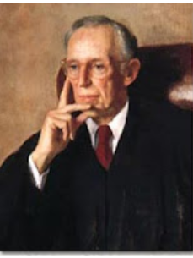
Corporate America Plans Class Warfare
Lewis Powell Memo – August 23, 1971
“Strength lies in organization, in careful long-range planning; in consistency of action over an indefinite period of years; in the scale of financing available only through joint effort; and in the political power only through united action and national organization”
Notes:
By the early 1970’s, leading strategists for Corporate America were developing long-term plans to reassert corporate dominance of our country. Throughout much of the 1960’s and early 1970’s, corporate power was being further restricted by the rising power of new movements. Race, gender, disability and age discrimination in the workplace was being restricted. Water, air and ground pollution by corporations was subject to major increases in federal regulation. The passage of the federal Occupational Safety and Health Act (OSHA) increased protections for workers and began to limit corporate abuses. The passage of pension protection legislation restricted corporate abuses of pension plans. This is only a partial list.
Movements of people of color, women, gays, youth, seniors, and environmentalists posed strong challenges to corporate power. Waves of strikes also put pressure on Corporate America.
It was time to launch a major long-term counterattack. One leading strategist was Lewis Powell, a corporate lawyer from Richmond, Virginia who served on many major corporate boards. On August 23, 1971, he wrote a confidential memo to a close ally and senior official at the U.S. Chamber of Commerce. In the memo, Powell outlined a brilliant long-term strategy for reasserting corporate dominance. Fundamentally, he called for Corporate America to use their money, power and influence to win a “War of Big Ideas.” In doing so, they would fundamentally reshape the thinking of the American people regarding the way our economic life should be shaped.
He called for the creation of a powerful intellectual machine that would wage that war.
Source: Greenpeace. http://www.greenpeace.org/usa/en/campaigns/global-warming-and-energy/polluterwatch/The-Lewis-Powell-Memo/

Slide 25
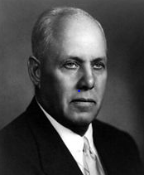
Labor’s Strategy for Disaster
“I used to worry about the size of the membership. I stopped worrying because it doesn’t make any difference. The organized fellow is the only fellow who matters.”
George Meany, President, AFL-CIO, 1972
Notes:
Sources:
Quote: http://www.baclocal7.org/history.aspx?zone=History&pID=1631
Image: http://en.wikipedia.org/wiki/George_Meany Image may be subject to copyright.

Slide 26
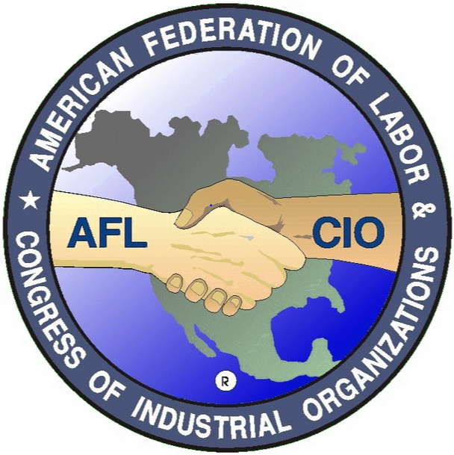
Labor Stands Apart from Many Movements Refuses to Unite Against Nixon - 1972
AFL-CIO remains neutral between Nixon and McGovern.
Nixon wins in landslide.
Corporate America and Business Roundtable plot all-out war.
Notes:
Image: http://deadline.com/2014/04/associated-actors-artistes-of-america-afl-cio-theodore-bikel-722211/ Image may be subject to copyright.

Slide 27
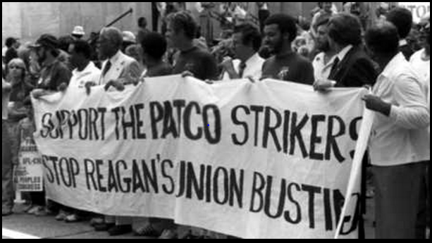
PATCO Endorse Reagan – 1980
Reagan Crushes PATCO – 1981
Notes:
Source: http://www.rwf2000.com/atc/ATC-Hist-11.htm Image may be subject to copyright.

Slide 28
Corporate Class Warfare; Divide and Conquer Works Like a Charm
Notes:
Source: Years 1890 - 1929, Vernon Briggs, Immigration and American Unionism, pages 71 and 113. Years 1930 -1970, U.S. Department of Commerce, “Historical Statistics of the U. S. – Colonial Times to 1970, page 178. Years 1971 to 2003, U.S. Department of Commerce, “Statistical Abstract of the U.S., several issues, tables typically labeled “Labor Union Membership by Sector. Years 2003 to 2012 Bureau of Labor Statistics
Barry T. Hirsch and David A. Macpherson, "Union Membership and Coverage Database from the Current Population Survey: Note," Industrial and Labor Relations Review, Vol. 56, No. 2, January 2003, pp. 349-54. (in pdf) URL: http://www.unionstats.com/

Slide 29
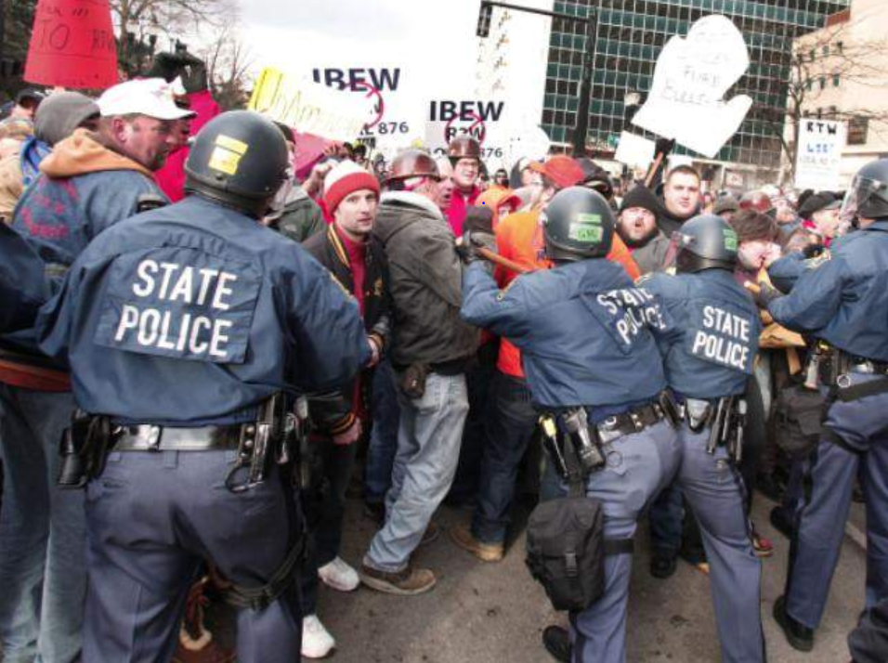
Corporate America Goes for the Kill
Right to Work in MI, IN and WI
Notes:
Image: http://www.abc15.com/news/region-southeast-valley/mesa/michigan-gov-snyder-signs-right-to-work-bills Image may be subject to copyright.

Slide 30
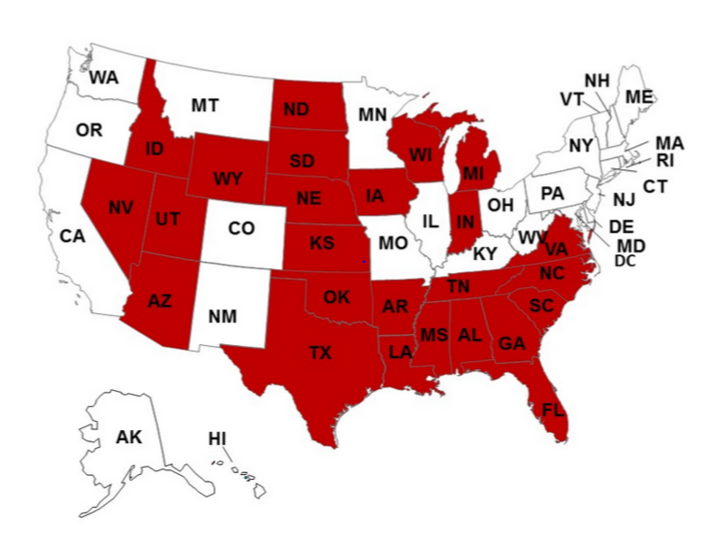
Class Warfare
Right to Work for Less – 2015
Notes:
Source: http://www.cnbc.com/id/102711178 Image may be subject to copyright.

Slide 31
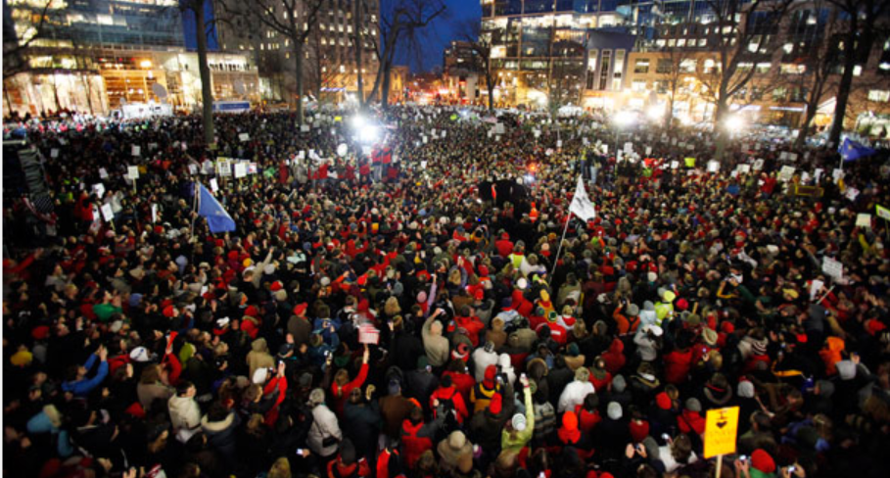
Wisconsin Governor Scott Walker
“National Right to Work a Legitimate Goal”
Notes:
Source: http://voiceofdetroit.net/2011/02/25/wisconsin-ignites-workers%E2%80%99-uprisings-across-the-u-s/ Image may be subject to copyright.
http://www.radioiowa.com/2015/04/25/governor-walker-a-national-right-to-work-law-a-legitimate-goal/

Slide 32
Do You Feel Like You Are Under Relentless Attacks from Your Employers and Corporate Backed Politicians?
Do You Think You Need More Allies to Restore Fairness and Justice for You and Our Communities?

Slide 33
What are the American People Thinking and Feeling these Days?

Slide 34
Do You Believe There is “Very Strong” or “Strong” Conflict Between the Rich and the Poor? – 2011
Notes:
Source: Pew Research Center, “Rising Share of Americans See Conflict Between Rich and Poor.” http://www.pewsocialtrends.org/files/2012/01/Rich-vs-Poor.pdf

Slide 35
Should Workers Have the Right to Organize? 2011 ABC/Washington Post Poll
Notes:
Source: http://www.washingtonpost.com/wp-srv/politics/polls/postpoll_03142011.html

Slide 36
Do You Approve or Disapprove of Unions? - Blue
Are Unions Necessary to Protect Workers? - Red
Note: Percentage of American adults.
Notes:
Sources:
Gallup Poll, http://www.gallup.com/poll/184622/americans-support-labor-unions-continues-recover.aspxq
Pew Research Center for the People and the Press, “Trends in Political Values and Core Attitudes: 1987-2012, page 157. http://www.people-press.org/2012/06/04/partisan-polarization-surges-in-bush-obama-years/
Part of the corporate strategy of Corporate America is to discredit labor unions in the eyes of the public. For decades corporate controlled media has demonized unions and systematically underplayed the positive role that unions have played in our country.
All too often I hear people say: The American people do not support unions. Well that is a feeling while the polling date shows a mixed statement.
Despite all of the media bashing of unions, a majority of people are still favorable and think they are necessary to protect working people. At the same time, this support is the lowest since major pollsters have been asking these questions.
WE HAVE WORK TO DO TO REEDUCATE THE AMERICAN PEOPLE ABOUT GREAT HISTORY OF LABOR AND WHAT IT HAS DONE FOR ALL AMERICANS.
Sources:
Gallup: Do You Approve or Disapprove of Labor Unions?
Pew: Labor Unions are Necessary to Protect the Working Person
Source: Gallup Poll, “In U.S., Labor Union Approval Steady at 52%.” http://www.gallup.com/poll/157025/labor-union-approval-steady.aspx

Slide 37
Which Group Do You Think Is Most Favorable to Unions?
18-29 years old
30-49 years old
50-64 years old
65 and older

Slide 38
Our Young People Are the Most Favorable to Organized Labor – 2013
Notes:
Note: Pew Research Center, “Favorable Views of Business, Labor Rebound,” June 27, 2013, page 3. http://www.people-press.org/files/legacy-pdf/6-27-13%20Business%20and%20Labor%20Release.pdf

Slide 39
Are Labor Unions Necessary to Protect Workers? – 18 to 29 Year Olds
Notes:
Source: http://www.americanprogressaction.org/wp-content/uploads/issues/2008/pdf/progressive_gap.pdf
Note: Pew Research Values Surveys – 1987 to 2007 average.

Slide 40
Attitudes of Republicans About Unions
2015
Notes:
Source: Pew Research Center, “Mixed Views of Impact of Long-Term Decline in Union Membership,” April 2015. http://www.people-press.org/2015/04/27/mixed-views-of-impact-of-long-term-decline-in-union-membership/

Slide 41
No one cares how much you know until they know how much you care about them
Solidarity begins when the boot is on the other person’s throat; not when it is on our throats

Slide 42
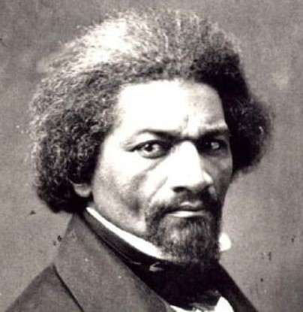
We Need Another Great Uprising of the People: Finding Hope and Getting Organized
“If there is no struggle, there can be no progress…find out what any people will quietly submit to and you will have found out the exact measure of injustice and wrong which will be imposed upon them.”
Frederick Douglass, 1857

Slide 43
We are Building the Great Uprising of 21st Century
Which Side of History Are You On?
Will You Help Build Our New Great Uprising?

Slide 44
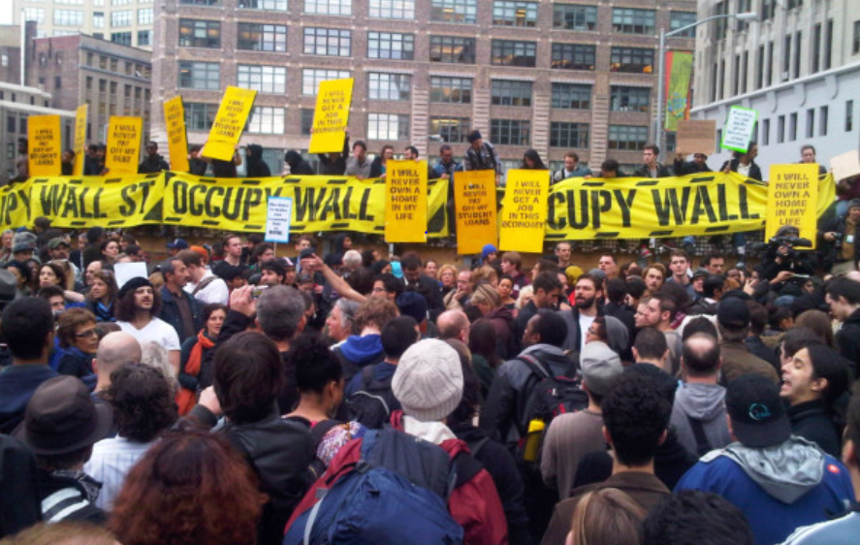
Occupy Wall Street Shifts Our Thinking
The 1% versus the 99%
Notes:
Image: http://latimesblogs.latimes.com/nationnow/2011/11/occupy-wall-street-eviction.html Image may be subject to copyright.

Slide 45
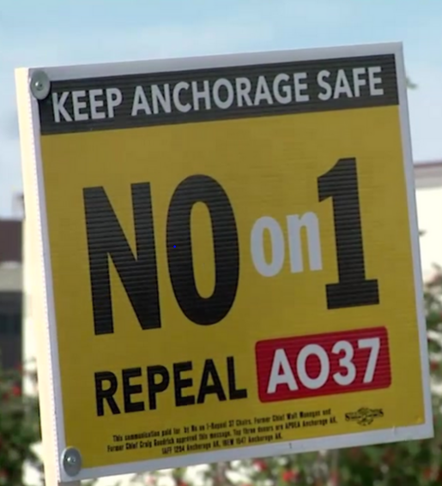
Labor/Community Alliance Beats the Union Busters – Anchorage – 2014
Anchorage labor and their community allies repeal public sector right to work by a vote of the people.
Notes:
Image: http://www.ktva.com/anchorage-voters-repeal-ao37-388/
Source: http://www.adn.com/article/20141104/anchorage-voters-favor-unions-repealing-mayor-sullivans-labor-law-rewrite

Slide 46
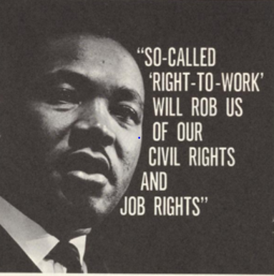
BIG WIN: Oregon Labor/Alliance Forces Business to Withdraw RTW Initiative - 2014
Notes:
Source: http://www.thekingcenter.org/archive/document/vote-no-state-question-409-oklahoma-naacp Image may be subject to copyright.

Slide 47
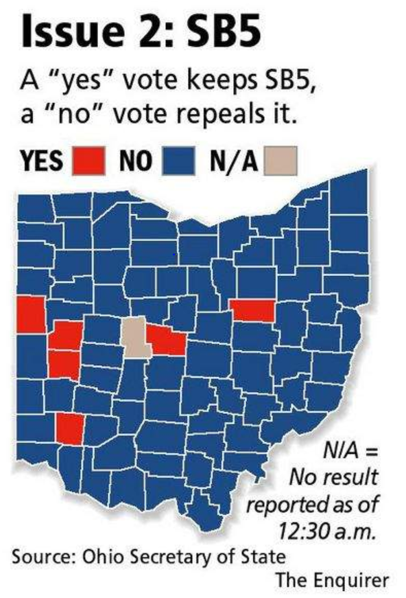
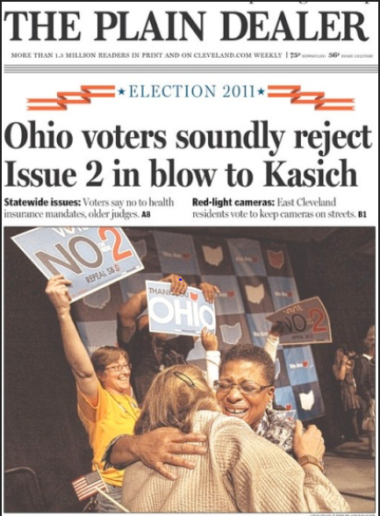
Who Says We Can’t Win Big? Not Ohio Anti-Union Law Repealed 62% to 38%
Notes:
Sources:
http://mirroronamerica.blogspot.com/2011_11_01_archive.html
http://news.cincinnati.com/article/20111108/NEWS0108/111090341/Issue-2-rejected-overturning-SB-5 Image may be subject to copyright.
In 2011, OOC and Stand Up for Ohio played a critical role in the defeat of SB5 (the collective bargaining attack in Ohio). Together, the organizations hired a team of 12 staff to coordinate outreach to churches, veterans, students, community groups, and other non- labor allies across the state;

Slide 48
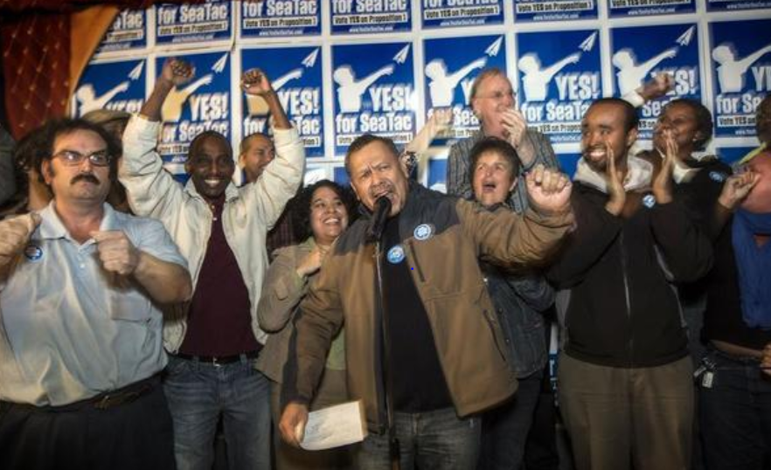
$15 Minimum Wage – Seatac and Seattle
Lets Take It Across the Country
Notes:
Image: http://www.realclearpolitics.com/2013/11/10/keep_eye_on_seatac039s_15_minimum_wage_experiment_319641.html Image may be subject to copyright.

Slide 49
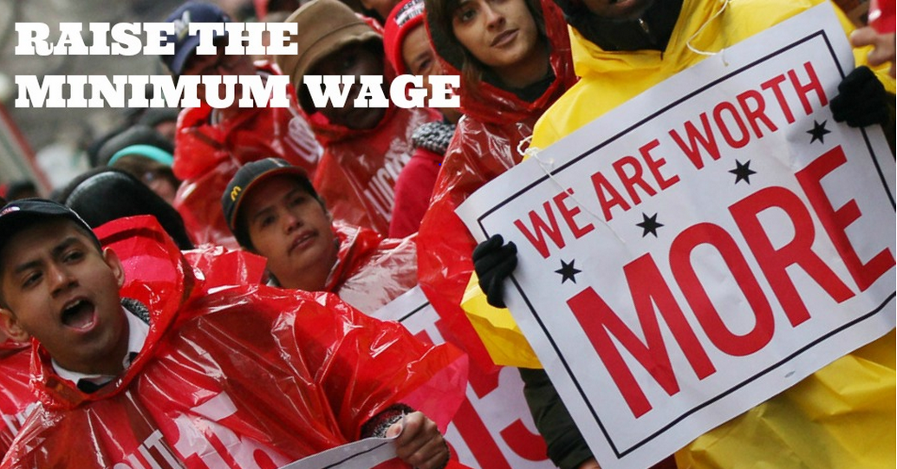
Winning Big In Red States - 2014
Alaska 69%; Arkansas 65%; Nebraska 59%
South Dakota 55%
Notes:
Sources:
Data: http://www.commondreams.org/news/2014/11/05/minimum-wage-measures-pass-overwhelmingly-even-red-states
Image: http://www.commondreams.org/election-2014-minimum-wage-ballot

Slide 50
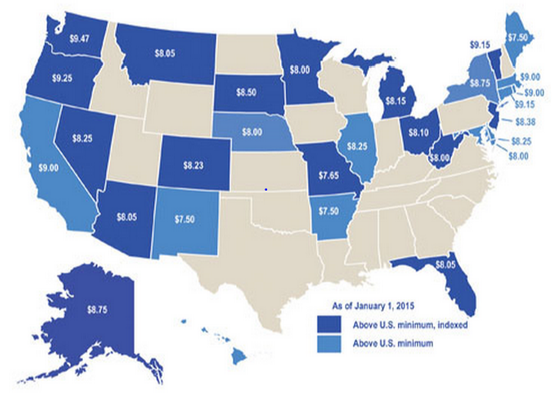
Fighting Forward – 29 Wins
Raise the Minimum Wage - 2015
Notes:
Source: http://iowapolicypoints.org/tag/minimum-wage/

Slide 51
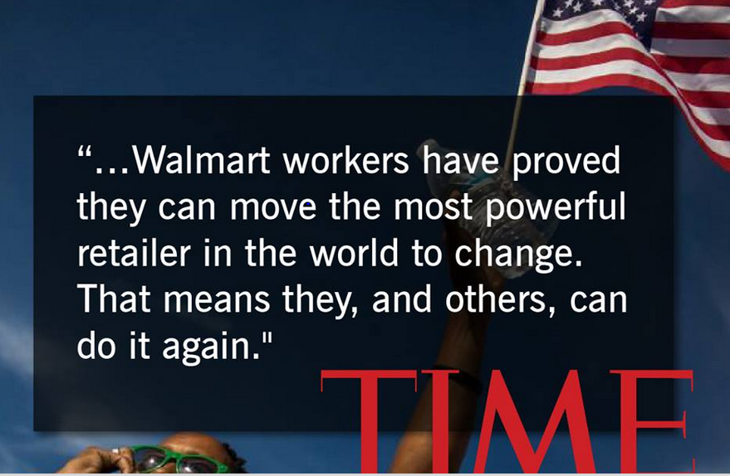
Walmart Caves: 500,000 Get a Raise
$10 Minimum Wage in 2016
Notes:
Image: http://makingchangeatwalmart.org/2015/03/02/10263/ Image may be subject to copyright.

Slide 52
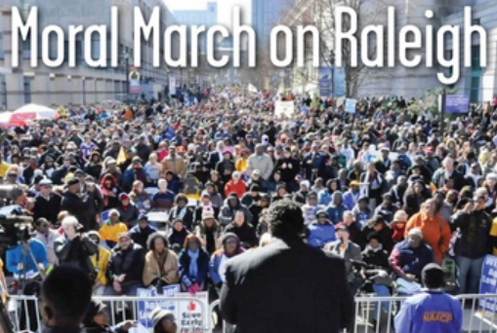
“A Movement, Not a Moment”
80,000 March – February 8, 2014
Notes:
Source:
http://www.hkonj.com/moral_march_on_raleigh Image may be subject to copyright.

Slide 53
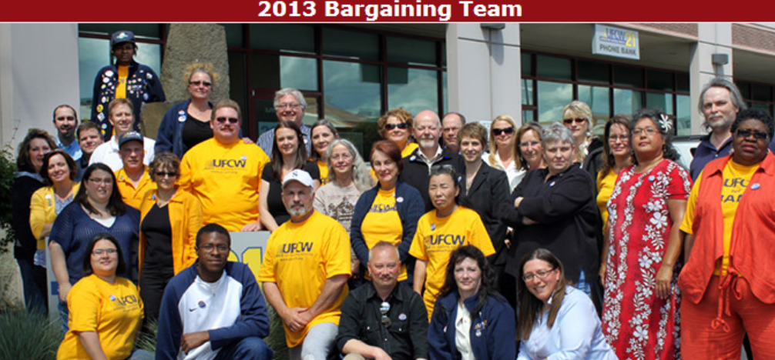
Grocery Workers Win Big With Strong Community Support – Western WA – 2013
Notes:
Source: http://www.ufcw21.org/content/98-strike-authorization

Slide 54
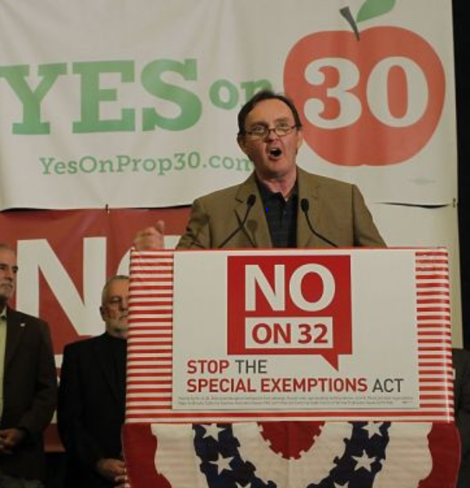
CA Labor and Community Partners Smash
Corporate Backed Prop 32 – 2012
Win 57% to 43%
Social Media plays key role for under–40s.
Long-term strategy to understand voters – “Now we are going to try to use this to create community.”
Art Pulaski, State Fed ST
Notes:
Image and Quote: http://www.sfgate.com/politics/joegarofoli/article/Labor-beat-Prop-32-via-social-media-4145607.php#photo-3702257 Image may be subject to copyright

Slide 55
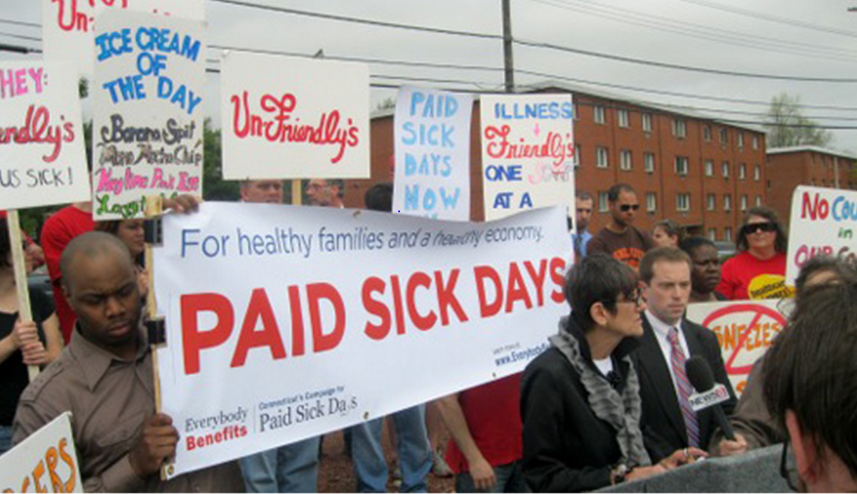
Labor Community Coalitions Win Paid Sick Leave CA, MA, Conn., OR, Seattle, NYC, SD
Notes:
Source: http://inthesetimes.com/working/entry/11608/rare_victory_for_common_sense_in_conn._paid_sick_time_law/
Image may be subject to copyright.
Under the law, which will affect about 200,000 to 400,000 workers statewide, reports the New York Times, a worker will earn paid sick time depending on how many hours they clock, up to five days per year. The measure targets service-sector workers like “waiters, cashiers, fast-food cooks, hair stylists, security guards and nursing home aides."

Slide 56
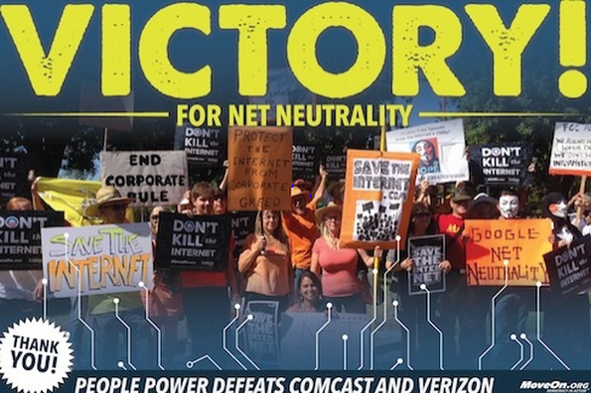
We the People Defeat Comcast and Verizon – 3+ Million Speak Out
Notes:
Source: http://f-a-l-d-p.blogspot.com/2015/02/net-neutrality-victory.html Image may be subject to copyright.

Slide 57
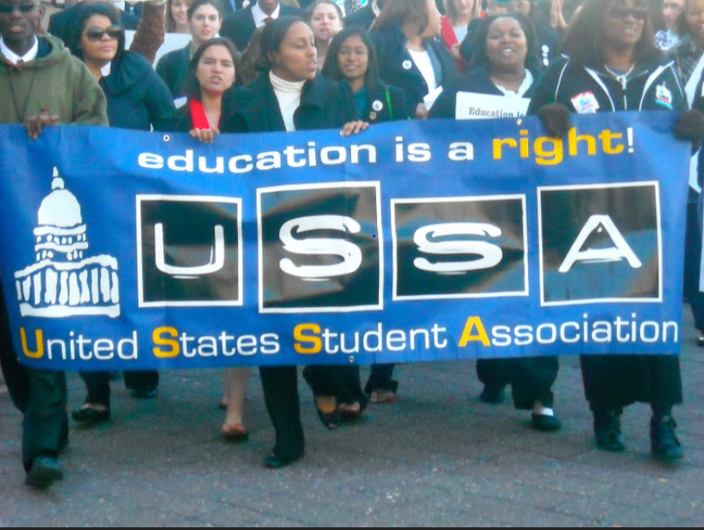
Militant Students Force Congress to Keep Low Interest Rates for Student Loans - 2012
Notes:
Source: U.S. Student Association http://usstudentassociation.blogspot.com/ Image may be subject to copyright.

Slide 58
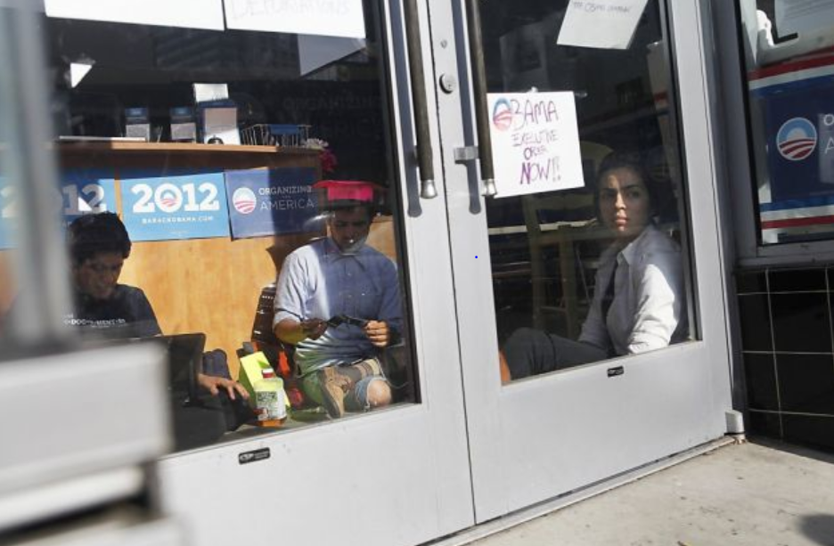
Militant Young Immigrants Occupy Obama HQs and Win Stay of Deportations
Notes:
Source: http://www.sfgate.com/bayarea/article/Immigration-policy-change-stirs-relief-doubt-3638601.php#photo-3077264 Image may be subject to copyright.
June 16, 2012 – SFGate article - Immigration policy change stirs relief, doubt by Nanette Asimov

Slide 59
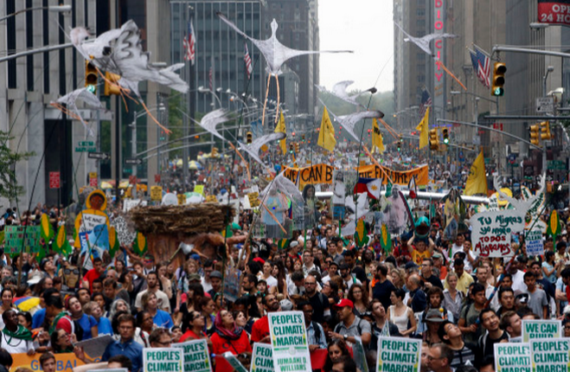
United We Can Build a More Just and Sustainable World
Notes:
Source: http://www.huffingtonpost.com/kofi-annan/climate-change-is-a-cause_b_5869280.html Image may be subject to copyright.

Slide 60
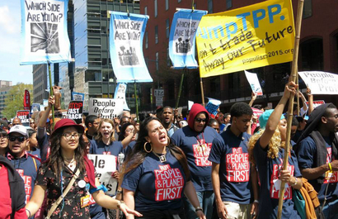
We Will Build a Better World
Smash the TPP
Notes:
Source: http://www.cwa-union.org/news/entry/cwa_e-newsletter_apr_23_2015#.VXtdVPlViko Image may be subject to copyright.

Slide 61
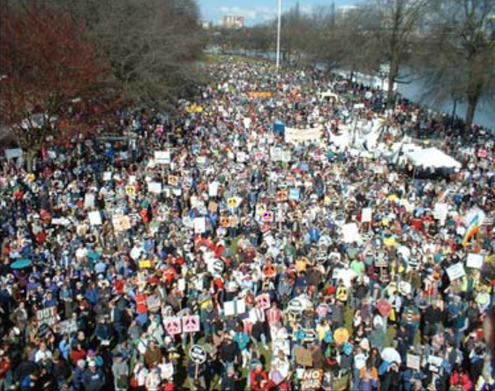
United We Can Build A New Uprising of the People and Build a Better Future
The ultimate test of a person, a union, a movement, and a people is not whether or not we get knocked down. It is what we do when we get up. Are we stronger, smarter, more determined, and more united?
This is always our choice.

