Slide 1
Fighting for Our Democracy and Our Future in the Age of Trump
International Brotherhood of Electrical Workers Electrical Workers Minority Caucus National Conference
January 12, 2018
Mark M. McDermott
www.markmmcdermott.com
www.facebook.com/markmcdermottworkshops
markmmcdermott1@msn.com

Slide 2
Do you feel the federal government is dominated by Corporate America and is more concerned about corporations and the wealthy than people like you?

Slide 3
Do you believe Trump, Corporate America and their political allies are trying to destroy our movement and steal the future from you and the people you love?

Slide 4
Do you want to take back our country from the racist, sexist, homophobic, anti-union, anti-worker, anti-immigrant, anti-poor, anti-environment, anti-senior citizen, pro-big business Trump regime and his allies?

Slide 5
Do you believe your union and our movement needs more active members and community allies to rebuild our power and take our country back?

Slide 6
125 Years of Struggle to Build Union and Working Class Power
Notes:
Source: Years 1890 - 1929, Vernon Briggs, Immigration and American Unionism, pages 71 and 113. Years 1930 -1970, U.S. Department of Commerce, “Historical Statistics of the U. S. – Colonial Times to 1970, page 178. Years 1971 to 2003, U.S. Department of Commerce, “Statistical Abstract of the U.S., several issues, tables typically labeled “Labor Union Membership by Sector. Years 2003 to 2016 Bureau of Labor Statistics. http://www.bls.gov/news.release/pdf/union2.htm
Barry T. Hirsch and David A. Macpherson, "Union Membership and Coverage Database from the Current Population Survey: Note," Industrial and Labor Relations Review, Vol. 56, No. 2, January 2003, pp. 349-54. (in pdf) URL: http://www.unionstats.com/

Slide 7

Republican Congress and Right Wing D’s Passed Right to Work for States – 1947
2016 Platform
National Right to Work Law
No federal minimum wage. Currently $7.25.
Notes:
Image: http://wksu.org/post/what-could-extended-republican-national-convention-mean-cleveland#stream/0 Image may be subject to copyright.
Source: Republican Platform 2016. https://prod-static-ngop-pbl.s3.amazonaws.com/media/documents/DRAFT_12_FINAL[1]-ben_1468872234.pdf

Slide 8
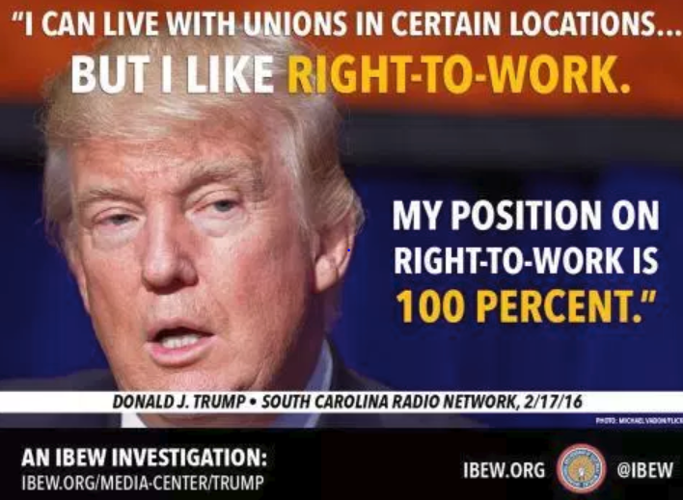
Notes:
Image: http://www.ibew553.org/labor/unions-in-the-trump-era/ Image may be subject to copyright.
Source: South Carolina Radio Network, February 17, 2016. http://www.southcarolinaradionetwork.com/2016/02/17/trump-backs-off-on-break-with-party-can-live-with-unions-at-certain-locations-interview/

Slide 9
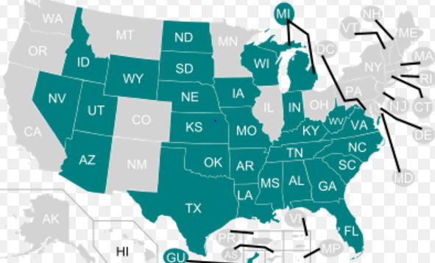
Corporate Class Warfare – 2017
Right to Work for Less
Notes:
Source: https://en.wikipedia.org/wiki/Right-to-work_law

Slide 10
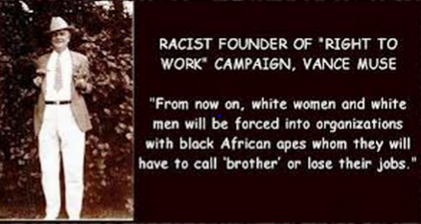
U.S. Supreme Court Will Rule on National Right to Work for Public Sector – 2018
Notes:
Image: http://www.criminalizeconservatism.com/2012_12_14_archive.html Image may be subject to copyright.
Source: LA Times, Supreme Court poised to deal a sharp blow to unions for teachers and public employees, September 28, 2017. http://www.latimes.com/politics/la-na-pol-court-unions-20170928-story.html

Slide 11
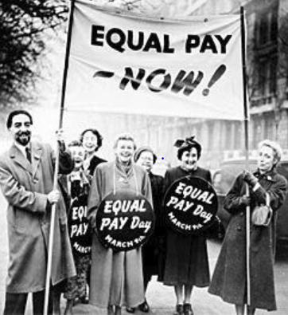
Trump Blocks EEOC Rule Requiring Pay Data by Job, Sex, Race and Ethnicity
How is equal pay for equal work served by ending requirement that large employers must report pay by job, sex, race and ethnicity?
Notes:
Image: https://www.pinterest.com/pin/74098356340130498 Image may be subject to copyright.
Source: http://www.epi.org/perkins/trump-administration-stays-ee0-1-pay-data-rule/

Slide 12
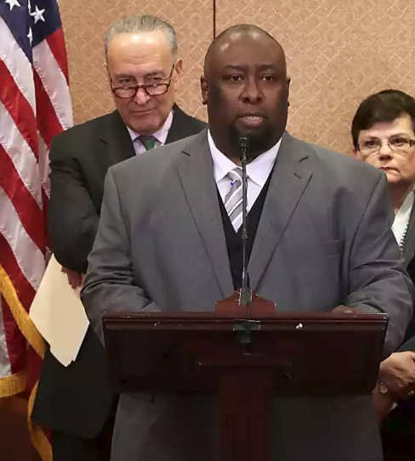
Trump Supreme Court Nominee Gorsuch: OK to Fire Trucker Fearing Death
27 Below Zero
Brakes Frozen on Truck Trailer
Fearing Death
Alphonse Maddin Disobeyed Order
10th Circuit Rules 6-1 in His Favor
Notes:
Image and Source: Joanne Walters, :”When Neil Gorsuch put corporate interests over a man freezing to death, The Guardian, March 23, 2017. https://www.theguardian.com/law/2017/mar/23/neil-gorsuch-supreme-court-frozen-trucker-alphonse-maddin

Slide 13
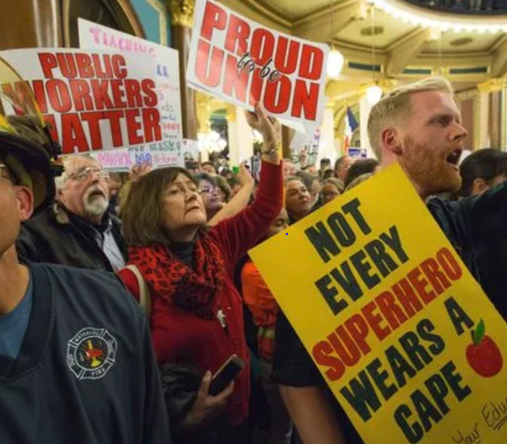
Who Says We Can’t Win Big?
Crushing the Union Busters in Iowa with Internal Organizing – 2017
Voting to recertify their unions:
28,448 – Yes
624 – No
98% - Yes
88% - Turnout
Notes:
Source: Des Moines Register, April 28, 2017. http://www.desmoinesregister.com/story/opinion/readers/2017/04/28/union-members-vote-their-dues-every-month/307683001/ Image may be subject to copyright.
Source: Des Moines Register, October 25, 2017. http://www.desmoinesregister.com/story/news/politics/2017/10/25/iowa-union-recertification-voting-results/797879001/

Slide 14
Gallup Poll: Do You Approve of Unions?
Highest National Support Since 2003
Notes:
Sources:
Gallup: Do You Approve or Disapprove of Labor Unions?
Pew: Labor Unions are Necessary to Protect the Working Person
Source: http://www.gallup.com/poll/217331/labor-union-approval-best-2003.aspx?version=print
Gallup Poll, http://www.gallup.com/poll/184622/americans-support-labor-unions-continues-recover.aspxq
Pew Research Center for the People and the Press, “Trends in Political Values and Core Attitudes: 1987-2012, page 157. http://www.people-press.org/2012/06/04/partisan-polarization-surges-in-bush-obama-years/
1987, 1988, 1989 Gallup added 1991, 2001, 2004, 2005, 2006, 2008, 2010, 2011 Pew added. Data points added to provide smooth lines. Data is consistent with overall trends.

Slide 15
Which Groups Do You Think Are Most Favorable to Unions?
18-29 years old
30-49 years old
50-64 years old
65+
Men or Women

Slide 16
Do You Have a Favorable View of Unions?
Pew Research – January 2017
Notes:
Source: Pew Research Center, “Most Americans see labor unions, corporations favorably,” January 30, 2017. http://www.pewresearch.org/fact-tank/2017/01/30/most-americans-see-labor-unions-corporations-favorably/

Slide 17
Women Are More Favorable to Unions than Men – Gallup Poll – 2015
Notes:
Source: Gallup Poll, 2015. http://www.gallup.com/poll/184622/americans-support-labor-unions-continues-recover.aspxq

Slide 18
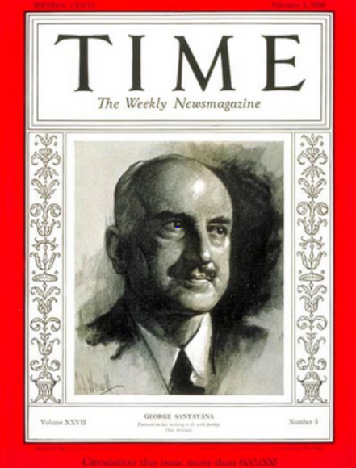
United We Grow Stronger; Divided We Grow Weaker – This is Always Our Choice
“Those who cannot learn from history are doomed to repeat it. Those who do not remember their past are condemned to repeat their mistakes."
George Santayana, 1936
Notes:
Sources:
Image: http://www.time.com/time/covers/0,16641,19360203,00.html Image may be subject to copyright.

Slide 19
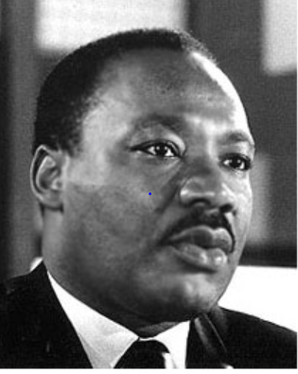
When We Fight for All Working People, We Can Build an American Dream for All
“The labor movement was the principal force that transformed misery and despair into hope and progress…The captains of industry did not lead this transformation.”
Rev. Dr. Martin Luther King Jr.
Notes:
Source:
Image: http://www.stmartin.edu/whatsnew/MediaReleases/images/MartinLutherKingJr.jpg Image may be subject to copyright.
Quote: Peter Bollen, Great Labor Quotations, page 138.

Slide 20
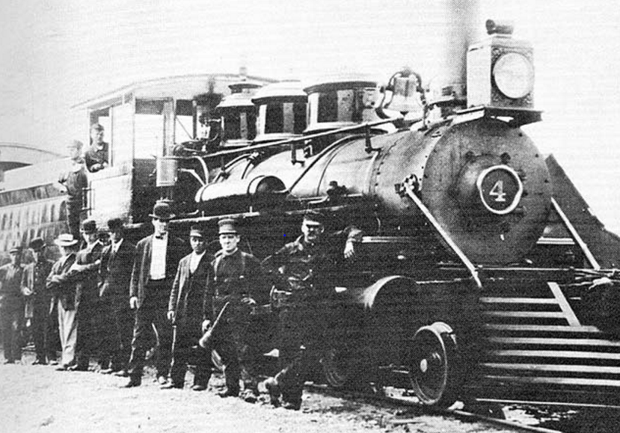
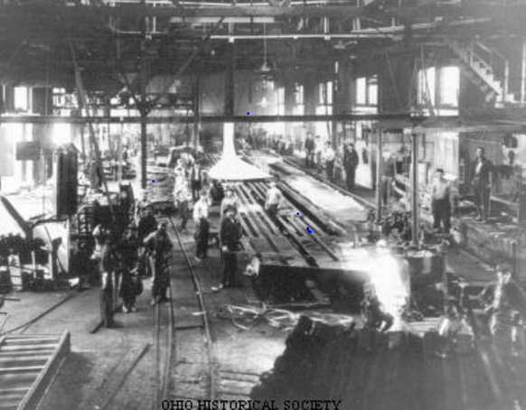
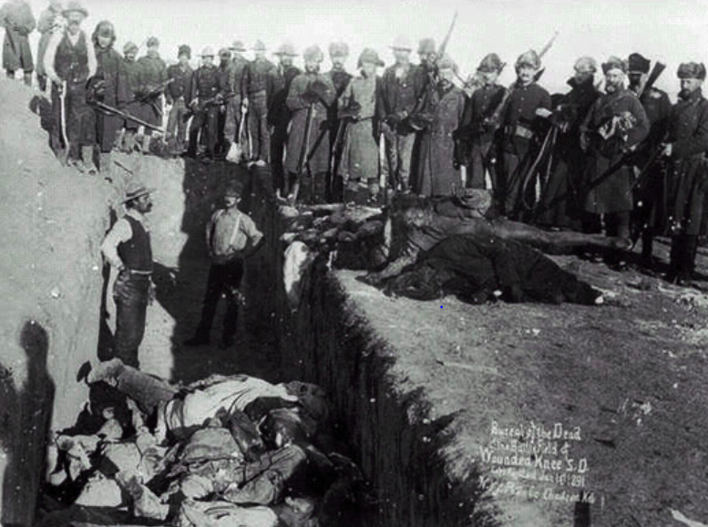
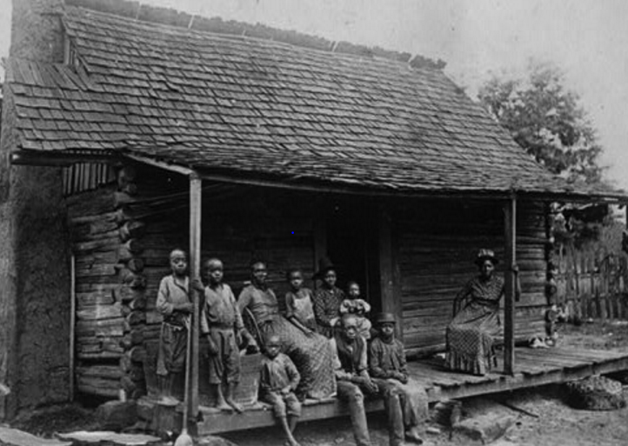
What Was Our Country Like in Late 19th Century?
Notes:
Images: All may be subject to copyright.
http://www.mendorailhistory.org/1_railroads/locos/4-6-0.htm
http://www.ohiohistorycentral.org/w/Steel_Mills
Htt
http://www.collectorsweekly.com/articles/why-arent-stories-like-12-years-a-slave-told-at-southern-plantation-museums/p://loopchicago.com/blog/then-and-now-a-brief-history-of-the-chicago-l

Slide 21
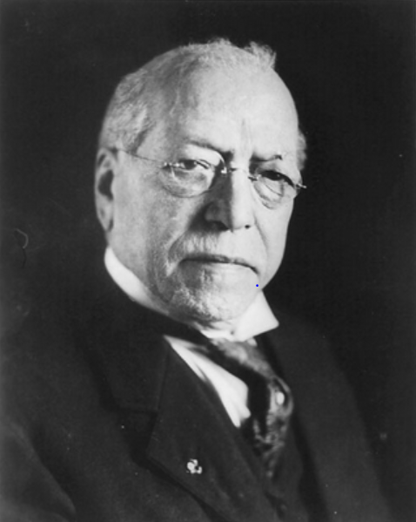
What Does Labor Want? For All Workers?
“We want more schoolhouses and less jails; more books and less arsenals; more learning and less vice; more leisure and less greed; more justice and less revenge; more opportunities to make childhood more happy and bright.”
Samuel Gompers, President AFL
Notes:
Sources:
Image: http://memory.loc.gov/ammem/nfhtml/nfexww1.html Image may be subject to copyright.
Quote: http://www.goodreads.com/quotes/109897-what-does-labor-want-we-want-more-schoolhouses-and-less

Slide 22
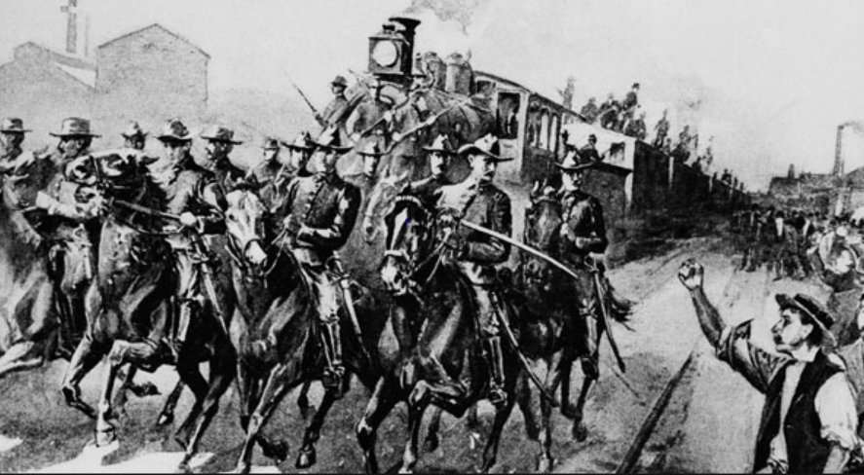
President Cleveland Uses the Army to Crush
Nationwide Rail Strike – Dozens Killed – 1894
Notes:
Note: President Cleveland mobilizes 14 thousand Army troops to crush the nation-wide rail strike sparked by the strike at Pullman Corporation in Chicago. Governor Altgeld and the Chicago mayor oppose the use of federal troops. 34 killed.
Source: http://www.politico.com/news/stories/0311/50885.html Image may be subject to copyright.

Slide 23
Supreme Court Serves the Wealthy not the People – 1890s Style
In 1894, Congress passes 2% flat income tax that only applies to the richest 10 percent of families.
U.S. Supreme Court rules it unconstitutional.
Notes:
Source: http://westlawinsider.com/legal-research/today-in-1895-federal-income-tax-ruled-unconstitutional/

Slide 24
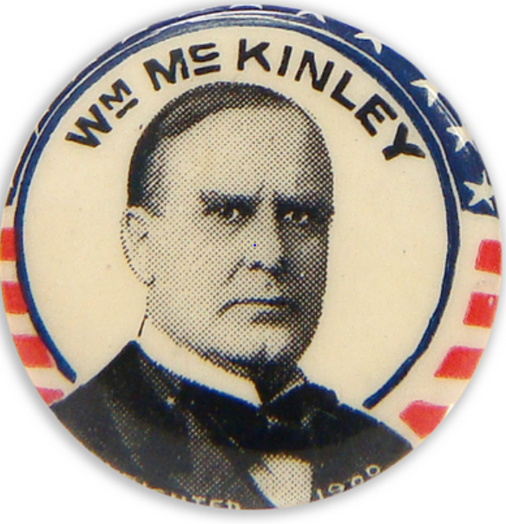
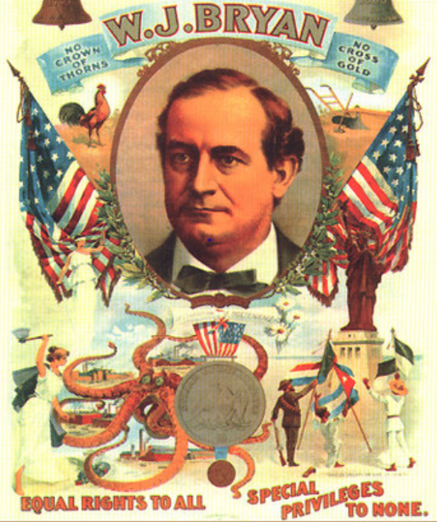
Buying the White House – 1896 Style
McKinley Outspends Bryan 11 to 1
Notes:
Source: http://en.wikipedia.org/wiki/Cross_of_Gold_speech
Source: Congressman Jim McDermott: Early Campaign Finance Reform. Y:\Mark_Mcdermott\mark\Documents\Labor Educator
Source: Popular vote – McKinley 51%; Bryan 47%. http://en.wikipedia.org/wiki/United_States_presidential_election,_1896
Image: http://prosperityuk.com/2001/01/a-wonderful-wizard-of-oz-a-monetary-reform-parable/ Image may be subject to copyright.
Image: http://www.nytstore.com/Vintage-1896-William-McKinley-Stars-and-Stripes-Pin_p_9612.html Image may be subject to copyright.

Slide 25

Voter Suppression and Fighting for Racial Justice – Early 20th Century:
Crush Black/White Unity in the South
“‘We wrested our state government from Negro supremacy.’ Almost all blacks and most poor whites were disenfranchised. In Mississippi, voter participation fell from 70% in 1876 to less than 10% in 1920.”
Notes:
Source: Colin Woodard, American Nations, page 305.
Image: http://www.sfvnaacp.org/archives/Western%20Region%201%202013%20Training/Voting%20Rights/National%20Voting%20Rights%20Toolkit.pdf Image may be subject to copright.

Slide 26
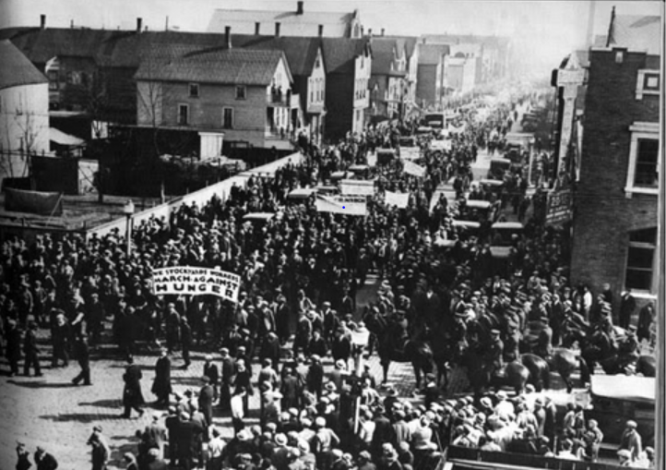
“We pursue policies to keep the races and nationalities apart…Stir up suspicion, rivalry and hatred among them.”
Philip Armour, CEO, world’s largest meatpacker
Notes:
Image: http://www.bobbosphere.org/2012/05/ Image may be subject to copyright.
Quote: Halpern, Rick, Down on the Killing Floor: Black and White Workers in Chicago’s Packinghouses, 1904-54, page 24.

Slide 27

25 Years of Gompers’ Leadership Sees Growing Racism in Labor Movement
AFL affiliates denying blacks membership grows from 4 to 11 during Gompers’ tenure as AFL President.
Notes:
Image: https://mstartzman.pbworks.com/w/page/21898889/American%20Federation%20of%20Labor%20
Source: Foner, Philip, Organized Labor and the Black Worker, 1619-1973, page 169.

Slide 28
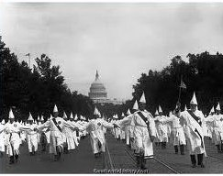
Ku Klux Klan: 4-5 Million Members
Larger than the Labor Movement – 1925
Notes:
Source: Authentic History. http://www.authentichistory.com/1921-1929/4-resistance/2-KKK/index.html Copyright – authentichistory.com

Slide 29
Culture Wars to Divide Us
100 Years Ago
Birth control is banned
Women should not have the right to vote
Interracial marriages are banned in many states
Alcohol prohibition is an attack on immigrants, Jews and Catholics
KKK – the violent defender of “pure, white, native born America”
Unionists are spreading anti-American radicalism

Slide 30
Finding Our Common Ground, We Strengthened Our Democracy
Congress passes Tillman Act – first major limitations on corporate campaign $$$ – 1907
U.S. constitutional amendment requiring direct election of Senators – 1913
U.S. constitutional amendment for income tax which only taxes the wealthy – 1913

Slide 31
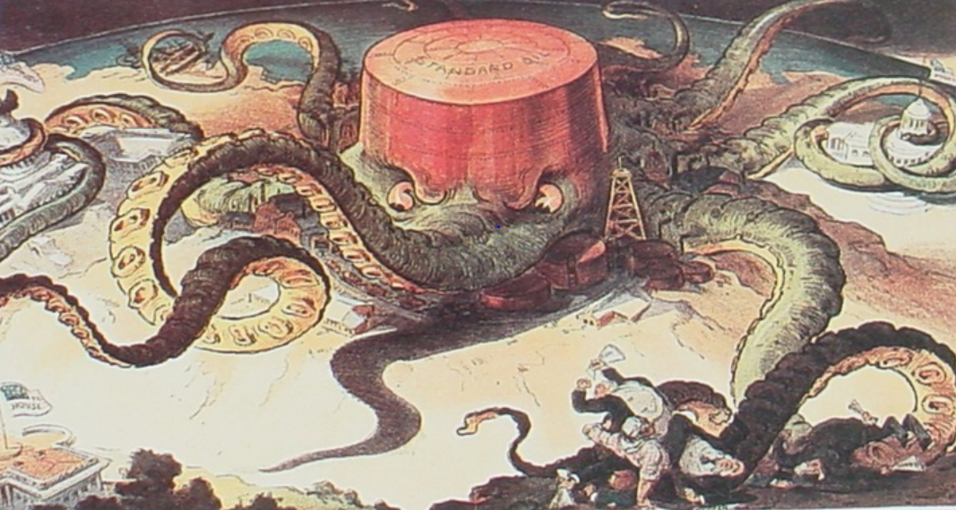
Attacking Corporate Power Directly: Busting the Trusts and Break Up Standard Oil
Notes:
Source: http://userpages.umbc.edu/~lindenme/hist102/Identifications/ids05.htm Image may be subject to copyright.
Note: Supreme Court orders the break up of Standard Oil in 1911. http://en.wikipedia.org/wiki/Standard_Oil_Company_of_New_Jersey_v._United_States

Slide 32
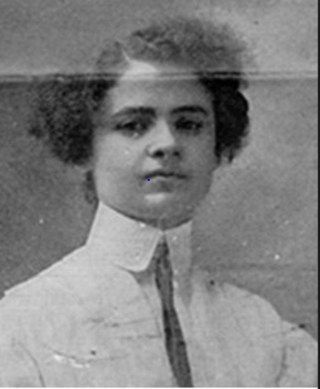
The Rising of the 20,000 Strike in NYC Immigrant Women Lead the Fight – 1909-10
"They used to say you couldn't even organize women. Well, we showed them! I have listened to all the speakers, and I have no further patience for talk. I move we go out in a general strike!“ – Clara Lemlich, age 19, Ukrainian Jewish immigrant
Notes:
Sources:
Image: http://www.xtimeline.com/evt/view.aspx?id=43225 Image may be subject to copyright
Quote: https://www.indypendent.org/2012/03/12/honoring-working-womens-struggles

Slide 33
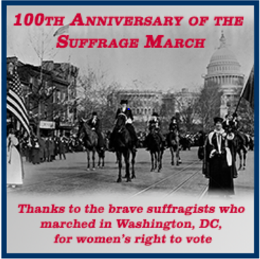
Decades of Struggle to Expand Democracy:
Women Win the Right to Vote in 1920
5,000 women march in D.C. in 1913
Violent attacks against marchers
Army called in to protect the marchers
100 marchers injured
Notes:
Source: http://www.lwv.org/blog/celebrating-100th-anniversary-women’s-suffrage-marc Image may be subject to copyright.

Slide 34

We the People Organize, Expand Our Democracy, and Win Greater Rights
Organized labor and our community allies curb corporate power with:
Initiatives
Referendums
Public ports
Workers’ compensation

Slide 35
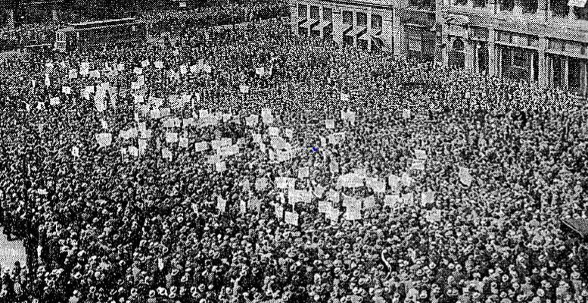
The Great Uprising of the People – 1930s
Jobs, Labor Rights and Help for the Unemployed and Those in Need
Notes:
Image: http://www.progressivehistorians.com/2010/04/international-unemployment-day.html Image may be subject to copyright.

Slide 36
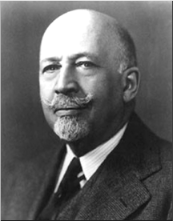
Growing Racial Solidarity
Key to Victories 1930-40s
“Probably the greatest and most effective effort toward interracial understanding among the working masses has come through the trade unions.”
W.E.B. DuBois, founder NAACP – late 1940s
Notes:
Source: Michael Yates, Why Unions Matter, page 147

Slide 37
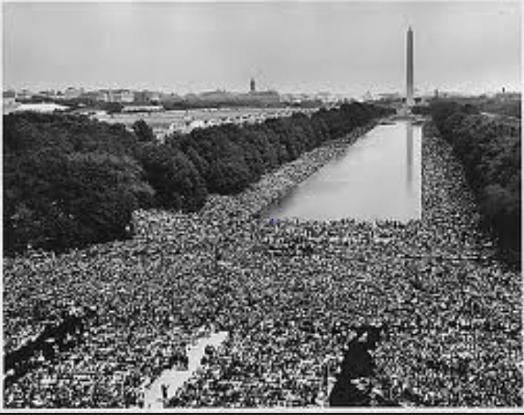

Fighting for Racial Justice
National AFL-CIO Refuses to Endorse
Notes:
Source: http://60snow.blogspot.com/2008_08_24_archive.html Image may be subject to copyright.
www.Heroesofcharacter.org Educator blog. Image may be subject to copyright.

Slide 38
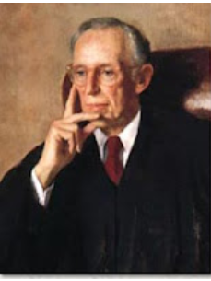
Corporate America Unleashes Class Warfare
Lewis Powell Memo – August 23, 1971
Decades-long strategy
Win the war of big ideas
Build national idea machine
Relentless political attacks
Appointed to U.S Supreme Court – 1971
Notes:
Source: Greenpeace. http://www.greenpeace.org/usa/en/campaigns/global-warming-and-energy/polluterwatch/The-Lewis-Powell-Memo/

Slide 39
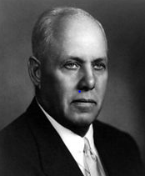
Strategic Mistakes Affect Us to This Day
“I used to worry about the size of the membership. I stopped worrying because it doesn’t make any difference. The organized fellow is the only fellow who matters.”
George Meany, President, AFL-CIO, 1972
Notes:
Sources:
Quote: http://www.baclocal7.org/history.aspx?zone=History&pID=1631
Image: http://en.wikipedia.org/wiki/George_Meany Image may be subject to copyright.

Slide 40
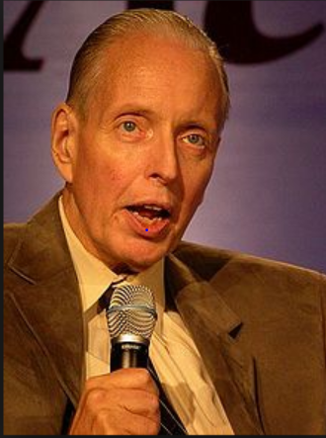
Corporate Attacks on Democratic Elections
“ I don’t want everybody to vote…our leverage in the elections quite candidly goes up as the voting populace goes down.”
Paul Weyrich, 1980. Co-founder, Heritage Foundation.
Notes:
Source:
Image: http://en.wikipedia.org/wiki/Paul_Weyrich Image may be subject to copyright.
Quote: Robert McChesney, Digital Disconnect, page 59.
Note: Co-founder of the Heritage Foundation, largest conservative think tank in WA D.C. and partially funded by Charles Koch Foundation and other right-wing billionaires.

Slide 41
Corporate America’s Class Warfare Today
Crush organized labor
Promote free trade and export manufacturing
Buy elections legally with big money
Voter suppression
Deregulate financial industries and corporations
Cut social programs for poor, unemployed and needy
Cut taxes on corporations and the wealthy
Privatize government
Divide and conquer
Notes:
The major victories of the 1960s and the early 1970s caused great alarm among corporate America, their right wing political allies and corporate mainstream politicians. Many of these victories coupled with an upsurge in labor unrest threatened many of their fundamental interests and furthered limited their power and freedom. Corporate America desperately wanted to regain political dominance and greater freedom from government control and strong unions.
On August 23, 1971, Lewis Powell, wrote a famous confidential memo to the U.S. Chamber of Commerce calling for a major counterattack by corporate America. http://reclaimdemocracy.org/corporate_accountability/powell_memo_lewis.html This memo along with the writings of other corporate allies laid the foundation for the corporate counterattack that helped achieve the election of Ronald Reagan in 1980s and a fundamental shift in American economic and political life.
The key elements and messages of the strategy are listed above. They also included the importance of winning the battle for the future vision of the country coupled with values, themes and messages that would become the dominant view of our future. This battle of ideas would be supported by the creation of many think tanks, endowment of chairs in university economics departments and business schools, attacks on leftist and progressive intellectuals, strengthening lobbying efforts, dominating the media and building powerful and well-funded permanent political and election campaign organizations. Crushing unions would be key.
What were the results? We have already seen the dramatic shift to economic inequality. Long gone were the days of a rising tide would lift all boats.

Slide 42
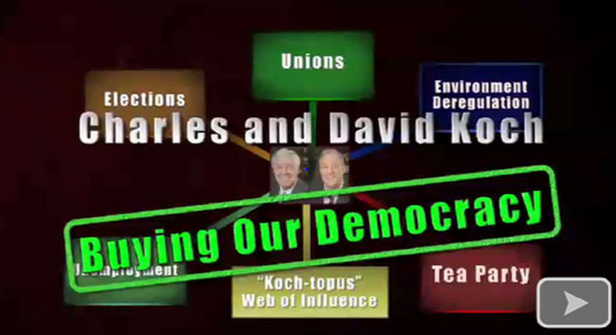
Legally Stealing Our Democracy
$400 Million – 2012; $900 Million – 2016
Notes:
Image: https://suzieqq.wordpress.com/2011/03/11/ Image may be subject to copyright.
Sources: http://www.nytimes.com/2015/01/27/us/politics/kochs-plan-to-spend-900-million-on-2016-campaign.html?_r=0
http://msnbc.tumblr.com/post/72567772382/rev-sharpton-explores-a-new-report-that-the

Slide 43
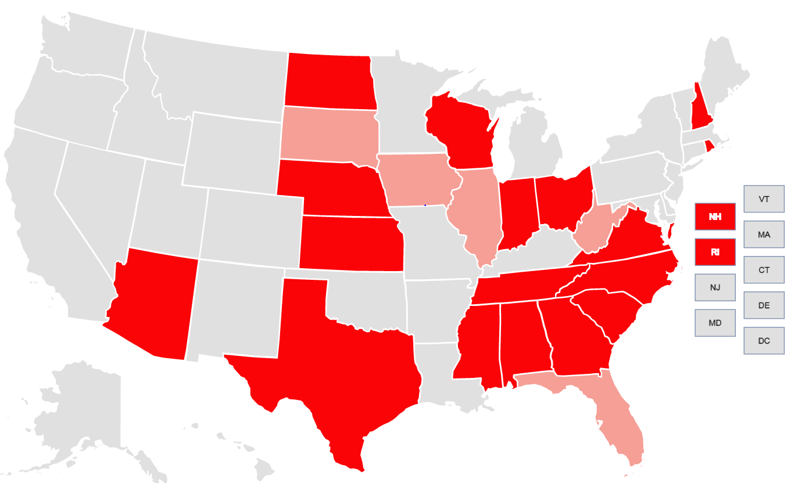
Supreme Court Aids in Voter Suppression New Restrictions in 2012 and 2016
Notes:
Source: Brennan Center for Voting Rights. https://www.brennancenter.org/voting-restrictions-first-time-2016 Image may be subject to copyright.
Light red shows restriction in place in 2012
Dark red shows restriction in place for 2016

Slide 44
Culture Wars to Divide Us Today
Demonize the poor
Fan the flames of racism
Bash Immigrants
Attack Women and their Health Care
Attack Lesbians and Gays, the Homeless, Transgenders, the Disabled, Muslims and Who Else?
Smash Unions

Slide 45
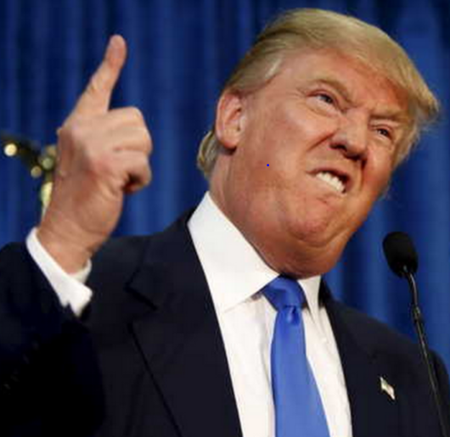
The Big Lie, No Proof, Claim Fraud, Promote Voter Suppression and Bash Immigrants
“In addition to winning the Electoral College in a landslide. I won the popular vote if you deduct the millions of people who voted illegally.”
“Three to five millions unauthorized immigrants voted for Mrs. Clinton.”
Notes:
Image: http://images.dailykos.com/images/150358/large/RTX1GZCO.jpg?1435250433
Image may be subject to copyright.
Quotes:
NBC News, November 27, 2016. http://www.nbcnews.com/politics/2016-election/tweet-flurry-president-elect-donald-trump-calls-recount-efforts-sad-n688761
Shear, Michael, and Huetteman, Emmarie, “Trump Repeats Lie About Popular Vote in Meeting with Lawmakers,” New York Times, January 23, 2017. https://www.nytimes.com/2017/01/23/us/politics/donald-trump-congress-democrats.html?_r=0

Slide 46
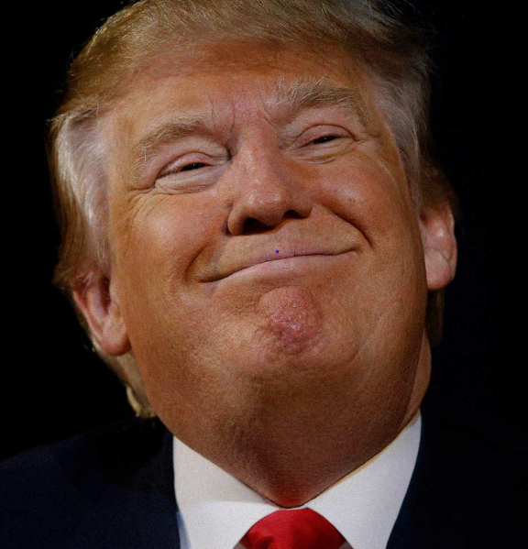
Spreading Hatred and Bigotry to Divide and Conquer 2016
“When Mexico sends its people, they’re not sending their best…They’re bringing drugs and crime. They’re rapists. And some, I assume, are good people.”
“I can never apologize for the truth.”
Notes:
Image: http://michaelmoore.com/trumpwillwin/ Image may be subject to copyright.
Quote: http://www.washingtonpost.com/blogs/fact-checker/wp/2015/07/08/donald-trumps-false-comments-connecting-mexican-immigrants-and-crime/
Source: Cato Institute, Criminal Immigrants: Their Numbers, Demographics and Countries of Origin, March 15, 2017. https://object.cato.org/sites/cato.org/files/pubs/pdf/immigration_brief-1.pdf
“All immigrants are less likely to be incarcerated than natives relative to their shares of the population. Even illegal immigrants are less likely to be incarcerated than native-born Americans.”

Slide 47
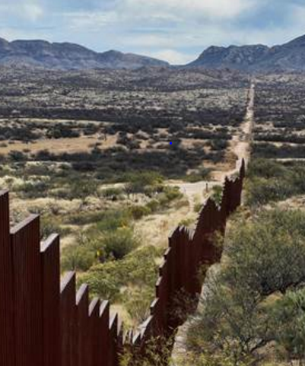
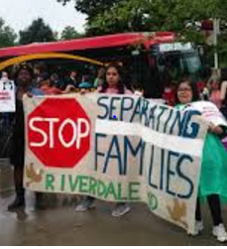
People Support Path to Citizenship: 70-25%
Oppose Mexican Wall: 62-35%
Notes:
Images: http://www.nbcnews.com/news/us-news/trump-suggests-canceling-meeting-mexico-s-president-after-shots-fired-n712461 Image may be subject to copyright.
Image: http://americasvoice.org/blog/united-states-trump-dreamers-parents-u-s-citizens-detained-deported/
Source: Path - http://edition.cnn.com/election/results/exit-polls/national/president
Source: Wall - http://www.pewresearch.org/fact-tank/2017/02/24/most-americans-continue-to-oppose-u-s-border-wall-doubt-mexico-would-pay-for-it/

Slide 48
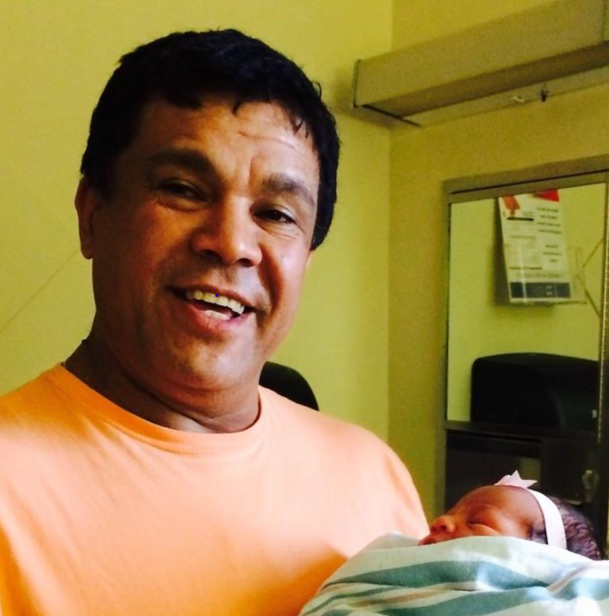
120,000-Member NYC Teamsters District Council 16 Says: “We Are a Sanctuary Union!”
Eber Garcia Vasquez
26-year member deported
Father of 4
Grandfather of 3
Disabled wife
Fled Guatemala after his mother and other family members killed in civil war.
Notes:
Image: Teamsters Joint Council 16, http://teamsters.nyc/2017/09/06/teamster-eber-garcia-vasquez-deported-ice/ Image may be subject to copyright.
Sources: http://teamsters.nyc/2017/09/06/teamster-eber-garcia-vasquez-deported-ice/
http://teamsters.nyc/2017/09/13/new-york-teamsters-become-sanctuary-union-following-deportation-union-member/

Slide 49
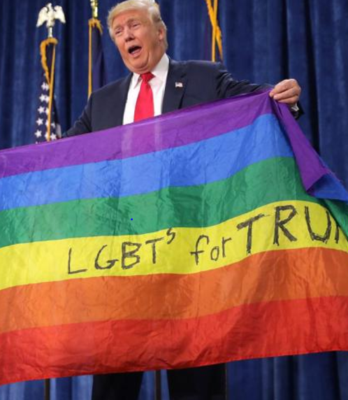
Trump Bans Transgender People from Military Service – It is Very Unpopular
68% of voters believe transgender people should be allowed to serve in the military.
55% of voters in military households agree.
Notes:
Image: New York Daily News, July 27, 2017. http://www.nydailynews.com/news/politics/trump-announces-transgender-military-service-ban-twitter-article-1.3357685
Source: Farber, Madeline, “Poll Finds Most Americans Support Transgender Military Service,” Time, August 3, 2017. http://time.com/4886165/trump-transgender-ban-poll/

Slide 50
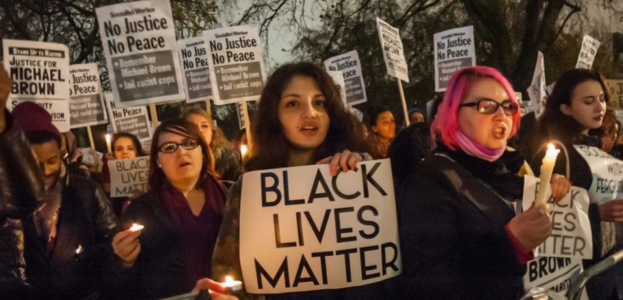
It’s time to draw the line. Some people are still getting hurt in our communities because of the color of their skin and that is not right.
Richard Trumka, President, AFL-CIO, 2014.
Notes:
Sources:
Quote: http://www.aflcio.org/Press-Room/Speeches/At-the-2014-Missouri-AFL-CIO-Convention
Image: Epic Times, http://www.epictimes.com/2015/06/new-billboard-in-orange-mound-puts-twist-on-black-lives-matter/ Image may be subject to copyright.

Slide 51
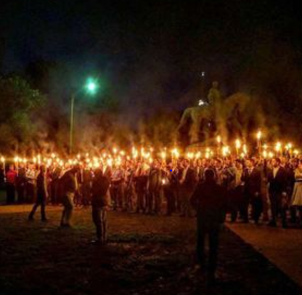
“Whether he intended to or not, what he (Trump) said caused racists to rejoice, minorities to weep and the vast heart of America to mourn.” – Mitt Romney
Charlottesville VA
White Supremacists
KKK
Neo-Nazis
Anti-Muslim
One of the chants was:
“We will not be ruled by Jews.”
Notes:
Image: Dallas Weekly News, http://www.dallasweekly.com/news/national/article_5c3677ec-3b3f-11e7-bee2-6bf5a938c6c9.html Image may be subject to copyright.

Slide 52
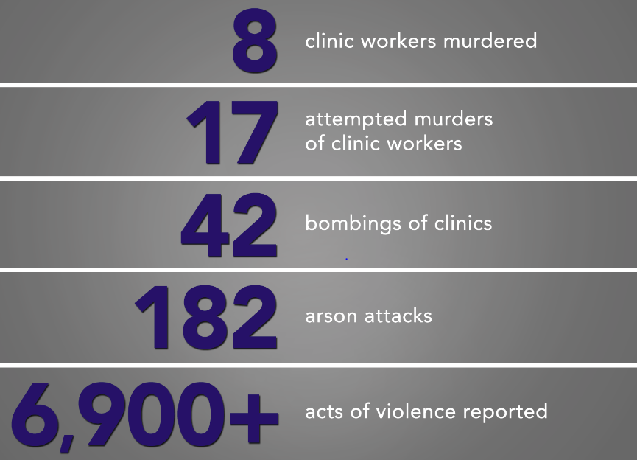
Women’s Health Care Workers Under Relentless Attack
Notes:
Source: NARAL Pro-Choice America. Data from 1977 to 2014. Source: National Abortion Federation.

Slide 53

Do You Support the Right to a Safe Workplace for Workers Providing Women’s Health Services?
Notes:
Image: http://www.latimes.com/business/hiltzik/la-fi-mh-planned-parenthood-and-the-cynical-20150904-column.html Image may be subject to copyright.
Source: http://www.cnn.com/2015/11/30/us/anti-abortion-violence/

Slide 54
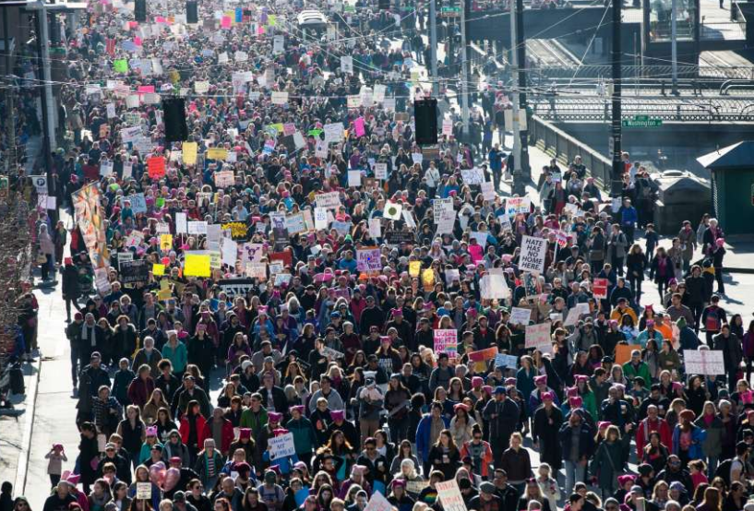
The Resistance Grows: 600 Women-Led Marches Rock Our Country – 2017
Notes:
Image: http://www.seattlepi.com/elections/article/Women-allies-march-on-Seattle-10872707.php#photo-12233902 Image may be subject to copyright.
The historic and extremely large women‘s marches of January 21, 2017 brought millions of women and men, young and old, people of color and white, citizens and non-citizens, and LGBT and straight in to the streets as a massive show of unity and solidarity to fight forward and move our country toward a better future. The time is now

Slide 55
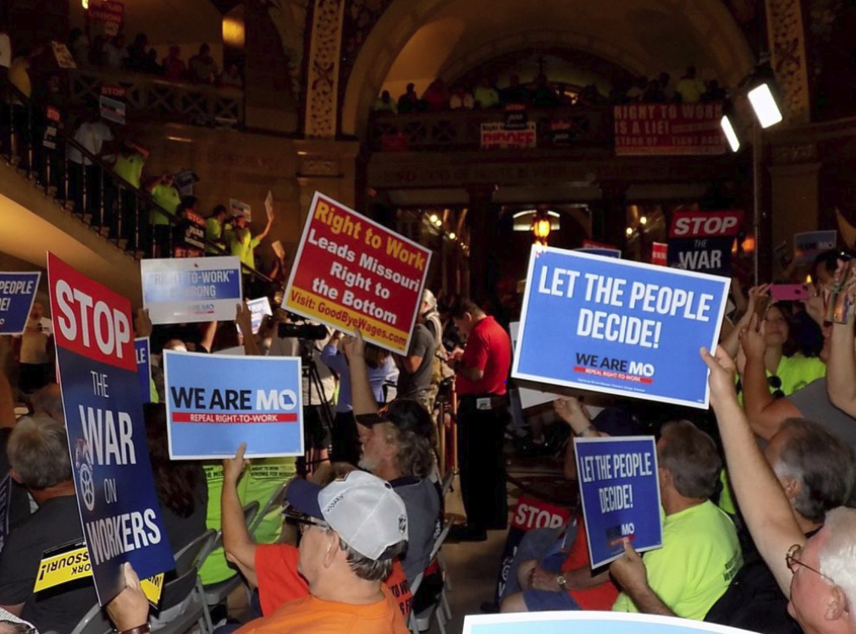
310,567 Missouri Workers and Allies Sign Petition to Repeal Right to Work – 2017
Notes:
Image and source: St. Louis Labor Tribune, August 28, 2017. Image may be subject to copyright. http://labortribune.com/photo-gallery-mass-turnout-for-rtw-repeal-rally-signature-turn-in-at-state-capitol/floor-signs/

Slide 56
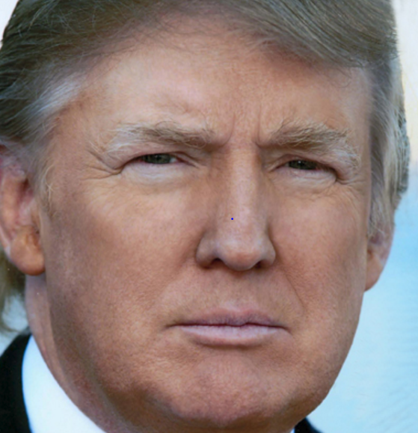
98% of Americans Believe Affordable Health Insurance is Important
“I was the 1st and only potential GOP candidate to state there will be no cuts to Social Security, Medicare and Medicaid.”
He has a “plan with a goal of ‘insurance for everybody.’”
Notes:
Quote: Donald J. Trump (@realDonaldTrump) May 7, 2015
Quote: Costa, Robert, Trump vows ‘insurance for everybody’ in Obamacare replacement plan, Washington Post, January 15, 2017.
Image: https://twitter.com/realdonaldtrump Image may be subject to copyright.
Quote: Wasik, John, “Three Ways Trump, GOP May Cut Social Security, Medicare,” Forbes, November 16, 2016. http://www.forbes.com/sites/johnwasik/2016/11/16/three-ways-trump-gop-may-cut-social-security-medicare/#724abc2b4e0e
Poll: Quinnipiac Poll, March 23, 2017 - https://poll.qu.edu/images/polling/us/us03232017_Ukqbwg46.pdf/

Slide 57
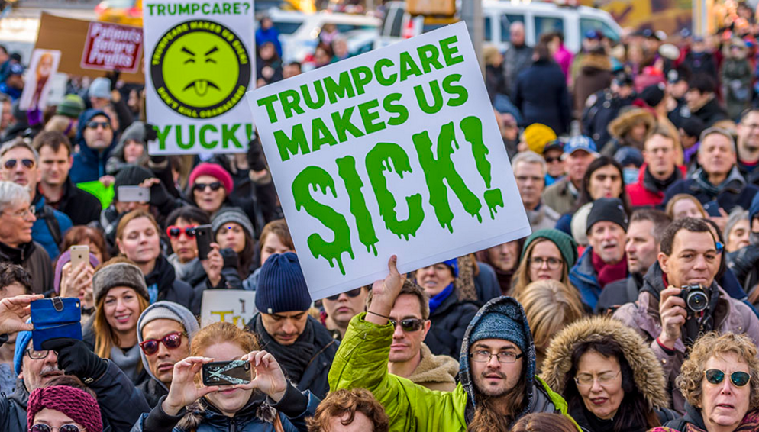
The People: 3 – Trumpcare: 0
Let’s Keep the Winning Streak Going!
Notes:
Image: Investor’s Business Daily. http://www.investors.com/politics/editorials/will-trumpcare-be-worse-than-obamacare/ May be subject to copyright.

Slide 58
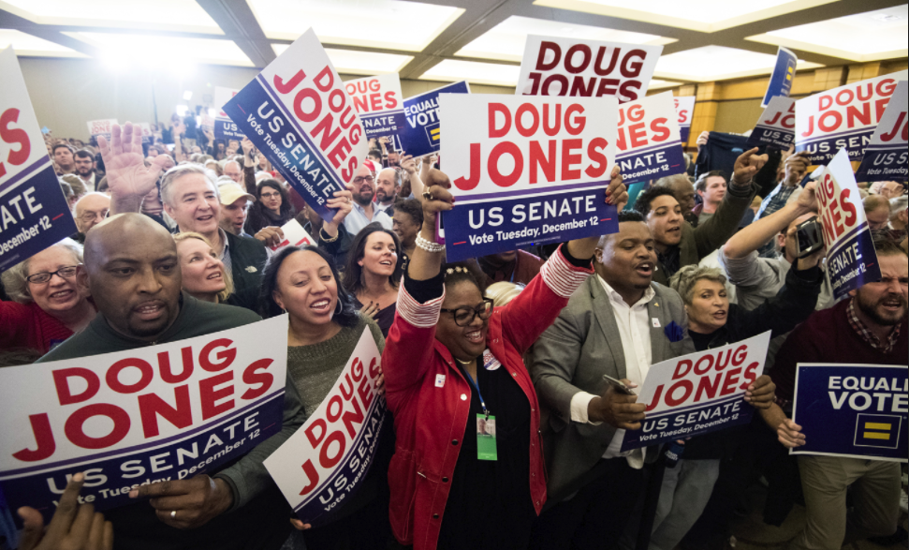
Black Women and Men, Mothers and Young Crush “King Bigot” Roy Moore – Dec. 2017
Notes:
Source: The Nation, December 13, 2017. https://www.thenation.com/article/black-voters-mothers-and-millennials-carried-doug-jones-to-victory/

Slide 59
The Great Lesson of Nazi Germany: When Should Solidarity Start?
First they came for the communists, and I said nothing, as I was not one of them.
Then they came for the socialists…
Then they came for the trade unionists…
Then the gays and lesbians…
Then the intellectuals…
Then the gypsies…
Then the Jews…
Then they came for me, and there was no one to speak for me.

Slide 60
An Injury to One is an Injury to All; Do We Really Mean It Today?
Where do you and your union fit in this?
First they attacked the ___, and I said nothing, as I was not one of them.
Then they attacked ___...
Then they attacked ___...
Then they attacked ___…
Then they attacked ___...
Then they attacked ___…

Slide 61
An Injury to One is an Injury to All; Do We Really Mean It? – Part 2
Then the ____…
Then the ____…
Then the ____…
Then the ____…
Then they came for me and there was no one to stand with me.
IF WE BELIEVE AN INJURY TO ONE IS AN INJURY TO ALL, WE MUST ALL STAND TOGETHER

Slide 62
100 years ago, many white union members and working people in our country made tragic mistakes by buying into bigotry, ignorance and tolerating injustice. In doing so they harmed the labor movement and our entire country.
Today we can and must make a different choice.

Slide 63
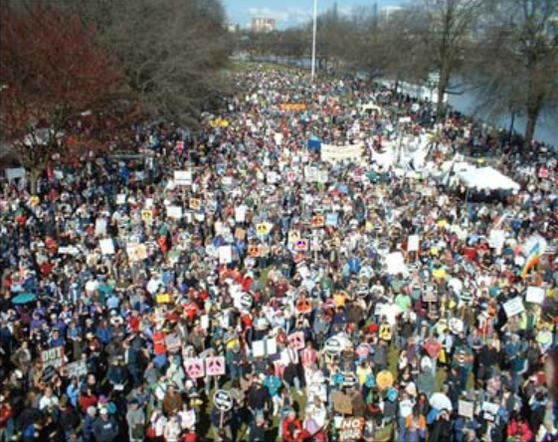
United We Can and Will Take Our Democracy and Country Back
The ultimate test of a person, a union, a movement and a people is not whether or not we get knocked down. It is what we do when we get up. Are we stronger, smarter, more determined, and more united?
This is always our choice.
Notes:
These young leaders are taking Margaret Mead’s famous quote to heart and taking action to build new movements. We must join with them. We need to remember that our ancestors faced great odds and obstacles to creating a better future. They won after decades of defeats. We face new yet similar challenges. Yes, we can.
Source: Quote: http://www.goodreads.com/author/quotes/61107.Margaret_Mead

Slide 64
Information Sources I Trust – Page 1
The Stand – WA State Labor Council daily newspaper – www.thestand.org
Trump Attacks on Labor – Economic Policy Institute - www.epi.org/policywatch/
The Nation – www.thenation.org
The American Prospect – www.prospect.org
The New York Times – www.nytimes.com
Democracy Now - www.democracynow.org
In These Times – www.inthesetimes.com

Slide 65
Information Sources I Trust – Page 2
Rachel Maddow - www.rachelmaddow.com
The Progressive – www.progressive.org
The Union Edge – https://theunionedge.com
Economic Policy Institute – www.epi.org
Center for Tax Justice – www.ctj.org
Brennan Center for Justice – www.brennancenter.org
Puget Sound Advocates for Retirement Security – www.psara.org

Slide 66
Mark M. McDermott www.markmmcdermott.com www.facebook.com/markmcdermottworkshops
Email: markmmcdermott1@msn.com

