Slide 1
Making the American Dream Real for Everyone
Cement Masons Local 528
May 12, 2018
Mark M. McDermott
www.markmmcdermott.com
markmmcdermott1@msn.com
www.facebook.com/markmcdermottworkshops
Notes:
I know that most, if not all, of you, are deeply concerned about economic hard times facing the people that you love and care about. We are also troubled by a growing feeling that the American Dream is being taken away from us. There is a growing sense that working hard and playing by the rules no longer guarantees a rising standard of living, greater opportunity for the people we love, and a secure retirement.
I want to tell you a three generation story of how working people like us struggled to create a better future for their descendants, broadened political and economic opportunity for more people, and created a better way of life.
It is a story of great victories and great defeats. It is a story of working together for the common good and being deeply divided by racism, sexism, anti-immigrant hostility and other forms of bigotry. It is a hopeful story as great defeats have been followed by great victories.
One of the fundamental truths of this story is that when we are united as a people we can create a better future. Unity alone does not guarantee progress, but deep disunity almost always guarantees defeat. People like us have changed the course of American history before and we can do it again. The question is how?
As I tell this story, many of you may feel that I did not give enough attention to specific issues. I acknowledge your concerns but trying to tell a 100+ year history in one presentation requires recognizing yet touching lightly on many important issues.

Slide 2
Finding Our Common Ground
How many of you:
Have relatives in the building trades unions?
Came from union families?
Have been in a union before?
Worked non-union in construction?
Were organized into the union?
Worked for low wages before joining the union?

Slide 3
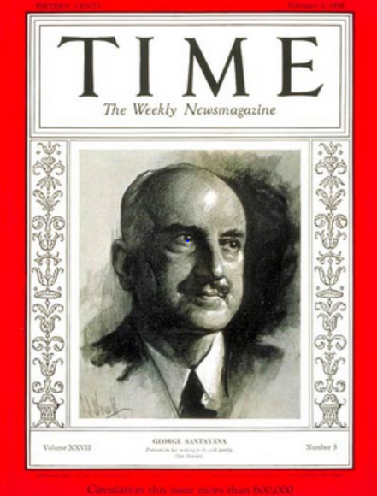
Our Stories Are the Game Films of History
“Those who cannot learn from history are doomed to repeat it. Those who do not remember their past are condemned to repeat their mistakes."
George Santayana, 1936
Notes:
Sources:
Image: http://www.time.com/time/covers/0,16641,19360203,00.html Image may be subject to copyright.

Slide 4
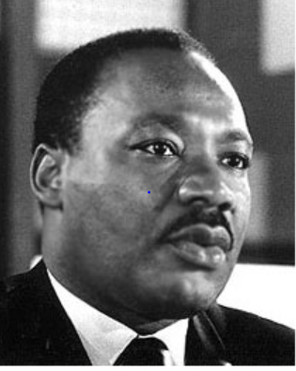
At Our Best, We are Heroes and Heroines of the American Dream
“The labor movement was the principal force that transformed misery and despair into hope and progress …The captains of industry did not lead this transformation.”
Rev. Dr. Martin Luther King Jr.
Notes:
Source:
Image: http://www.stmartin.edu/whatsnew/MediaReleases/images/MartinLutherKingJr.jpg Image may be subject to copyright.
Quote: Peter Bollen, Great Labor Quotations, page 138.

Slide 5
Building Our Movement and Power and Corporate America Counterattacking
Notes:
Source: Years 1890 - 1929, Vernon Briggs, Immigration and American Unionism, pages 71 and 113. Years 1930 -1970, U.S. Department of Commerce, “Historical Statistics of the U. S. – Colonial Times to 1970, page 178. Years 1971 to 2003, U.S. Department of Commerce, “Statistical Abstract of the U.S., several issues, tables typically labeled “Labor Union Membership by Sector. Years 2003 to 2016 Bureau of Labor Statistics. http://www.bls.gov/news.release/pdf/union2.pdf
Barry T. Hirsch and David A. Macpherson, "Union Membership and Coverage Database from the Current Population Survey: Note," Industrial and Labor Relations Review, Vol. 56, No. 2, January 2003, pp. 349-54. (in pdf) URL: http://www.unionstats.com/

Slide 6
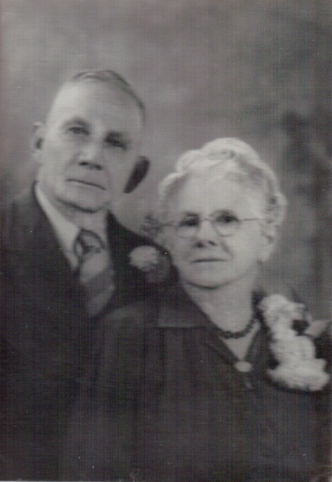
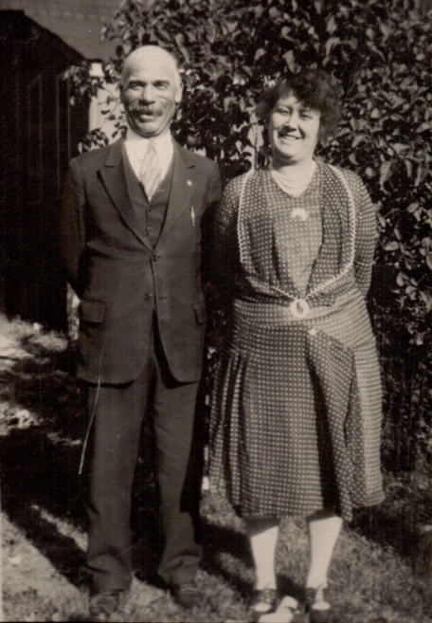
My McDermott and Wabel Grandparents
Child Laborers at Ages 10 and 12
Notes:
On the left are my Irish-American grandfather, Jim, with his wife Jane. On the right, are my German-American grandfather, Adelbert, and his wife Mabel. Grandfather Jim was pulled out of 3rd grade at age ten and sent to work in a brickyard. He worked for 65 years. Grandfather Adelbert was pulled out of 6th grade and sent to work. He worked until his untimely death.
Why were they pulled out of school? In a non-union corporate-dominated America, millions of working class parents could not support their families without the labor and wages of their children. Both of my grandparents had their childhoods stolen due to economic desperation and injustice. They never got a chance at an education and to reach for their dreams.

Slide 7

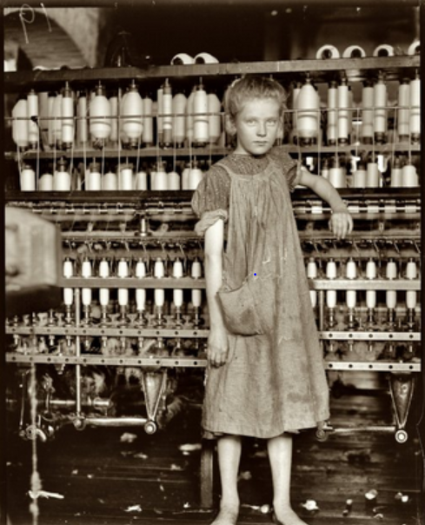
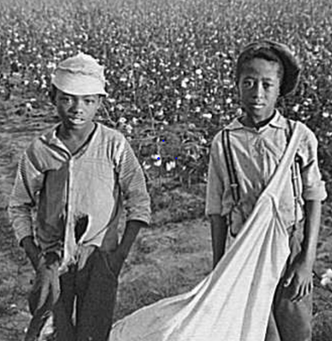
The most beautiful sight that we see is the child at labor. As early as he may get at labor, the more beautiful, the more useful does his life get to be.
Asa Griggs Candler, founder of Coca-Cola
Notes:
Sources:
Quote: Peter Bollen, Great Labor Quotations: Sourcebook and Reader, page 7.
Image: Coca-Cola - http://hu.wikipedia.org/wiki/Coca-Cola Image may be subject to copyright.
Image: http://newleftpatriot.blogspot.com/2005_03_01_archive.html Image may be subject to copyright.

Slide 8
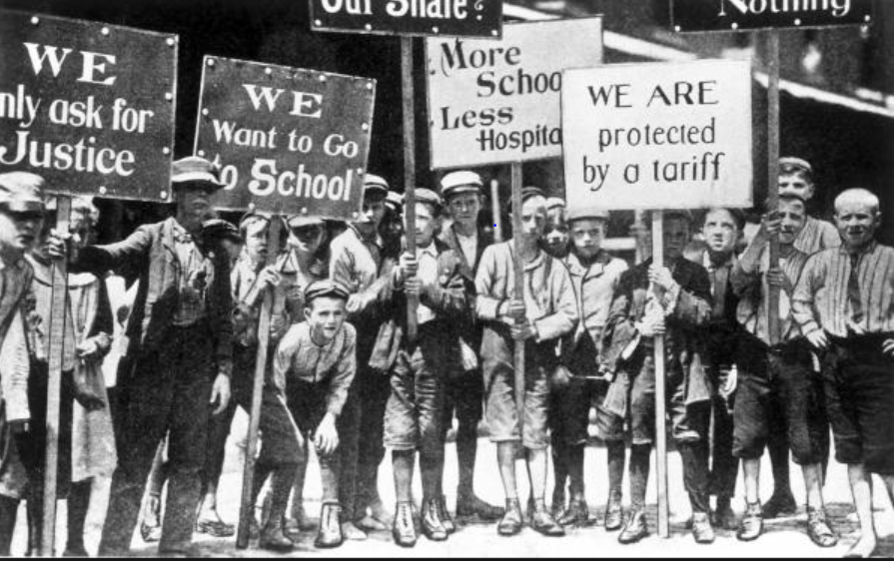
100,000 Strike for 55 Hour Week
16,000 Child Workers Join the Fight - 1903
Notes:
Image: http://teeniegehres.blogspot.com/2011_12_01_archive.html Image may be subject to copyright.
Quote and information: Susan Campbell Bartoletti, Kids on Strike, pages 1098 and 129.
“10-year old James Ashworth walked all day, carrying bundles of yarn from one department to the next. The bundles weighed 75 pounds. James’s stooped back and shoulders showed signs of deformity: he looked like an old man.”
The strike was broken after three months. Six years later, Pennsylvania passed a new child labor law outlawing child labor under the age of 14. The hour maximum was 58 hours.

Slide 9
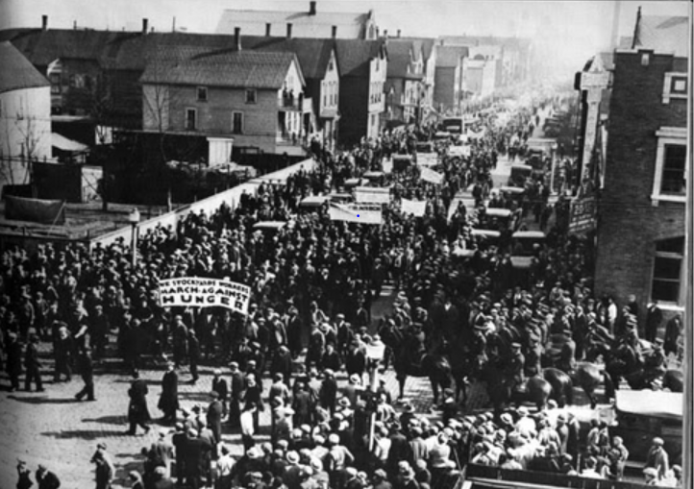
“We pursue policies to keep the races and nationalities apart…Stir up suspicion, rivalry and hatred among them.” – 1915
Philip Armour, CEO, world’s largest meatpacker
Notes:
Image: http://www.bobbosphere.org/2012/05/ Image may be subject to copyright.
Quote:

Slide 10
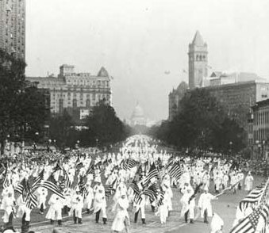
The Ku Klux Klan is Larger than the Labor Movement – 1925
Notes:
Source: Smithsonian National Museum of American History.

Slide 11
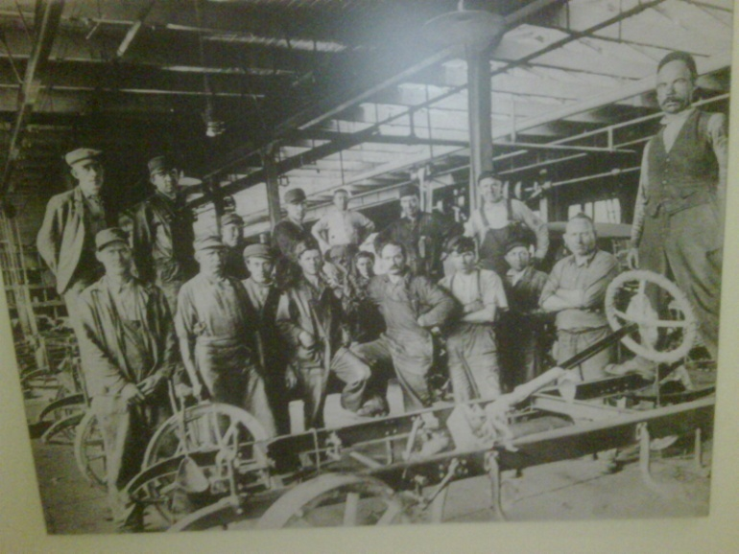
Grandpa Wabel Leaves Union Job for “Lifetime” Non-Union Job at Ford – 1925

Slide 12
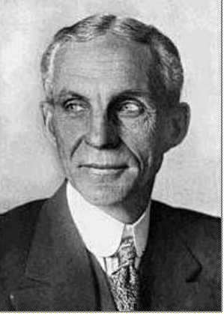
Henry Ford Lays Off 91,000 – 1931
“The average man won't really do a day's work unless he is caught and cannot get out of it. There is plenty of work to do if people would do it.”
Notes:
Source: Photo: Wisconsin Historical Society – 1997. Copyright. Quote: Howard Zinn, People’s History of the United States, page 378.

Slide 13
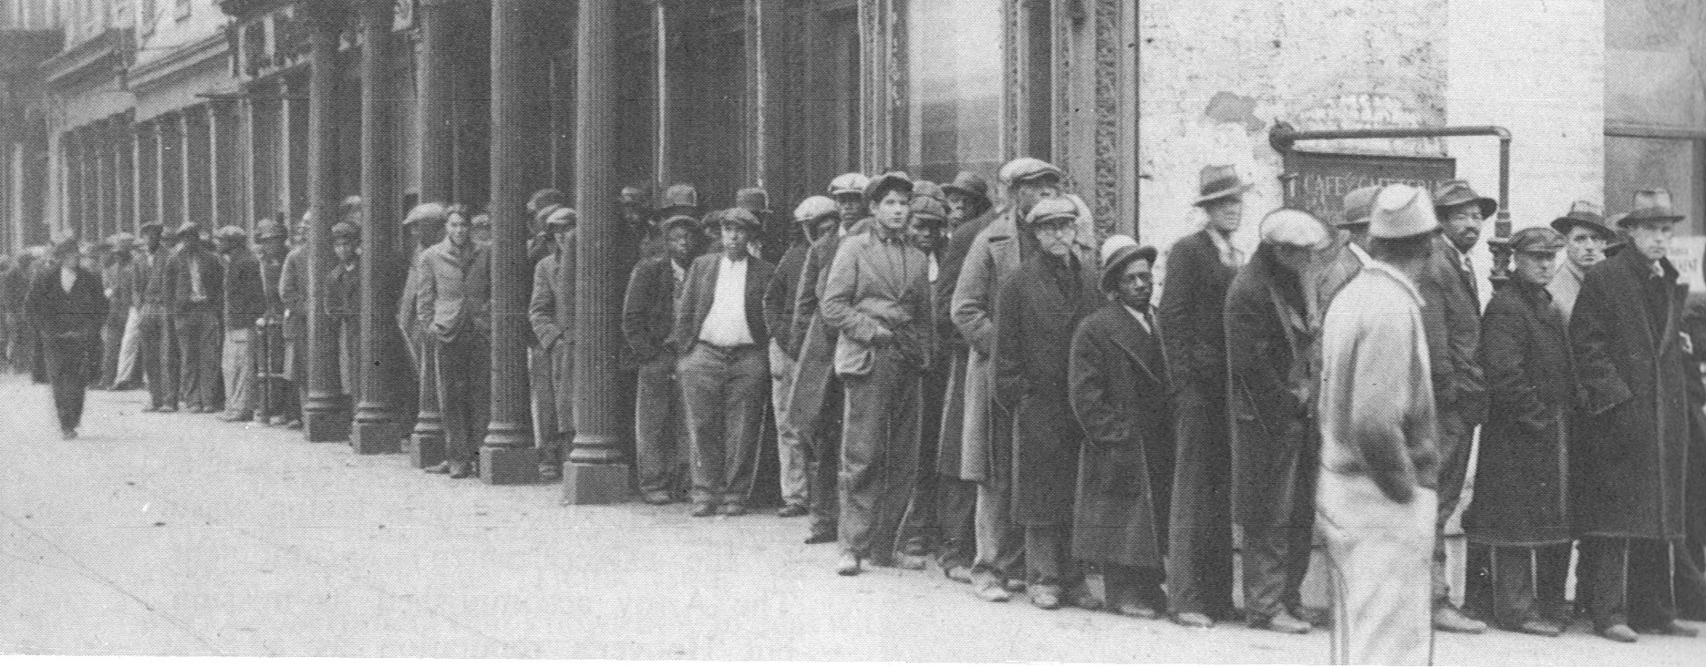
Wall Street Speculators and Big Business Crash the Economy – Tens of Millions Suffer – 1932
.
Notes:
Source: M. B. Schnapper, American Labor: A Bicentennial History, Public Affairs Press, 1975, page 462. Copyright.
COMMUNITY ORGANIZING RISES IN RESPONSE TO THE DEEPENING CRISIS.
By 1932, the Great Depression had reached its depths. The official national unemployment rate was 25 percent and the unofficial rate of working involuntarily working part-time was 35 percent. People of color were particularly hard hit.
For decades, Corporate America and their political allies had prevented legislation that would have provided unemployment insurance, adequate public assistance to the needy, affordable housing, badly needed food, social security for the elderly and the disabled, and an end of home and farm foreclosures. Working people, both employed and unemployed, were living in misery and desperation.
In midst of this untold and unjustified suffering, people began to organize particularly around issues of unemployment insurance, public assistance, affordable housing, social security. Massive demonstrations became a permanent part of the American story. Workers, whether employed or unemployed, the poor and the oppressed would not remain silent.

Slide 14
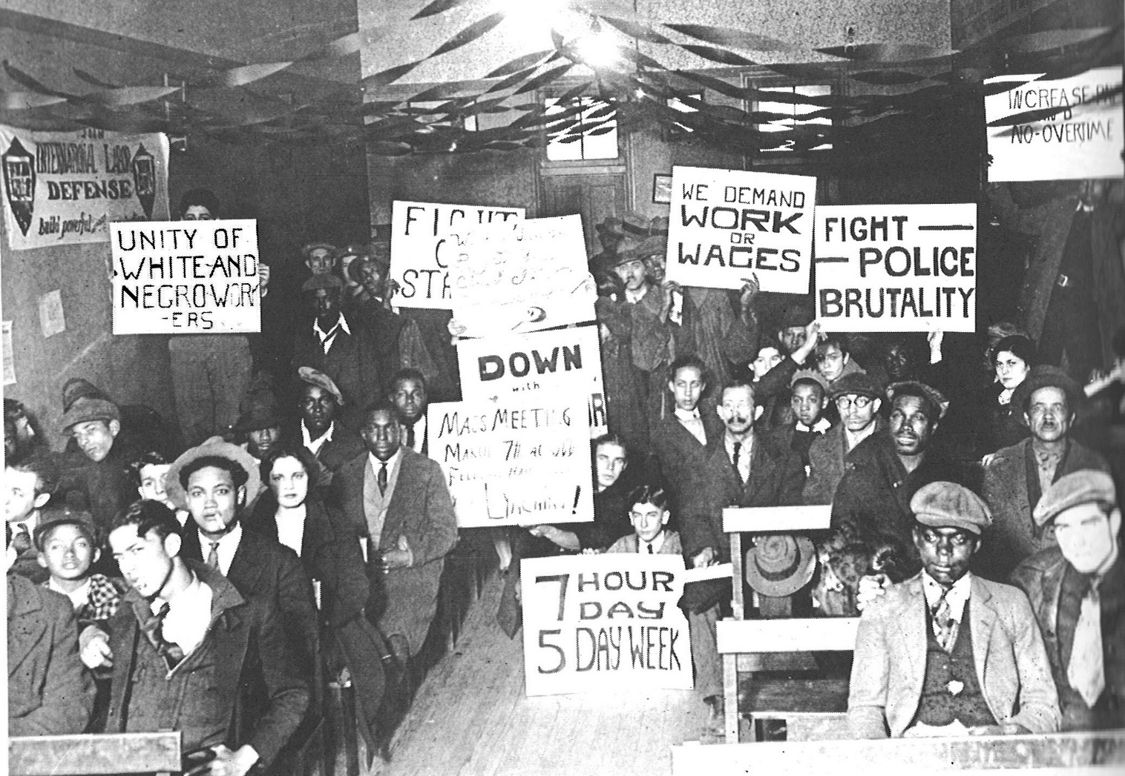
Growing Solidarity Between White and Black Workers – Early 1930s
Notes:
Source: M. B. Schnapper, American Labor: A Bicentennial History, Public Affairs Press, 1975, page 474. Copyright.
From the late 1790s to the early 1930s, the American labor movement largely excluded or restricted the membership of people of color. Many unions had outright bans while others restricted membership to segregated locals. This racist approach was both wrong but also played into the hands of the corporations that were determined to keep America non-union.
There were important exceptions to racial exclusion in the Mine Workers, the Amalgamated Clothing Workers, International Ladies Garment Workers and the Brewery Workers Unions. There were also many examples of white and people of color unionists joining together to build unions and demand justice on the job and in the larger community.
Racism, sexism, religious intolerance and anti-immigrant hatred divided the working class. By the early 1920s the Ku Klux Klan had 4 to 5 million members which is equivalent to 12 to 15 million members in 2011.
However, there was growing awareness among political radicals, progressive trade unionists and working class people that the struggle against racism and for genuine multi-racial unity was critical to creating a better life for all Americans. This awareness was being translated into movements of the unemployed and their families as well as organizing unions in the great mass production industries of auto, steel, meatpacking, rubber and others. A new consciousness was emerging out of a long history of racism and divisions among working people.

Slide 15
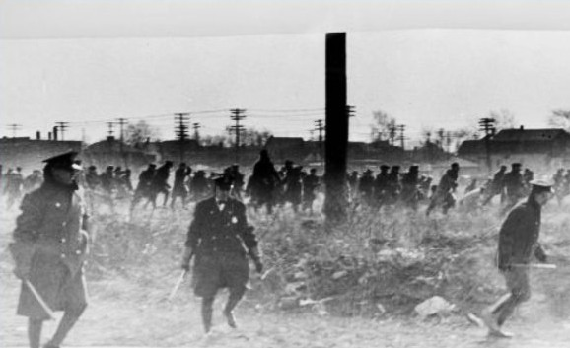
Police Kill 5 Ford Hunger Marchers
Dearborn Michigan – 1932
Notes:
Source: Wayne State University, Walter P. Reuther Library, Ford Hunger Strike Collection, #DN_77646_2,. Copyright. https://www.reuther.wayne.edu/print/7283

Slide 16
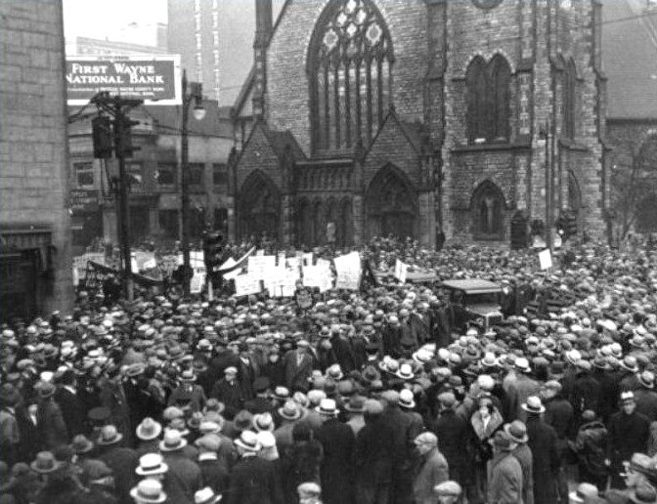
100,000 in Funeral Procession for Martyrs of Ford Hunger March Massacre
Notes:
Source: Wayne State University, Walter P. Reuther Library, Ford Hunger Strike Collection, #12273 Copyright. https://www.reuther.wayne.edu/print/7262

Slide 17
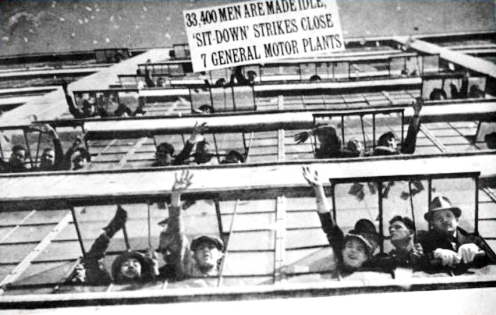
GM Sit-Down Strikers
Occupy Flint, Michigan - 1937
Notes:
Source: Wayne State University, Walter Reuther Library, Flint Sit-Down Strike Collection, #3991. Copyright. https://www.reuther.wayne.edu/node/3123
In January 1937, the small Autoworkers Union began massive sit-down strikes in the General Motors plants in Flint Michigan. GM was the largest and most powerful corporation in the world. They were the bedrock of anti-union corporate power.
At GM’s urging, Flint police attacked the sit-down strikers but were driven out of the plants by determined strikers and their supporters. At this point, the Union called for supporters to come for all over the Midwest to defend the sit-down strikers. Thousands came to Flint to defend the strikers and to hopefully prevent another massacre. This was the Occupy Flint movement of its time. They occupied the factories where wealth was being created. It was the Arab Spring of its time.

Slide 18
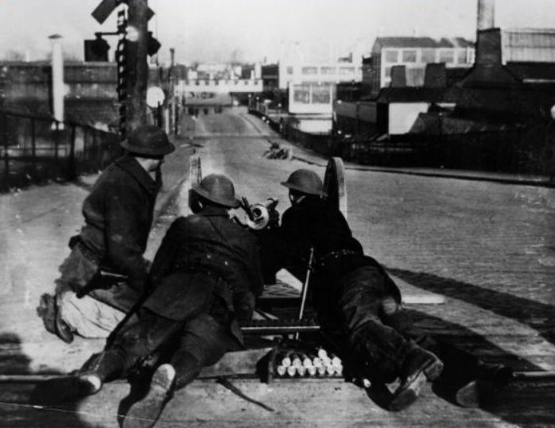
National Guard Occupies Flint
Notes:
Source: Wayne State University, Walter Reuther Library, Flint Sit-Down Strike Collection, #3991. Copyright. https://www.reuther.wayne.edu/node/3123

Slide 19
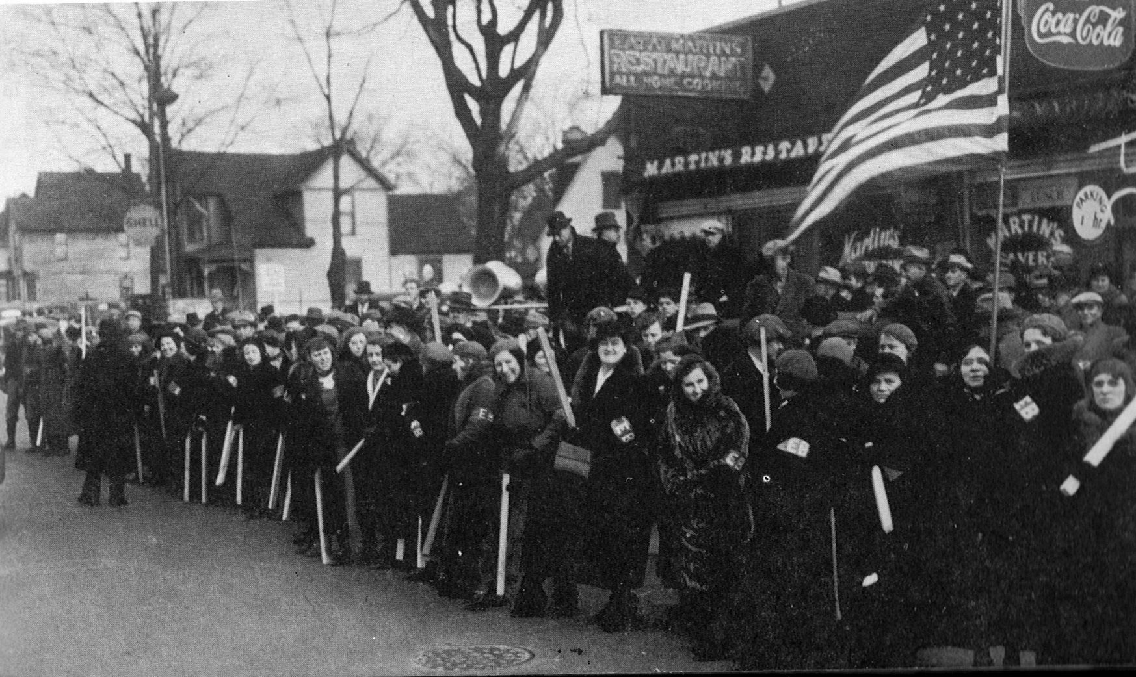
They carried themselves with a different walk, their heads were high, and they had confidence in themselves.”
Notes:
Source: M. B. Schnapper, American Labor: A Bicentennial History, Public Affairs Press, 1975, page 523. Copyright.
Armed with a court injunction, GM called on Governor Murphy to use the National Guard to drive the strikers out. The Governor refused. GM called on President Roosevelt to use the U.S. Army to drive them out. The President refused.

Slide 20
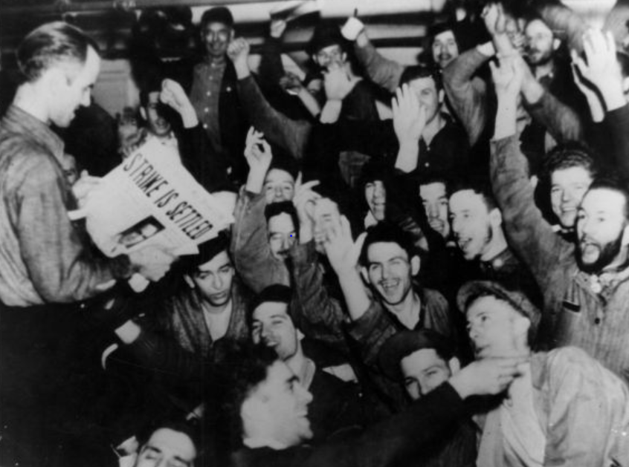
The Great Uprising of the People – 1937
UAW Defeats GM – Flint MI
Notes:
WE WON. THEY SAID WE COULDN’T FIND OUR COMMON GROUND, STICK TOGETHER AND DEFEAT THE MOST POWERFUL AND WEALTHIEST CORPORATION ON EARTH.
After a siege of 44 days, GM surrendered and signed a six month contract.
This was a turning point in American history.
A few months later, U.S. Steel, the world’s largest steel maker, surrendered and signed a contract with the new United Steel Workers Union without a strike. 18 years earlier, when 365 thousand steel workers struck for recognition, U.S. Steel had the support of the police and National Guard in Gary Indiana where 18 strikers were killed.
In 2 years, the percentage of unionized workers doubled to record highs. It was the rising of native born and foreign born, white and people of color, male and female workers. At long last, it was the time of the working class and their allies.
Source: https://www.reuther.wayne.edu/node/2068 Image may be subject to copyright.

Slide 21
The Great Uprising of the People Led by Labor Wins Great Victories in the 1930s
Right to organize unions and strong labor movement
Social Security and public assistance for poor families
Unemployment insurance, minimum wage and overtime pay, eight hour day and five day week
Child labor and child welfare protections
Strong regulation of financial industries
Farmworkers and domestic workers excluded from many rights and programs due to racism
Notes:
Increasing solidarity among working people – white and people of color; native-born and immigrant; people of various faith traditions; young and old; men and women; employed and unemployed – key to explosive growth in the labor movement and winning the New Deal reforms.
In the mid-1930s, most of the American people won Social Security, unemployment insurance, the right to organize unions, minimum wage and overtime pay, child welfare, public assistance for poor families, protections for bank deposits, assistance in buying homes and more.
After decades of defeats, working people had won many fundamental labor, economic and social rights in five years.

Slide 22
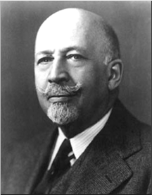
Growing Racial Solidarity
Key to Victories 1930-40s
“Probably the greatest and most effective effort toward interracial understanding has come through the trade unions…Probably no movement in the past 30 years has been so successful in softening race prejudice.”
W.E.B. DuBois – late 1940s

Slide 23
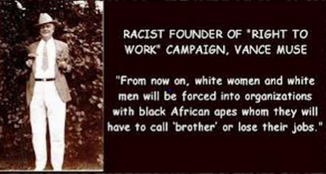
Corporate Divide and Conquer:
Right to Work = Union-Busting + Racism
Notes:
Source: http://www.criminalizeconservatism.com/2012_12_14_archive.html Image may be subject to copyright.

Slide 24
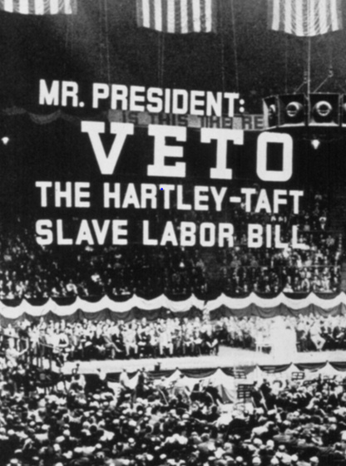
Corporate America’s Counterattack
Right to Work and Taft-Hartley Act – 1947
Right to work laws grant equal pay and benefits to workers who are not required to join the union or pay dues or fees.
Non-members have full rights to union protection including the union is required to protect them against management discipline.
Notes:
Image: http://teamster.org/content/teamster-history-visual-timeline
Source: Nicholson, Labor’s Story in the U.S., Pages 250-52.

Slide 25
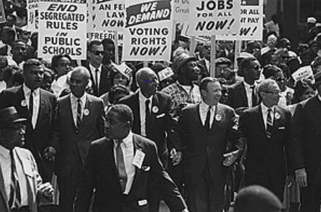
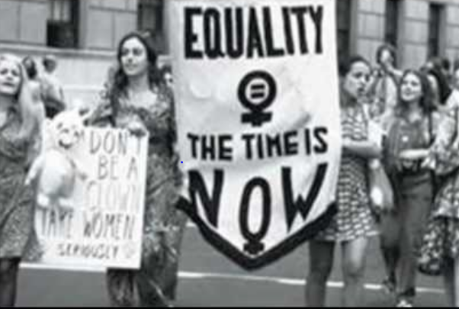
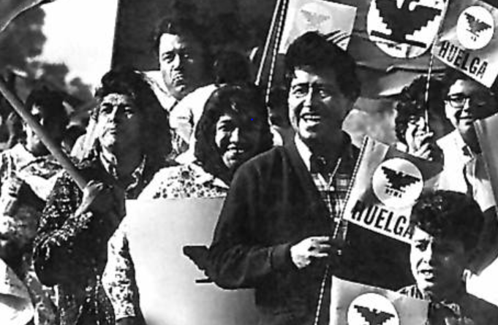
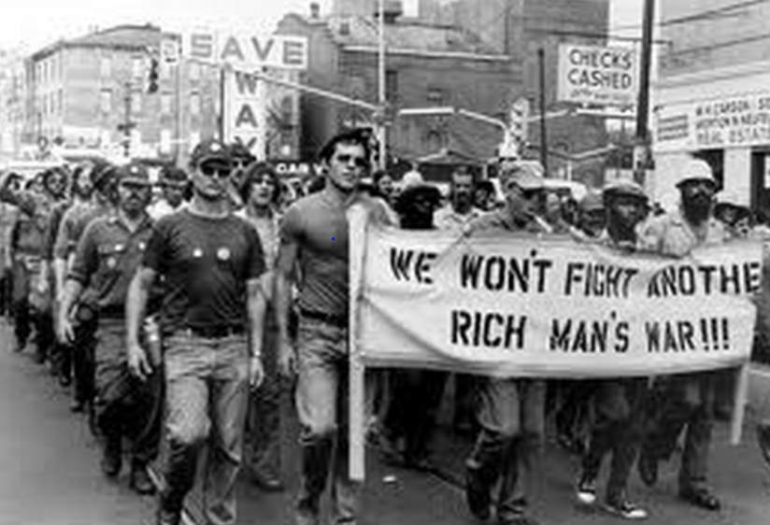
The Great Uprising of the People – 1960’s
Notes:
Sources:
Civil Rights: http://en.wikipedia.org/wiki/Civil_rights_movement Image may be subject to copyright.
Women’s Rights: http://www.youtube.com/watch?v=bX2hfiLEiiQ Image may be subject to copyright.
Viet Nam War: http://www.lpusd.k12.ca.us/rm1/online/hotpotatoestav/TAV17-3b.htm Image may be subject to copyright
Farmworkers: http://www.ncfh.org/?pid=4&page=2 Image may be subject to copyright.

Slide 26
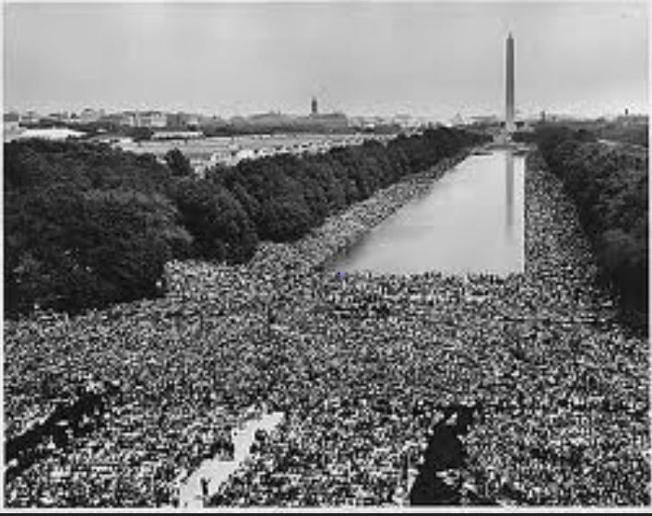
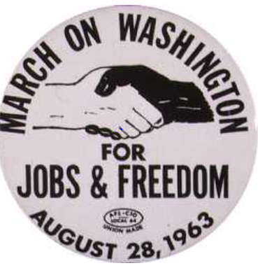
Fighting for Racial Justice
National AFL-CIO Refuses to Endorse
Notes:
Source: http://60snow.blogspot.com/2008_08_24_archive.html Image may be subject to copyright.
www.Heroesofcharacter.org Educator blog. Image may be subject to copyright.

Slide 27
Labor and Our Allies Win Historic People’s Victories –1960s and Early 1970s
Right to a safe workplace – OSHA
Health insurance and pensions
Civil Rights and Voting Right Acts
Medicare/Medicaid
Anti-poverty programs
Anti-discrimination laws
More college opportunities for working class/poor
Clean air and water protections
Notes:
These new movements led to many historic victories that expanded our democracy and economic opportunities for tens of millions of Americans. Once again the people had demonstrated their power to demand and win major changes. None of these victories were given to the people. They built power to make them a reality. It was the second great uprising of the people in the 20th century.
These victories had very direct impacts on my family. My unemployed autoworker grandfather Wabel died at age 53 lacking affordable health care that might have saved his life. In sharp contrast, my beloved mother and father died in their 90s with access to some of the best health care in the world at the University of Washington. They were poor but the victories of Medicare, Medicaid and Social Security coupled with the support of their children ensured that they died in dignity. My grandfather died one of the wretched of the earth with no justice in his death. My parents died with dignity and justice. It was the victorious struggles of working people, organized labor and their many allies that gave them the help they needed as they aged.

Slide 28
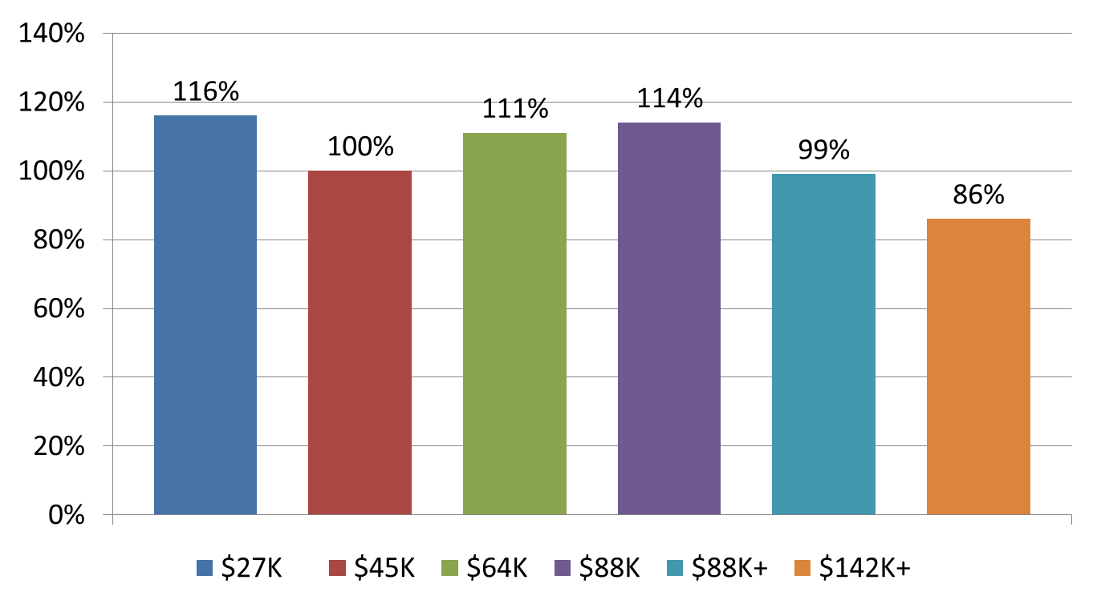
We Organized and Won Decades of Shared Prosperity – 1947-1979
Notes:
Source: Mishel and Bernstein, The State of Working America 1994-95, M.E. Sharpe, 1994, page 37. U.S. Census Bureau, Historical Income Tables. F-1 for income ranges in 2010 dollars and F-3 for income changes. http://www.census.gov/hhes/www/income/data/historical/families/index.html

Slide 29
Corporate America Stealing our Shared Prosperity – 1979-2016
Notes:
Source: U.S. Census Bureau, Historical Income Tables. F-1 for income ranges in 2016 dollars and F-3 for income changes. https://www.census.gov/data/tables/time-series/demo/income-poverty/historical-income-families.html
Top 0.01% 1979 to 2005. Congressional Budget Office, “Historical Effective Tax Rates,” 2008., Table 3. http://www.cbo.gov/ftpdocs/98xx/doc9884/12-23-EffectiveTaxRates_Letter.pdf

Slide 30
The Super-Rich Stealing our Shared Prosperity – 1979-2016
Richest 13,000 families’ average income rises 315%. Their minimum income is $12.1 million and their average income is $36.8 million in 2012
Notes:
Source: U.S. Census Bureau, Historical Income Tables. F-1 for income ranges in 2016 dollars and F-3 for income changes. http://www.census.gov/hhes/www/income/data/historical/families/index.html Top 0.01% 1979 to 2005. Congressional Budget Office, “Historical Effective Tax Rates,” 2008., Table 3. http://www.cbo.gov/ftpdocs/98xx/doc9884/12-23-EffectiveTaxRates_Letter.pdf
https://www.cbo.gov/sites/default/files/110th-congress-2007-2008/reports/12-23-effectivetaxrates_letter.pdf
IRS, “Individual Income Tax Shares, 2012,” http://www.irs.gov/pub/irs-soi/soi-a-ints-id1506.pdf

Slide 31
Public Opinion Poll

Slide 32
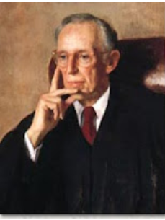
Future U.S. Supreme Court Justice Lewis Powell’s Secret Memo – August 23, 1971
Decades-long strategy for corporate domination
Win the war of big ideas
Build national idea machine
Relentless political attacks
Notes:
Source: Greenpeace. http://www.greenpeace.org/usa/en/campaigns/global-warming-and-energy/polluterwatch/The-Lewis-Powell-Memo/

Slide 33
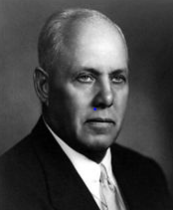
Strategic Mistakes Affect Us to This Day
“I used to worry about the size of the membership. I stopped worrying because it doesn’t make any difference. The organized fellow is the only fellow who matters.”
George Meany, President, AFL-CIO, 1972
Notes:
Sources:
Quote: http://www.baclocal7.org/history.aspx?zone=History&pID=1631
Image: http://en.wikipedia.org/wiki/George_Meany Image may be subject to copyright.

Slide 34
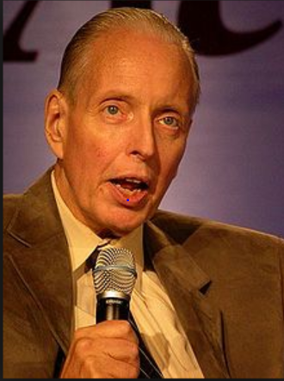
Corporate Attacks on Democratic Elections
“ I don’t want everybody to vote…our leverage in the elections quite candidly goes up as the voting populace goes down.”
Paul Weyrich, 1980. Co-founder of the Heritage Foundation.
Notes:
Source:
Image: http://en.wikipedia.org/wiki/Paul_Weyrich Image may be subject to copyright.
Quote: Robert McChesney, Digital Disconnect, page 59.
Note: Co-founder of the Heritage Foundation, largest conservative think tank in WA D.C. and partially funded by Charles Koch Foundation and other right-wing billionaires.

Slide 35
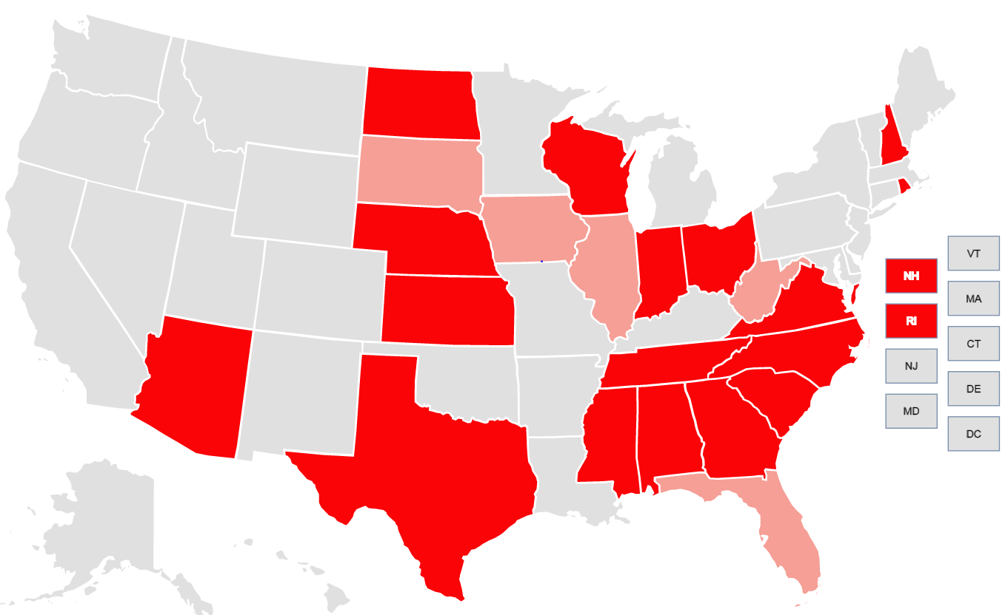
Supreme Court Aids in Voter Suppression New Restrictions in 2012 and 2016
Notes:
Source: Brennan Center for Voting Rights. https://www.brennancenter.org/voting-restrictions-first-time-2016 Image may be subject to copyright.
Light red shows restriction in place in 2012
Dark red shows restriction in place for 2016

Slide 36
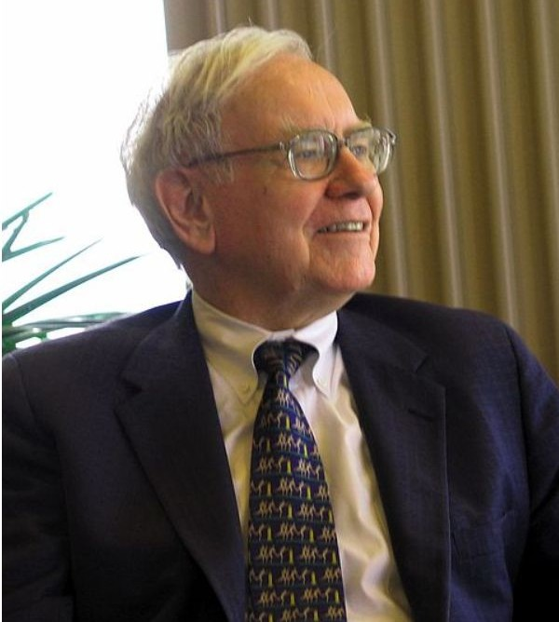
Corporate America Declares War On America’s Workers: 1980 to Present
“There’s Class Warfare, all right. But it’s my class, the rich class, that’s making war, and we’re winning.”
Warren Buffett, World’s Third Richest Man
Notes:
Source: Wikipedia. http://en.wikipedia.org/wiki/File:Warren_Buffett_KU_Visit.jpg

Slide 37
Corporate America’s Class Warfare
Crush organized labor
Promote free trade and export manufacturing
Buy elections with big money
Voter suppression
Deregulate financial industries and corporations
Cut social programs for poor, unemployed and needy
Cut taxes on corporations and the wealthy
Privatize government
Divide and conquer
Notes:
The major victories of the 1960s and the early 1970s caused great alarm among corporate America, their right wing political allies and corporate mainstream politicians. Many of these victories coupled with an upsurge in labor unrest threatened many of their fundamental interests and furthered limited their power and freedom. Corporate America desperately wanted to regain political dominance and greater freedom from government control and strong unions.
On August 23, 1971, Lewis Powell, wrote a famous confidential memo to the U.S. Chamber of Commerce calling for a major counterattack by corporate America. http://reclaimdemocracy.org/corporate_accountability/powell_memo_lewis.html This memo along with the writings of other corporate allies laid the foundation for the corporate counterattack that helped achieve the election of Ronald Reagan in 1980s and a fundamental shift in American economic and political life.
The key elements and messages of the strategy are listed above. They also included the importance of winning the battle for the future vision of the country coupled with values, themes and messages that would become the dominant view of our future. This battle of ideas would be supported by the creation of many think tanks, endowment of chairs in university economics departments and business schools, attacks on leftist and progressive intellectuals, strengthening lobbying efforts, dominating the media and building powerful and well-funded permanent political and election campaign organizations. Crushing unions would be key.
What were the results? We have already seen the dramatic shift to economic inequality. Long gone were the days of a rising tide would lift all boats.

Slide 38
What Do The American People Think of Organized Labor?

Slide 39
Which Groups Do You Think Are Most Favorable to Unions?
18-29 years old
30-49 years old
50-64 years old
65+
Men or Women

Slide 40
Do You Have a Favorable View of Unions?
Pew Research – January 2017
Notes:
Source: Pew Research Center, “Most Americans see labor unions, corporations favorably,” January 30, 2017. http://www.pewresearch.org/fact-tank/2017/01/30/most-americans-see-labor-unions-corporations-favorably/

Slide 41
Women Are More Favorable to Unions than Men – Gallup Poll – 2015
Notes:
Source: Gallup Poll, 2015. http://www.gallup.com/poll/184622/americans-support-labor-unions-continues-recover.aspxq

Slide 42
Low Wage Workers Are Overwhelmingly Pro-Union – 2015
Notes:
Source: National Employment Law Project, http://www.nelp.org/content/uploads/Low-Wage-Worker-Survey-Memo-October-2015.pdf

Slide 43

Republican Convention Calls for National Right to Work and Repeal of Davis-Bacon
2016 Platform
National Right to Work Law
Repeal prevailing wage (Davis-Bacon)
Ban project labor agreements
No federal minimum wage. Currently $7.25.
Notes:
Image: http://wksu.org/post/what-could-extended-republican-national-convention-mean-cleveland#stream/0 Image may be subject to copyright.
Source: Republican Platform 2016. https://prod-static-ngop-pbl.s3.amazonaws.com/media/documents/DRAFT_12_FINAL[1]-ben_1468872234.pdf

Slide 44
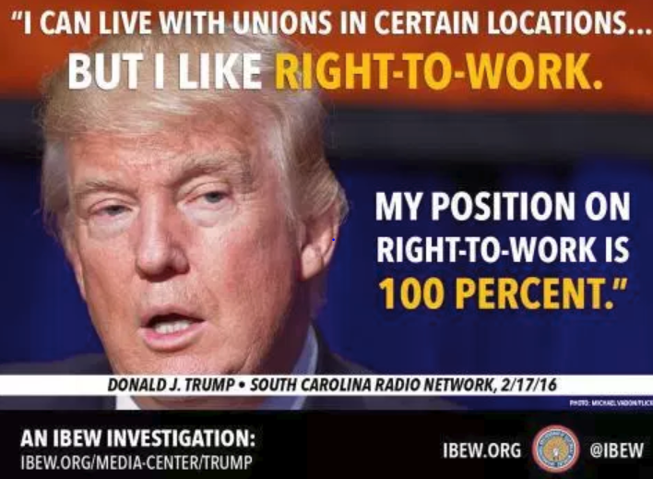
Notes:
Image: http://www.ibew553.org/labor/unions-in-the-trump-era/ Image may be subject to copyright.
Source: South Carolina Radio Network, February 17, 2016. http://www.southcarolinaradionetwork.com/2016/02/17/trump-backs-off-on-break-with-party-can-live-with-unions-at-certain-locations-interview/

Slide 45
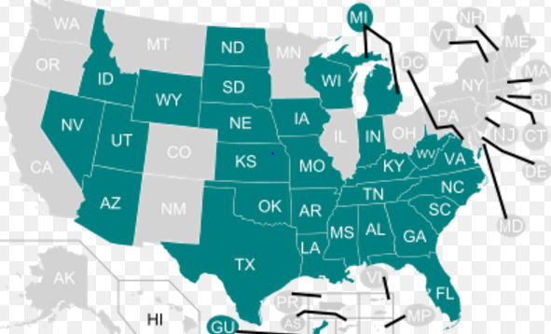
Corporate Class Warfare – 2017
Right to Work for Less
Notes:
Source: https://en.wikipedia.org/wiki/Right-to-work_law

Slide 46
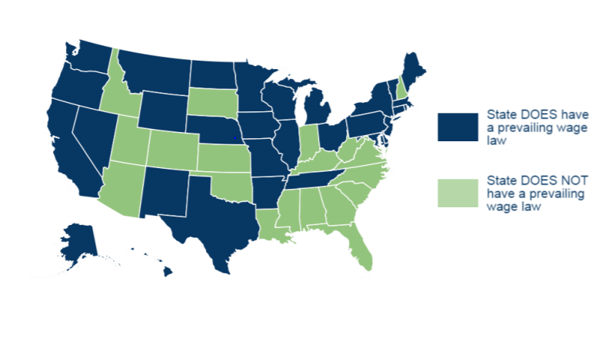
Corporate Class Warfare on the Building Trades and Prevailing Wage – 2017
Notes:
Image: Council of State Governments, “Trends in Prevailing Wage Laws,”, page 2. http://knowledgecenter.csg.org/kc/system/files/CR_wagelaws%202017.pdf

Slide 47
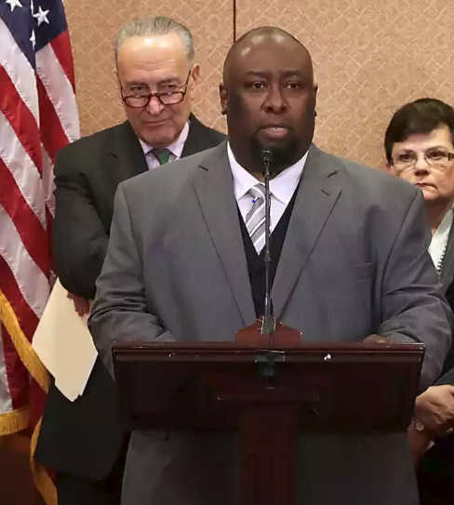
Trump Supreme Court Nominee Gorsuch: OK to Fire Trucker Fearing Death
27 Below Zero
Brakes Frozen on Truck Trailer
Fearing Death
Alphonse Maddin Disobeyed Order
10th Circuit Rules 6-1 in His Favor
Notes:
Image and Source: Joanne Walters, :”When Neil Gorsuch put corporate interests over a man freezing to death, The Guardian, March 23, 2017. https://www.theguardian.com/law/2017/mar/23/neil-gorsuch-supreme-court-frozen-trucker-alphonse-maddin

Slide 48
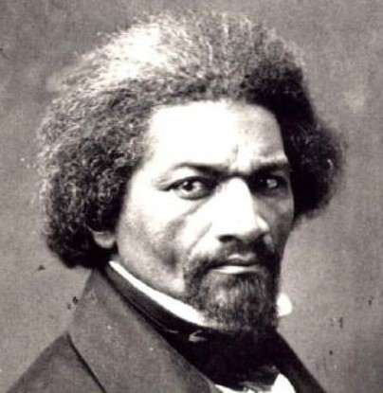
We Are Building A New Great Uprising of the People: Finding Hope and Getting Active
“If there is no struggle, there can be no progress…find out what any people will quietly submit to and you will have found out the exact measure of injustice and wrong which will be imposed upon them.”
Frederick Douglass, 1857

Slide 49
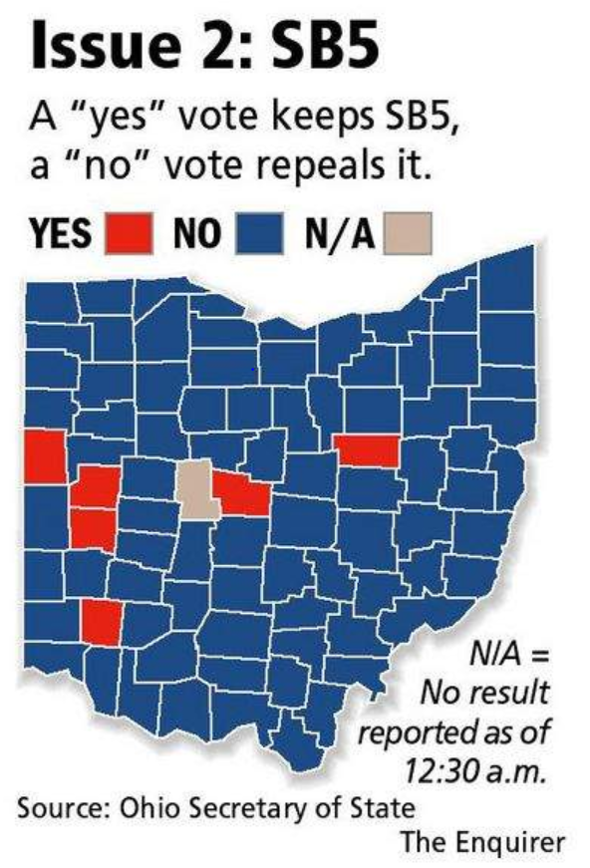
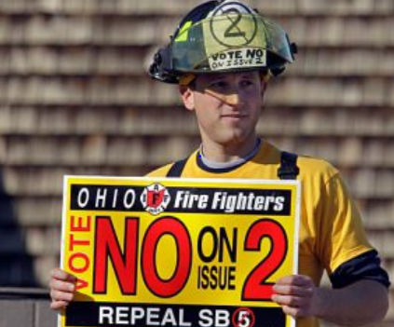
Labor/Community Alliance Crush the Union Busters in Ohio – 62% to 38% – 2011
Notes:
Sources:
http://mirroronamerica.blogspot.com/2011_11_01_archive.html
http://news.cincinnati.com/article/20111108/NEWS0108/111090341/Issue-2-rejected-overturning-SB-5 Image may be subject to copyright.
In 2011, OOC and Stand Up for Ohio played a critical role in the defeat of SB5 (the collective bargaining attack in Ohio). Together, the organizations hired a team of 12 staff to coordinate outreach to churches, veterans, students, community groups, and other non- labor allies across the state;

Slide 50
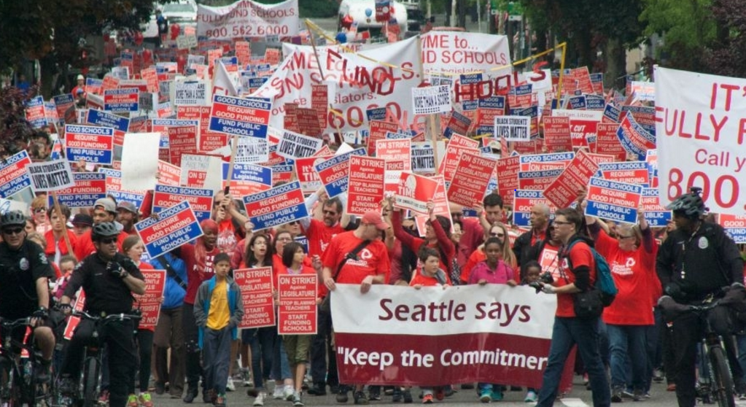
Students, Parents and Teachers Win Big in Seattle Strike – 2015
Notes:
Source: http://www.commondreams.org/news/2015/09/11/wont-back-down-seattle-teacher-strike-continues-third-day Image may be subject to copyright.

Slide 51
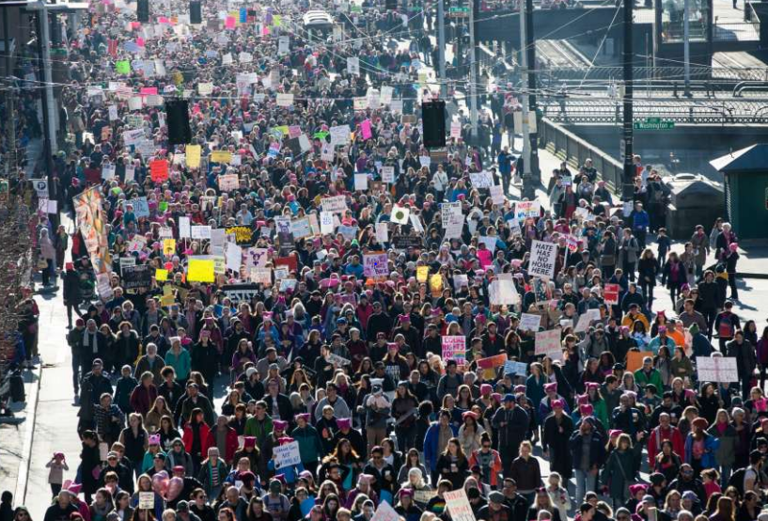
Historic Women’s Marches:
The People Are Rising – 2017
Notes:
Image: http://www.seattlepi.com/elections/article/Women-allies-march-on-Seattle-10872707.php#photo-12233902 Image may be subject to copyright.
The historic and extremely large women‘s marches of January 21, 2017 brought millions of women and men, young and old, people of color and white, citizens and non-citizens, and LGBT and straight in to the streets as a massive show of unity and solidarity to fight forward and move our country toward a better future. The time is now

Slide 52
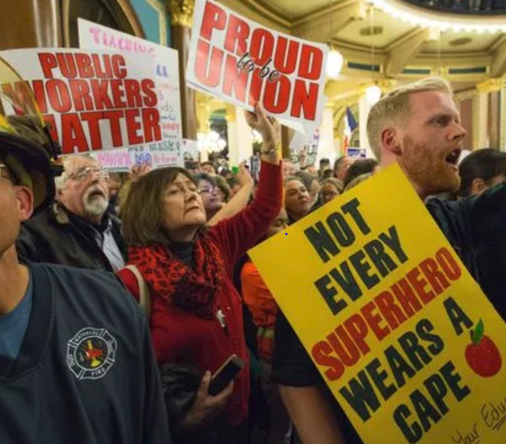
Who Says We Can’t Win Big?
Crushing the Union Busters in Iowa with Internal Organizing – 2017
Voting to recertify their unions:
28,448 – Yes
624 – No
98% - Yes
88% - Turnout
Notes:
Source: Des Moines Register, April 28, 2017. http://www.desmoinesregister.com/story/opinion/readers/2017/04/28/union-members-vote-their-dues-every-month/307683001/ Image may be subject to copyright.
Source: Des Moines Register, October 25, 2017. http://www.desmoinesregister.com/story/news/politics/2017/10/25/iowa-union-recertification-voting-results/797879001/

Slide 53
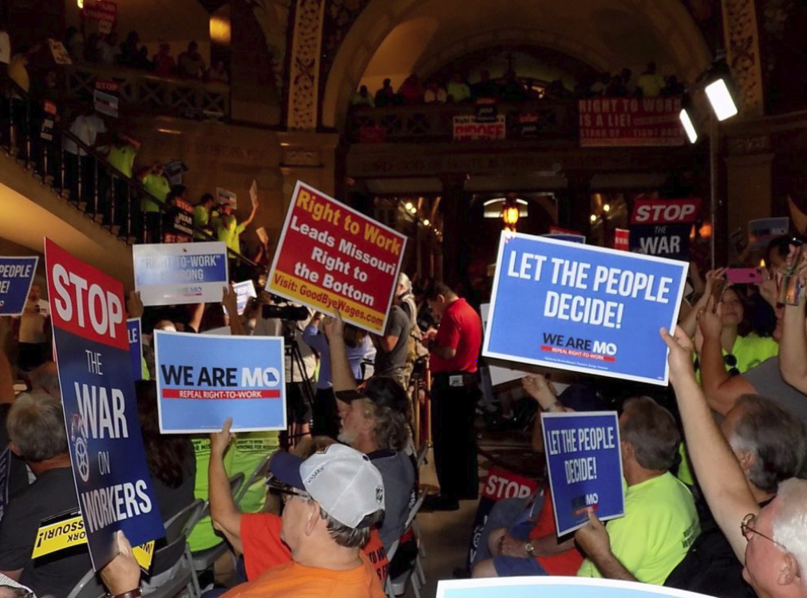
310,567 Missouri Workers and Allies Sign Petition to Repeal Right to Work – 2017
Notes:
Image and source: St. Louis Labor Tribune, August 28, 2017. Image may be subject to copyright. http://labortribune.com/photo-gallery-mass-turnout-for-rtw-repeal-rally-signature-turn-in-at-state-capitol/floor-signs/

Slide 54
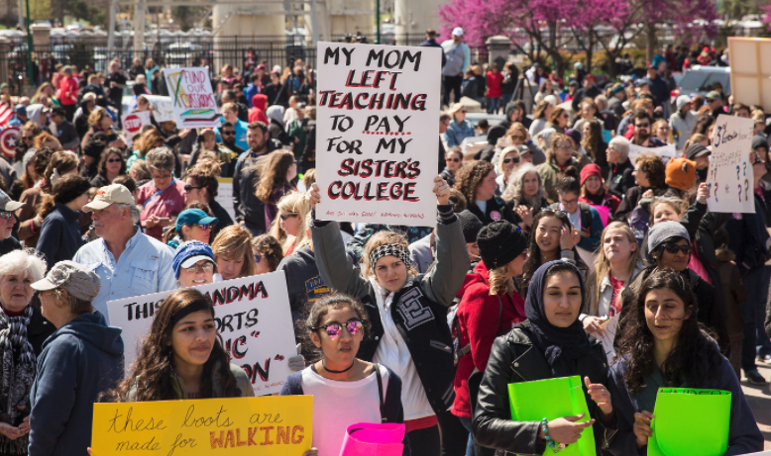
“We Elected the Wrong People”
10 Years No Raise - Oklahoma Teachers Strike and Win $6,000 Raise – 2018
Notes:
Image: Time magazine. April 9, 2018. http://time.com/5233965/oklahoma-teachers-strike-extension/ Image may be subject to copyright.
Source: No raise for ten years. NewsOK. January 22, 2018. http://newsok.com/article/5580331/oklahoma-teachers-continue-wait-for-pay-raise-a-decade-after-last-increase
Source: $6,000 pay raise. “Oklahoma Teachers End Walkout After Winning Raises and Additional Funding.” New York Times. April 12, 2018. https://www.nytimes.com/2018/04/12/us/oklahoma-teachers-strike.html

Slide 55
We Defeat Repeal of Federal Davis-Bacon (Prevailing Wage) – July 26, 2017
The U.S. House vote:
All 191 Democrats Voted No Repeal
178 Republicans Voted to Repeal
Notes:
Source: https://www.congress.gov/amendment/115th-congress/house-amendment/227
http://clerk.house.gov/evs/2017/roll419.xml

Slide 56
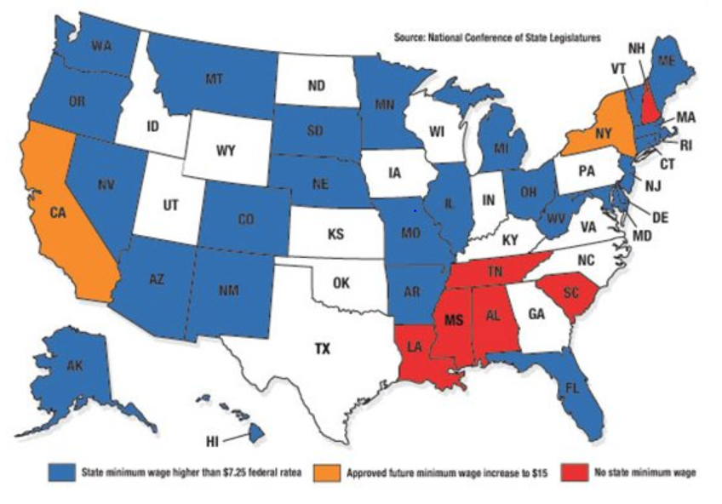
Fighting for All Workers, We Raise Minimum Wage for Tens of Millions in 29 States – 2018
Notes:
Source: State Net Capitol Journal, December 31, 2017. 29 States have higher minimum wage than U.S.
https://www.lexisnexis.com/communities/state-net/b/capitol-journal/archive/2016/05/20/majority-of-states-have-minimum-wage-higher-than-federal-standard.aspx

Slide 57
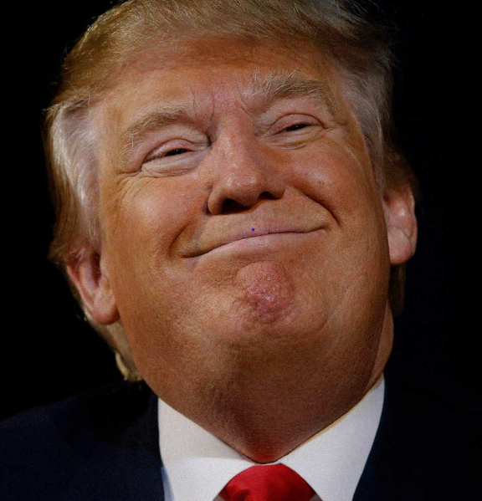
Spreading Hatred to Divide and Conquer 2016
“When Mexico sends its people, they’re not sending their best…They’re bringing drugs and crime. They’re rapists. And some, I assume, are good people.”
“I can never apologize for the truth.”
Notes:
Image: http://michaelmoore.com/trumpwillwin/ Image may be subject to copyright.
Quote: http://www.washingtonpost.com/blogs/fact-checker/wp/2015/07/08/donald-trumps-false-comments-connecting-mexican-immigrants-and-crime/
Source: Cato Institute, Criminal Immigrants: Their Numbers, Demographics and Countries of Origin, March 15, 2017. https://object.cato.org/sites/cato.org/files/pubs/pdf/immigration_brief-1.pdf
“All immigrants are less likely to be incarcerated than natives relative to their shares of the population. Even illegal immigrants are less likely to be incarcerated than native-born Americans.”

Slide 58
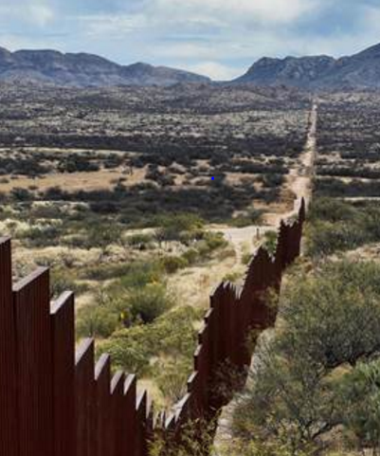
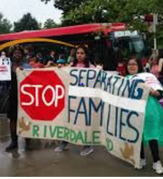
People Support Path to Citizenship: 70-25%
Oppose Mexican Wall: 62-35%
Notes:
Images: http://www.nbcnews.com/news/us-news/trump-suggests-canceling-meeting-mexico-s-president-after-shots-fired-n712461 Image may be subject to copyright.
Image: http://americasvoice.org/blog/united-states-trump-dreamers-parents-u-s-citizens-detained-deported/
Source: Path - http://edition.cnn.com/election/results/exit-polls/national/president
Source: Wall - http://www.pewresearch.org/fact-tank/2017/02/24/most-americans-continue-to-oppose-u-s-border-wall-doubt-mexico-would-pay-for-it/

Slide 59

120,000-Member NYC Teamsters District Council 16 Says: “We Are a Sanctuary Union!”
Eber Garcia Vasquez
26-year member deported
Father of 4
Grandfather of 3
Disabled wife
Fled Guatemala after his mother and other family members killed in civil war.
Notes:
Image: Teamsters Joint Council 16, http://teamsters.nyc/2017/09/06/teamster-eber-garcia-vasquez-deported-ice/ Image may be subject to copyright.
Sources: http://teamsters.nyc/2017/09/06/teamster-eber-garcia-vasquez-deported-ice/
http://teamsters.nyc/2017/09/13/new-york-teamsters-become-sanctuary-union-following-deportation-union-member/

Slide 60

We Can Not Let History Repeats!
We Must Unite Against Hate
Charlottesville VA
White Supremacists
KKK
Neo-Nazis
One of the chants was:
“We will not be ruled by Jews.”
Notes:
Image: Dallas Weekly News, http://www.dallasweekly.com/news/national/article_5c3677ec-3b3f-11e7-bee2-6bf5a938c6c9.html Image may be subject to copyright.

Slide 61

United We Can Change Our World
The ultimate test of a person, a union, a movement and a people is not whether or not we get knocked down. It is what we do when we get up. Are we stronger, smarter, more determined, and more united?
This is always our choice.

Slide 62
DISCUSSION
What ideas and ideas came up for you today?
How would you like to be involved in your union?

Slide 63
Information Sources I Trust – Page 1
The Stand – WA State Labor Council daily newspaper – www.thestand.org
Trump Attacks on Labor – Economic Policy Institute - www.epi.org/policywatch/
The Nation – www.thenation.org
The American Prospect – www.prospect.org
The New York Times – www.nytimes.com
Democracy Now - www.democracynow.org
In These Times – www.inthesetimes.com

Slide 64
Information Sources I Trust – Page 2
Rachel Maddow - www.rachelmaddow.com
The Progressive – www.progressive.org
The Union Edge – https://theunionedge.com
Economic Policy Institute – www.epi.org
Center for Tax Justice – www.ctj.org
Brennan Center for Justice – www.brennancenter.org
Puget Sound Advocates for Retirement Security – www.psara.org

Slide 65
Mark McDermott www.markmmcdermott.com
Facebook: markmcdermottworkshops markmmcdermott1@msn.com

