Slide 1
Fighting for Our Unions, Our Democracy and Our Future
Pacific Northwest Regional Council of Carpenters
February 15, 2018
Mark M. McDermott
www.markmmcdermott.com
www.facebook.com/markmcdermottworkshops

Slide 2
What Will We Do Today?
Find our common ground
What does the war on workers look like?
What do Americans think about unions?
Divide and conquer in the past
Labor and our allies fighting forward in the past
Group exercise on income inequality
Divide and conquer today
Labor and our allies fight forward today
What have we learned?

Slide 3
Finding Our Common Ground
How many of you, your close friends or members of your or their extended families have or are experiencing any of the following in recent years?
Lost a job or can’t find a full-time good job
Paying the bills or rent is hard
Worried about adequate income in retirement
Discriminated against because of who they are
College is too expensive or large student loans
Lost or didn’t have health insurance
Were not paid wages that were legally owed
Worried about rising racism, sexism and bigotry

Slide 4
Do you feel the federal government is dominated by Corporate America and is more concerned about corporations and the wealthy than people like you?

Slide 5
Do you believe Corporate America and their political allies are trying to destroy our movement and steal the future from you and the people you love?

Slide 6
How do you feel about these problems facing you, your family, and your friends and their families?
Notes:
Many of you have shared the hard times that you and those you love and care about have been having. I would like you to share how feel about these hard times. Again if you do not feel comfortable doing so, don’t feel pressured to do so. At the same, I encourage everyone to participate.
Please turn to the person next to you. Each of you talk for one minute about how you feel about your hard times.
Let’s have 10 or 12 of you report out to the group one or two words or a short phrase that captures a key feeling. We don’t have time for long report outs.
I will write them down on the easel pad.
Last question: How many of you feel hopeful that we, the people, can take control of our country again and move it back in the direction of a brighter present and future for all? Please raise your hands.

Slide 7
Do you want to take back our country and government and create a better future for you, your family, and your communities?

Slide 8
Do you believe your union and our movement needs more active members and community allies to rebuild our power and create a better future for all of us?

Slide 9
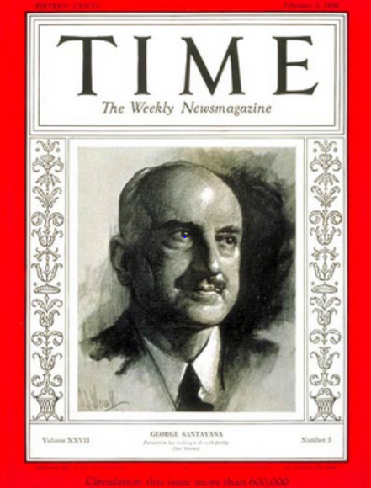
Our Stories Are the Game Films of History
“Those who cannot learn from history are doomed to repeat it. Those who do not remember their past are condemned to repeat their mistakes."
George Santayana, 1936
Notes:
Sources:
Image: http://www.time.com/time/covers/0,16641,19360203,00.html Image may be subject to copyright.

Slide 10
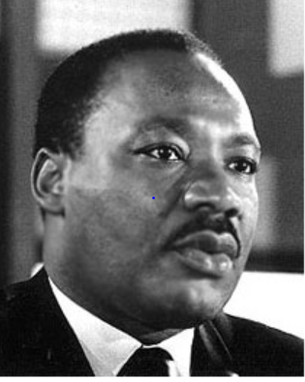
At Our Best, We are Heroes and Heroines of the American Dream
“The labor movement was the principal force that transformed misery and despair into hope and progress …The captains of industry did not lead this transformation; they resisted until they were overcome”
Rev. Dr. Martin Luther King Jr.
Notes:
Source:
Image: http://www.stmartin.edu/whatsnew/MediaReleases/images/MartinLutherKingJr.jpg Image may be subject to copyright.
Quote: Peter Bollen, Great Labor Quotations, page 138.

Slide 11
Corporate America Knows Dr. King is Right
Solution: Destroy Our Movement
Notes:
Source: Years 1890 - 1929, Vernon Briggs, Immigration and American Unionism, pages 71 and 113. Years 1930 -1970, U.S. Department of Commerce, “Historical Statistics of the U. S. – Colonial Times to 1970, page 178. Years 1971 to 2003, U.S. Department of Commerce, “Statistical Abstract of the U.S., several issues, tables typically labeled “Labor Union Membership by Sector. Years 2003 to 2016 Bureau of Labor Statistics. http://www.bls.gov/news.release/pdf/union2.pdf
Barry T. Hirsch and David A. Macpherson, "Union Membership and Coverage Database from the Current Population Survey: Note," Industrial and Labor Relations Review, Vol. 56, No. 2, January 2003, pp. 349-54. (in pdf) URL: http://www.unionstats.com/

Slide 12
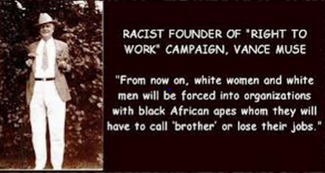
Corporate Divide and Conquer:
Right to Work = Union-Busting + Racism
Notes:
Source: http://www.criminalizeconservatism.com/2012_12_14_archive.html Image may be subject to copyright.

Slide 13
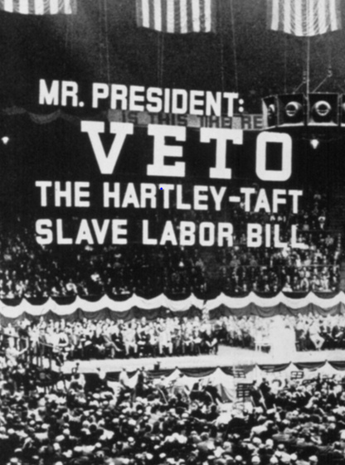
Corporate America’s Counterattack
Right to Work and Taft-Hartley Act – 1947
State right to work laws grant equal pay and benefits to workers who are not required to join the union or pay dues or fees.
Non-members have full rights to union protection including the union is required to protect them against management discipline.
Notes:
Image: http://teamster.org/content/teamster-history-visual-timeline
Source: Nicholson, Labor’s Story in the U.S., Pages 250-52.

Slide 14

Republican National Platform
National Right to Work Law
Repeal prevailing wage (Davis-Bacon)
Ban project labor agreements
No federal minimum wage. Currently $7.25.
Notes:
Image: http://wksu.org/post/what-could-extended-republican-national-convention-mean-cleveland#stream/0 Image may be subject to copyright.
Source: Republican Platform 2016. https://prod-static-ngop-pbl.s3.amazonaws.com/media/documents/DRAFT_12_FINAL[1]-ben_1468872234.pdf

Slide 15
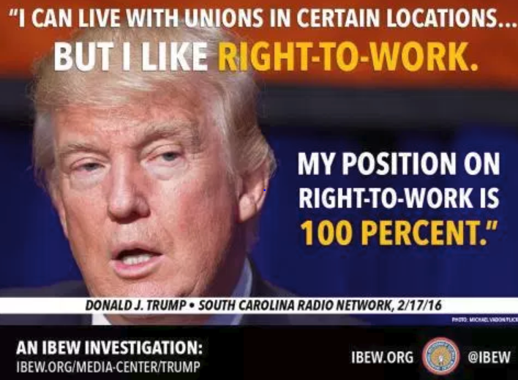
Notes:
Image: http://www.ibew553.org/labor/unions-in-the-trump-era/ Image may be subject to copyright.
Source: South Carolina Radio Network, February 17, 2016. http://www.southcarolinaradionetwork.com/2016/02/17/trump-backs-off-on-break-with-party-can-live-with-unions-at-certain-locations-interview/

Slide 16
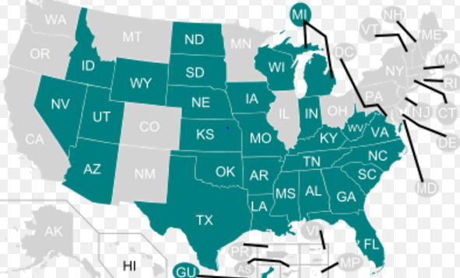
Corporate Class Warfare – 2017
Right to Work for Less
Notes:
Source: https://en.wikipedia.org/wiki/Right-to-work_law

Slide 17
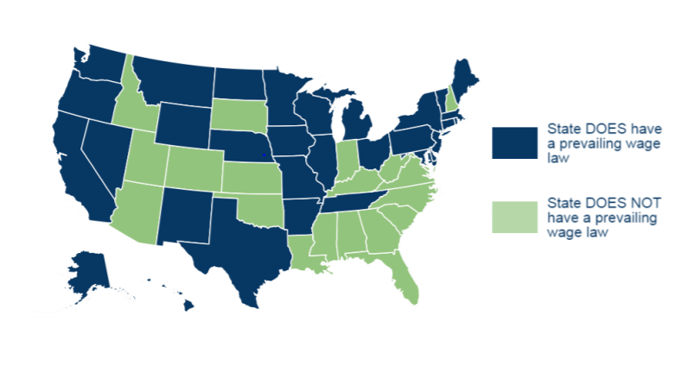
Corporate Class Warfare on the Building Trades and Prevailing Wage – 2017
Notes:
Image: Council of State Governments, “Trends in Prevailing Wage Laws,”, page 2. http://knowledgecenter.csg.org/kc/system/files/CR_wagelaws%202017.pdf

Slide 18
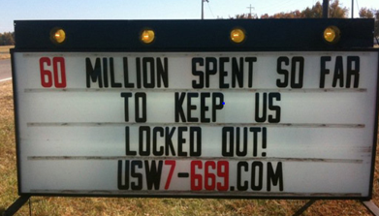
Department of Labor is Repealing Rule that Exposes Union Busters – June 12, 2017
Notes:
Image: Source unknown
Source: http://www.epi.org/blog/by-rescinding-the-persuader-rule-trump-is-once-again-siding-with-corporate-interests-over-working-people/
https://www.federalregister.gov/documents/2017/06/12/2017-11983/rescission-of-rule-interpreting-advice-exemption-in-section-203c-of-the-labor-management-reporting

Slide 19
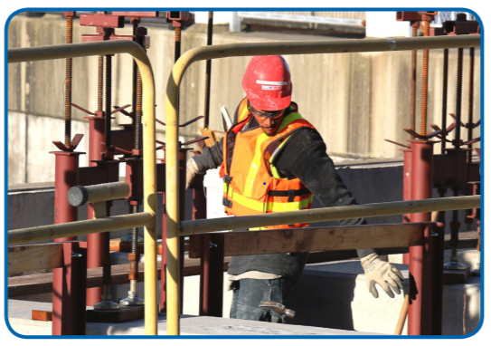
USDOT Kills Pilot Program for Local Hire Agreements in PLA’s – August 25, 2017
Former pre-apprentice and current Laborers apprentice
Notes:
Image:
http://www.seattle.gov/Documents/Departments/FAS/PurchasingAndContracting/Labor/PH_Legislation201501.pdf
Source: http://jobstomoveamerica.org/trump-administration-drops-local-hire-program-employed-hundreds-thousands-americans-communities/

Slide 20
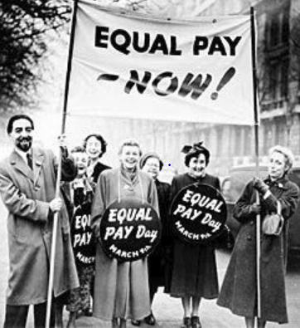
Trump Blocks EEOC Rule Requiring Pay Data by Job, Sex, Race and Ethnicity
How is equal pay for equal work served by ending requirement that large employers must report pay by job, sex, race and ethnicity?
Notes:
Image: https://www.pinterest.com/pin/74098356340130498 Image may be subject to copyright.
Source: http://www.epi.org/perkins/trump-administration-stays-ee0-1-pay-data-rule/

Slide 21
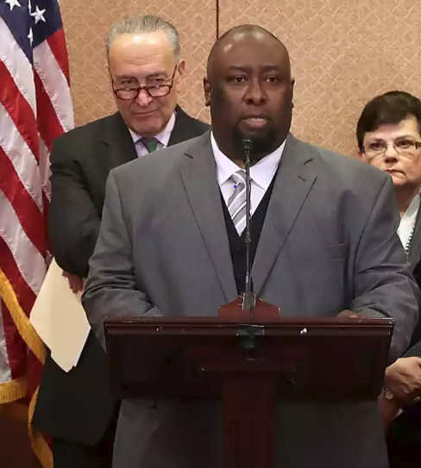
Trump Supreme Court Nominee Gorsuch: OK to Fire Trucker Fearing Death
27 Below Zero
Brakes Frozen on Truck Trailer
Fearing Death
Alphonse Maddin Disobeyed Order
10th Circuit Rules 6-1 in His Favor
Notes:
Image and Source: Joanne Walters, :”When Neil Gorsuch put corporate interests over a man freezing to death, The Guardian, March 23, 2017. https://www.theguardian.com/law/2017/mar/23/neil-gorsuch-supreme-court-frozen-trucker-alphonse-maddin

Slide 22
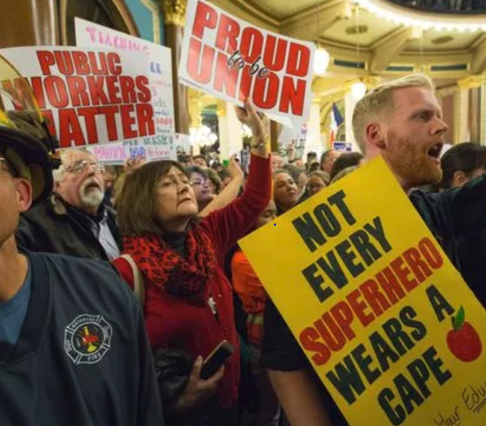
Who Says We Can’t Win Big?
Crushing the Union Busters in Iowa with Internal Organizing – 2017
Voting to recertify their unions:
28,448 – Yes
624 – No
98% - Yes
88% - Turnout
Notes:
Source: Des Moines Register, April 28, 2017. http://www.desmoinesregister.com/story/opinion/readers/2017/04/28/union-members-vote-their-dues-every-month/307683001/ Image may be subject to copyright.
Source: Des Moines Register, October 25, 2017. http://www.desmoinesregister.com/story/news/politics/2017/10/25/iowa-union-recertification-voting-results/797879001/

Slide 23
Gallup Poll: Do You Approve of Unions?
Highest Percentage Support Since 2003
Notes:
Sources:
Gallup: Do You Approve or Disapprove of Labor Unions?
Pew: Labor Unions are Necessary to Protect the Working Person
Source: http://www.gallup.com/poll/217331/labor-union-approval-best-2003.aspx?version=print
Gallup Poll, http://www.gallup.com/poll/184622/americans-support-labor-unions-continues-recover.aspxq
Pew Research Center for the People and the Press, “Trends in Political Values and Core Attitudes: 1987-2012, page 157. http://www.people-press.org/2012/06/04/partisan-polarization-surges-in-bush-obama-years/
1987, 1988, 1989 Gallup added 1991, 2001, 2004, 2005, 2006, 2008, 2010, 2011 Pew added. Data points added to provide smooth lines. Data is consistent with overall trends.

Slide 24
Which Groups Do You Think Are Most Favorable to Unions?
18-29 years old
30-49 years old
50-64 years old
65+
Men or Women

Slide 25
Do You Have a Favorable View of Unions?
Pew Research – January 2017
Notes:
Source: Pew Research Center, “Most Americans see labor unions, corporations favorably,” January 30, 2017. http://www.pewresearch.org/fact-tank/2017/01/30/most-americans-see-labor-unions-corporations-favorably/

Slide 26
Women Are More Favorable to Unions than Men – Gallup Poll – 2015
Notes:
Source: Gallup Poll, 2015. http://www.gallup.com/poll/184622/americans-support-labor-unions-continues-recover.aspxq

Slide 27
Low Wage Workers Are Overwhelmingly Pro-Union – 2015
Notes:
Source: National Employment Law Project, http://www.nelp.org/content/uploads/Low-Wage-Worker-Survey-Memo-October-2015.pdf

Slide 28
Why Do You Think Public Support for Unions Is Rising Again?
Why Do You Think Women, Young People and People of Color Are the Most Pro-Labor Groups?

Slide 29
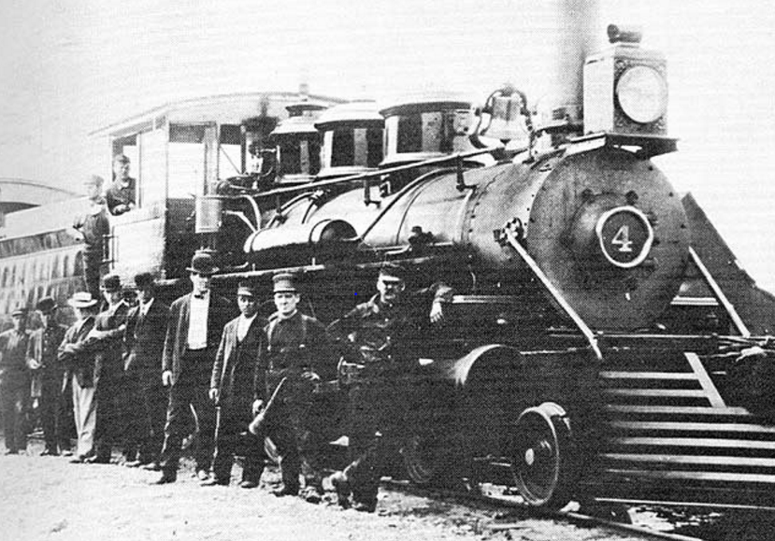
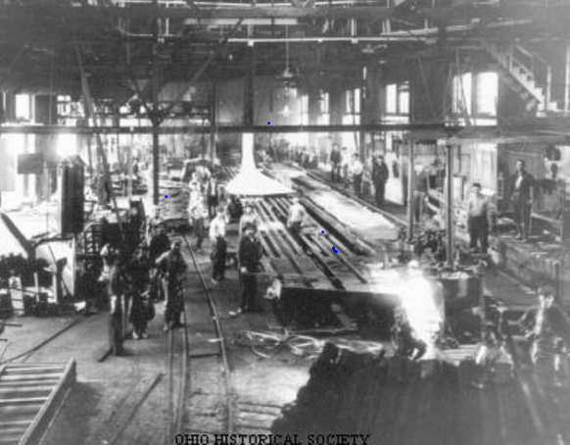
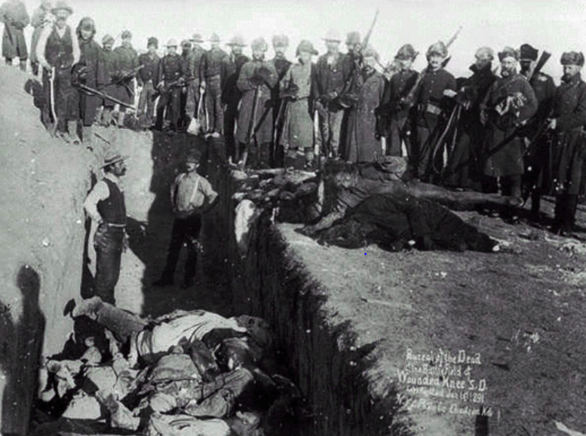
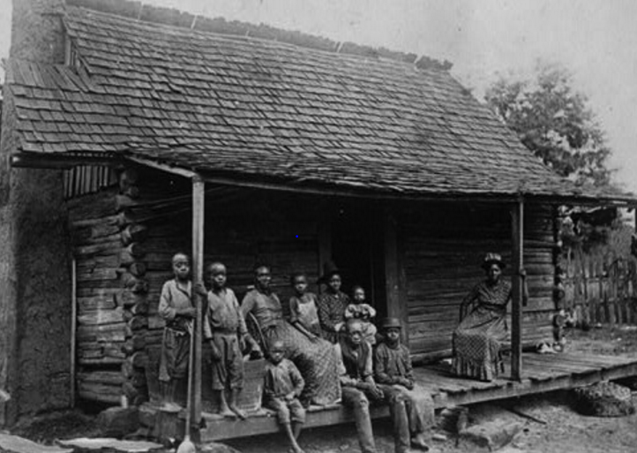
What Was Our Country Like in Late 19th Century?
Notes:
Images: All may be subject to copyright.
http://www.mendorailhistory.org/1_railroads/locos/4-6-0.htm
http://www.ohiohistorycentral.org/w/Steel_Mills
Htt
http://www.collectorsweekly.com/articles/why-arent-stories-like-12-years-a-slave-told-at-southern-plantation-museums/p://loopchicago.com/blog/then-and-now-a-brief-history-of-the-chicago-l

Slide 30

Corporations are Legal Persons with Constitutional Rights – 1886
Notes:
Source: http://en.wikipedia.org/wiki/Supreme_Court_of_the_United_States Image may be subject to copyright.
Note: Santa Clara County versus Southern Pacific Railroad case grants legal personhood to corporations under the 14th Amendment intended to grant full rights to former slaves.

Slide 31
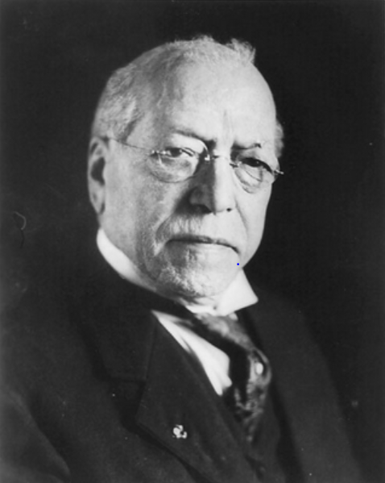
What Does Labor Want? For All Workers?
“We want more schoolhouses and less jails; more books and less arsenals; more learning and less vice; more leisure and less greed; more justice and less revenge; more opportunities to make childhood more happy and bright.”
Samuel Gompers, President AFL
Notes:
Sources:
Image: http://memory.loc.gov/ammem/nfhtml/nfexww1.html Image may be subject to copyright.
Quote: http://www.goodreads.com/quotes/109897-what-does-labor-want-we-want-more-schoolhouses-and-less

Slide 32
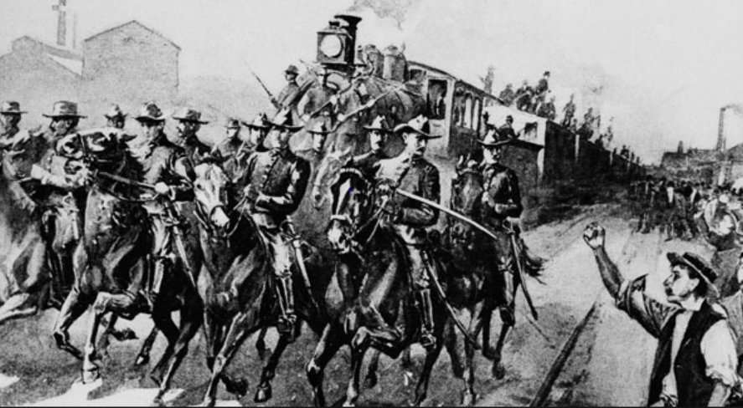
President Cleveland Uses the Army to Crush
Nationwide Rail Strike - Dozens Killed – 1894
Notes:
Note: President Cleveland mobilizes 14 thousand Army troops to crush the nation-wide rail strike sparked by the strike at Pullman Corporation in Chicago. Governor Altgeld and the Chicago mayor oppose the use of federal troops. 34 killed.
Source: http://www.politico.com/news/stories/0311/50885.html Image may be subject to copyright.

Slide 33
Supreme Court Serves the Wealthy not the People – 1890s Style
In 1894, Congress passes 2% flat income tax that only applies to the richest 10 percent of families.
U.S. Supreme Court rules it unconstitutional.
Notes:
Source: http://westlawinsider.com/legal-research/today-in-1895-federal-income-tax-ruled-unconstitutional/

Slide 34
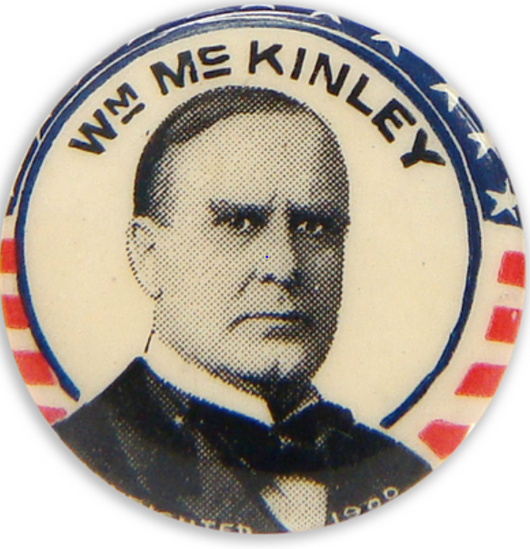
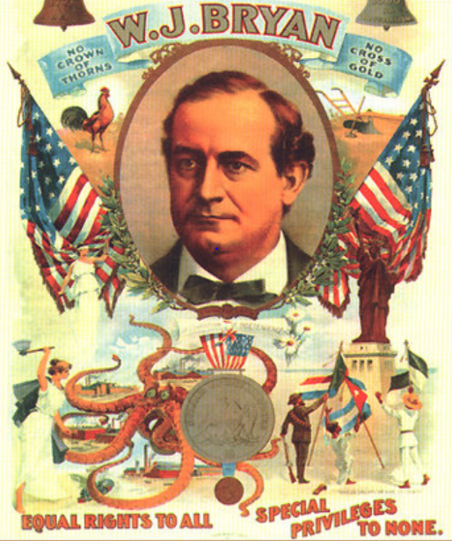
Buying the White House – 1896 Style
McKinley Outspends Bryan 11 to 1
Notes:
Source: http://en.wikipedia.org/wiki/Cross_of_Gold_speech
Source: Congressman Jim McDermott: Early Campaign Finance Reform. Y:\Mark_Mcdermott\mark\Documents\Labor Educator
Source: Popular vote – McKinley 51%; Bryan 47%. http://en.wikipedia.org/wiki/United_States_presidential_election,_1896
Image: http://prosperityuk.com/2001/01/a-wonderful-wizard-of-oz-a-monetary-reform-parable/ Image may be subject to copyright.
Image: http://www.nytstore.com/Vintage-1896-William-McKinley-Stars-and-Stripes-Pin_p_9612.html Image may be subject to copyright.

Slide 35
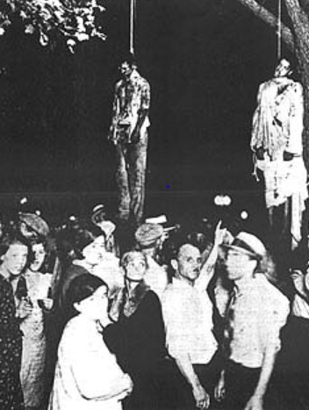
Voter Suppression – Early 20th Century:
Crush Black/White Unity in the South
“‘We wrested our state government from Negro supremacy.’ Almost all blacks and most poor whites were disenfranchised. In Mississippi, voter participation fell from 70% in 1876 to less than 10% in 1920.”
Notes:
Source: Colin Woodard, American Nations, page 305.
Image: http://jmichaelphillips.blogspot.com/2013/02/just-eastwooding-lynched-empty-chairs.html Image may be subject to copright.

Slide 36
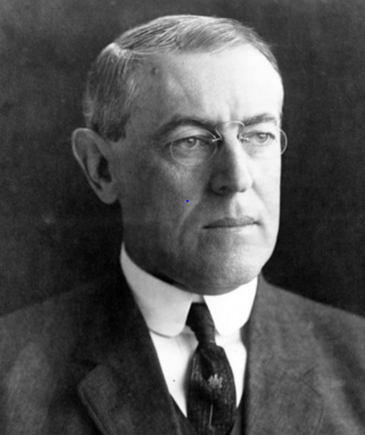
Woodrow Wilson, Future President of United States, Bashing Immigrants
“Southern European countries are unburdening themselves of the more sordid and hapless elements of their population.”
Eastern Europeans – “had neither skill nor energy nor any initiative of quick intelligence.” – 1903
Notes:
Source: Susan Martin, A Nation of Immigrants, page 141-42. Quotes Woodrow Wilson, History of the American People, 1903, page 212.
Image: http://www.studyblue.com/notes/note/n/history-130-test-2/deck/767061 Image may be subject to copyright.

Slide 37
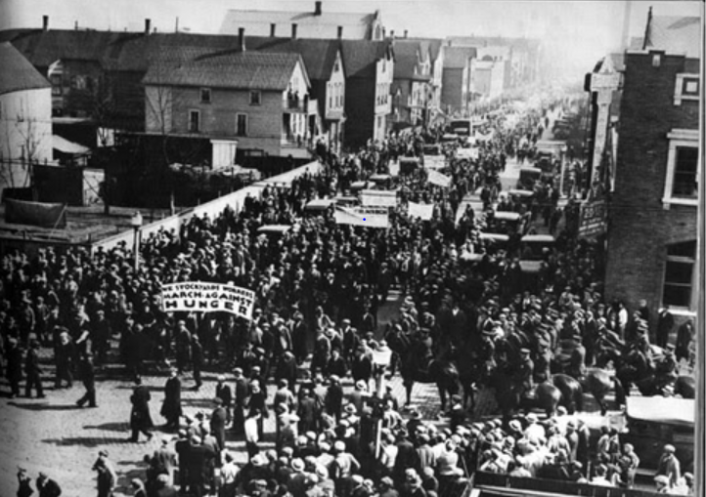
“We pursue policies to keep the races and nationalities apart…Stir up suspicion, rivalry and hatred among them.”
Philip Armour, CEO, world’s largest meatpacker
Notes:
Image: http://www.bobbosphere.org/2012/05/ Image may be subject to copyright.
Quote: Halpern, Rick, Down on the Killing Floor: Black and White Workers in Chicago’s Packinghouses, 1904-54, page 24.

Slide 38

25 Years of Gompers’ Leadership Sees Growing Racism in Labor Movement
AFL affiliates denying blacks membership grows from 4 to 11 during Gompers’ tenure as AFL President.
Notes:
Image: https://mstartzman.pbworks.com/w/page/21898889/American%20Federation%20of%20Labor%20
Source: Foner, Philip, Organized Labor and the Black Worker, 1619-1973, page 169.

Slide 39
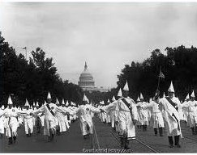
Ku Klux Klan: 4-5 Million Members
Larger than the Labor Movement – 1925
Notes:
Source: Authentic History. http://www.authentichistory.com/1921-1929/4-resistance/2-KKK/index.html Copyright – authentichistory.com

Slide 40
Culture Wars to Divide Us in the “Good Old Days”
Birth control is banned
Women should not have the right to vote
Marriages between people of different races is banned in many states
Alcohol prohibition is an attack on immigrants, Jews and Catholics
KKK – the violent defender of “pure, white, native born America”

Slide 41
Militant Labor Movement Stalls Amid Working Class Disunity – 1900’s to 1930’s
Notes:
Source: Years 1890 - 1929, Vernon Briggs, Immigration and American Unionism, pages 71 and 113. Years 1930 -1970, U.S. Department of Commerce, “Historical Statistics of the U. S. – Colonial Times to 1970, page 178. Years 1971 to 2003, U.S. Department of Commerce, “Statistical Abstract of the U.S., several issues, tables typically labeled “Labor Union Membership by Sector. Years 2003 to 2012 Bureau of Labor Statistics
Barry T. Hirsch and David A. Macpherson, "Union Membership and Coverage Database from the Current Population Survey: Note," Industrial and Labor Relations Review, Vol. 56, No. 2, January 2003, pp. 349-54. (in pdf) URL: http://www.unionstats.com/

Slide 42
Finding Our Common Ground, We Strengthened Our Democracy
Congress passes Tillman Act – first major limitations on corporate campaign $$$ – 1907
U.S. constitutional amendment requiring direct election of Senators – 1913
U.S. constitutional amendment for income tax which only taxes the wealthy – 1913

Slide 43
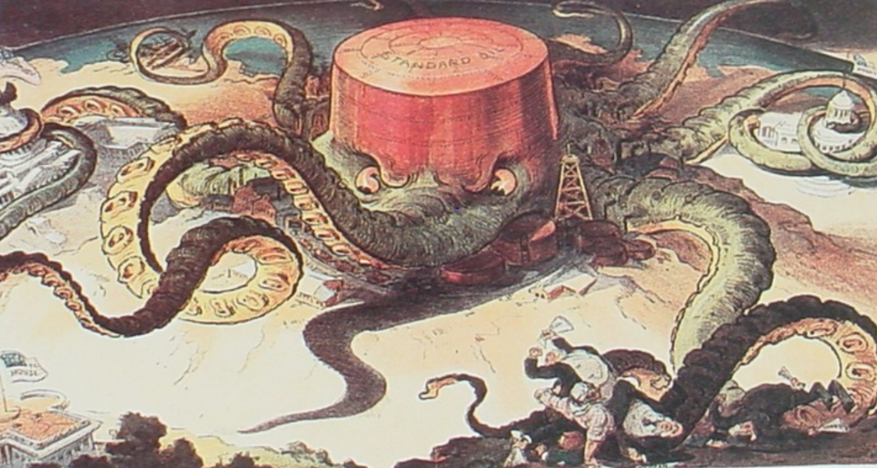
Attacking Corporate Power Directly: Busting the Trusts and Break Up Standard Oil
Notes:
Source: http://userpages.umbc.edu/~lindenme/hist102/Identifications/ids05.htm Image may be subject to copyright.
Note: Supreme Court orders the break up of Standard Oil in 1911. http://en.wikipedia.org/wiki/Standard_Oil_Company_of_New_Jersey_v._United_States

Slide 44
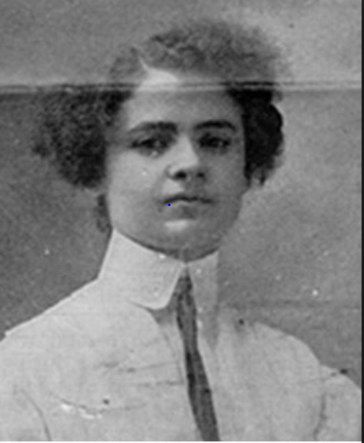
The Rising of the 20,000 Strike in NYC Immigrant Women Lead the Fight – 1909-10
"They used to say you couldn't even organize women. Well, we showed them! I have listened to all the speakers, and I have no further patience for talk. I move we go out in a general strike!“ – Clara Lemlich, Ukrainian Jewish immigrant
Notes:
Sources:
Image: http://www.xtimeline.com/evt/view.aspx?id=43225 Image may be subject to copyright
Quote: https://www.indypendent.org/2012/03/12/honoring-working-womens-struggles

Slide 45
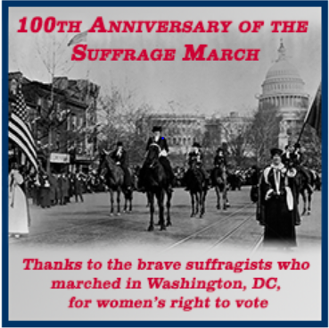
Decades of Struggle to Expand Democracy:
Women Win the Right to Vote in 1920
5,000 women march in D.C. in 1913
Violent attacks against marchers
Army called in to protect the marchers
100 marchers injured
Notes:
Source: http://www.lwv.org/blog/celebrating-100th-anniversary-women’s-suffrage-marc Image may be subject to copyright.

Slide 46

We the People Organize, Expand Our Democracy, and Win Greater Rights
Organized labor and our community allies curb corporate power with:
Initiatives
Referendums
Public ports
Workers’ compensation

Slide 47
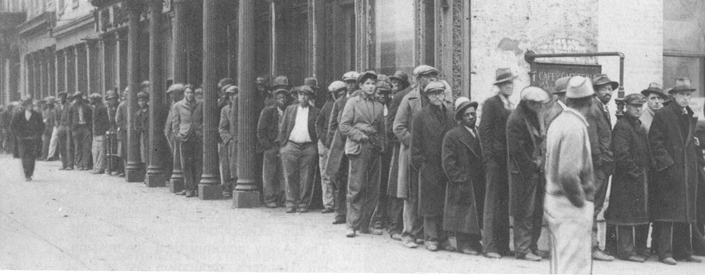
Wall Street Speculators and Big Business Crash the Economy
Tens of Millions Suffer – 1932
.
Notes:
Source: M. B. Schnapper, American Labor: A Bicentennial History, Public Affairs Press, 1975, page 462. Copyright.
COMMUNITY ORGANIZING RISES IN RESPONSE TO THE DEEPENING CRISIS.
By 1932, the Great Depression had reached its depths. The official national unemployment rate was 25 percent and the unofficial rate of working involuntarily working part-time was 35 percent. People of color were particularly hard hit.
For decades, Corporate America and their political allies had prevented legislation that would have provided unemployment insurance, adequate public assistance to the needy, affordable housing, badly needed food, social security for the elderly and the disabled, and an end of home and farm foreclosures. Working people, both employed and unemployed, were living in misery and desperation.
In midst of this untold and unjustified suffering, people began to organize particularly around issues of unemployment insurance, public assistance, affordable housing, social security. Massive demonstrations became a permanent part of the American story. Workers, whether employed or unemployed, the poor and the oppressed would not remain silent.

Slide 48
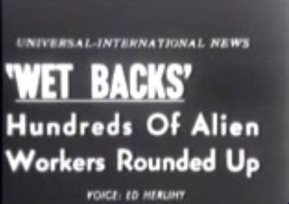
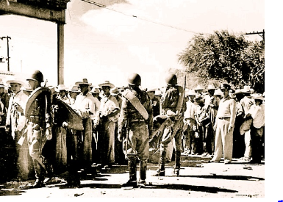
Blaming the Depression on Latinos
1 to 2 Million Mexican-Americans and Mexicans Deported – Early 1930’s
Notes:
Craig S. Frame, California State University San Marcos
http://public.csusm.edu/frame004/images.html Copyright.

Slide 49
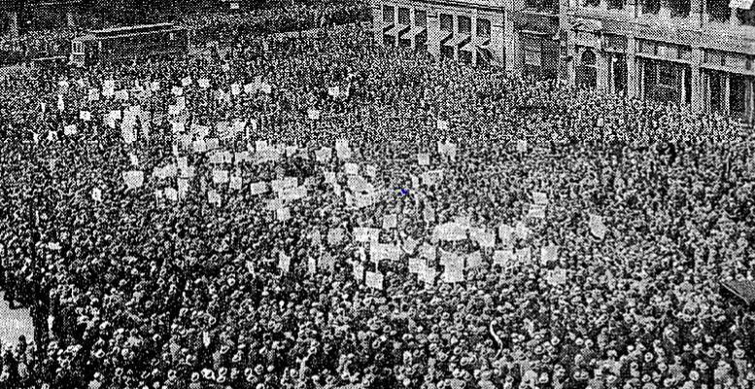
The Great Uprising of the People – 1930s
Jobs, Labor Rights and Help for the Unemployed and Those in Need
Notes:
Image: http://www.progressivehistorians.com/2010/04/international-unemployment-day.html Image may be subject to copyright.

Slide 50
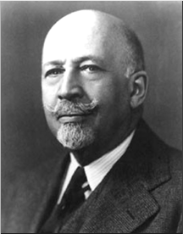
Growing Racial Solidarity
Key to Victories 1930-40s
“Probably the greatest and most effective effort toward interracial understanding among the working masses has come through the trade unions.”
W.E.B. DuBois, founder NAACP – late 1940s
Notes:
Source: Michael Yates, Why Unions Matter, page 147

Slide 51
We Build a Powerful Labor Movement After Decades of Struggle – 1890 to 1945
Notes:
Source: Years 1890 - 1929, Vernon Briggs, Immigration and American Unionism, pages 71 and 113. Years 1930 -1970, U.S. Department of Commerce, “Historical Statistics of the U. S. – Colonial Times to 1970, page 178. Years 1971 to 2003, U.S. Department of Commerce, “Statistical Abstract of the U.S., several issues, tables typically labeled “Labor Union Membership by Sector. Years 2003 to 2012 Bureau of Labor Statistics
Barry T. Hirsch and David A. Macpherson, "Union Membership and Coverage Database from the Current Population Survey: Note," Industrial and Labor Relations Review, Vol. 56, No. 2, January 2003, pp. 349-54. (in pdf) URL: http://www.unionstats.com/
1982 data point added for continuous private sector data series.

Slide 52
What ideas and feelings came up in this presentation?
How is this history relevant to our struggles today?

Slide 53
Fighting for Our Unions, Our Democracy and Our Future

Slide 54
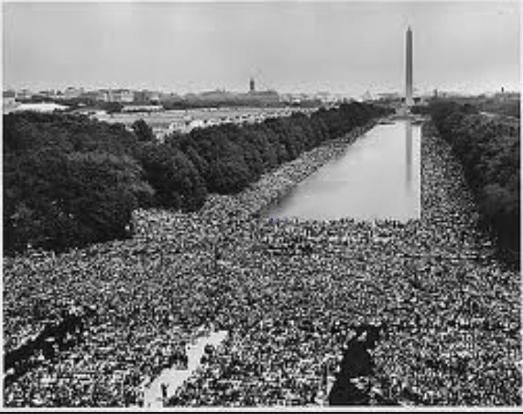

Fighting for Racial Justice
National AFL-CIO Refuses to Endorse
Notes:
Source: http://60snow.blogspot.com/2008_08_24_archive.html Image may be subject to copyright.
www.Heroesofcharacter.org Educator blog. Image may be subject to copyright.

Slide 55
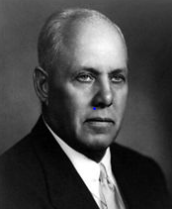
Strategic Mistakes Affect Us to This Day
“I used to worry about the size of the membership. I stopped worrying because it doesn’t make any difference. The organized fellow is the only fellow who matters.”
George Meany, President, AFL-CIO, 1972
Notes:
Sources:
Quote: http://www.baclocal7.org/history.aspx?zone=History&pID=1631
Image: http://en.wikipedia.org/wiki/George_Meany Image may be subject to copyright.

Slide 56
Labor’s Power Peaks and Begins Slow Decline – 1945 to 1971
Notes:
Source: Years 1890 - 1929, Vernon Briggs, Immigration and American Unionism, pages 71 and 113. Years 1930 -1970, U.S. Department of Commerce, “Historical Statistics of the U. S. – Colonial Times to 1970, page 178. Years 1971 to 2003, U.S. Department of Commerce, “Statistical Abstract of the U.S., several issues, tables typically labeled “Labor Union Membership by Sector. Years 2003 to 2013 Bureau of Labor Statistics. http://www.bls.gov/news.release/pdf/union2.pdf
Barry T. Hirsch and David A. Macpherson, "Union Membership and Coverage Database from the Current Population Survey: Note," Industrial and Labor Relations Review, Vol. 56, No. 2, January 2003, pp. 349-54. (in pdf) URL: http://www.unionstats.com/

Slide 57
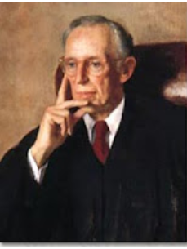
Corporate America Unleashes Class Warfare
Lewis Powell Memo – August 23, 1971
Decades-long strategy
Win the war of big ideas
Build national idea machine
Relentless political attacks
Appointed to U.S Supreme Court – 1971
Notes:
Source: Greenpeace. http://www.greenpeace.org/usa/en/campaigns/global-warming-and-energy/polluterwatch/The-Lewis-Powell-Memo/

Slide 58
Corporate America’s Class Warfare
Crush organized labor
Promote free trade and export manufacturing
Buy elections with big money
Voter suppression
Deregulate financial industries and corporations
Cut social programs for poor, unemployed and needy
Cut taxes on corporations and the wealthy
Privatize government
Divide and conquer
Notes:
The major victories of the 1960s and the early 1970s caused great alarm among corporate America, their right wing political allies and corporate mainstream politicians. Many of these victories coupled with an upsurge in labor unrest threatened many of their fundamental interests and furthered limited their power and freedom. Corporate America desperately wanted to regain political dominance and greater freedom from government control and strong unions.
On August 23, 1971, Lewis Powell, wrote a famous confidential memo to the U.S. Chamber of Commerce calling for a major counterattack by corporate America. http://reclaimdemocracy.org/corporate_accountability/powell_memo_lewis.html This memo along with the writings of other corporate allies laid the foundation for the corporate counterattack that helped achieve the election of Ronald Reagan in 1980s and a fundamental shift in American economic and political life.
The key elements and messages of the strategy are listed above. They also included the importance of winning the battle for the future vision of the country coupled with values, themes and messages that would become the dominant view of our future. This battle of ideas would be supported by the creation of many think tanks, endowment of chairs in university economics departments and business schools, attacks on leftist and progressive intellectuals, strengthening lobbying efforts, dominating the media and building powerful and well-funded permanent political and election campaign organizations. Crushing unions would be key.
What were the results? We have already seen the dramatic shift to economic inequality. Long gone were the days of a rising tide would lift all boats.

Slide 59
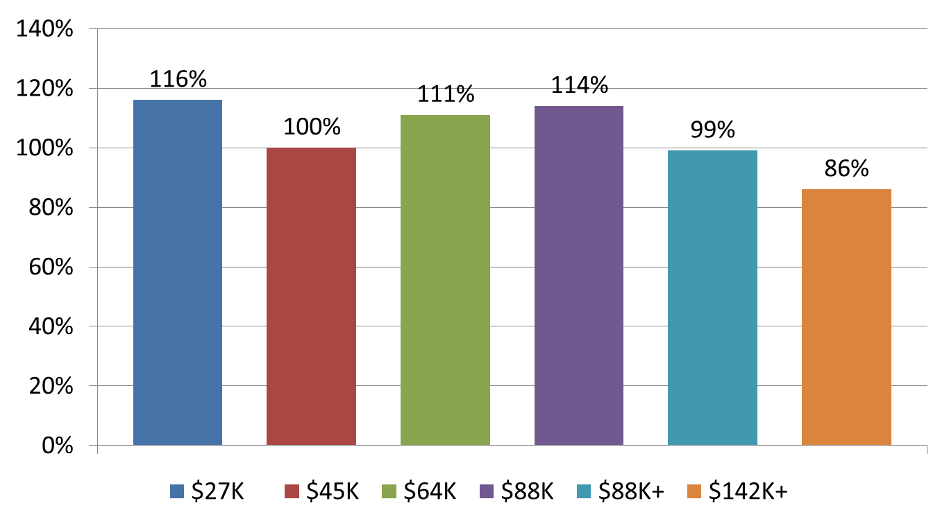
Decades of Shared Prosperity – 1947-1979
Notes:
Source: Mishel and Bernstein, The State of Working America 1994-95, M.E. Sharpe, 1994, page 37. U.S. Census Bureau, Historical Income Tables. F-1 for income ranges in 2010 dollars and F-3 for income changes. http://www.census.gov/hhes/www/income/data/historical/families/index.html

Slide 60
Corporate America Stealing our Shared Prosperity – 1979-2014
Notes:
Source: U.S. Census Bureau, Historical Income Tables. F-1 for income ranges in 2013 dollars and F-3 for income changes. http://www.census.gov/hhes/www/income/data/historical/families/index.html Top 0.01% 1979 to 2005. Congressional Budget Office, “Historical Effective Tax Rates,” 2008., Table 3. http://www.cbo.gov/ftpdocs/98xx/doc9884/12-23-EffectiveTaxRates_Letter.pdf

Slide 61
The Super-Rich Stealing our Shared Prosperity – 1979-2014
Richest 13,000 families’ average income rises 315%. Their minimum income is $12.1 million and their average income is $36.8 million in 2012
Notes:
Source: U.S. Census Bureau, Historical Income Tables. F-1 for income ranges in 2013 dollars and F-3 for income changes. http://www.census.gov/hhes/www/income/data/historical/families/index.html Top 0.01% 1979 to 2005. Congressional Budget Office, “Historical Effective Tax Rates,” 2008., Table 3. http://www.cbo.gov/ftpdocs/98xx/doc9884/12-23-EffectiveTaxRates_Letter.pdf
https://www.cbo.gov/sites/default/files/110th-congress-2007-2008/reports/12-23-effectivetaxrates_letter.pdf
IRS, “Individual Income Tax Shares, 2012,” http://www.irs.gov/pub/irs-soi/soi-a-ints-id1506.pdf

Slide 62
Public Opinion Poll

Slide 63
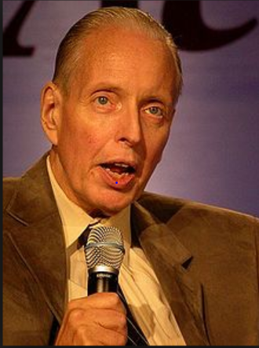
Corporate Attacks on Democratic Elections
“ I don’t want everybody to vote…our leverage in the elections quite candidly goes up as the voting populace goes down.”
Paul Weyrich, 1980. Co-founder, Heritage Foundation.
Notes:
Source:
Image: http://en.wikipedia.org/wiki/Paul_Weyrich Image may be subject to copyright.
Quote: Robert McChesney, Digital Disconnect, page 59.
Note: Co-founder of the Heritage Foundation, largest conservative think tank in WA D.C. and partially funded by Charles Koch Foundation and other right-wing billionaires.

Slide 64
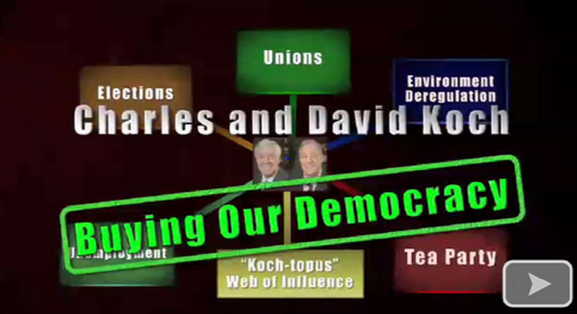
Legally Stealing Our Democracy
$400 Million – 2012; $900 Million – 2016
Notes:
Image: https://suzieqq.wordpress.com/2011/03/11/ Image may be subject to copyright.
Sources: http://www.nytimes.com/2015/01/27/us/politics/kochs-plan-to-spend-900-million-on-2016-campaign.html?_r=0
http://msnbc.tumblr.com/post/72567772382/rev-sharpton-explores-a-new-report-that-the

Slide 65
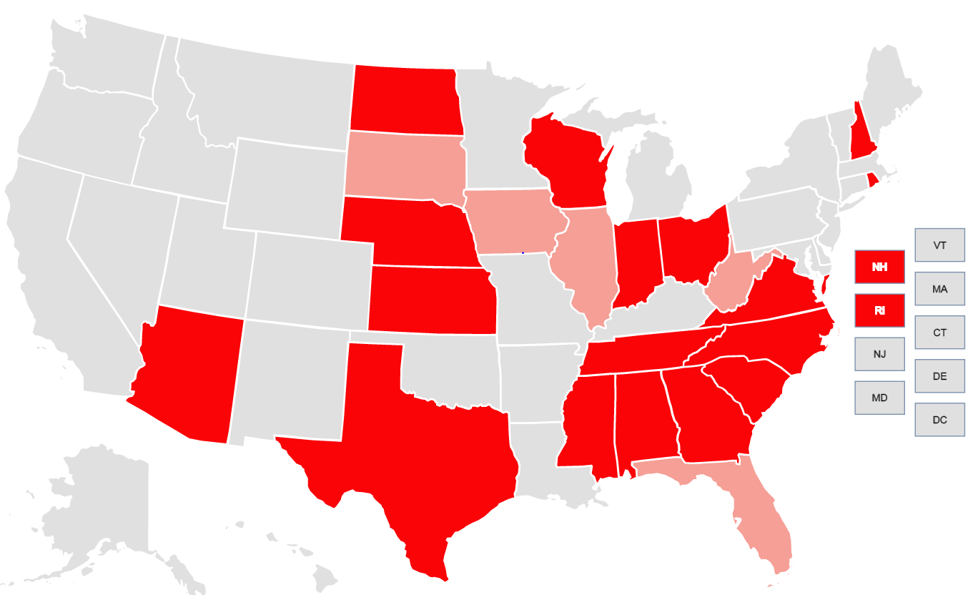
Supreme Court Aids in Voter Suppression New Restrictions in 2012 and 2016
Notes:
Source: Brennan Center for Voting Rights. https://www.brennancenter.org/voting-restrictions-first-time-2016 Image may be subject to copyright.
Light red shows restriction in place in 2012
Dark red shows restriction in place for 2016

Slide 66
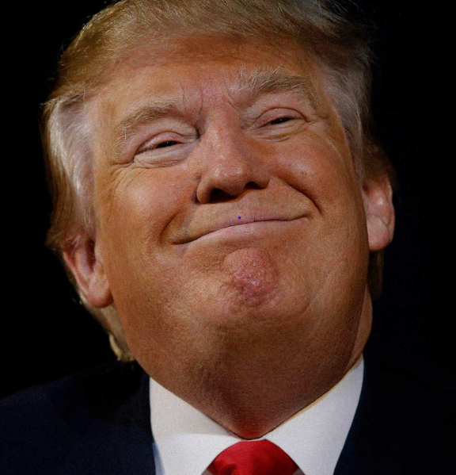
Spreading Hatred and Bigotry to Divide and Conquer 2016
“When Mexico sends its people, they’re not sending their best…They’re bringing drugs and crime. They’re rapists. And some, I assume, are good people.”
“I can never apologize for the truth.”
Notes:
Image: http://michaelmoore.com/trumpwillwin/ Image may be subject to copyright.
Quote: http://www.washingtonpost.com/blogs/fact-checker/wp/2015/07/08/donald-trumps-false-comments-connecting-mexican-immigrants-and-crime/
Source: Cato Institute, Criminal Immigrants: Their Numbers, Demographics and Countries of Origin, March 15, 2017. https://object.cato.org/sites/cato.org/files/pubs/pdf/immigration_brief-1.pdf
“All immigrants are less likely to be incarcerated than natives relative to their shares of the population. Even illegal immigrants are less likely to be incarcerated than native-born Americans.”

Slide 67
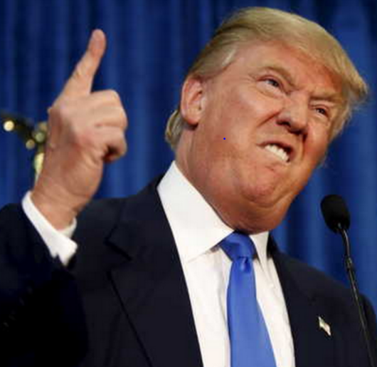
The Big Lie, No Proof, Claim Fraud, Promote Voter Suppression and Bash Immigrants
“In addition to winning the Electoral College in a landslide. I won the popular vote if you deduct the millions of people who voted illegally.”
“Three to five millions unauthorized immigrants voted for Mrs. Clinton.”
Notes:
Image: http://images.dailykos.com/images/150358/large/RTX1GZCO.jpg?1435250433
Image may be subject to copyright.
Quotes:
NBC News, November 27, 2016. http://www.nbcnews.com/politics/2016-election/tweet-flurry-president-elect-donald-trump-calls-recount-efforts-sad-n688761
Shear, Michael, and Huetteman, Emmarie, “Trump Repeats Lie About Popular Vote in Meeting with Lawmakers,” New York Times, January 23, 2017. https://www.nytimes.com/2017/01/23/us/politics/donald-trump-congress-democrats.html?_r=0

Slide 68
The Great Lesson of Nazi Germany: When Does Solidarity Start?
First they came for the communists, and I said nothing, as I was not one of them.
Then they came for the socialists…
Then they came for the trade unionists…
Then the gays and lesbians…
Then the intellectuals…
Then the gypsies…
Then the Jews…
Then they came for me, and there was no one to speak for me.

Slide 69
An Injury to One is an Injury to All; Do We Really Mean It Today?
Where do you and your union fit in this?
First they attacked the ___, and I said nothing, as I was not one of them.
Then they attacked ___...
Then they attacked ___...
Then they attacked ___…
Then they attacked ___...
Then they attacked ___…

Slide 70
An Injury to One is an Injury to All; Do We Really Mean It? – Part 2
Then the ____…
Then the ____…
Then the ____…
Then the ____…
Then they came for me and there was no one to stand with me.
IF WE BELIEVE AN INJURY TO ONE IS AN INJURY TO ALL, WE MUST ALL STAND TOGETHER

Slide 71
Class War and Culture Wars Today
Divide and Conquer
Corporate America Buying Our Government
Stealing Our Right to Vote and Fair Elections
Bashing Immigrants
Attacking Women and their Health Care
Attacking People of Color, Gays, the Homeless, Transgenders, the Disabled, Muslims and Who Else?
Smashing Unions

Slide 72
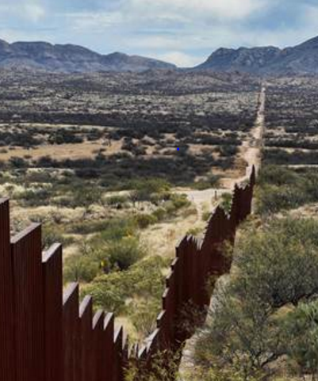
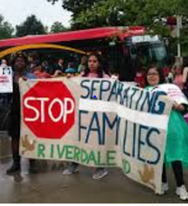
People Support Path to Citizenship: 70-25%
Oppose Mexican Wall: 62-35%
Notes:
Images: http://www.nbcnews.com/news/us-news/trump-suggests-canceling-meeting-mexico-s-president-after-shots-fired-n712461 Image may be subject to copyright.
Image: http://americasvoice.org/blog/united-states-trump-dreamers-parents-u-s-citizens-detained-deported/
Source: Path - http://edition.cnn.com/election/results/exit-polls/national/president
Source: Wall - http://www.pewresearch.org/fact-tank/2017/02/24/most-americans-continue-to-oppose-u-s-border-wall-doubt-mexico-would-pay-for-it/

Slide 73

Carpenters Standing for Justice With Our Immigrant Sisters and Brothers
“We declare that the PNWRCC is a sanctuary organization that welcomes, defends, and fights to protect immigrants.”
May 20, 2017
Notes:
Image: Carpenters Union. https://www.carpenters.org/about-ubc/21st-century-union/the-ubc-emblem/ Image may be subject to copyright.
Source: Pacific NW Regional Council of Carpenters. https://www.nwcarpenters.org/pnwrcc-a-sanctuary-organization/

Slide 74
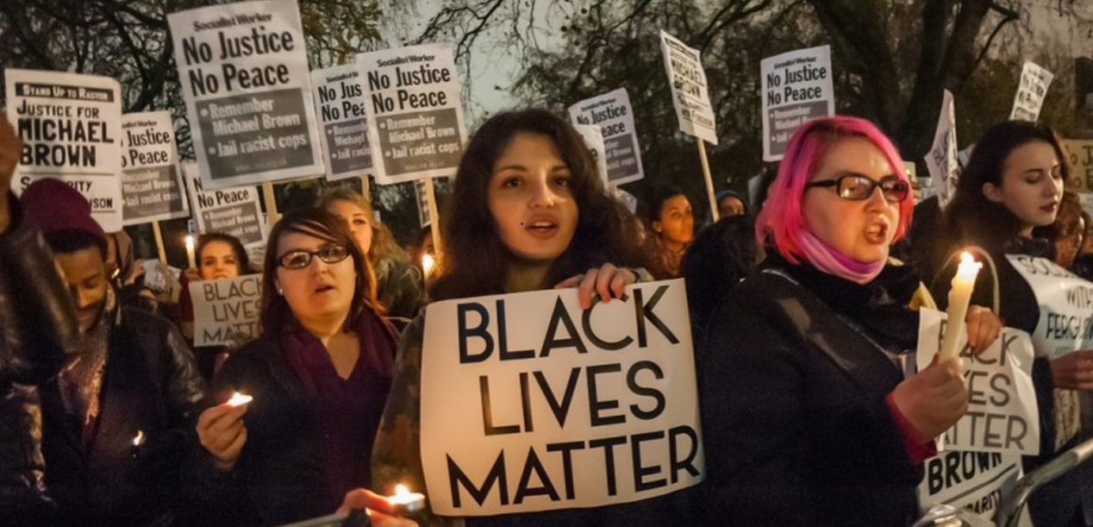
It’s time to draw the line. Some people are still getting hurt in our communities because of the color of their skin and that is not right.
Richard Trumka, President, AFL-CIO, 2014.
Notes:
Sources:
Quote: http://www.aflcio.org/Press-Room/Speeches/At-the-2014-Missouri-AFL-CIO-Convention
Image: Epic Times, http://www.epictimes.com/2015/06/new-billboard-in-orange-mound-puts-twist-on-black-lives-matter/ Image may be subject to copyright.

Slide 75
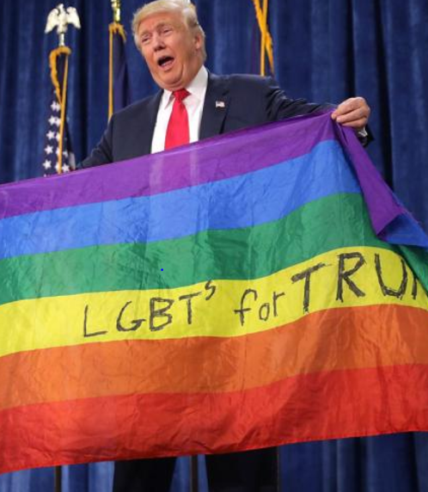
Trump Bans Transgender People from Military Service – It is Very Unpopular
68% of American voters believe transgender people should be allowed to serve in the U.S. military.
55% of voter in military household agree.
Notes:
Image: New York Daily News, July 27, 2017. http://www.nydailynews.com/news/politics/trump-announces-transgender-military-service-ban-twitter-article-1.3357685
Source: Farber, Madeline, “Poll Finds Most Americans Support Transgender Military Service,” Time, August 3, 2017. http://time.com/4886165/trump-transgender-ban-poll/

Slide 76
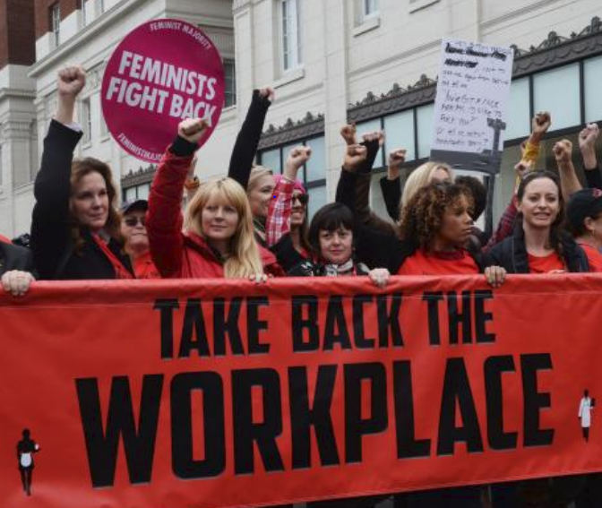
All Women Have a Right to a Workplace Free from Harassment and Discrimination
Notes:
Image: UPI. https://www.upi.com/Trump-natural-disasters-MeToo-How-2017-changed-the-world/7531512616649/ Image may be subject to copyright.

Slide 77
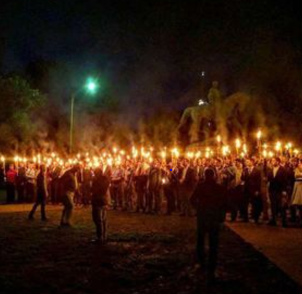
Will History Repeats Itself?
We Must Unite Against Hate
Charlottesville VA
White Supremacists
KKK
Neo-Nazis
One of the chants was:
“We will not be ruled by Jews.”
Notes:
Image: Dallas Weekly News, http://www.dallasweekly.com/news/national/article_5c3677ec-3b3f-11e7-bee2-6bf5a938c6c9.html Image may be subject to copyright.

Slide 78
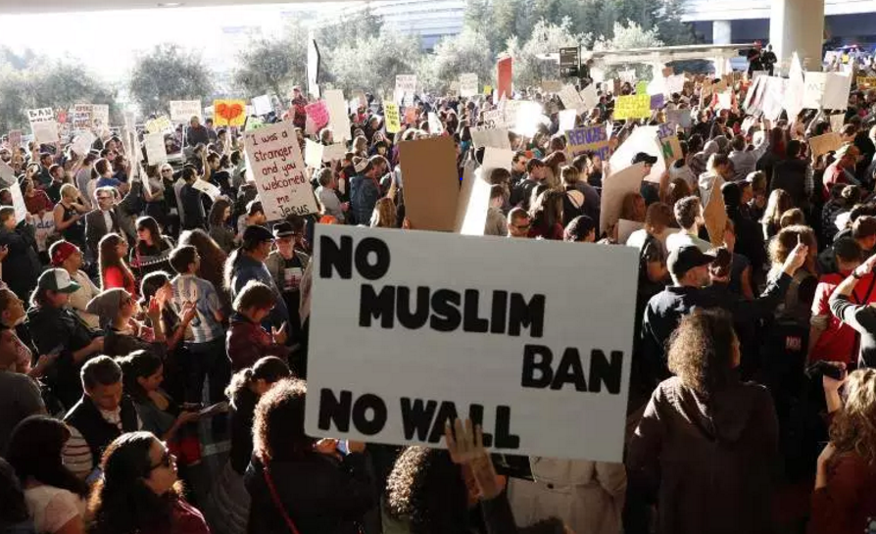
United We Stand – Divided We Fall
This is Our Choice
Notes:
Image: http://heavy.com/news/2017/01/muslim-immigration-ban-protests-photos-where-dfw-jfk-lax-white-house-cities-states-pictures-list/ Image may be subject to copyright.

Slide 79
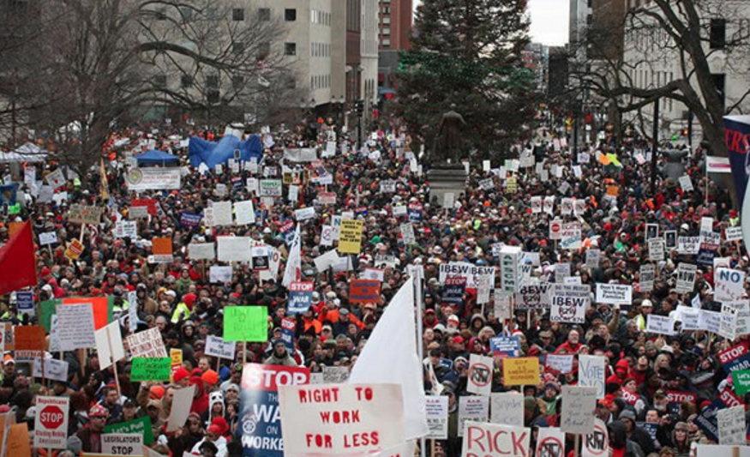
We Can and Will Regain Our Rights No Matter How Long It Takes
Notes:
Image: https://www.afscme.org/now/thousands-protest-michigans-right-to-work-for-less-bills

Slide 80
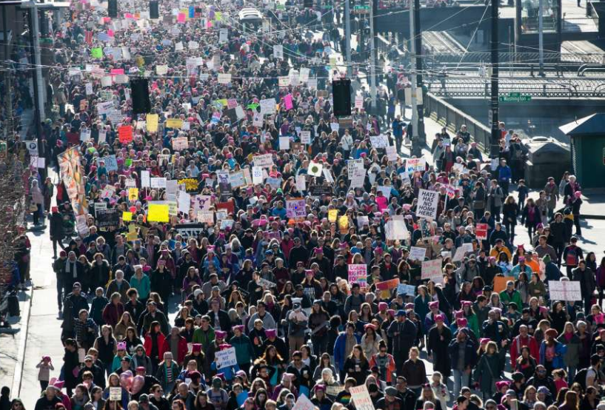
The Resistance Grows: 600 Women-Led Marches Rock Our Country – 2017
Notes:
Image: http://www.seattlepi.com/elections/article/Women-allies-march-on-Seattle-10872707.php#photo-12233902 Image may be subject to copyright.
The historic and extremely large women‘s marches of January 21, 2017 brought millions of women and men, young and old, people of color and white, citizens and non-citizens, and LGBT and straight in to the streets as a massive show of unity and solidarity to fight forward and move our country toward a better future. The time is now

Slide 81

SeaTac Workers Win 11-Year Fight for Union Contract after Union Bust – 2017
Notes:
Image: http://universaldeclaration.org/works/billboards-for-justice/ Image may be subject to copyright.
Source: http://www.seattletimes.com/business/boeing-aerospace/alaska-airs-baggage-handlers-at-sea-tac-get-an-upgrade/
In 2008, a federal arbitrator ruled that the airline had breached the IAM contract with the outsourcing but did not order reinstatement of the workforce.

Slide 82

CA State BT Protects Union Jobs and Public Safety – SB54 – 2013
Skilled trades doing construction and maintenance in refineries must use state registered apprentices and qualified journey workers.
Notes:
Image: https://sites.google.com/site/metroforensics3/csb-releases-board-approved-regulatory-report-on-chevron-refinery-fire---proposes-a-more-rigorous-refinery-industry-regulatory-system-in-california?tmpl=%2Fsystem%2Fapp%2Ftemplates%2Fprint%2F&showPrintDialog=1 Image may be subject to copyright.
Source: CA State Building Trades. http://www.sbctc.org/doc.asp?id=4694&parentid=6

Slide 83
We Defeat Repeal of Federal Davis-Bacon July 26, 2017
The U.S. House vote:
All 191 Democrats Voted No Repeal
178 Republicans Voted to Repeal
Kathy McMorris-Rodgers and Jamie Butler-Herrara Voted to Repeal
Notes:
Source: https://www.congress.gov/amendment/115th-congress/house-amendment/227
http://clerk.house.gov/evs/2017/roll419.xml

Slide 84

310,567 Missouri Workers and Allies Sign Petition to Repeal Right to Work – 2017
Notes:
Image and source: St. Louis Labor Tribune, August 28, 2017. Image may be subject to copyright. http://labortribune.com/photo-gallery-mass-turnout-for-rtw-repeal-rally-signature-turn-in-at-state-capitol/floor-signs/

Slide 85

98% of Americans Believe Affordable Health Insurance is Important
“I was the 1st and only potential GOP candidate to state there will be no cuts to Social Security, Medicare and Medicaid.”
He has a “plan with a goal of ‘insurance for everybody.’”
Notes:
Quote: Donald J. Trump (@realDonaldTrump) May 7, 2015
Quote: Costa, Robert, Trump vows ‘insurance for everybody’ in Obamacare replacement plan, Washington Post, January 15, 2017.
Image: https://twitter.com/realdonaldtrump Image may be subject to copyright.
Quote: Wasik, John, “Three Ways Trump, GOP May Cut Social Security, Medicare,” Forbes, November 16, 2016. http://www.forbes.com/sites/johnwasik/2016/11/16/three-ways-trump-gop-may-cut-social-security-medicare/#724abc2b4e0e
Poll: Quinnipiac Poll, March 23, 2017 - https://poll.qu.edu/images/polling/us/us03232017_Ukqbwg46.pdf/

Slide 86
Trumpcare Hurts Millions of Low Wage Workers
Congressional Budget Office reports:
14 million lose insurance 2018; 24 million 2026
$880 billion in cuts to Medicaid
9 million lose Medicaid 2020; 14 million 2026
$594 billion in tax cuts – most go to wealthy and corporations
Notes:
Sources:
Main source: Congressional Budget Office:
Taxes: Center for Budget and Tax Priorities citing Tax Policy Centerhttp://www.cbpp.org/research/federal-tax/house-republicans-aca-repeal-plan-would-mean-big-tax-cuts-for-wealthy-insurers

Slide 87

The People: 3 – Trumpcare: 0
Let’s Keep the Winning Streak Going!
Notes:
Image: Investor’s Business Daily. http://www.investors.com/politics/editorials/will-trumpcare-be-worse-than-obamacare/ May be subject to copyright.

Slide 88
100 years ago, many union members and working people in our country made tragic mistakes by buying into bigotry, ignorance and tolerating injustice. In doing so they harmed the labor movement and our entire country.
Today we can and must make a different choice.

Slide 89

United We Can and Will Take Our Democracy and Country Back
The ultimate test of a person, a union, a movement and a people is not whether or not we get knocked down. It is what we do when we get up. Are we stronger, smarter, more determined, and more united?
This is always our choice.
Notes:
These young leaders are taking Margaret Mead’s famous quote to heart and taking action to build new movements. We must join with them. We need to remember that our ancestors faced great odds and obstacles to creating a better future. They won after decades of defeats. We face new yet similar challenges. Yes, we can.
Source: Quote: http://www.goodreads.com/author/quotes/61107.Margaret_Mead

Slide 90
Questions and Comments
What have you learned in this presentation that is useful in helping you build a stronger union, labor movement and deeper ties with community allies?

Slide 91
Information Sources I Trust – Page 1
The Stand – WA State Labor Council daily newspaper – www.thestand.org
Trump Attacks on Labor – Economic Policy Institute - www.epi.org/policywatch/
The Nation – www.thenation.org
The American Prospect – www.prospect.org
The New York Times – www.nytimes.com
Democracy Now - www.democracynow.org
In These Times – www.inthesetimes.com

Slide 92
Information Sources I Trust – Page 2
Rachel Maddow - www.rachelmaddow.com
The Progressive – www.progressive.org
The Union Edge – https://theunionedge.com
Economic Policy Institute – www.epi.org
Center for Tax Justice – www.ctj.org
Brennan Center for Justice – www.brennancenter.org
Puget Sound Advocates for Retirement Security – www.psara.org

Slide 93
Mark M. McDermott www.markmmcdermott.com www.facebook.com/markmcdermottworkshops
Email: markmmcdermott1@msn.com

