Slide 1
Making the American Dream Real for Everyone
International Brotherhood of Electrical Workers
National Progress Meeting
September 12, 2013
Mark McDermott
www.markmmcdermott.com
www.facebook.com/markmcdermottworkshops
Notes:
I know that most, if not all, of you, are deeply concerned about economic hard times facing the people that you love and care about. We are also troubled by a growing feeling that the American Dream is being taken away from us. There is a growing sense that working hard and playing by the rules no longer guarantees a rising standard of living, greater opportunity for the people we love, and a secure retirement.
I want to tell you a three generation story of how working people like us struggled to create a better future for their descendants, broadened political and economic opportunity for more people, and created a better way of life.
It is a story of great victories and great defeats. It is a story of working together for the common good and being deeply divided by racism, sexism, anti-immigrant hostility and other forms of bigotry. It is a hopeful story as great defeats have been followed by great victories.
One of the fundamental truths of this story is that when we are united as a people we can create a better future. Unity alone does not guarantee progress, but deep disunity almost always guarantees defeat. People like us have changed the course of American history before and we can do it again. The question is how?
As I tell this story, many of you may feel that I did not give enough attention to specific issues. I acknowledge your concerns but trying to tell a 100+ year history in one presentation requires recognizing yet touching lightly on many important issues.

Slide 2
Finding Our Common Ground
How many of you, your family members, or your close friends and their family members have experienced the following in the past five years?
Lost a job
Worried about losing job or can’t find full-time work
Couldn’t get or exhausted unemployment benefits
Lost or didn’t have health insurance
Were not paid wages that were legally owed

Slide 3
Finding Our Common Ground
How many of you, your family members, or your close friends and their family members have experienced the following in the past five years?
Difficulties in paying the bills or facing bankruptcy
Lost their home, facing foreclosure, underwater mortgage, or difficulties in paying the rent
Facing large student loans
Moved in relatives because they can’t pay the rent
Worried about adequate income in retirement

Slide 4
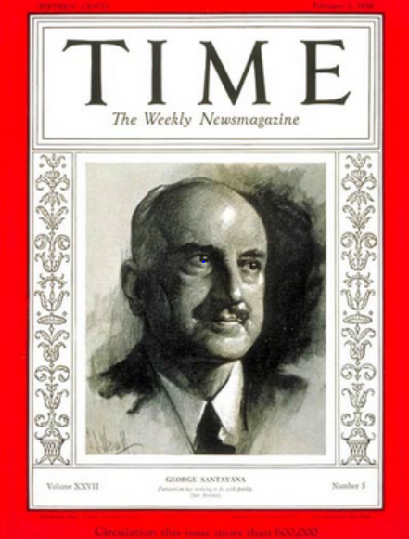
The Power of Our Stories
“Those who cannot learn from history are doomed to repeat it. Those who do not remember their past are condemned to repeat their mistakes."
George Santayana, 1936
Notes:
Sources:
Image: http://www.time.com/time/covers/0,16641,19360203,00.html Image may be subject to copyright.

Slide 5
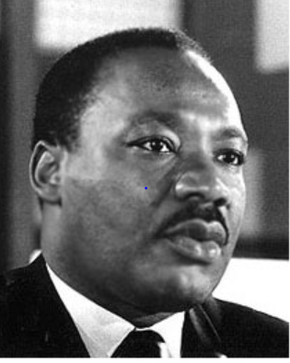
Telling the True Story of Labor’s Role in Creating the American Dream
“The labor movement was the principal force that transformed misery and despair into hope and progress …The captains of industry did not lead this transformation.”
Rev. Dr. Martin Luther King Jr.
Notes:
Source:
Image: http://www.stmartin.edu/whatsnew/MediaReleases/images/MartinLutherKingJr.jpg Image may be subject to copyright.
Quote: Peter Bollen, Great Labor Quotations, page 138.

Slide 6
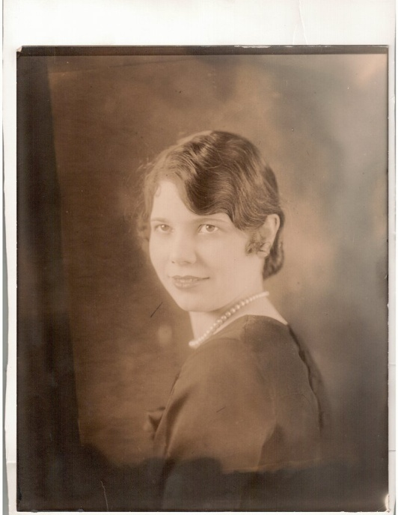
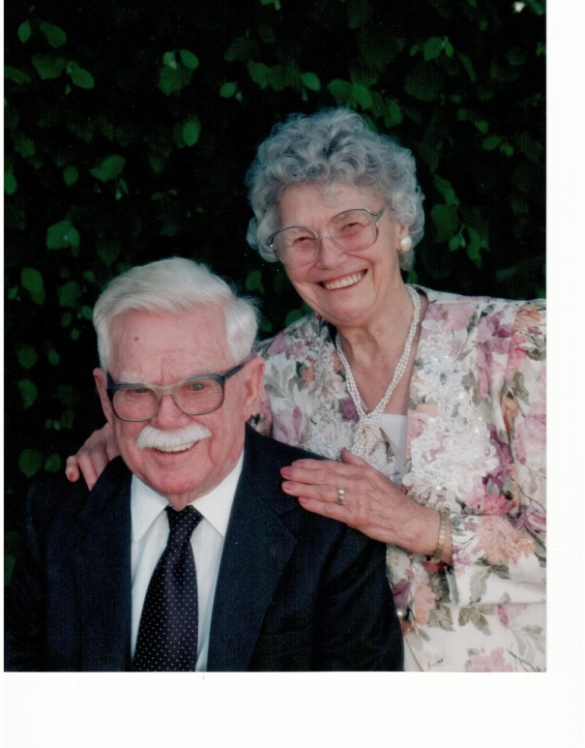
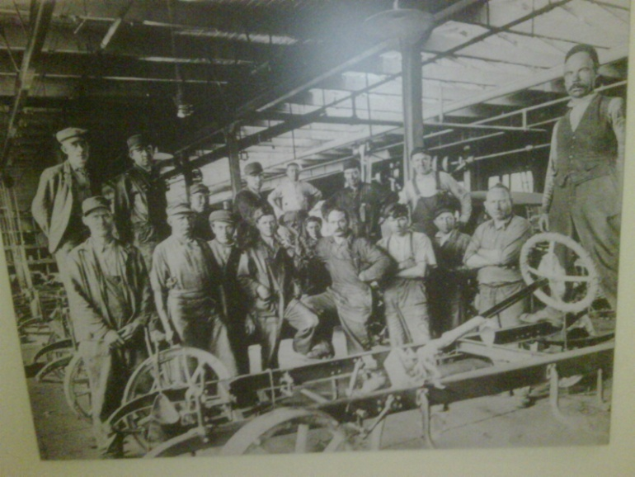
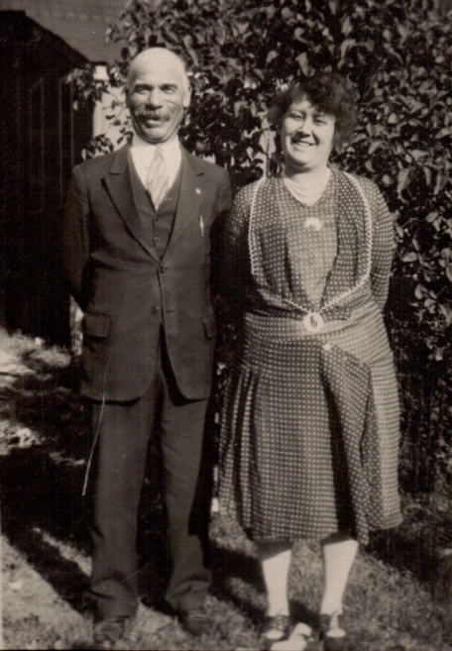
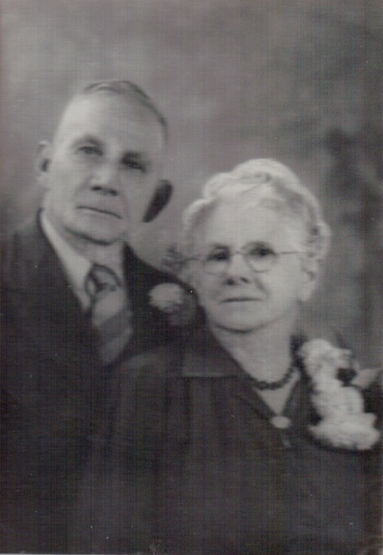
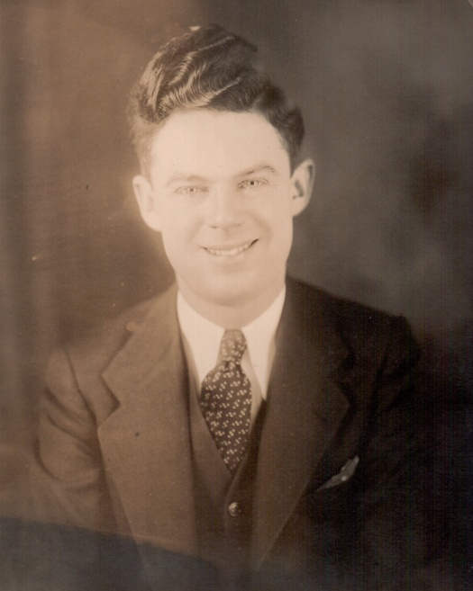
My Family’s Story
Notes:
My family’ story spans three generations of working class history in the United States. It is a story of struggle to create a more prosperous and secure future that would provide greater opportunity for each succeeding generation. My Irish-American grandfather had a third grade education, went to work at age 10 and retired after 65 years of work. My German-American grandfather had a sixth grade education and worked until he was laid off by Ford Motor Company at the start of the Great Depression. He died an untimely death at age 53 as an unemployed autoworker after being seriously injured. He died in poverty without unemployment insurance or health insurance that might have allowed him to get better medical care that might have saved his life. We don’t know if better care would have saved his life but we know that no money and insurance made his chances much slimmer.
My grandparents were union men and their generation helped build the great fortunes of America but they never shared fairly in the wealth they created.
Throughout the lives of my grandparents’ generation, working people fought to win the right to organize unions and bargain collectively, unemployment insurance, public assistance for families in need, affordable housing, health care protections, social security when they were old, protections for their bank deposits and security during hard economic times. They fought from the 1880s into the 1930s and were repeatedly defeated but they kept the faith and continued to struggle.
The Great Depression would provide the historic opportunity to change the lives of working people for decades to come.

Slide 7
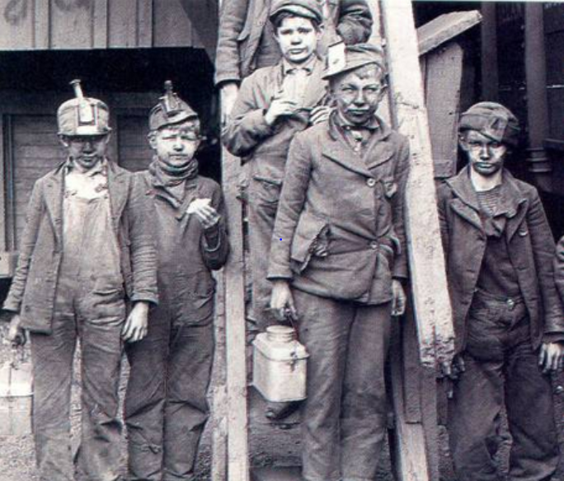
Organized Labor and Working People Fighting for Our Children
“It was the tradesmen who came to the legislature to plead the cause of public education, for they realized that their sons and daughters would forever remain slaves to an industrial machine unless given equal opportunity for education with the sons and daughters of the wealthy.” – Horace Mann
Notes:
Sources:
Image: http://www.lpusd.k12.ca.us/rm1/online/hotpotatoestav/TAV5-1e.htm Image may be subject to copyright.
Quote: Peter Bollen, Great Labor Quotations: Sourcebook and Reader,” page 117.
Muckraker John Spargo’s book The Bitter Cry of the Children

Slide 8

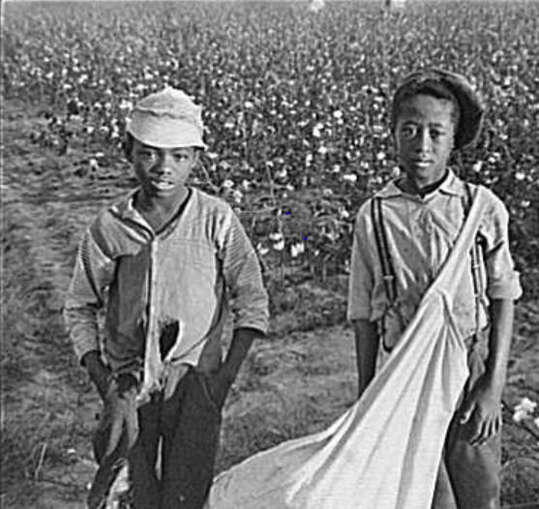
The most beautiful sight that we see is the child at labor. As early as he may get at labor, the more beautiful, the more useful does his life get to be.
Asa Griggs Candler, founder of Coca-Cola
Notes:
Sources:
Quote: Peter Bollen, Great Labor Quotations: Sourcebook and Reader, page 7.
Image: Coca-Cola - http://logobuffer.com/coca-cola-logo-coca-cola-logo-wallpaper-2012-logo-database/ Image may be subject to copyright.
Image: http://newleftpatriot.blogspot.com/2005_03_01_archive.html Image may be subject to copyright.

Slide 9
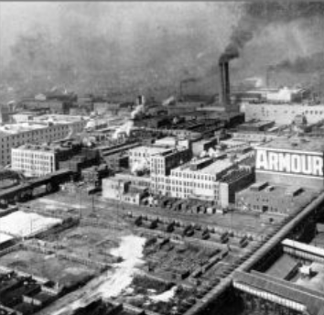
Racism and Bigotry as Corporate Strategy
“We pursue policies to keep the races and nationalities apart…Stir up suspicion, rivalry and hatred among them.”
Philip Armour, CEO of largest meatpacking company in the world.
Notes:
http://hhsapush.wikispaces.com/Meat+Packing+Industry

Slide 10
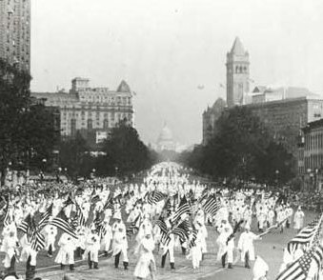
A Nation Divided
Ku Klux Klan March in D.C. - 1925
Notes:
Source: Smithsonian National Museum of American History.

Slide 11
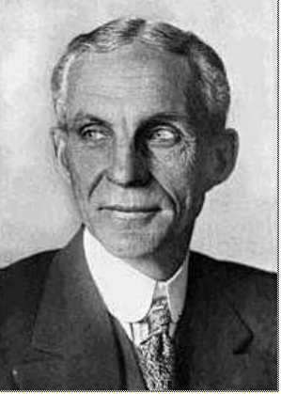
Henry Ford Lays Off 91,000 – 1931
“The average man won't really do a day's work unless he is caught and cannot get out of it. There is plenty of work to do if people would do it.”
Notes:
Source: Photo: Wisconsin Historical Society – 1997. Copyright. Quote: Howard Zinn, People’s History of the United States, page 378.

Slide 12
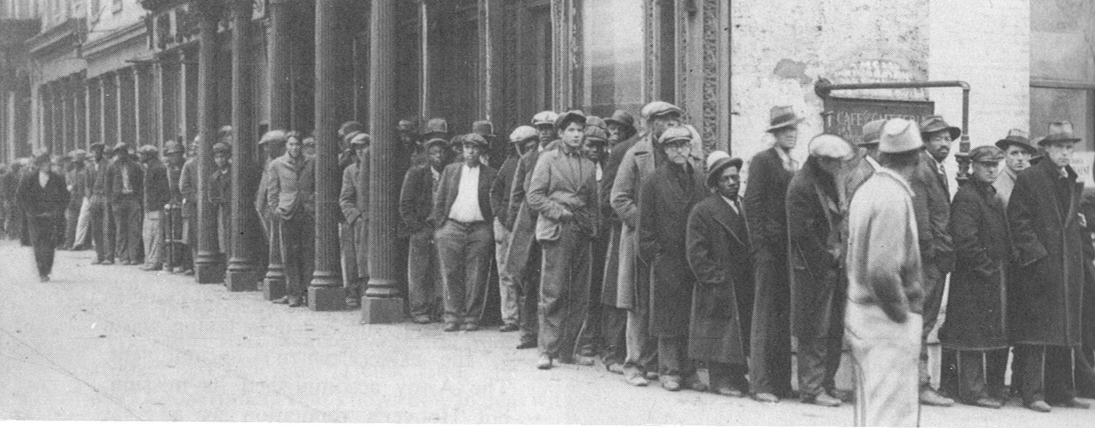
Hunger, Poverty and Homelessness Plagues Our Nation - Depression 1932
Notes:
Source: M. B. Schnapper, American Labor: A Bicentennial History, Public Affairs Press, 1975, page 462. Copyright.
COMMUNITY ORGANIZING RISES IN RESPONSE TO THE DEEPENING CRISIS.
By 1932, the Great Depression had reached its depths. The official national unemployment rate was 25 percent and the unofficial rate of working involuntarily working part-time was 35 percent. People of color were particularly hard hit.
For decades, Corporate America and their political allies had prevented legislation that would have provided unemployment insurance, adequate public assistance to the needy, affordable housing, badly needed food, social security for the elderly and the disabled, and an end of home and farm foreclosures. Working people, both employed and unemployed, were living in misery and desperation.
In midst of this untold and unjustified suffering, people began to organize particularly around issues of unemployment insurance, public assistance, affordable housing, social security. Massive demonstrations became a permanent part of the American story. Workers, whether employed or unemployed, the poor and the oppressed would not remain silent.

Slide 13
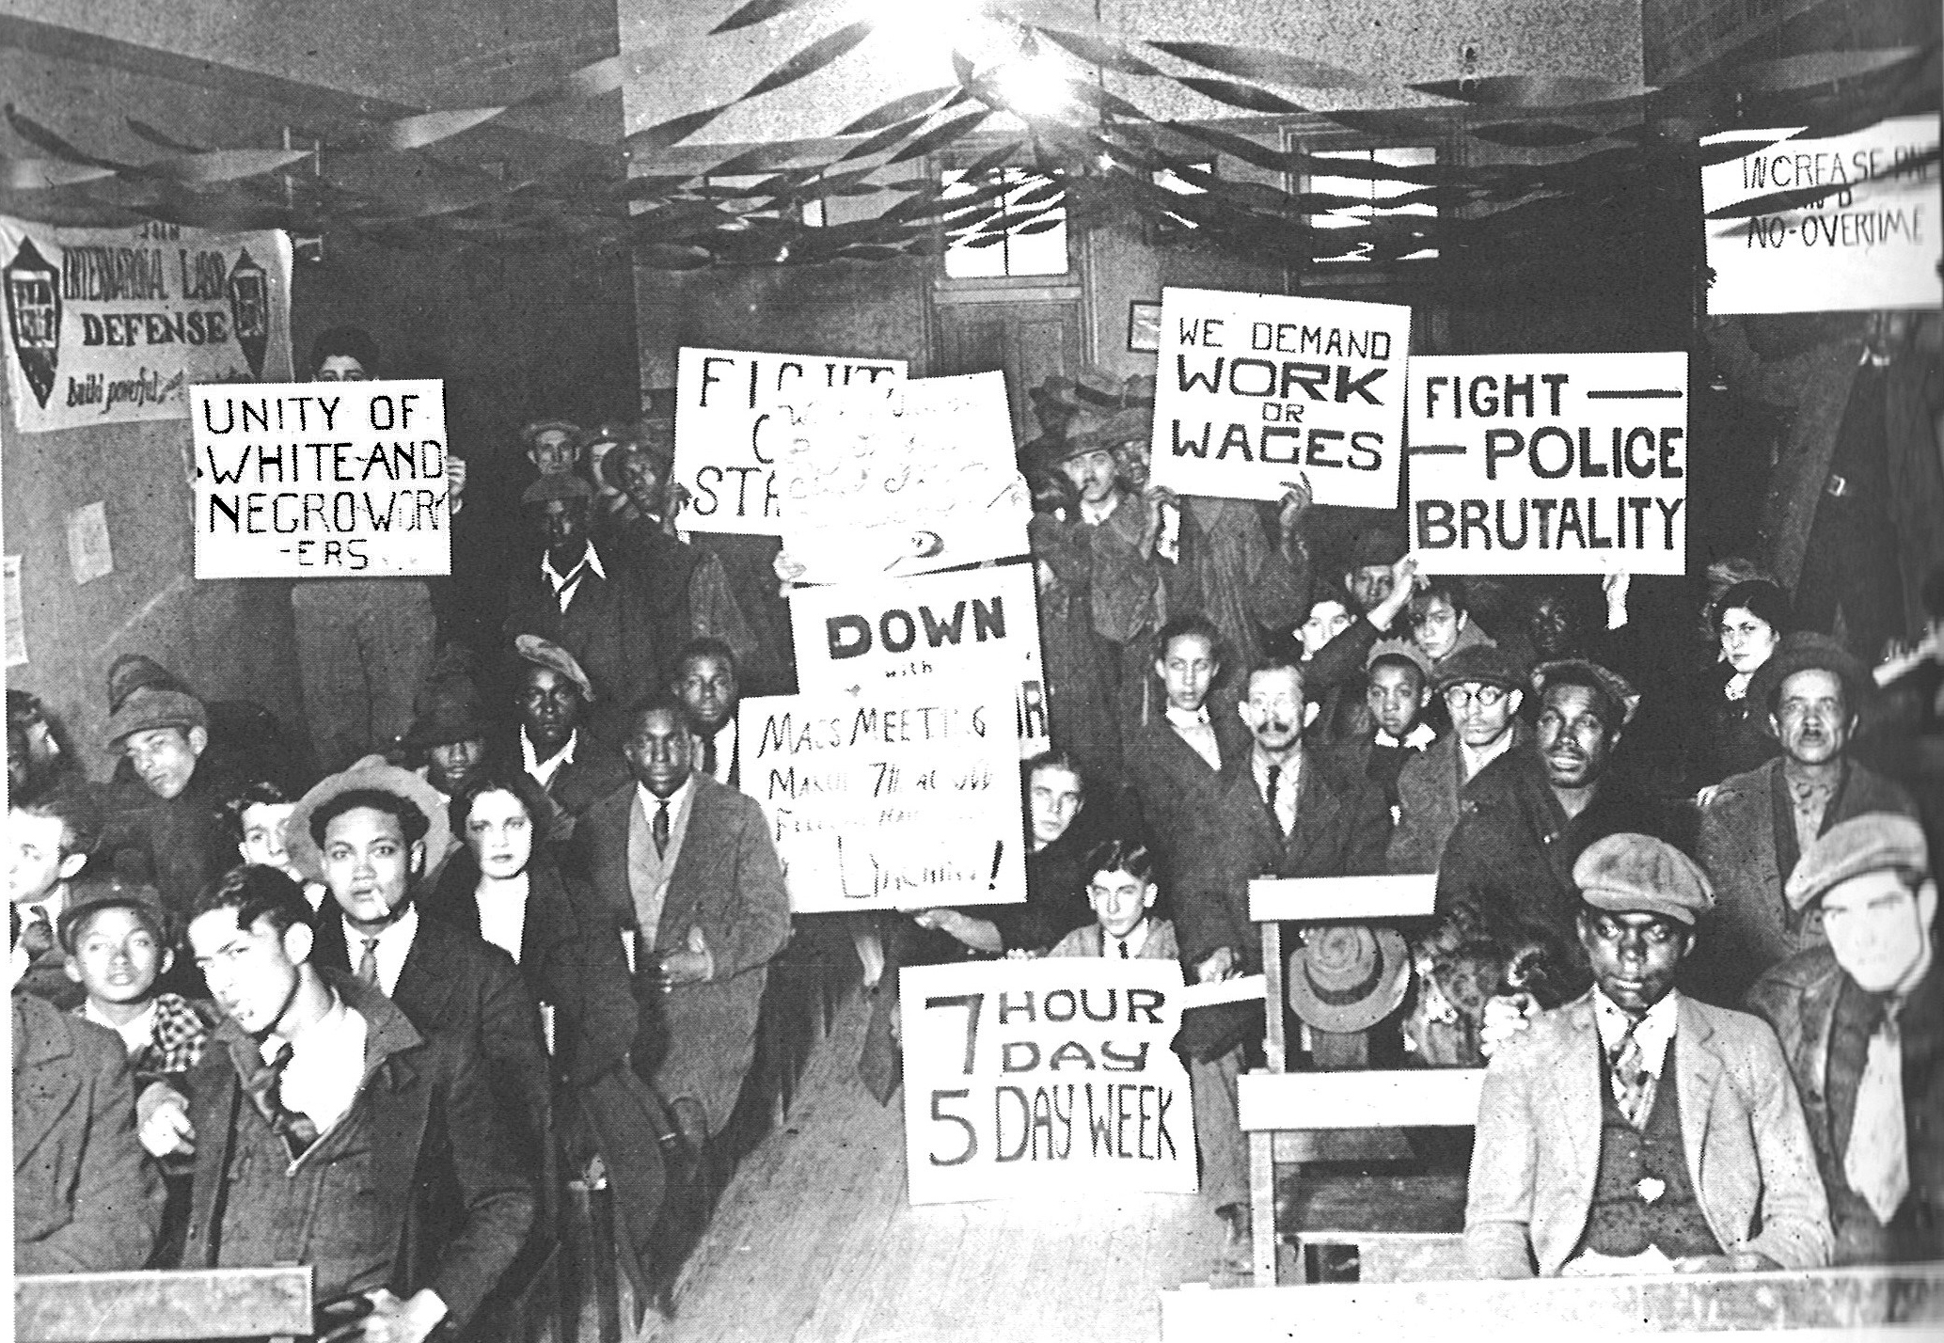
Growing Solidarity Between Black and White Workers – Early 1930s
Notes:
Source: M. B. Schnapper, American Labor: A Bicentennial History, Public Affairs Press, 1975, page 474. Copyright.
From the late 1790s to the early 1930s, the American labor movement largely excluded or restricted the membership of people of color. Many unions had outright bans while others restricted membership to segregated locals. This racist approach was both wrong but also played into the hands of the corporations that were determined to keep America non-union.
There were important exceptions to racial exclusion in the Mine Workers, the Amalgamated Clothing Workers, International Ladies Garment Workers and the Brewery Workers Unions. There were also many examples of white and people of color unionists joining together to build unions and demand justice on the job and in the larger community.
Racism, sexism, religious intolerance and anti-immigrant hatred divided the working class. By the early 1920s the Ku Klux Klan had 4 to 5 million members which is equivalent to 12 to 15 million members in 2011.
However, there was growing awareness among political radicals, progressive trade unionists and working class people that the struggle against racism and for genuine multi-racial unity was critical to creating a better life for all Americans. This awareness was being translated into movements of the unemployed and their families as well as organizing unions in the great mass production industries of auto, steel, meatpacking, rubber and others. A new consciousness was emerging out of a long history of racism and divisions among working people.

Slide 14
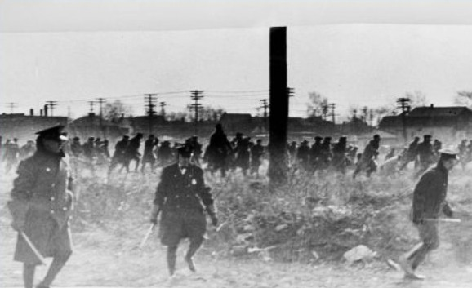
Police Kill 5 Ford Hunger Marchers
Dearborn Michigan – 1932
Notes:
Source: Wayne State University, Walter P. Reuther Library, Ford Hunger Strike Collection, #DN_77646_2,. Copyright. https://www.reuther.wayne.edu/print/7283

Slide 15
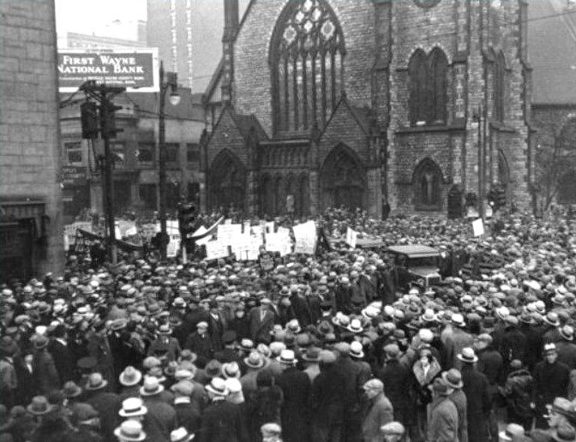
100,000 in Funeral Procession for Martyrs of Ford Hunger March Massacre
Notes:
Source: Wayne State University, Walter P. Reuther Library, Ford Hunger Strike Collection, #12273 Copyright. https://www.reuther.wayne.edu/print/7262

Slide 16
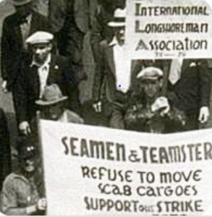
Solidarity Critical in Victory in 83-Day 1934 West Coast Longshore Strike
Notes:
Source: The Pogues Forum. http://www.pogues.com/forum/viewtopic.php?f=38&t=11561&p=200646

Slide 17
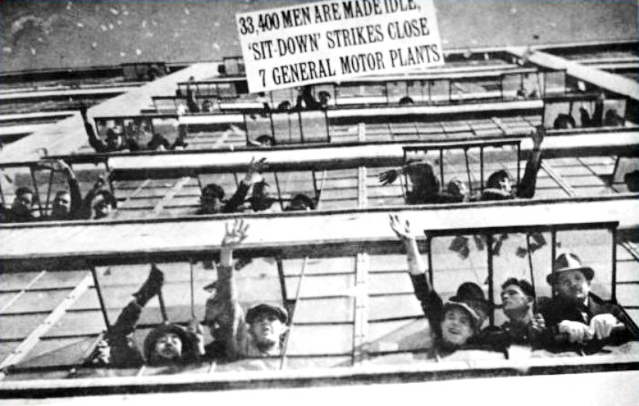
GM Sit-Down Strikers
Occupy Flint, Michigan - 1937
Notes:
Source: Wayne State University, Walter Reuther Library, Flint Sit-Down Strike Collection, #3991. Copyright. https://www.reuther.wayne.edu/node/3123
In January 1937, the small Autoworkers Union began massive sit-down strikes in the General Motors plants in Flint Michigan. GM was the largest and most powerful corporation in the world. They were the bedrock of anti-union corporate power.
At GM’s urging, Flint police attacked the sit-down strikers but were driven out of the plants by determined strikers and their supporters. At this point, the Union called for supporters to come for all over the Midwest to defend the sit-down strikers. Thousands came to Flint to defend the strikers and to hopefully prevent another massacre. This was the Occupy Flint movement of its time. They occupied the factories where wealth was being created. It was the Arab Spring of its time.

Slide 18
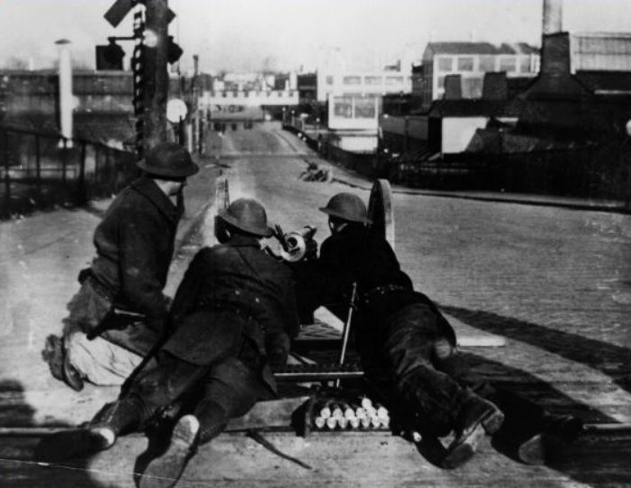
National Guard Occupies Flint
Notes:
Source: Wayne State University, Walter Reuther Library, Flint Sit-Down Strike Collection, #3991. Copyright. https://www.reuther.wayne.edu/node/3123

Slide 19
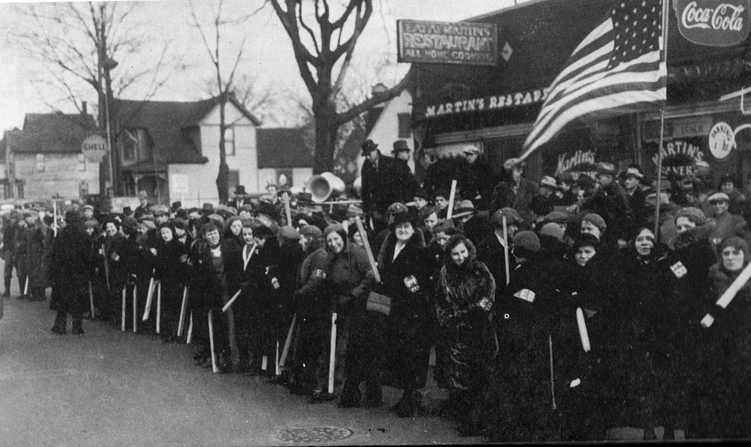
Women Defending Striking Workers
Notes:
Source: M. B. Schnapper, American Labor: A Bicentennial History, Public Affairs Press, 1975, page 523. Copyright.
Armed with a court injunction, GM called on Governor Murphy to use the National Guard to drive the strikers out. The Governor refused. GM called on President Roosevelt to use the U.S. Army to drive them out. The President refused.

Slide 20
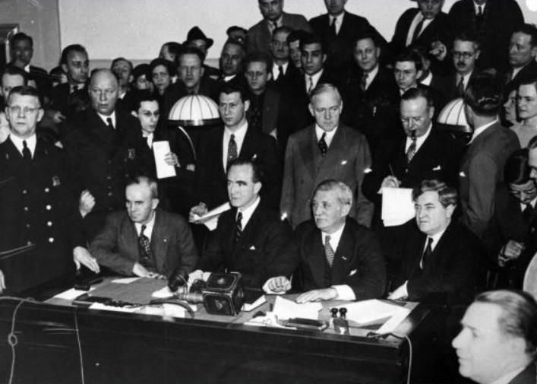
Occupy GM in Flint: Victory
Notes:
Source: Wayne State University, Walter Reuther Library, Flint Sit-Down Strike Collection, #3997. Copyright. https://www.reuther.wayne.edu/node/3123
After a siege of 44 days, GM surrendered and signed a six month contract.
This was a turning point in American history.
A few months later, U.S. Steel, the world’s largest steel maker, surrendered and signed a contract with the new United Steel Workers Union without a strike. 18 years earlier, when 365 thousand steel workers struck for recognition, U.S. Steel had the support of the police and National Guard in Gary Indiana where 18 strikers were killed.
In 2 years, the percentage of unionized workers doubled to record highs. It was the rising of native born and foreign born, white and people of color, male and female workers. At long last, it was the time of the working class and their allies.

Slide 21
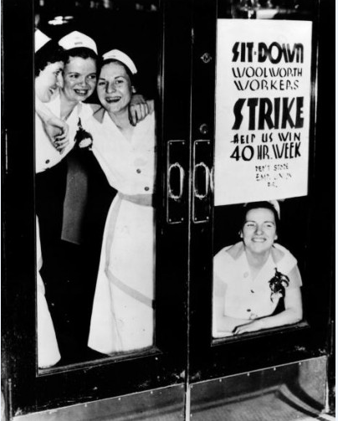
Women Sitdown Strikers Occupy Racist Woolworth
Notes:
Source: UFCW Local 324. http://www.ufcw324.org/WorkArea/linkit.aspx?LinkIdentifier=id&ItemID=777
Sitdown strikes were not limited to largely male workplaces. Woolworth’s was the Walmart of it time with over 60,000 employees. They had an explicit ban on hiring black employees.
The courageous women strikers in Detroit led to the unionization of many Woolworth stores in many large cities.

Slide 22
The Rise and Decline of the American Labor Movement - 1890 to 2012
Notes:
Source: Years 1890 - 1929, Vernon Briggs, Immigration and American Unionism, pages 71 and 113. Years 1930 -1970, U.S. Department of Commerce, “Historical Statistics of the U. S. – Colonial Times to 1970, page 178. Years 1971 to 2003, U.S. Department of Commerce, “Statistical Abstract of the U.S., several issues, tables typically labeled “Labor Union Membership by Sector. Years 2003 to 2012 Bureau of Labor Statistics
Barry T. Hirsch and David A. Macpherson, "Union Membership and Coverage Database from the Current Population Survey: Note," Industrial and Labor Relations Review, Vol. 56, No. 2, January 2003, pp. 349-54. (in pdf) URL: http://www.unionstats.com/

Slide 23
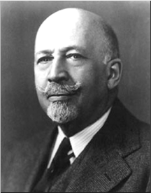
Growing Racial Solidarity
Key to Victories 1930-40s
Probably the greatest and most effective effort toward interracial understanding among the working masses has come through the trade unions…Probably no movement in the past 30 years has been so successful in softening race prejudice.”
W.E.B. DuBois – late 1940s

Slide 24
Labor Leads the Way
The Great Victories of the 1930s
Right to organize unions and strong labor movement
Social Security and public assistance for poor families
Unemployment insurance, minimum wage and overtime pay, eight hour day and five day week
Child labor and child welfare protections
Secure bank deposits
Strong regulation of financial industries
Farmworkers and domestic workers excluded from many rights and programs
Notes:
Increasing solidarity among working people – white and people of color; native-born and immigrant; people of various faith traditions; young and old; men and women; employed and unemployed – key to explosive growth in the labor movement and winning the New Deal reforms.
In the mid-1930s, most of the American people won Social Security, unemployment insurance, the right to organize unions, minimum wage and overtime pay, child welfare, public assistance for poor families, protections for bank deposits, assistance in buying homes and more.
After decades of defeats, working people had won many fundamental labor, economic and social rights in five years.

Slide 25
Labor Plays Key Role in Historic People’s Victories –1960s and Early 1970s
Civil Rights and Voting Right Acts
Medicare/Medicaid
Anti-poverty programs
Anti-discrimination
Open housing
Expanded higher education opportunities
Environmental victories – Clean air and water
Safer workplaces – OSHA
Health insurance and pensions
Notes:
These new movements led to many historic victories that expanded our democracy and economic opportunities for tens of millions of Americans. Once again the people had demonstrated their power to demand and win major changes. None of these victories were given to the people. They built power to make them a reality. It was the second great uprising of the people in the 20th century.
These victories had very direct impacts on my family. My unemployed autoworker grandfather Wabel died at age 53 lacking affordable health care that might have saved his life. In sharp contrast, my beloved mother and father died in their 90s with access to some of the best health care in the world at the University of Washington. They were poor but the victories of Medicare, Medicaid and Social Security coupled with the support of their children ensured that they died in dignity. My grandfather died one of the wretched of the earth with no justice in his death. My parents died with dignity and justice. It was the victorious struggles of working people, organized labor and their many allies that gave them the help they needed as they aged.

Slide 26
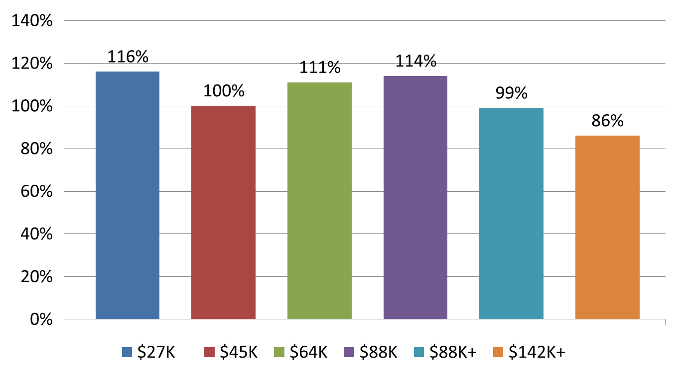
Decades of Shared Prosperity – 1947-1979
Notes:
Source: Mishel and Bernstein, The State of Working America 1994-95, M.E. Sharpe, 1994, page 37. U.S. Census Bureau, Historical Income Tables. F-1 for income ranges in 2010 dollars and F-3 for income changes. http://www.census.gov/hhes/www/income/data/historical/families/index.html

Slide 27
Corporate America Stealing our Shared Prosperity – 1979-2011

Slide 28
The Super-Rich Stealing our Shared Prosperity: 1979-2011
Richest 11,000 families’ average income rises 386%. Their minimum income is $8.6 million and their average income is $35.5 million (2006 data.)
Notes:
Source: U.S. Census Bureau, Historical Income Tables. F-1 for income ranges in 2010 dollars and F-3 for income changes. http://www.census.gov/hhes/www/income/data/historical/families/index.html Top 0.01% 1979 to 2005. Congressional Budget Office, “Historical Effective Tax Rates,” 2008., Table 3. http://www.cbo.gov/ftpdocs/98xx/doc9884/12-23-EffectiveTaxRates_Letter.pdf

Slide 29
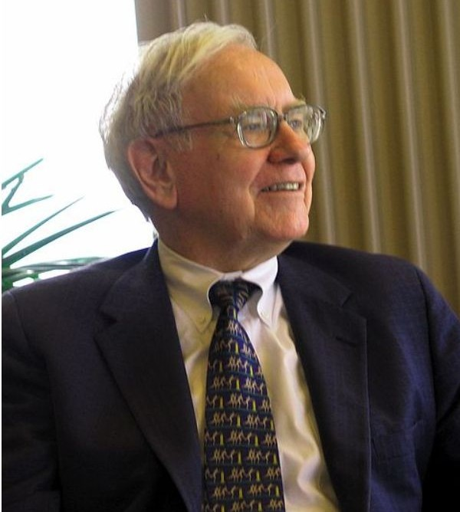
Corporate America Declares War On America’s Workers: 1980 to Present
“There’s Class Warfare, all right. But it’s my class, the rich class, that’s making war, and we’re winning.”
Warren Buffett, World’s Third Richest Man
Notes:
Source: Wikipedia. http://en.wikipedia.org/wiki/File:Warren_Buffett_KU_Visit.jpg

Slide 30
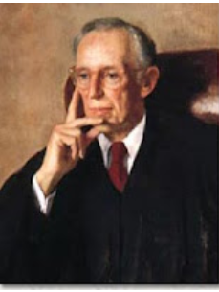
Lewis Powell – August 23, 1971
Confidential Memo
To: Eugene Sydnor, Chairman, Education Committee, U.S. Chamber of Commerce
Subject: Attack on Free Enterprise System
2 months later, President Nixon appointed Powell to the U.S. Supreme Court.
Notes:
Source: Greenpeace. http://www.greenpeace.org/usa/en/campaigns/global-warming-and-energy/polluterwatch/The-Lewis-Powell-Memo/

Slide 31
Corporate America’s Class Warfare
Crush organized labor
Promote free trade and export manufacturing jobs
Undermine democracy with massive campaign spending by corporations and wealthy
Voter suppression
Deregulate financial industries and corporations
Cut social programs for poor, unemployed and needy
Sharply reduce taxes on corporations and the wealthy
Privatize government
Notes:
The major victories of the 1960s and the early 1970s caused great alarm among corporate America, their right wing political allies and corporate mainstream politicians. Many of these victories coupled with an upsurge in labor unrest threatened many of their fundamental interests and furthered limited their power and freedom. Corporate America desperately wanted to regain political dominance and greater freedom from government control and strong unions.
On August 23, 1971, Lewis Powell, wrote a famous confidential memo to the U.S. Chamber of Commerce calling for a major counterattack by corporate America. http://reclaimdemocracy.org/corporate_accountability/powell_memo_lewis.html This memo along with the writings of other corporate allies laid the foundation for the corporate counterattack that helped achieve the election of Ronald Reagan in 1980s and a fundamental shift in American economic and political life.
The key elements and messages of the strategy are listed above. They also included the importance of winning the battle for the future vision of the country coupled with values, themes and messages that would become the dominant view of our future. This battle of ideas would be supported by the creation of many think tanks, endowment of chairs in university economics departments and business schools, attacks on leftist and progressive intellectuals, strengthening lobbying efforts, dominating the media and building powerful and well-funded permanent political and election campaign organizations. Crushing unions would be key.
What were the results? We have already seen the dramatic shift to economic inequality. Long gone were the days of a rising tide would lift all boats.

Slide 32
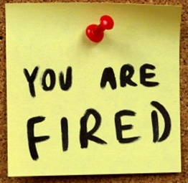
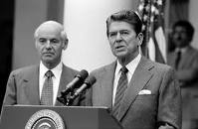
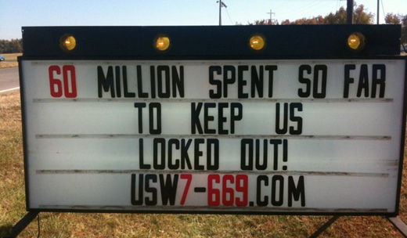
The War Against Workers
Published on Thursday, February 10, 2005 by the Associated Press
As Union Nears Win, Wal-Mart Closes Store
Notes:
UNIONS ARE THE LARGEST AND STRONGEST MOVEMENT RESISTING CORPORATE DOMINATION.
ECONOMIC RESISTANCE TO PROFIT MAXIMIZATION
STRONG POLITICAL EFFORTS TO ELECT PRO-JUSTICE CANDIDATES
CORPORATE AMERICA KNOWS OUR HISTORY BETTER THAN WE DO
Corporate America, aided by the political allies, launched a massive offensive against organized labor in the 1980’s. President Reagan’s mass firing of striking air traffic controllers in the 1981 PATCO strike sent a signal to corporate America that the federal government was their ally in destroying organized labor.
Many major strikes were lost including Phelps-Dodge in the copper industry, Greyhound in interstate transportation, Caterpillar in heavy equipment and many more. Corporate America wanted major concessions in wages, benefits, pensions, working conditions and if possible to wipe out the unions. They also wanted to ensure that the growing service industries would remain nonunion. A union-free America was their dream and battle cry.
Between 1980 and 1990, the percentage of unionized workers was cut by a third. Systematic violations of labor laws became the order of the day. The widespread use of permanent striker replacements became a way of life. The days of organized labor serving as a powerful counterbalance to corporate power were fading away in the workplace and in political life.
I lost my job in a union bust in 1982 when the unionized plant I worked in was sold. We were all fired on 5 hours notice and the union was broken. I lost my pension and spent the next 15 months out of work. I took a 50% pay cut when I finally found a new job in a new career field. It was a new day in America for workers. A dark, dark day.

Slide 33


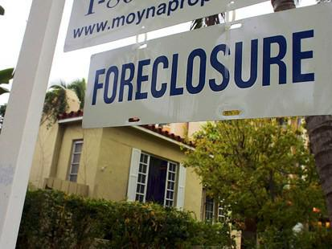
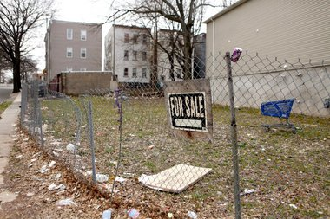
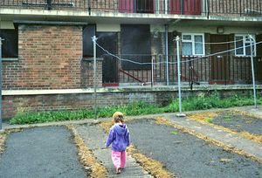
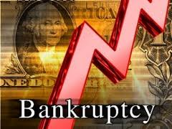
Notes:
Years of financial deregulation and rapacious and abusive corporate behavior, rapidly rising housing prices, stagnant incomes for many Americans and tax cuts for the wealthy and corporations eventually led to a financial and economic crisis. The financial crisis of 2007-08 and the resulting Great Recession has wreaked havoc in the lives of tens of millions of Americans and their families.
The number of Americans in poverty soared by 8.9 million between 2007 and 2010 with the poverty rates for blacks and Hispanics more than twice that of whites. The poverty rate for Asians was slightly lower than the rate for whites.
The number of Americans reducing their food intake due to a lack of money rose from 11.9 million in 2007 to 17.7 million in 2009.
Personal bankruptcies skyrocketed from 598,000 in 2006 to 1.54 million in 2010.
The rate of homeowners with prime mortgages in foreclosure exploded 560 percent between 2006 and 2009.
Sources:
U.S. Census Bureau, “Historical Poverty Tables, Table 2.” http://www.census.gov/hhes/www/poverty/data/historical/people.html
Nord, Mark, Coleman-Jensen, Alisha, Andrews, Margaret, and Carlson, Steven, “Household Food Security in the United States, 2009, U.S. Department of Agriculture, page 6. http://www.ers.usda.gov/Publications/ERR108/ERR108.pdf
American Bankruptcy Institute, “Annual Business and Non-Business Filings by Year (1980-2009). www.abiworld.org/AM/AMTemplate.cfm?Section=Home&CONTENTID=60229&TEMPLATE=/CM/ContentDisplay.cfm
U.S. Census Bureau, Statistical Abstract of the U.S 2011, “Mortgage Originations and Delinquency and Foreclosure Rates”, Table 1193. http://www.census.gov/compendia/statab/2011/tables/11s1193.pdf

Slide 34
Economic Hard Times Hit Unevenly
People of color – higher unemployment and smaller wealth than whites
Construction workers devastated
Manufacturing workers hit very hard by offshoring
Women’s wages continue to trail men’s
Our youth face growing challenges in pursuing education
Upward mobility is lower in the U.S. than in much of Western Europe

Slide 35
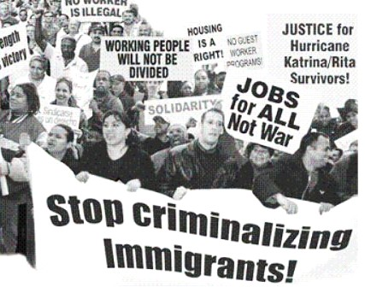
Immigrants Didn’t Wreck the Economy: They are our Sisters and Brothers

Slide 36
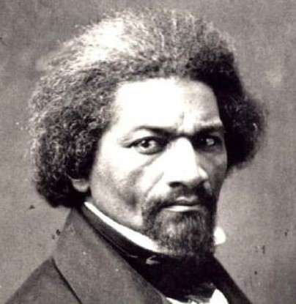
Fighting for the American Dream:
Finding Hope and Getting Organized
“If there is no struggle, there can be no progress…find out what any people will quietly submit to and you will have found out the exact measure of injustice and wrong which will be imposed upon them.”
Frederick Douglass, 1857

Slide 37
Corporations Have Too Much Power:
The People Speak - 2011
National Harris Poll, June 2011
These groups have too much power:
Major corporations – 88%
Banks and financial institutions – 85%
Lobbyists – 84%
Notes:
Source: Harris Poll, “Big Companies, PACs, Banks, Financial Institutions and Lobbyists Seen by Strong Majorities as Having Too Much Power and Influence in DC,”, June 1, 2011. http://www.harrisinteractive.com/NewsRoom/HarrisPolls/tabid/447/mid/1508/articleId/790/ctl/ReadCustom%20Default/Default.aspx

Slide 38
Gallup: Do You Approve or Disapprove of Unions?
Pew: Are Unions Necessary to Protect Workers?
Notes:
Sources:
Gallup: Do You Approve or Disapprove of Labor Unions?
Pew: Labor Unions are Necessary to Protect the Working Person
Source: Gallup Poll, “In U.S., Labor Union Approval Steady at 52%.” http://www.gallup.com/poll/157025/labor-union-approval-steady.aspx
Pew Research Center for the People and the Press, “Trends in Political Values and Core Attitudes: 1987-2012, page 157. http://www.people-press.org/2012/06/04/partisan-polarization-surges-in-bush-obama-years/
1987, 1988, 1989 Gallup added 1991, 2001, 2004, 2005, 2006, 2008, 2010, 2011 Pew added. Data points added to provide smooth lines. Data is consistent with overall trends.

Slide 39
Would You Like Labor Unions to Have More or Less Influence than They Have Now?
Notes:
Source: Gallup Poll, “In U.S., Labor Union Approval Steady at 52%,” August 31, 2012. http://www.gallup.com/poll/157025/labor-union-approval-steady.aspx

Slide 40
Democratic President, Big Congressional Majorities - What Happened?
1965-68, 1977-80, 1993-94, and 2009-10. Democratic President and large Congressional majorities.
We only won broad reforms in 1965-68 – Great Society victories.
Labor law reform beaten four times.
Last three periods – major reforms largely blocked
Why?

Slide 41
What Do We Do to Take Our Country Back?
Inspire hope anchored in our history of victories
Build unity around our vision, values and agenda
Educate public about critical role of labor
Rebuild a resurgent growing labor movement
Create permanent long-term broad coalitions
Support aggressive mass movements
Involve young people
Defeat corporate Democrats who oppose reforms

Slide 42
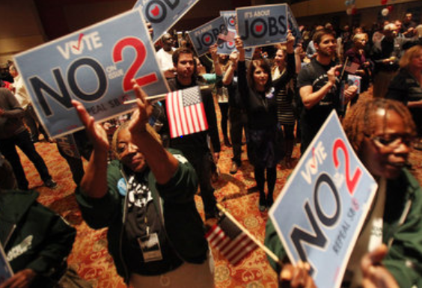
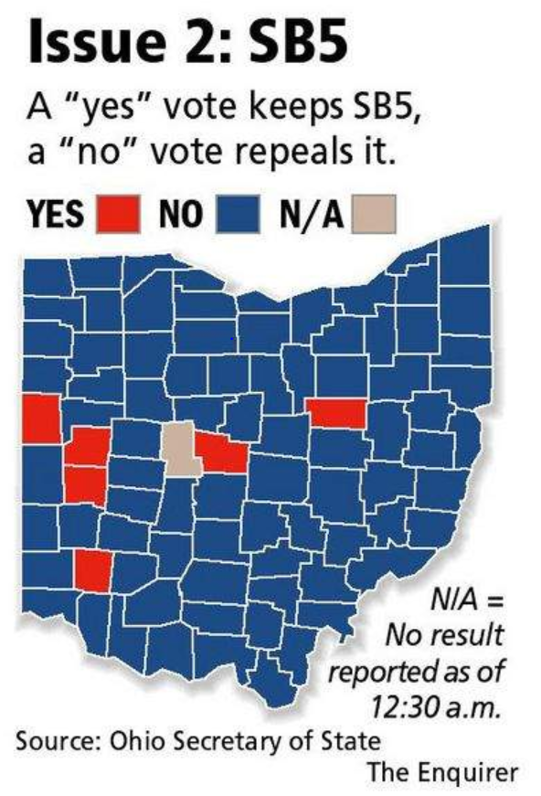
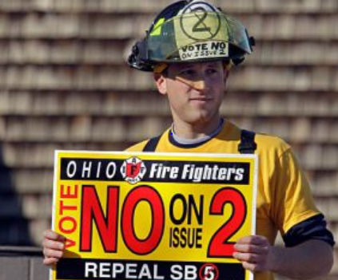
Notes:
Sources:
http://www.cleveland.com/politics/index.ssf/2011/11/ohio_voters_overwhelmingly_rej.html Image may be subject to copyright.
http://swampland.time.com/2011/11/15/the-lessons-of-issue-2s-defeat-in-ohio/ Image may be subject to copyright.
http://news.cincinnati.com/article/20111108/NEWS0108/111090341/Issue-2-rejected-overturning-SB-5 Image may be subject to copyright.

Slide 43
Which Group Do You Think Is Most Favorable to Unions?
18-29 years old
30-49 years old
50-64 years old
65 and older

Slide 44
Listen to and Support Our Youth
Are You Favorable or Unfavorable to Unions?
Notes:
Note: Pew Research Center, “Favorable Views of Business, Labor Rebound,” June 27, 2013, page 3. http://www.people-press.org/files/legacy-pdf/6-27-13%20Business%20and%20Labor%20Release.pdf

Slide 45
Major Victories Led by Young People 2011-12
Bank of America $5 debit charge stopped
Verizon $2 pay online charge stopped
Student loans – Congress forced to keep 3.4% interest rate
President’s directive staying deportations of young immigrant students

Slide 46
People Like Us Have and Can Change the World. This is our Time.
Women’s right to vote - 1920
American labor movement – 1930s
Sweeping New Deal victories – 1930s
Civil rights movement – 1950-60s
Sweeping Great Society victories – 1960s
Anti-war movement – 1960-70s
World-wide anti-apartheid movement – 1940-90s
Toppling the Berlin Wall – 1980-90s
The United States – 2013 forward
Notes:
Let’s us dedicate ourselves to building a better world. As the Reverend Dr. Martin Luther King Jr. once said: “The moral arc of the universe is long and it bends toward justice.” I humbly add: “But only if the people make it bend.” This is our historic task.

Slide 47
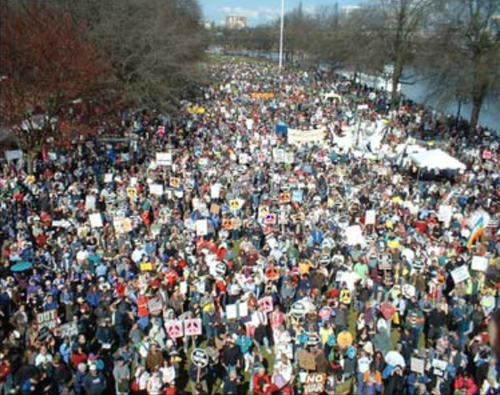
United We Can Change Our World
The ultimate test of a person, a movement and a people is not whether or not we get knocked down. It is what we do when we get up. Are we stronger, smarter, more determined, and more united?
This is always our choice.

Slide 48
What have you learned that will help you build a stronger union, a stronger labor movement and a powerful people’s movement to make the American Dream real for everyone?

Slide 49
Mark McDermott www.markmmcdermott.com
Facebook: markmcdermottworkshops

Slide 50
The author wishes to acknowledge the financial contributions and technical assistance from United Food and Commercial Workers Local 21 that helped create the original version of this presentation and slideshow. The author is solely responsible for the content.

